Slide 1
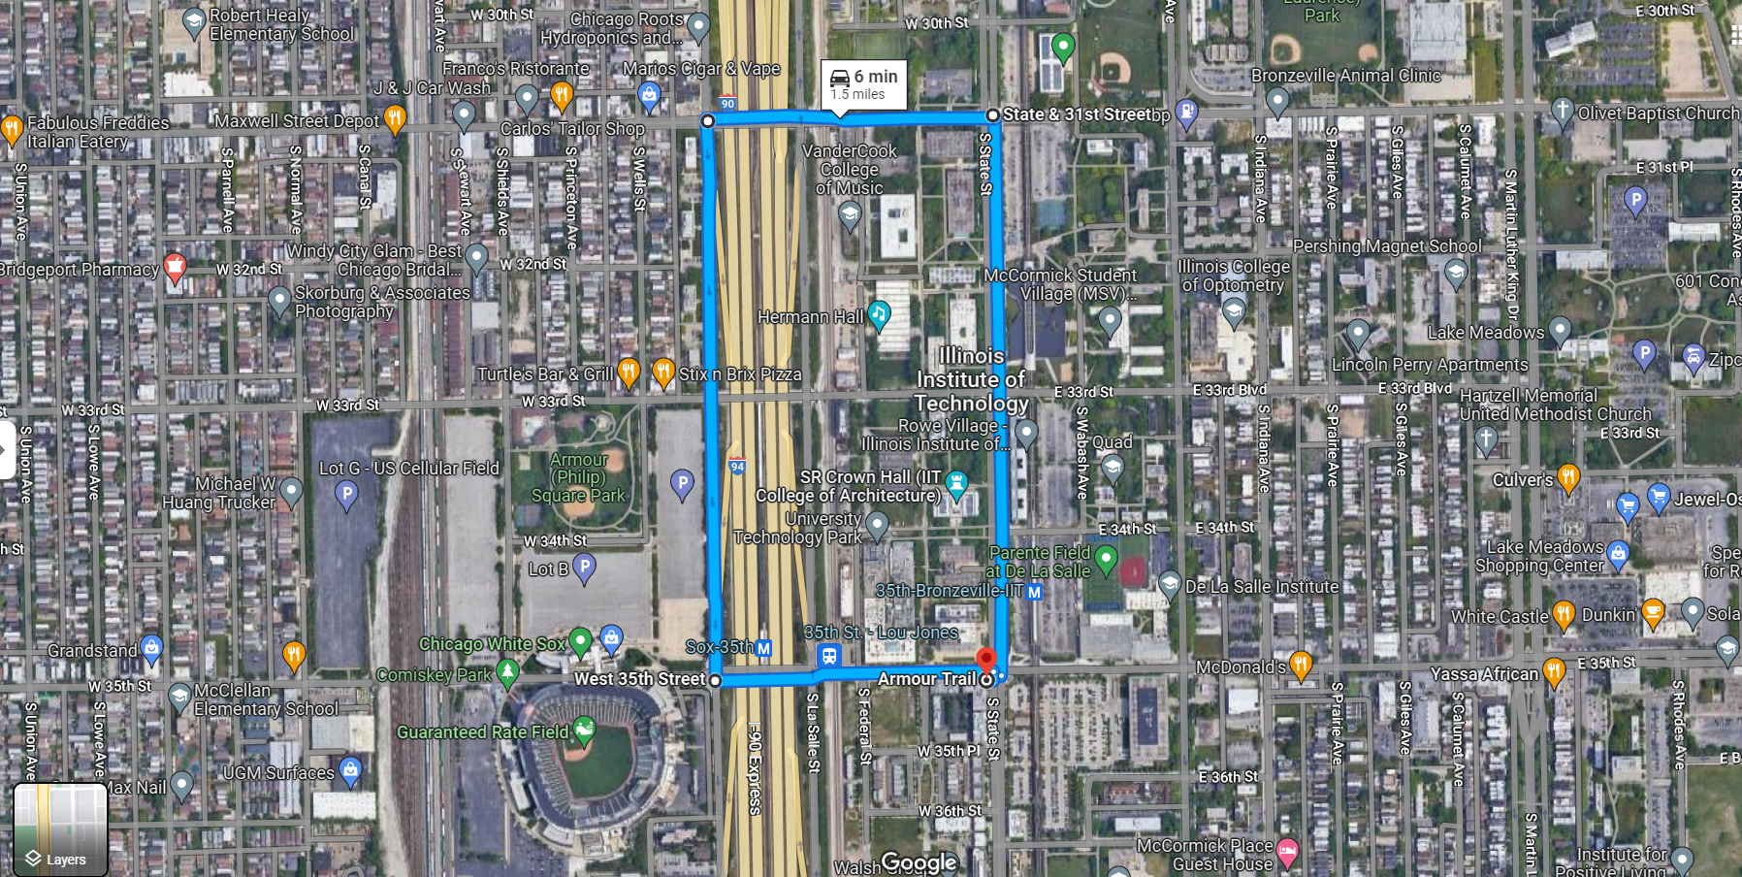
Route A

Slide 2
Assumptions
30 mph
30 mph
2
3
4
Traffic lights have random schedules, are independent of each other
40 mph
25 mph
1
5
40 mph
25 mph
30 mph
0
30 mph
30 mph
6
7
8

