Slide 1
Figure 1

Slide 2
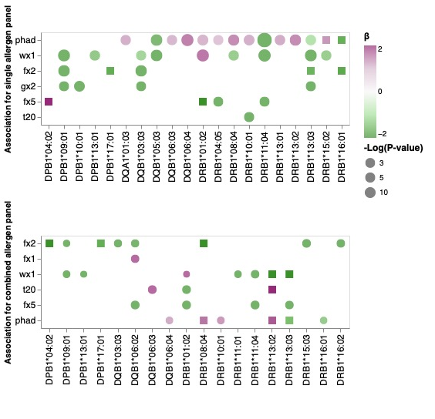
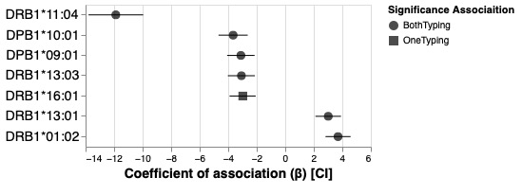
Figure 2

Slide 3
Figure 3

