Slide 1
CSE 4128 Image Processing and Computer Vision Laboratory Week 3: Histogram Equalization
Dr. Sk. Md. Masudul Ahsan
Professor
Dept. of CSE, KUET
Md Tajmilur Rahman
Lecturer
Dept. of CSE, KUET

Slide 2
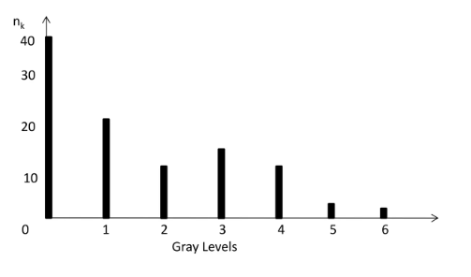

Histogram
The histogram of an image consists of the x-axis representing the intensity levels r_{k} and the y-axis denoting the h(r_{k}) or the p(r_{k}) functions.
$h(r_{k})=n_{k}$

Slide 3
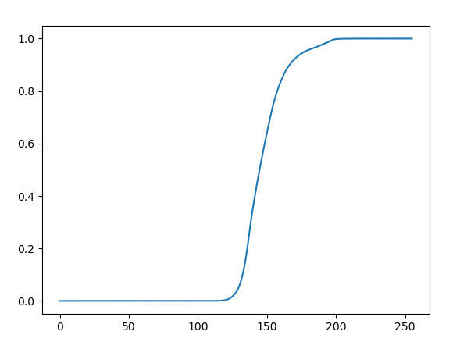
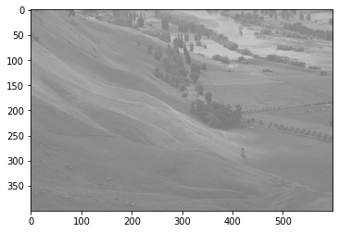
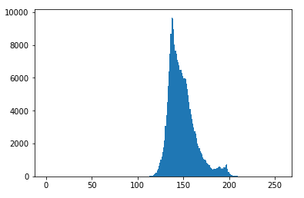
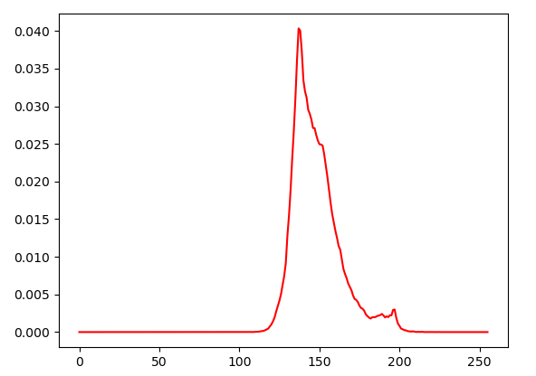
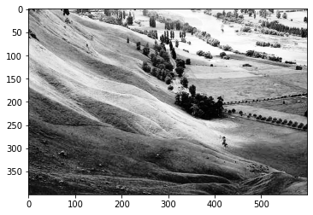
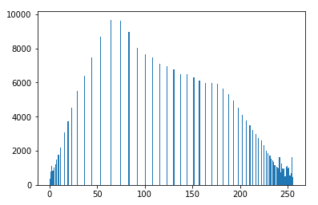
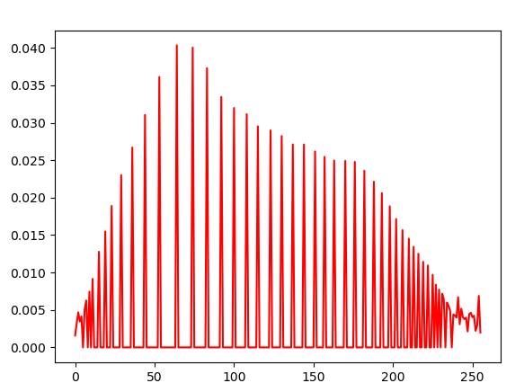
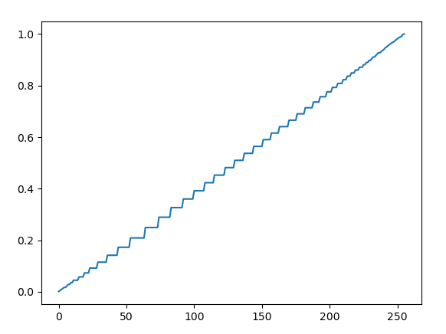
Histogram Equalization
Histogram equalization is used to enhance contrast.
Input Image
Histogram of the Input Image
PDF of the Input Image
CDF of the Input Image
Equalized Image
Histogram of the Equalized Image
PDF of the Equalized Image
CDF of the Equalized Image

Slide 4
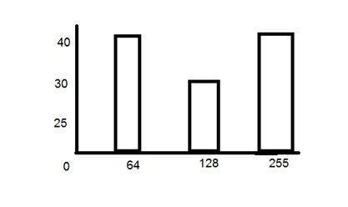
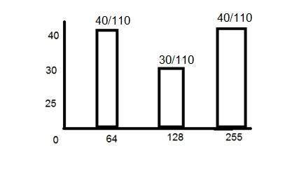


PDF
PDF stands for probability density function. It's a function where you can think of the x values as the range of possible occurring values and y values as their probability of occurrence.
$p\left(r_{k}\right)=\frac{n_{k}}{MN}$ $k=0,1,2……L−1$
$$n_{k}\text{: }\text{the} \text{number} \text{of} \text{pixels} \text{in} \text{the} \text{image} \text{of} \text{size} \text{M}×\text{N} \text{with} \text{intensity} r_{k}$$
$$n_{k}$$
PDF

Slide 5
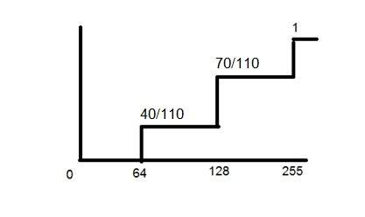
CDF
CDF holds the probability of a probability distribution less than or equal to a particular value.
It is a function that calculates the cumulative sum of all the values that are calculated by PDF.
PDF
CDF

Slide 6
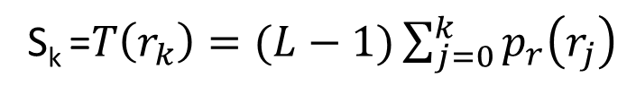
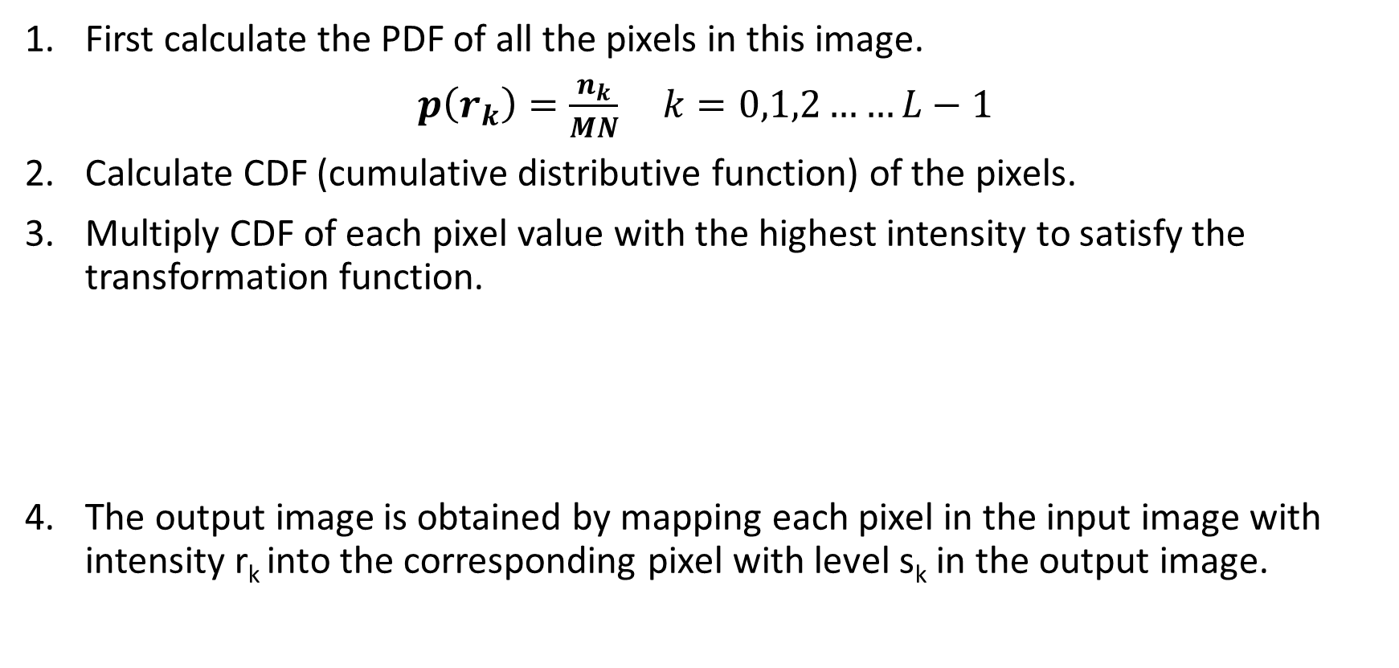
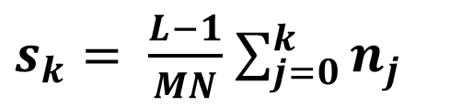
Histogram Equalization
First calculate the PDF of all the pixels in this image.
$p\left(r_{k}\right)=\frac{n_{k}}{MN}$ $k=0,1,2……L−1$
Calculate CDF (cumulative distributive function) of the pixels.
Multiply CDF of each pixel value with the highest intensity to satisfy the transformation function.
The output image is obtained by mapping each pixel in the input image with intensity r_{k} into the corresponding pixel with level s_{k} in the output image.
S_{k} =$T\left(r_{k}\right)=(L−1)\sum_{j=0}^{k}{p_{r}\left(r_{j}\right)}$
$s_{k}= \frac{L−1}{MN}$ $\sum_{j=0}^{k}{n_{j}}$

Slide 7
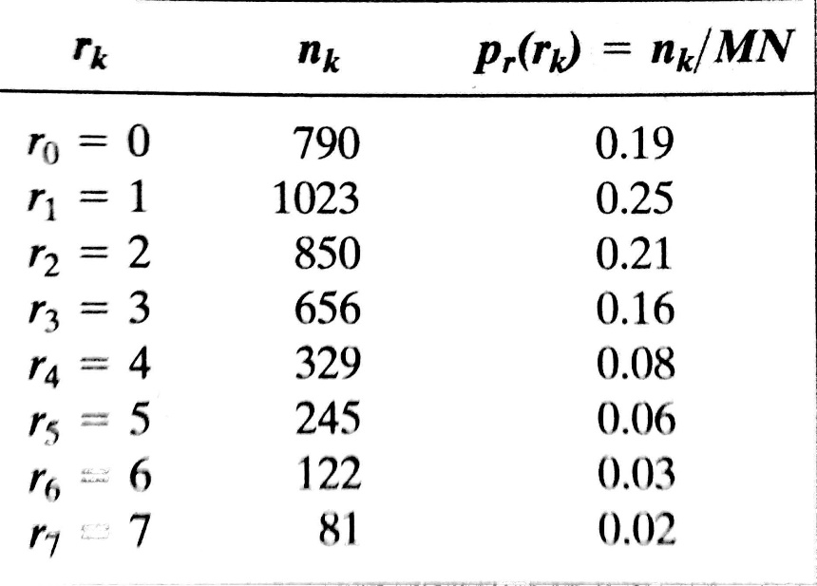
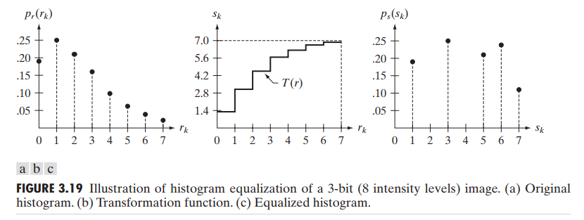
Map s_{k} to its r_{k}
s_{k}
S₀ = 1.33 = 1
S₁ = 3.08 = 3
S₂ = 4.55 = 5
S₃ = 5.67 = 6
S₄ = 6.23 = 6
S₅ = 6.65 = 7
S₆ = 6.86 = 7
S₇ = 7.00 = 7

Slide 8
Classwork
Take an input gray scale image and apply histogram equalization to enhance contrast:
1. Apply Histogram Equalization
a) HE1 = Manual_equalizeHist(input_image)
b) HE2 = cv2.equalizeHist(input_img)
2. Show the following outputs:
Input Image | Output Images (HE1 and HE2)
Input Histogram | Histogram of HE1
Input CDF | CDF of HE1

Slide 9
Python Functions
Using openCV:
cv2.calcHist(images, channels, mask, histSize,
ranges[, hist[, accumulate]])
hist_HE1 = cv2.calcHist([HE1],[0],None,[256],[0,256])
output = cv2.LUT(input_image, array)
Show output Using Matplotlib:
plt.figure(figsize=(12,16))
plt.subplot(3,2,1)
plt.imshow(img, cmap='gray’)
plt.title("Original Image")
plt.axis("off")

Slide 10
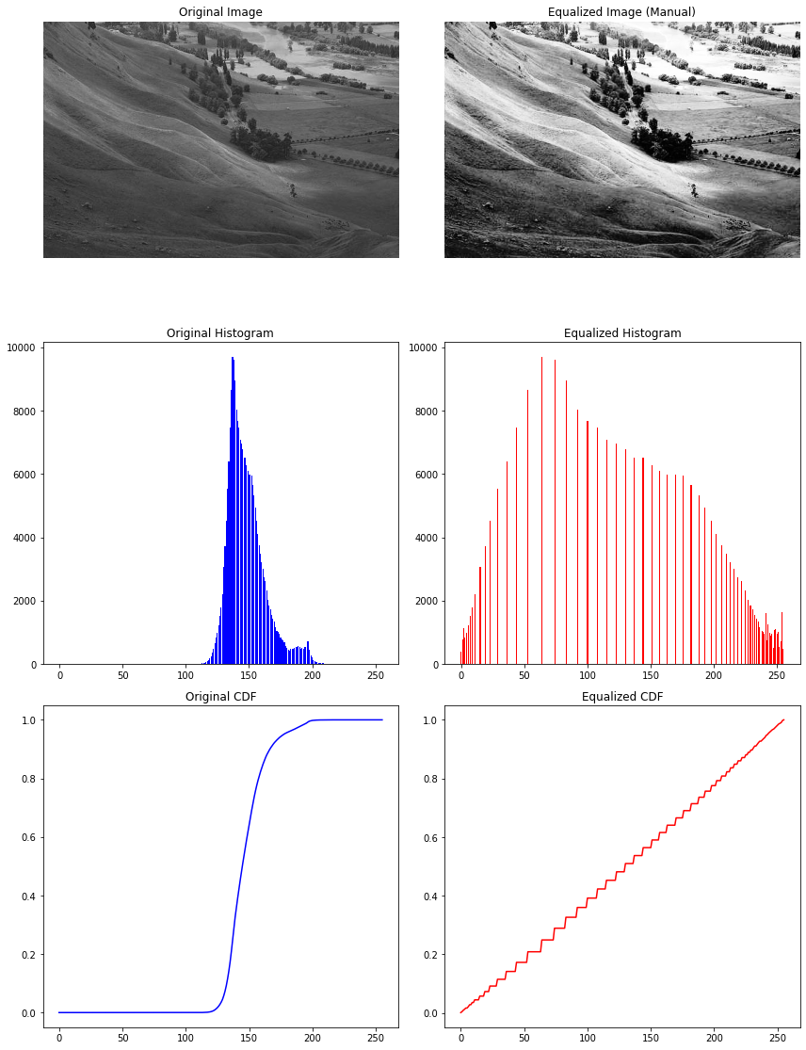
Show Outputs
plt.figure(figsize=(12,16))
# Row 1: Images
plt.subplot(3,2,1)
plt.imshow(img, cmap='gray')
plt.title("Original Image")
plt.axis("off")
plt.subplot(3,2,2)
plt.imshow(equalized, cmap='gray')
plt.title("Equalized Image (Manual)")
plt.axis("off")

Slide 11
Assignment 1
Take an input color image and apply histogram equalization to enhance contrast.
For the RGB image, apply histogram equalization to each of the 3 channels separately. Merge the 3 channels to view the enhanced image.
Convert the RGB image to the HSV image and apply histogram equalization only in the Value channel. Merge the new equalized value channel with the other two to generate the final output equalized image.
Show the histogram of input and the equalized image
Show the histogram of CDF and PDF calculated from the input and output images.

Slide 12
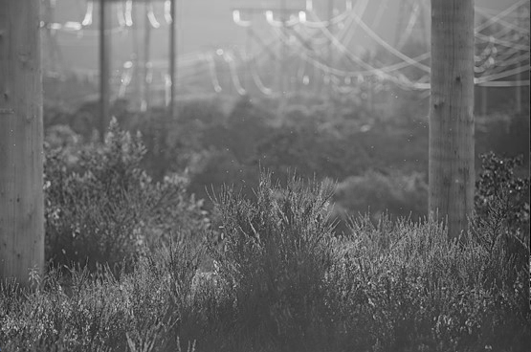
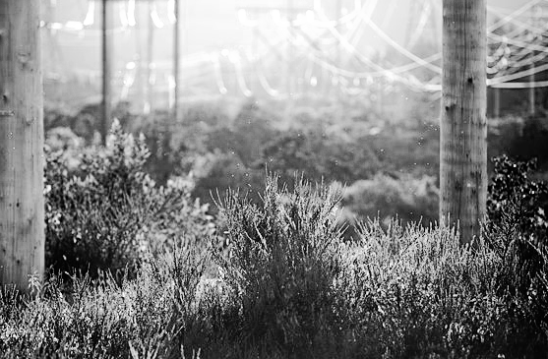
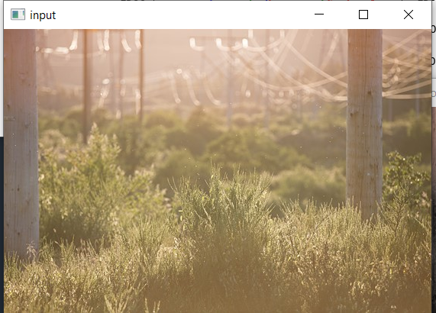
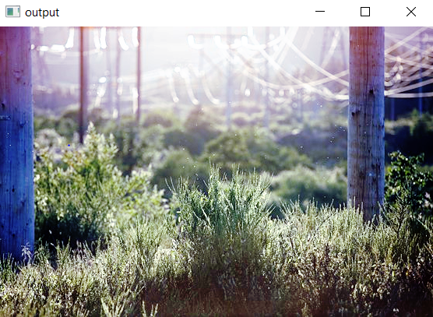
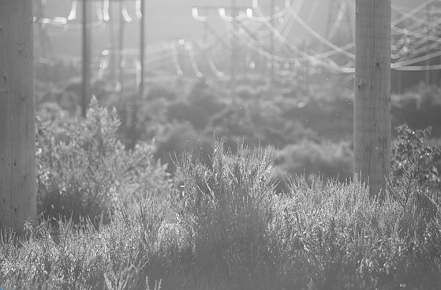
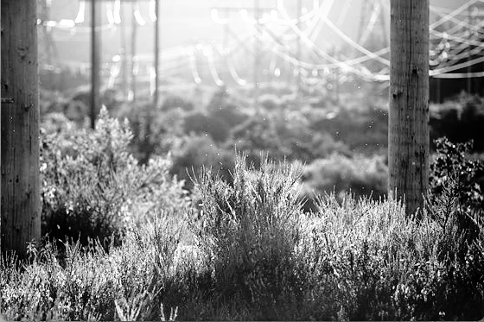
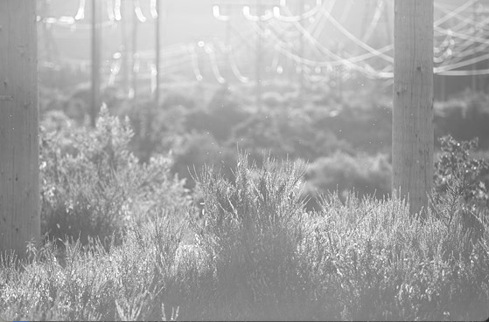
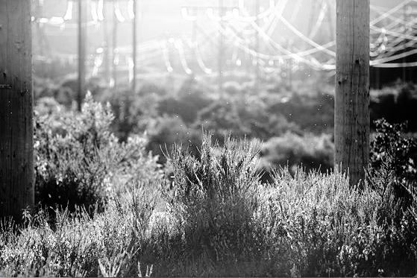
Assignment 1
Green Channel
Equalization
Equalization
Blue Channel
Input
Equalization
Output
Red Channel

Slide 13
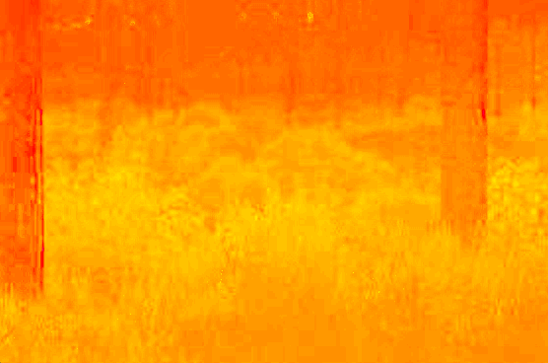
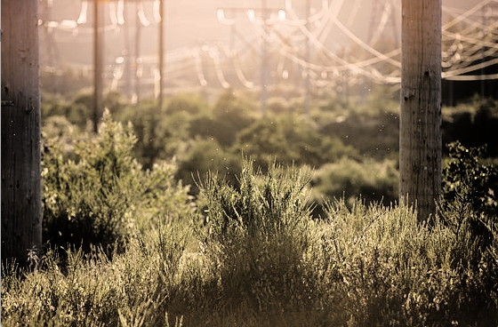
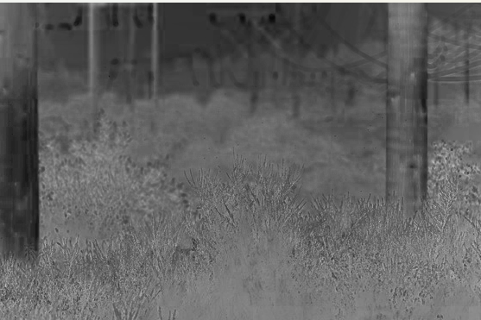

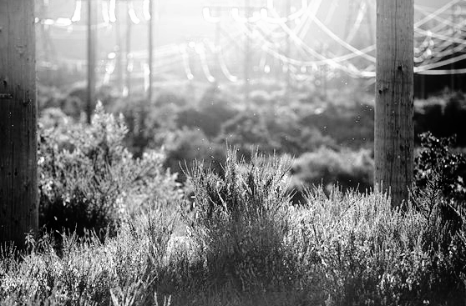
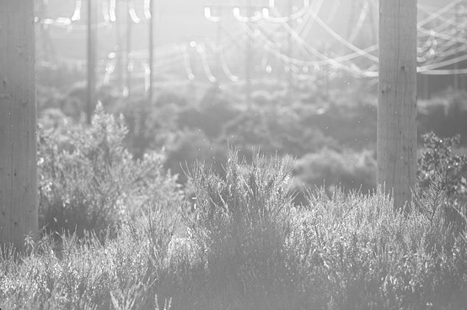
Assignment 1
Hue channel
Saturation channel
Output
Input
Equalization
Value channel

Slide 14
Assignment 2
Histogram Matching (Specification)
-- where the target histogram follows an Erlang distribution.
Instructions:
Generate the target histogram using Erlang distribution and plot it for visualization. Take shape parameter (k) and scale parameter (µ) as user input.
Apply histogram matching to update the histogram of an input grayscale image to the target one.
Show the input and output image.
Plot the Histogram, PDF, and CDF of both input and output images.

Slide 15
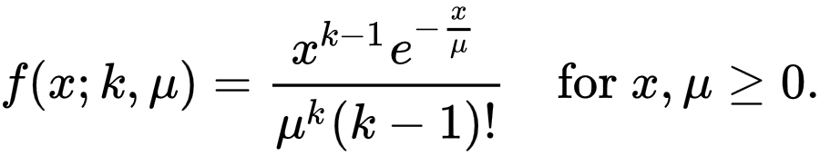
Erlang distribution
The Erlang distribution is a two-parameter family of continuous probability distributions
Shape parameter (k) (positive integer)
Rate parameter (λ) (positive real number)
The ‘scale parameter’, µ the reciprocal of the rate parameter,μ = 1/λ.

Slide 16
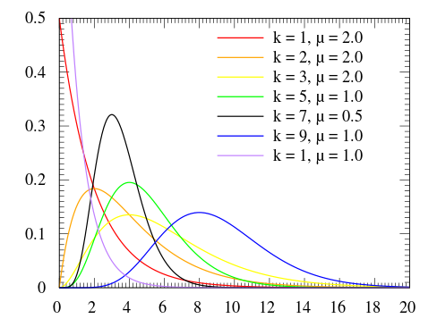
Erlang distribution

Slide 17
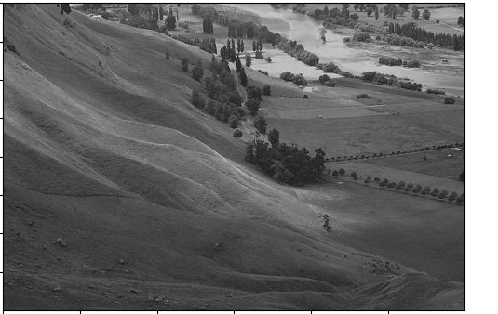
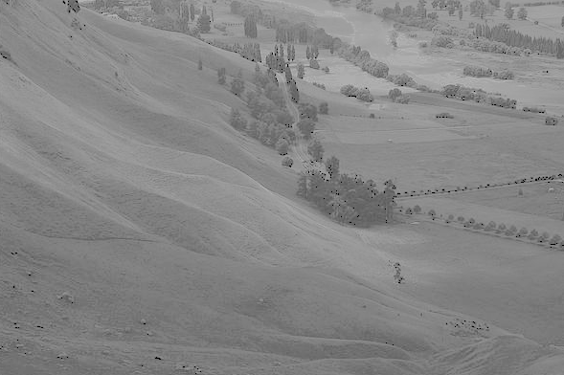
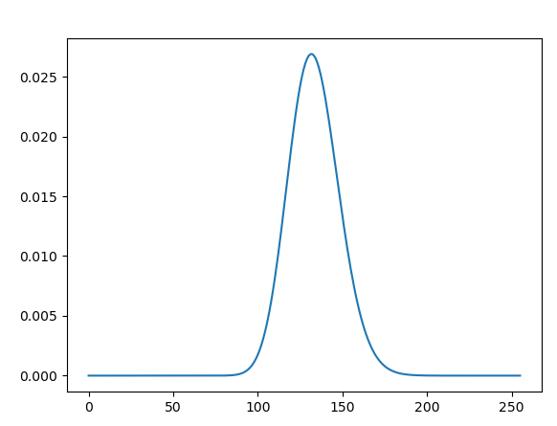
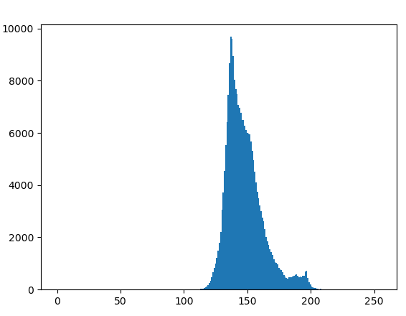
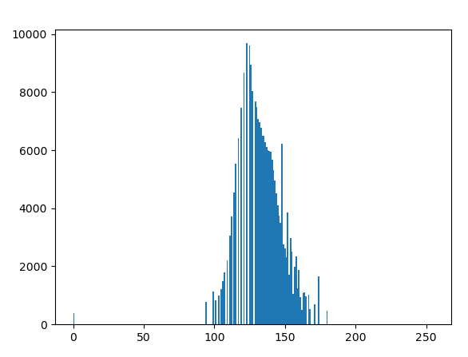
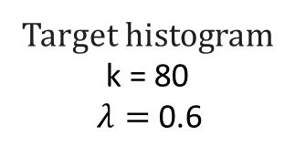
Histogram Matching with Erlang distribution
Input Image
Output Image
Target histogram
k = 80
$λ=$ 0.6
Histogram of the Input Image
Histogram of the Output Image

