Slide 1
CSE 4128 Image Processing and Computer Vision Laboratory Week 2: Segmentation(Edge Detection)
Dr. Sk. Md. Masudul Ahsan
Professor
Dept. of CSE, KUET
Md Tajmilur Rahman
Lecturer
Dept. of CSE, KUET

Slide 2
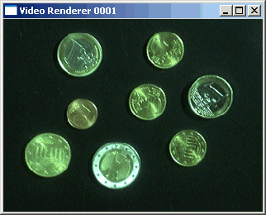

Segmentation
Segmentation subdivides an image into its constituent regions or objects.
Separating objects from the background and giving them individual labels(ID numbers)
Segmentation attempts to partition the pixels of an image into groups that strongly correlate with the objects in an image

Slide 3
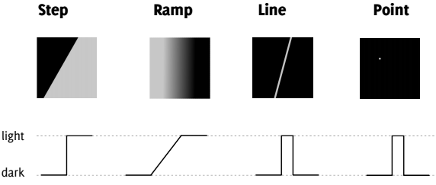
Edge Detection
It is most frequently used for segmenting images based on abrupt(local) changes in intensity. It centers around contour detection.
An edge is a set of connected pixels that lie on the boundary between two regions
Edge models

Slide 4
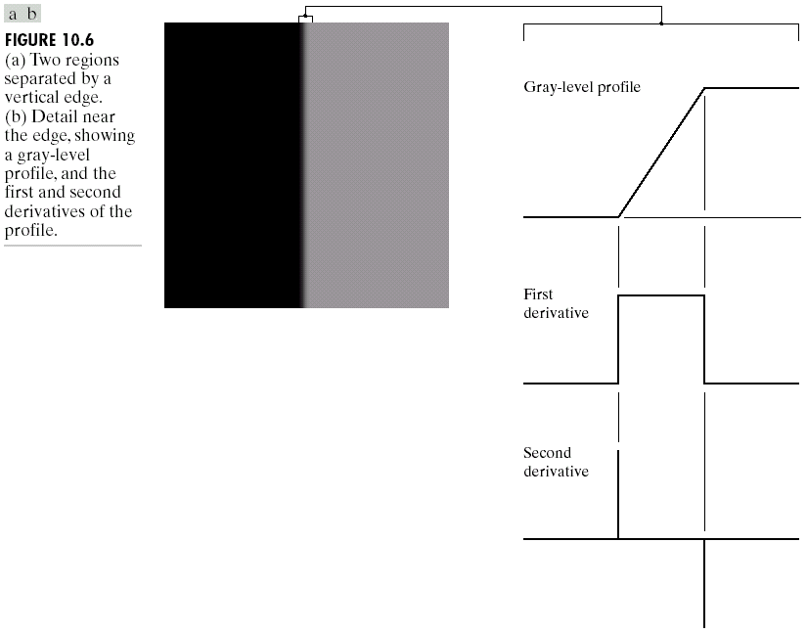
Edge and 1st Derivatives
Derivatives are used to find discontinuities.
1st derivative tells us where an edge is.
It gives Peaks at edges (large positive/negative values)

Slide 5
Edge and 2nd Derivatives
2nd derivative can be used to show edge side.
It gives Zero crossing at edges (sign change)
Zero-crossing gives exact edge position

Slide 6
Laplacian Edge Detection
Unlike first-order filters that detect the edges based on local maxima or minima, Laplacian detects the edges at zero crossings i.e. where the value changes from negative to positive and vice-versa.
zero crossing
f
f’
f’’
image
Laplacian
operator
edge
map
zero-crossing
f(x,y)
g(x,y)
E(x,y)

Slide 7
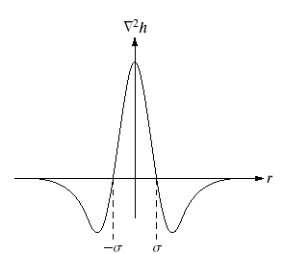
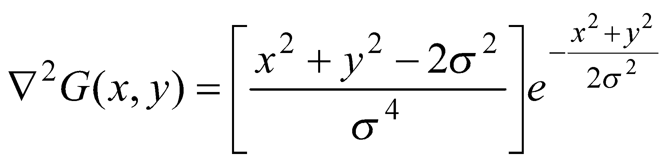
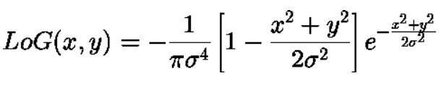
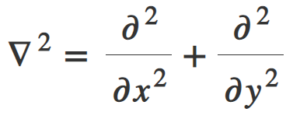
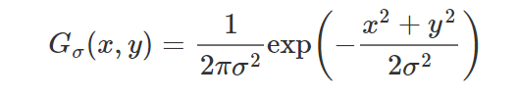
Laplacian Of Gaussian
The Laplacian of Gaussian (or Mexican hat) filter uses the Gaussian for noise removal and the Laplacian for edge detection
this can also be performed by smoothing with a Gaussian kernel and then taking its Laplace, we can obtain the Laplacian of the Gaussian kernel.
Laplacian:
Gaussian:

Slide 8
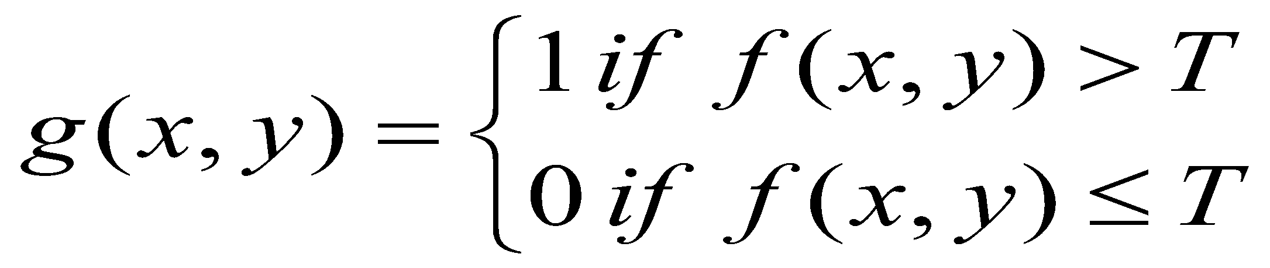
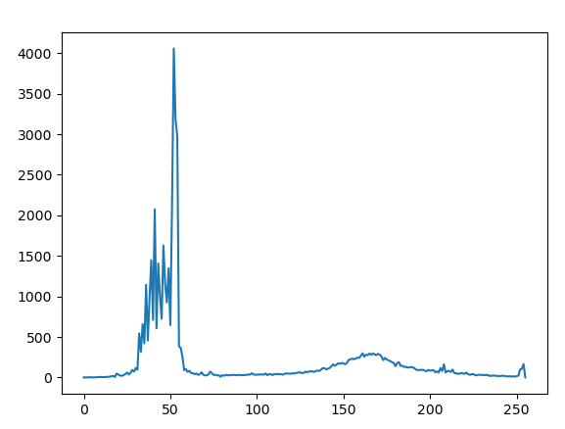
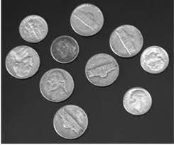

Thresholding
By selecting an adequate threshold value T, the gray level image can be converted to binary image.
Global Thresholding partitions the image histogram using a single global threshold T midway between the two gray value distributions
T = 110

Slide 9
Simple Laplacian-based Edge Detector
Zero cross strength ZS = ∑ Absolute( current_pixel – neighbor_pixel)
Th = Threshold value
yes
LoG
operator
zero
crossing?
Edge
point
Input Image
ZS > Th
No
No
not an
edge point
not an
edge point

Slide 10
4 Neighborhood Zero crossing
ZS = ∑ Absolute( current_pixel – neighbor_pixel)
1 | 1 | 1 | -1 | 1
3 | -3 | -3 | 3 | 4
3 | 4 | 4 | 3 | 1
1 | -1 | 1 | 1 | 2
1 | 2 | -2 | 1 | 2
0 | 0 | 0 | 0 | 0
0 | 3 | -3 | 3 | 0
0 | 4 | 4 | 0 | 0
0 | -1 | 1 | 0 | 0
0 | 0 | 0 | 0 | 0
0 | 0 | 0 | 0 | 0
0 | 6 | 17 | 10 | 0
0 | 12 | 7 | 0 | 0
0 | 12 | 4 | 0 | 0
0 | 0 | 0 | 0 | 0
zero
crossing
ZS
Zero Cross pixels
In 4-Neighborhood
(inner pixels)
Th = 6
LoG Response of
Input Image
0 | 0 | 0 | 0 | 0
0 | 0 | 255 | 255 | 0
0 | 0 | 255 | 0 | 0
0 | 255 | 0 | 0 | 0
0 | 0 | 0 | 0 | 0

Slide 11
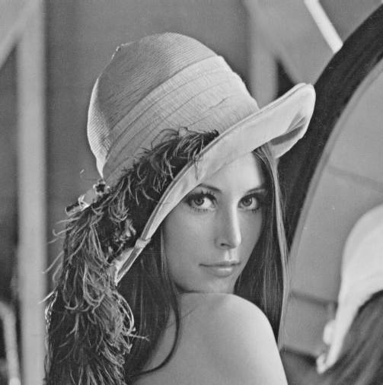
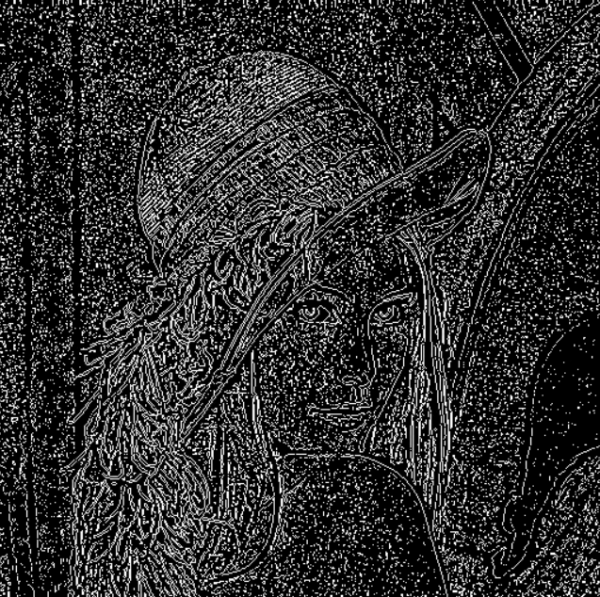
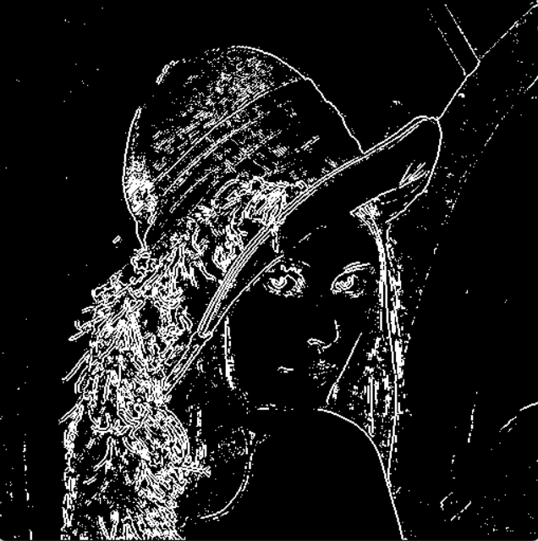
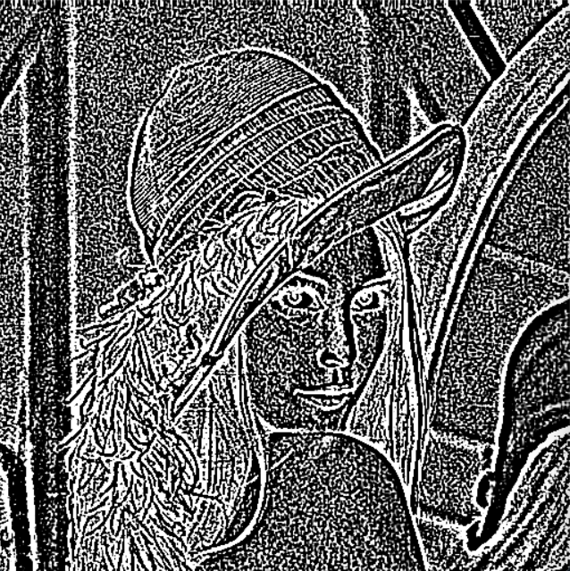
Segmentation with Edge Detection
Input
Applying Zero-crossing
ZS_Map with Th = 10
Convolving with LoG kernel with Sigma = 1, kernel size= 9X9

Slide 12
Class Work
Generate a LoG filter with size of 9xsigma with the following equation and apply convolution on an input image
Detect 4-neighborhood zero-cross pixels in the LoG response
Calculate the Zero cross strength ZS
ZS = ∑ Absolute( current_pixel – neighbor_pixel)
Applying thresholding:
pixel set to 255 if ZS > Th
otherwise pixel set to 0

Slide 13
Assignment
estimate
local variance
σ²
LoG
operator
zero
crossing?
yes
edge
point
image
σ²>th
No
No
not an
edge point
not an
edge point
Robust Laplacian-based Edge Detector

Slide 14
Thank You

