Slide 1
CSE 4128 Image Processing and Computer Vision Laboratory Week 2: Segmentation(Edge Detection)
Dr. Sk. Md. Masudul Ahsan
Professor
Dept. of CSE, KUET
Md Tajmilur Rahman
Lecturer
Dept. of CSE, KUET

Slide 2
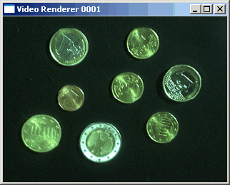

Segmentation
Segmentation subdivides an image into its constituent regions or objects.
Separating objects from the background and giving them individual labels(ID numbers)
Segmentation attempts to partition the pixels of an image into groups that strongly correlate with the objects in an image

Slide 3
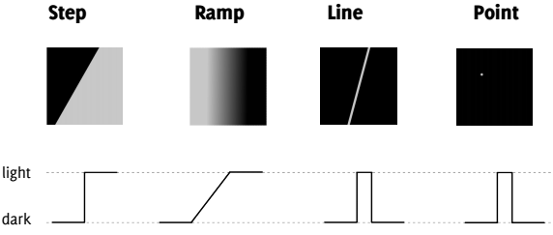
Edge Detection
It is most frequently used for segmenting images based on abrupt(local) changes in intensity. It centers around contour detection.
An edge is a set of connected pixels that lie on the boundary between two regions
Edge models

Slide 4
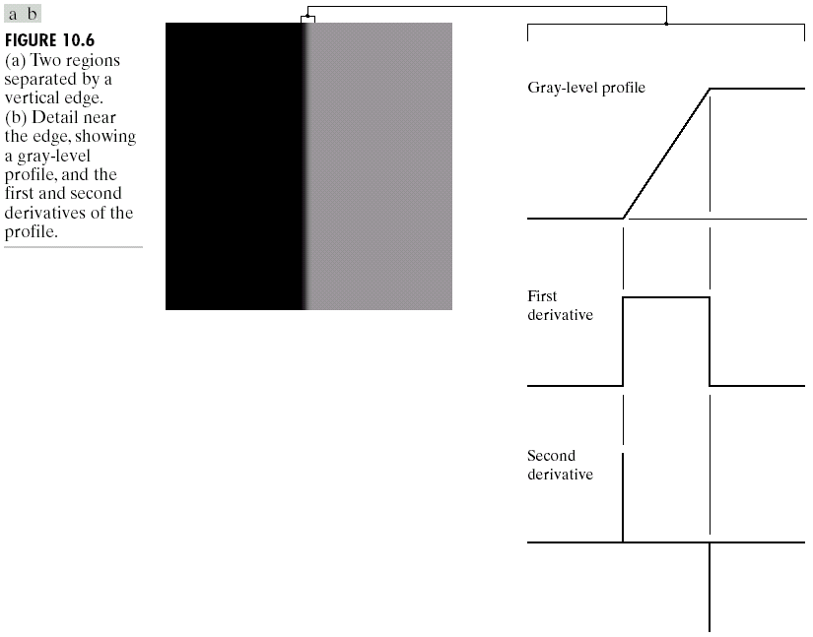
Edge and Derivatives
Derivatives are used to find discontinuities.
1st derivative tells us where an edge is.

Slide 5
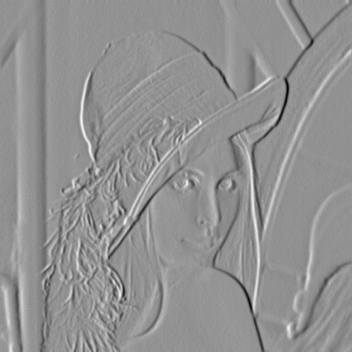
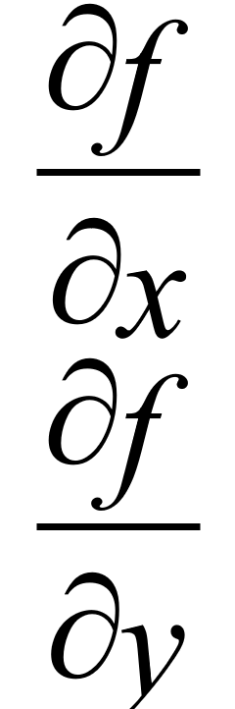
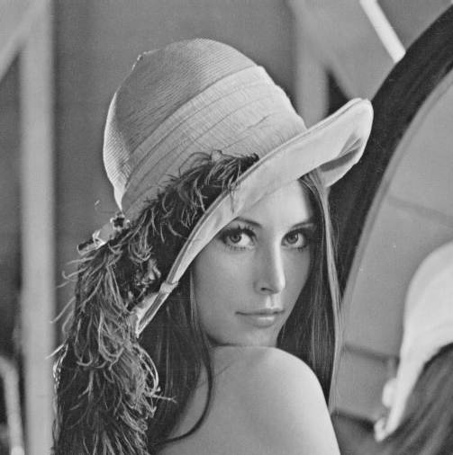
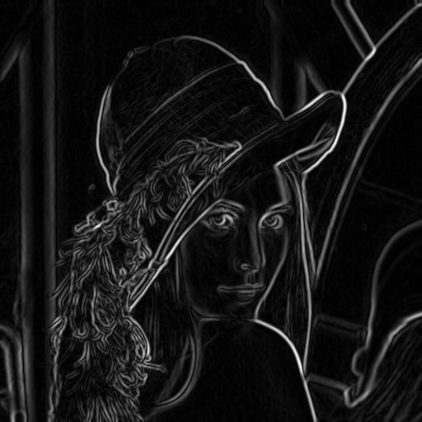
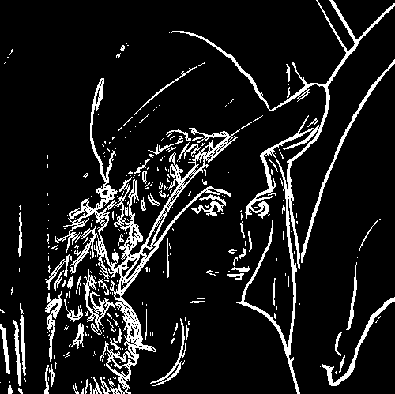
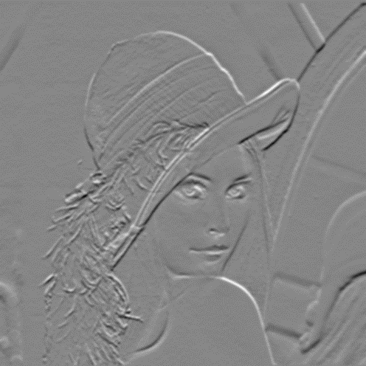

Segmentation with Edge Detection
Applying
thresholding
X-Derivative
Gradient Magnitude
Edge Detected
Y-Derivative

Slide 6
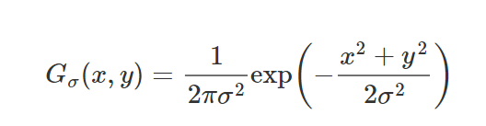
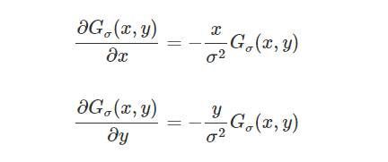
Gradient
A 2-dimensional continuous Gaussian filter is defined as follows:
For the 2-dimensional Gaussian G_{σ}(x,y) the 1st order partial derivatives are:
The edge strength can be obtained from gradient magnitude:

Slide 7
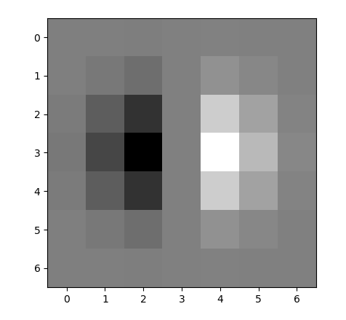
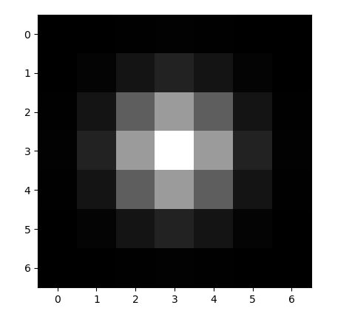
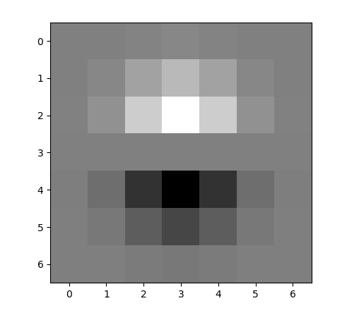
Gaussian filter & its Derivatives
x-direction
y-direction
7X7 kernel with sigma = 1

Slide 8
X-derivative kernel
0 0 0 0 0 0 0
0 -2 -3 0 3 2 0
-1 -7 -15 0 15 7 1
-1 -11 -25 0 25 11 1
-1 -7 -15 0 15 7 1
0 -2 -3 0 3 2 0
0 0 0 0 0 0 0
Normalized values (-25,25)

Slide 9
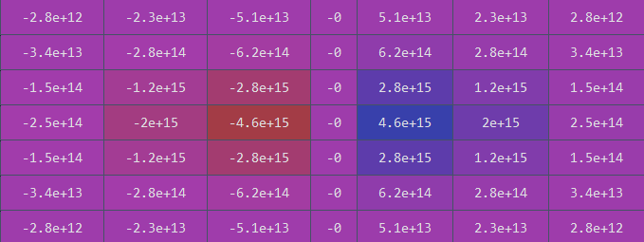
X-derivative kernel
0 0 0 0 0 0 0
0 -2 -3 0 3 2 0
-1 -7 -15 0 15 7 1
-1 -11 -25 0 25 11 1
-1 -7 -15 0 15 7 1
0 -2 -3 0 3 2 0
0 0 0 0 0 0 0
Normalized values (-25,25)
Actual kernel values for sigma = 1

Slide 10
Y-derivative kernel
0 0 1 1 1 0 0
0 2 7 11 7 2 0
0 3 15 25 15 3 0
0 0 0 0 0 0 0
0 -3 -15 -25 -15 -3 0
0 -2 -7 -11 -7 -2 0
0 0 -1 -1 -1 0 0
Normalized values (-25,25)

Slide 11
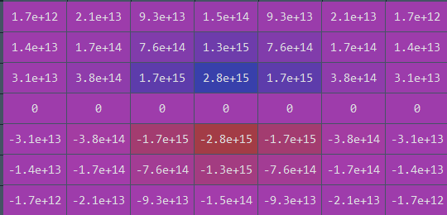
Y-derivative kernel
0 0 1 1 1 0 0
0 2 7 11 7 2 0
0 3 15 25 15 3 0
0 0 0 0 0 0 0
0 -3 -15 -25 -15 -3 0
0 -2 -7 -11 -7 -2 0
0 0 -1 -1 -1 0 0
Normalized values (-25,25)
Actual kernel values for sigma = 1

Slide 12
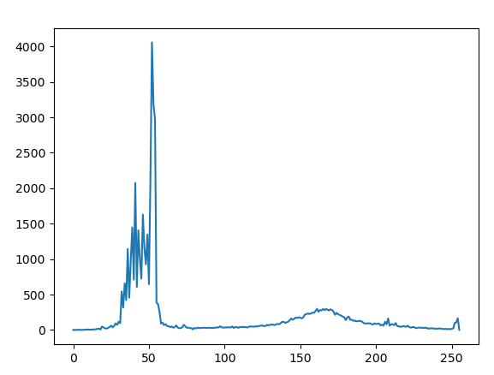
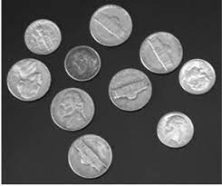

Thresholding
By selecting an adequate threshold value T, the gray level image can be converted to binary image.
Global Thresholding partitions the image histogram using a single global threshold T midway between the two gray value distributions
T = 110

Slide 13
Double Thresholding
We use two thresholds:
High threshold (T_high)
Low threshold (T_low)
Given a gradient magnitude image:
Strong edges
Pixels with gradient magnitude ≥ T_high
Immediately marked as strong edges (255).
Weak edges
Pixels with gradient magnitude between T_low and T_high
Marked as weak edges (often 128).
Non-edges
Pixels with gradient magnitude < T_low
Suppressed to 0.

Slide 14
Workflow
Generate kernels for 1st order derivatives (x and y) for Gaussian filter, the kernel generation function takes sigma as parameter and generates kernels of size 7xsigma.
Apply convolution on the image using the x and y derivative kernels.
Calculate the gradient magnitude from gradient images gx and gy: gradient_magnitude = cv2.magnitude(gx.astype(np.float32), gy.astype(np.float32))
4. Apply double thresholding on the gradient magnitude.
5. The resultant image shows the edges of the input image.

Slide 15



Output Results with different sigma value
sigma = 1 (kernel = 7X7)
sigma = 2 (kernel = 13X13)
T_low = 100 T_high = 150

Slide 16
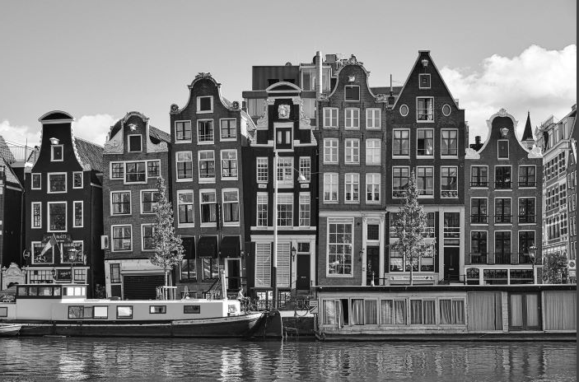
Another Input Image

Slide 17

Sigma = 1, T_l = 100, T_h = 150
Background/
No Edge
Strong Edge
Weak Edge

Slide 18
Assignment
Apply Hysteresis Thresholding instead of double thresholding for detecting edges in gradient magnitude image. Observe the differences with your class work and discuss it in your report.
Apply Canny edge detection algorithm on the image using the opencv library function. Compare the output with the previous ones.

Slide 19
Hysteresis Threshold
Threshold at low/high levels to get weak/strong edge pixels
Do connected components, starting from strong edge pixels
Canny uses hysteresis threshold to fill up the narrow gap along the edge.
Uses two threshold - high threshold T_h and low threshold T_l.
Pixels with gray values greater than T_h is set as the initial edge pixels
Pixels are set as background if their values are lower than T_l.

Slide 20
Thank You

