Slide 1
Chapter 2 Application Layer
Notes:
Version History
8.1. Updates throughout, including a lot more animations. These are the ppt files used to make Chapter 2 online lectures in Sept. 2020.
8.0 (April 2020)
All slides reformatted for 16:9 aspect ratio
All slides updated to 8th edition material
Use of Calibri font, rather that Gill Sans MT
Add LOTS more animation throughout

Slide 2
Application layer: overview
Principles of network applications
Web and HTTP
Web Cache and HTTP/2

Slide 3


Web caches
Goal: satisfy client requests without involving origin server
user configures browser to point to a (local) Web cache
browser sends all HTTP requests to cache
if object in cache: cache returns object to client
else cache requests object from origin server, caches received object, then returns object to client
Web
cache
HTTP request
HTTP request
client
HTTP response
HTTP response
origin
server
HTTP request
HTTP response
client
Notes:
t’

Slide 4


Web caches (aka proxy servers)
Web cache acts as both client and server
server for original requesting client
client to origin server
Why Web caching?
reduce response time for client request
cache is closer to client
reduce traffic on an institution’s access link
Internet is dense with caches
enables “poor” content providers to more effectively deliver content
server tells cache about object’s allowable caching in response header:
Notes:
re: poor content providers – like in real-estate, location is everything. servers want to be close to clients.

Slide 5
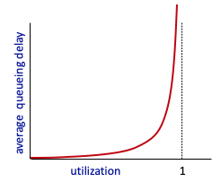


Caching example
Scenario:
access link rate: 1.54 Mbps
RTT from institutional router to server: 2 sec
web object size: 100K bits
average request rate from browsers to origin servers: 15/sec
avg data rate to browsers: 1.50 Mbps
origin
servers
public
Internet
1.54 Mbps
access link
Performance:
access link utilization = .97
LAN utilization: .0015
end-end delay = Internet delay +
access link delay + LAN delay
= 2 sec + minutes + usecs
problem: large queueing delays at high utilization!
institutional
network
1 Gbps LAN
Notes:
explain why minutes (recall earlier delay versus arrival rate curve from Chapter 1)

Slide 6
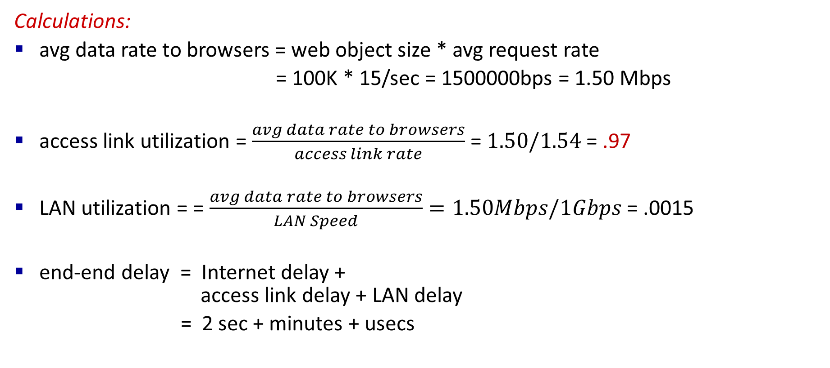
Caching example
Calculations:
avg data rate to browsers = web object size * avg request rate
= 100K * 15/sec = 1500000bps = 1.50 Mbps
access link utilization = $\frac{avg data rate to browsers}{access link rate}$ =$1.50/1.54$ = .97
LAN utilization = = $\frac{avg data rate to browsers}{LAN Speed}=1.50Mbps/1Gbps$ = .0015
end-end delay = Internet delay +
access link delay + LAN delay
= 2 sec + minutes + usecs
Notes:
explain why minutes (recall earlier delay versus arrival rate curve from Chapter 1)

Slide 7
Caching example
Performance:
access link utilization = .97
problem: large queueing delays at high utilization!
ρ = Average incoming traffic load / Link capacity
If ρ < 0.6, queueing delay ≈ milliseconds (tiny compared to RTT).
If ρ ≈ 1, queueing delay dominates (seconds).​
Notes:
explain why minutes (recall earlier delay versus arrival rate curve from Chapter 1)

Slide 8
Option 1: buy a faster access link
Scenario:
access link rate: 1.54 Mbps
RTT from institutional router to server: 2 sec
web object size: 100K bits
average request rate from browsers to origin servers: 15/sec
avg data rate to browsers: 1.50 Mbps
154 Mbps
origin
servers
public
Internet
154 Mbps
1.54 Mbps
access link
Performance:
access link utilization = .97
LAN utilization: .0015
end-end delay = Internet delay +
access link delay + LAN delay
= 2 sec + minutes + usecs
.0097
institutional
network
1 Gbps LAN
Cost: faster access link (expensive!)
msecs
Notes:
t’

Slide 9
Option 2: install a web cache
Scenario:
access link rate: 1.54 Mbps
RTT from institutional router to server: 2 sec
web object size: 100K bits
average request rate from browsers to origin servers: 15/sec
avg data rate to browsers: 1.50 Mbps
origin
servers
public
Internet
1.54 Mbps
access link
Cost: web cache (cheap!)
institutional
network
Performance:
LAN utilization: .?
access link utilization = ?
average end-end delay = ?
1 Gbps LAN
How to compute link
utilization, delay?
local web cache
Notes:
t’

Slide 10
Calculating access link utilization, end-end delay with cache:
suppose cache hit rate is 0.4:
40% requests served by cache, with low (msec) delay
origin
servers
public
Internet
60% requests satisfied at origin
rate to browsers over access link
= 0.6 * 1.50 Mbps = .9 Mbps
access link utilization = 0.9/1.54 = .58 means low (msec) queueing delay at access link
1.54 Mbps
access link
institutional
network
average end-end delay:
= 0.6 * (delay from origin servers + queuing delay) + 0.4 * (delay when satisfied at cache)
= 0.6 (2sec + .01sec) + 0.4 (~msecs) = ~ 1.2 secs
1 Gbps LAN
local web cache
lower average end-end delay than with 154 Mbps link (and cheaper too!)
Notes:
t’

Slide 11
Consistency of Web caching
The major issue: How to maintain consistency?
Two ways:
Pull
Web caches periodically pull the web server to see if a document is modified
Push
Whenever a server gives a copy of a web page to a web cache, they sign a lease with an expiration time; if the web page is modified before the lease, the server notifies the cache

Slide 12
Browser caching: Conditional GET
client
server
Goal: don’t send object if browser has up-to-date cached version
no object transmission delay (or use of network resources)
client: specify date of browser-cached copy in HTTP request
If-modified-since: <date>
server: response contains no object if browser-cached copy is up-to-date:
HTTP/1.0 304 Not Modified
HTTP request msg
If-modified-since: <date>
object
not
modified
before
<date>
HTTP response
HTTP/1.0
304 Not Modified
HTTP request msg
If-modified-since: <date>
object
modified
after
<date>
HTTP response
HTTP/1.0 200 OK
<data>
Notes:
t’

Slide 13
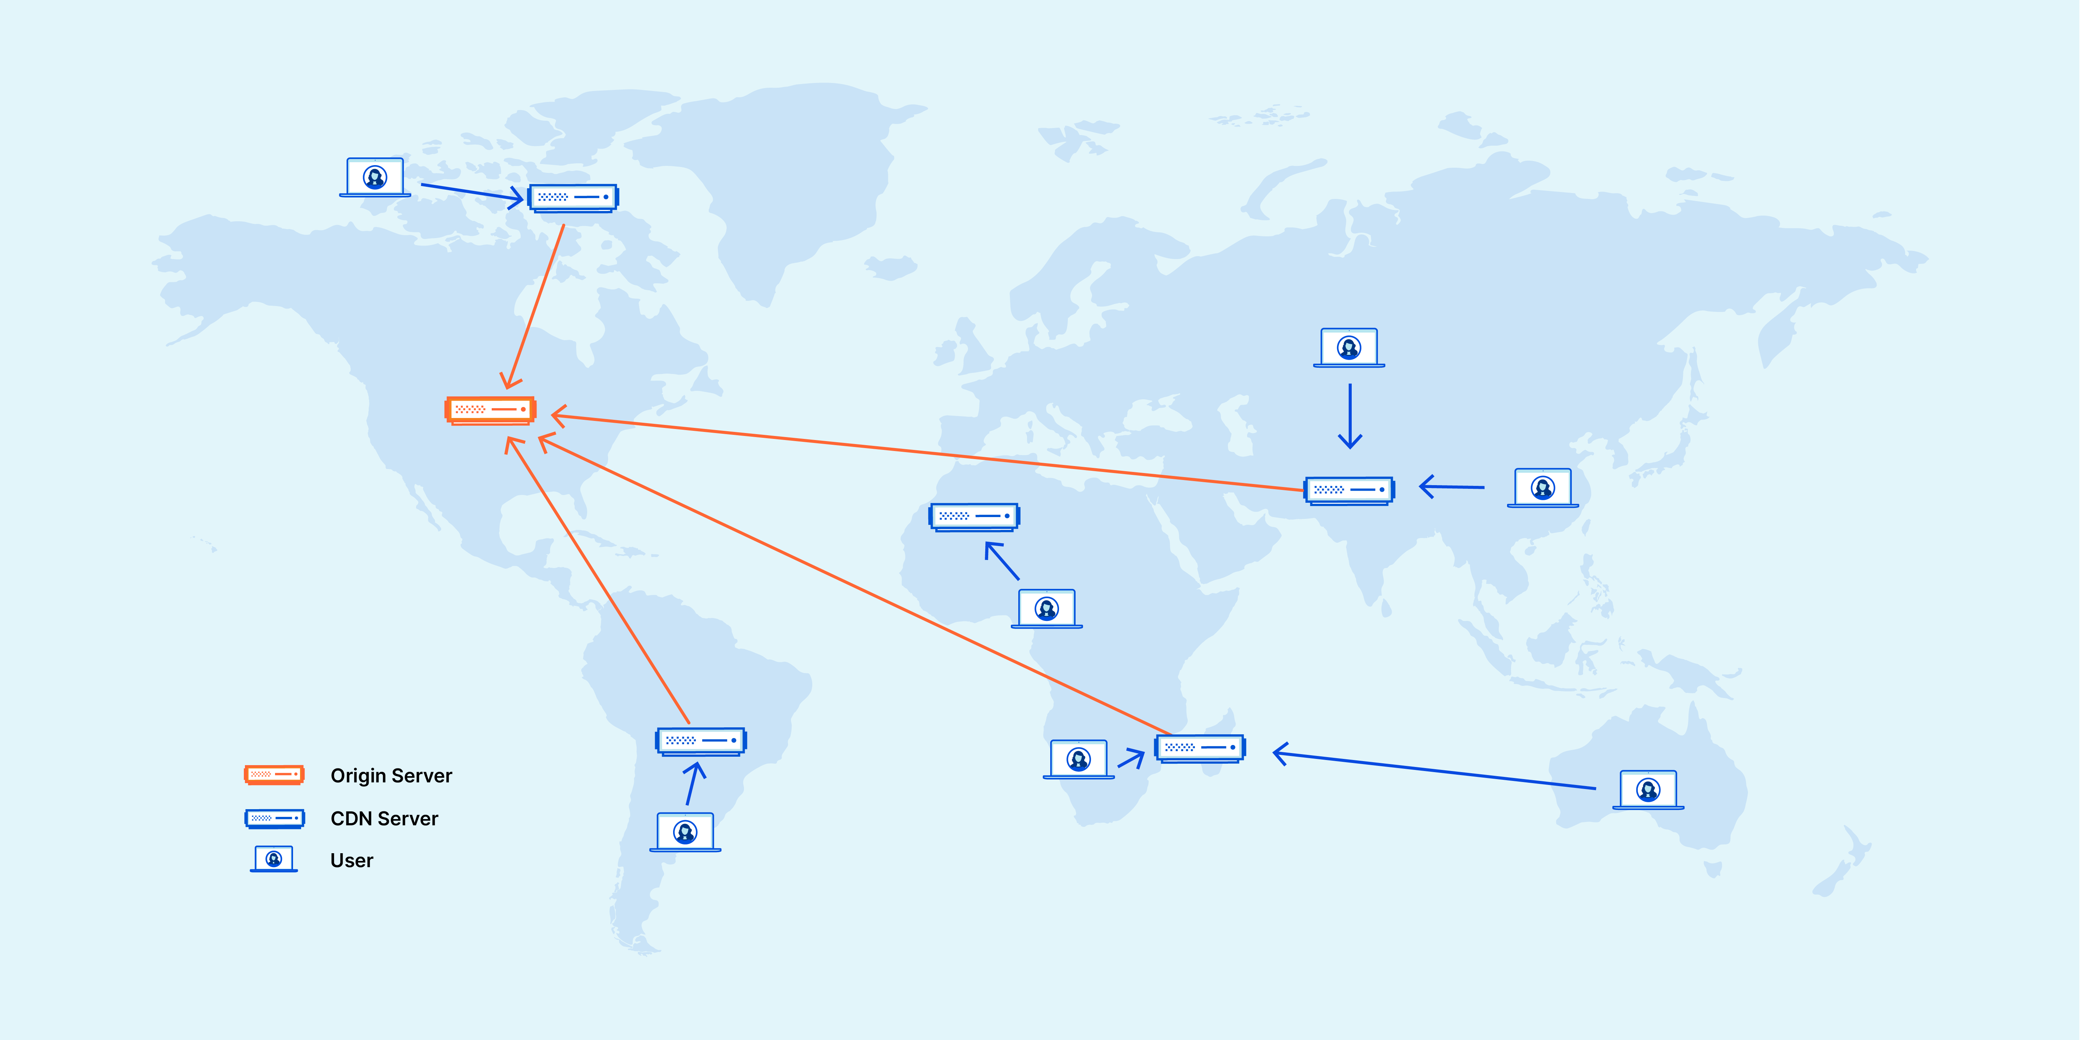
Content Delivery Network (CDN) – Self Study
https://www.cloudflare.com/learning/cdn/what-is-a-cdn/

Slide 14
HTTP/2
Key goal: decreased delay in multi-object HTTP requests
HTTP1.1: introduced multiple, pipelined GETs over single TCP connection
server responds in-order (FCFS: first-come-first-served scheduling) to GET requests
with FCFS, small object may have to wait for transmission (head-of-line (HOL) blocking) behind large object(s)
loss recovery (retransmitting lost TCP segments) stalls object transmission
Notes:
t’

Slide 15
HTTP/2
Key goal: decreased delay in multi-object HTTP requests
HTTP/2: [RFC 7540, 2015] increased flexibility at server in sending objects to client:
methods, status codes, most header fields unchanged from HTTP 1.1
transmission order of requested objects based on client-specified object priority (not necessarily FCFS)
push unrequested objects to client
divide objects into frames, schedule frames to mitigate HOL blocking
Notes:
t’

Slide 16
HTTP/2: mitigating HOL blocking
HTTP 1.1: client requests 1 large object (e.g., video file) and 3 smaller objects
server
GET O₄
GET O₃
GET O₂
GET O₁
object data requested
client
O₁
O₂
O₁
O₃
O₂
O₃
O₄
O₄
objects delivered in order requested: O₂, O₃, O₄ wait behind O₁
Notes:
t’

Slide 17
HTTP/2: mitigating HOL blocking
HTTP/2: objects divided into frames, frame transmission interleaved
server
GET O₄
GET O₃
GET O₂
GET O₁
object data requested
client
O₂
O₄
O₃
O₁
O₂
O₃
O₄
O₁
O₂, O₃, O₄ delivered quickly, O₁ slightly delayed
Notes:
shortest job first: decreased average delay!

Slide 18
HTTP/2 to HTTP/3
HTTP/2 over single TCP connection means:
recovery from packet loss still stalls all object transmissions
as in HTTP 1.1, browsers have incentive to open multiple parallel TCP connections to reduce stalling, increase overall throughput
no security over vanilla TCP connection
HTTP/3: adds security, per object error- and congestion-control (more pipelining) over UDP
more on HTTP/3 in transport layer
Notes:
t’

Slide 19
References
Computer Networking: A Top-Down Approach
Chapter 2
Why Web Cache? Example 1
Why Web Cache? Example 2
Why Web Cache? Example 3
Content Delivery Network
HTTP/2 vs HTTP/1.1
HTTP/2 Explained

Slide 20
Thank You

