Slide 1
Introduction to functional programming
λ λ
Tautvilas Mečinskas 2015
WIX.COM

Slide 2
Lecture outline
What is a function?
What is functional programming?
What is lambda calculus?

Slide 3
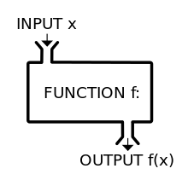
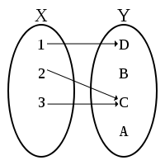
What is a function?

Slide 4
Function examples in code

Slide 5
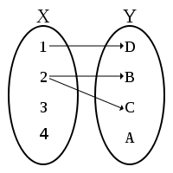
What is not a function?

Slide 6
Currying
In mathematics and computer science, currying is the technique of translating the evaluation of a function that takes multiple arguments into evaluating a sequence of functions, each with a single argument

Slide 7
So what is functional programming?

Slide 8

Factorial example

Slide 9
F-programming traits
Declarative (vs Imperative)
Immutable data
No state
Referential transparency

Slide 10
Benefits
Shorter codebase
Code is easy to test
Less bugs
Concurrency
Helps you learn new ways to think and code

Slide 11
Disadvantages
Code is harder to read
Possible performance issues (recursion, garbage collection)
Pure f-p solutions are not well suited for real business problems modeling (e.g. banking)

Slide 12
Bank account example

Slide 13
You can’t do pure f-programming
Actions like
getting time
generating random number
reading/writing to/from file/ram/screen
Are inherently non-functional

Slide 14
Mix both styles in a clever way

Slide 15
Basic F-programming toolkit
map(values, f)
reduce(values, f)
filter(values, f)

Slide 16
What is lambda calculus?
Valid λ-calculus expressions can be defined inductively as follows:
A variable x is a valid λ-term. (variable)
If t is a valid λ-term and x is a variable, then λx. t is a valid λ-term. (function body)
If t and s are both valid λ-terms, then t s is a valid λ-term. (function application)

Slide 17
Lambda examples in code

Slide 18
Y-Combinator
λf. (λx. f (x x))(λx. f (x x))

Slide 19
Language examples
Haskell - purely functional
Lisp - closely resembles lambda calculus
Clojure - similar to lisp, uses JVM
Scala - uses JVM and mixed functional-OO approach
Any other language that supports first-class functions will be fine (e.g. Javascript)

Slide 20
Resources
Code examples for this lecture
Famous SICP MIT course (based on LISP)
Introduction to Lambda and Y-Combinator
Haskell online book

Slide 21
Thank you for your attention

