Slide 1
Introduction to
Web Frameworks
Tautvilas Mečinskas 2014

Slide 2
Things you will need
PHP 5.3
PHP SQLite module
Web-server (I recommend Apache 2 with mod-rewrite)
Git client (recommended)
git clone git@github.com:tautvilas/php-lecture.git
https://github.com/tautvilas/php-lecture/archive/master.zip

Slide 3
A very simple Blog webapp
Add post
List posts
SQLite file
Post
Text (varchar 255)

Slide 4
Example1: Simplest webapp
Things to note:
Use prepared statements
Redirect after POST
PHP short tag <?=
Template PHP flow control syntax

Slide 5

Example2: Separation of concerns

Slide 6
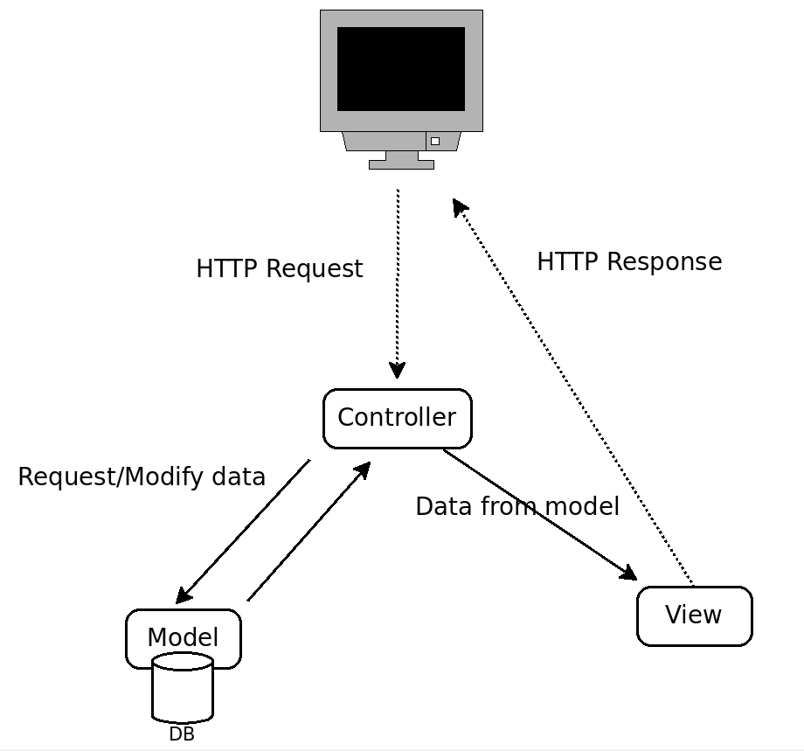
Example3: Basic OO MVC

Slide 7
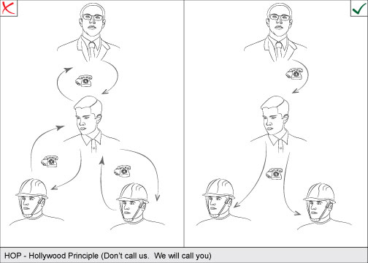
Inversion of Control concept
Framework
Web app
Controller
Model
Services

Slide 8
Web Framework
Gives structure to your project
Makes much easier for many developers to work on one project
Makes easier to maintain the project
Out of the box routing, templating, DI, component libraries, security and much more
Could be an obstacle when solving very specific problems or trying to optimize code

Slide 9
Example4: Routing
Routes need to be configured
Dispatcher chooses the correct route
Allows multiple views and controllers

Slide 10
Example5: Services
Single responsibility principle
Improves modularity

Slide 11
Example6: Dependency Injection
Singleton
IoC container
Dependency Injection concept

Slide 12
Symfony2 comparison
App code is in bundles
Views: Twig
Controller with routing annotation
Model: ORM
Dependency injection via configuration
http://symfony.com/doc/current/book/from_flat_php_to_symfony2.html

Slide 13
Symfony2 more core features
Composer.json for dependency management
Console commands
Security
Configuration: Annotations/YAML/XML/PHP
Forms + validation

Slide 14
That's it :)

