Slide 1
AJAX Overview
Giuseppe Attardi
Università di Pisa

Slide 2
AJAX
Asynchronous JavaScript And XML
Catchy acronym coined by Jesse James Garrett of Adaptive Path (February 2005)
Really a set of techniques used as far back as 1998
But came into vogue with new browsers supporting XmlHttpRequest() and broadband connections
Killer Apps: Gmail and Google Maps

Slide 3
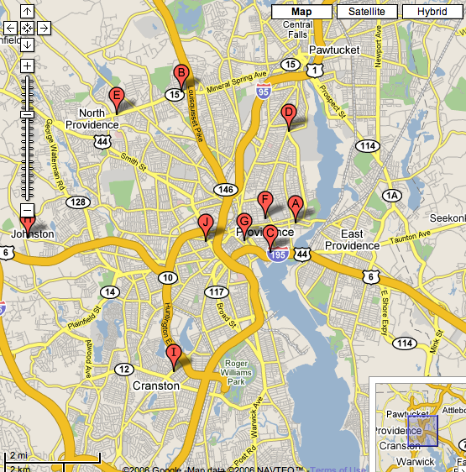
Google Maps
Live content refresh and manipulation without page refreshes
API for easy integration with other data sources

Slide 4
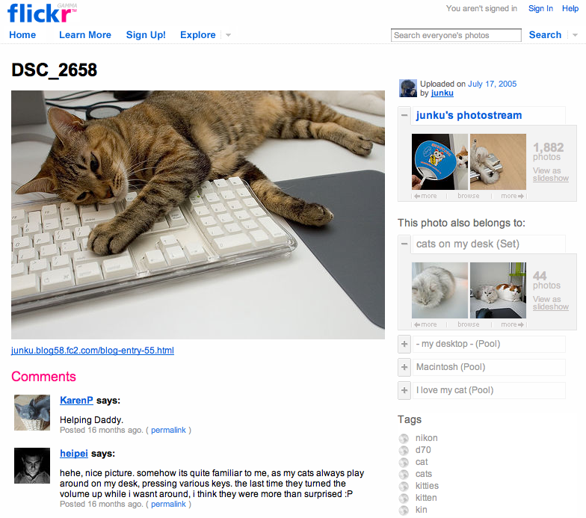
Flickr
Dynamic AJAX “photostream” slideshows
User-driven tagging
User comments and permalinking
RSS feeds

Slide 5
Ajax Requirements
DHTML capable browsers
  DOM, CSS, XHTML
XHR support across all browsers
Broadband connections
  AJAX-based JavaScript can take considerable bandwidth to download

Slide 6
Main features of AJAX
The Web page hosts entire JavaScript programs
The UI is manipulated programmatically and in real-time by changing the Document Object Model
The Web page isn’t reloaded unless completely new functionality is needed
Information is accessed in the background (asynchronously) by the browser via Web services
  XML, JSON, or anything HTTP can transmit

Slide 7
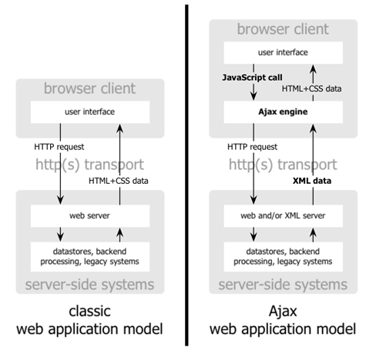
Ajax Model
Source: Garrett(2005)

Slide 8
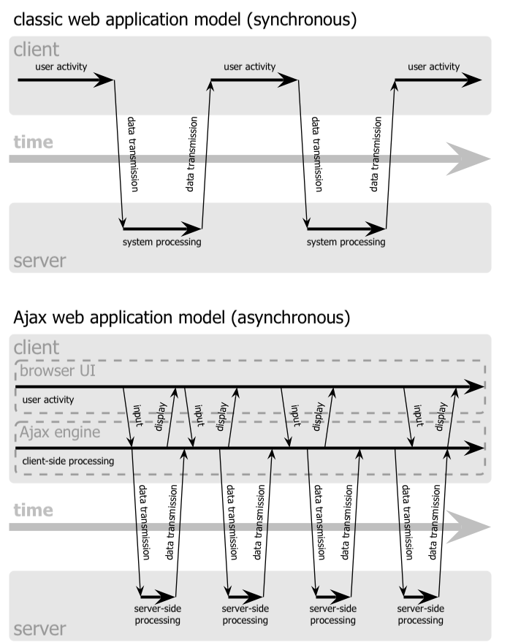
Ajax Asynchronous Model
Source: Garrett(2005)

Slide 9
The Result
Pure browser software that can become Rich Interactive Application (RIA)
The Web becomes a true software platform
An open software model that has no owner
  Not vendor controlled, based on neutral, open Web standards
A significant challenge as the browser client suddenly becomes quite complex

Slide 10
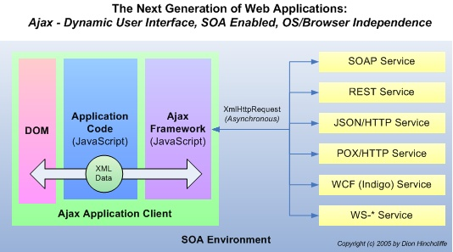
Ajax Application Frameworks

Slide 11
AJAX Alternatives
IFrame
  Standard HTML
Macromedia Flash
  Requires a plug-in
    Provided for almost every browser
Java Web Start/Applets
  Requires a runtime preinstalled
MS .NET, One Touch Deployment
Silverlight
  Requires a preinstalled plug-in

Slide 12
IFrame
Put on a page:
  <iframe id="buffer" style="visibility:hidden; display: none; height: 1px“
  onload=“some action"></iframe>
Fill it from a URL:
  <a href="date" id="display" target="buffer">Load me</a>
Action:
  var l=document.getElementById('display');
  var f=window.frames['buffer'].document.body;
  if (f.innerHTML != '') l.innerHTML=f.innerHTML

Slide 13
AJAX Limitations
Handheld device browsers provide limited support for Ajax technologies

Slide 14
Implementing AJAX
To implement AJAX we need to answer three questions:
  What triggers the AJAX request?
    Usually a JavaScript event (onblur, onclick, etc.)
  What is the server process that handles the AJAX request and issues the response?
    Some kind of URL (use a Service Locator)
  What processes the response from the server (what is the callback method)?
    A JavaScript function that gets the response and manipulates the DOM, based on the text returned

Slide 15
XmlHttpRequest Object (XHR)
The heart of AJAX
First implemented in IE in 1997 as part of the new DHTML standard
Response comes in one of two properties:
  responseXML – Returns a DOM document (can use functions such as, getElementById())
  responseText – A text string (can be HTML, or even JavaScript code)

Slide 16
XHR: Creating
function getXMLHTTPRequest() {
var xhr = null;
if (window.XMLHttpRequest) { // most modern web browsers
xhr = new XMLHttpRequest();
} else if (window.ActiveXObject) { // Internet Explorer
xhr = new ActiveXObject("Microsoft.XMLHTTP");
} // else stone age web browsers
return xhr;
}
Test it:
http://medialab.di.unipi.it/test/ajax.html
Notes:
Non-standard extensions to the web-browser DOM.

Slide 17
XHR: Simple RPC
function rpc(url) {
var args = rpc.arguments;
var uri = url + '?';
if (args != null) {
for (var i = 1; i < args.length; i++) {
if (i > 1)
uri += '&';
uri += "arg" + i + '=' + escape(args[i]);
}
}
var x = new getXMLHttpRequest();
x.open("GET", uri, false);
x.send(null);
if (x.status != 200)
return null;
var res = x.responseText;
delete x;
return res;
}

Slide 18
XHR: Sending the Request
function sendRequest(url, params, callBack) {
var req = new XMLHttpRequest();
req.onreadystatechange =
function() { callBack(req); };
req.open(“POST”, url, true);
req.setRequestHeader("Content-Type",
"application/x-www-form-urlencoded");
req.send(params);
}
closure
true = asynchronous
Notes:
Non-standard extensions to the web-browser DOM.

Slide 19
XHR: Using a callback handler
var READY_STATE_UNINITIALIZED = 0;
var READY_STATE_LOADING = 1;
var READY_STATE_LOADED = 2;
var READY_STATE_INTERACTIVE = 3;
var READY_STATE_COMPLETE = 4;
function onReadyStateChange(req) {
var ready = req.readyState;
var data = null;
if (ready == READY_STATE_COMPLETE) {
data = req.responseText;
} else {
data = "loading ...[" + ready + "]";
}
// ... do something with the data ...
}
Notes:
Non-standard extensions to the web-browser DOM.

Slide 20
Handling the Response
Response can be one of the following:
  Formatted data (XML, other custom format)
    XMLHttpRequest.responseXML
    Decouples the server from presentation issues
    Could perform XSLT transformation on returned XML
  HTML
    XMLHttpRequest.responseText
    Server generates HTML, script “injects” HTML via innerHTML
    Server is now concerned with presentation
  JavaScript
    XMLHttpRequest.responseText
    Use the eval() JavaScript command
    Again, our server code is concerned with presentation

Slide 21
AJAX Concerns
Security
  Same Origin Policy
Browser compatibility
Accessibility
The Back button
What if JavaScript is turned off?

Slide 22
Same Origin Policy
Cross-Origin Resource Sharing
  Adds new HTTP headers:
    Origin
    Access-Control-Allow-Origin
JSONP
  Send JSON data containing a <script> element which when loaded performs callback from a different domain
WebSockets (HTML5)

Slide 23
JSONP
Convention: tell the server to send back code to be used for callback to do parseResponse
HTML page contains
<script type="application/javascript“
src="http://s.com/Users/1234?callback=parseResponse">
</script>
The server at the specified URL returns code:
parseResponse({"Name": "Foo", "Id": 1234, "Rank": 7});
where:
{"Name": "Foo", "Id": 1234, "Rank": 7}
is the JSON data for the original request
The browser load the script and runs it, i.e. invokes parseResponse()

Slide 24
WebSockets
Protocol providing full-duplex communication channels over a single TCP connection
Uses prefix ws:// or wss://
Included in HTML5

Slide 25
AJAX and the Back Button
Huge usability issue
Returning to the previous state may not be possible when a page is updated dynamically
Difficult to bookmark on a particular page state

Slide 26
AJAX Libraries
jQuery
Prototype
Scriptaculous
Yahoo! UI Library
GWT
ASP .NET AJAX
DOJO
…

Slide 27
Server Side Frameworks
DWR (Java)
Ruby on Rails (Ruby)
Symfony2, Laravel (PHP)

Slide 28
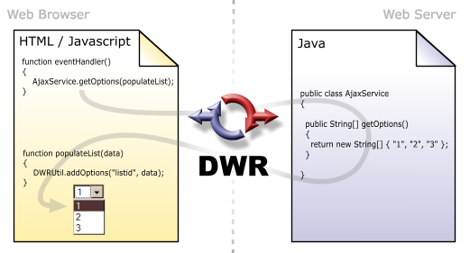
Direct Web Remoting

Slide 29
Comet
Generic term for web application model in which a long-held HTTP request allows a server to push data to a browser
Implementations:
  Persistent connection
  Hidden iFrame
  XMLHttpRequest

Slide 30
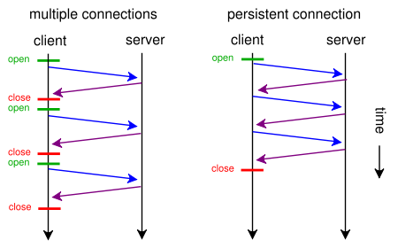
Persistent Connection
  HTTP 1.0: Connection: keep-alive (< 5-15 sec.)

Slide 31
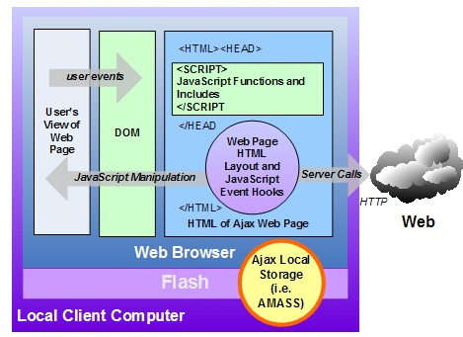
RIA with Ajax

Slide 32
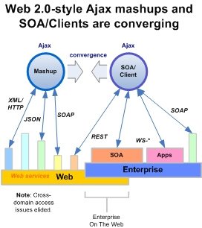
Ajax, Client/SOA, and Mashups
Common Elements:
Zero footprint apps
No plug-ins or admin rights needed
Leverages Web services
Dynamic user interface
JavaScript powered
Can be made secure
With a little work, can communicate and combine data from Web services anywhere in the world
Easier with pre-built widgets, frameworks, IDEs, and Web service stacks
Gives us new Web components...

Slide 33
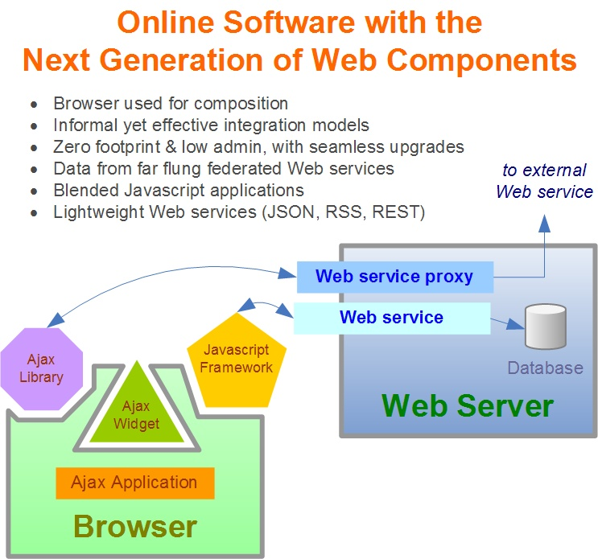
Ajax for Software Composition

