Slide 1
Introduction to jQuery
Giuseppe Attardi
Università di Pisa
Some slides from: BreadFish

Slide 2
JavaScript
A script language interpreted by browser
OOP (prototype based, not class based)
Dynamic typing
Run-time evaluation

Slide 3
JavaScript
Cannot access host computer (except cookie)
Same origin policy
Non-persistence
Cannot access history object
Cannot write the value of file upload field

Slide 4
JavaScript Libraries
jQuery
Mootools
Prototype
YUI

Slide 5
Introduction to jQuery
Developed in 2006 by John Resig at Rochester Institute of Technology
jQuery is a lightweight JavaScript library that emphasizes interaction between JavaScript and HTML
jQuery is free, open source software Dual-licensed under the MIT License and the GNU General Public License
Helps web developers to create simple pieces of interaction without being forced to write long, complex, book-length pieces of code

Slide 6
Introduction to jQuery
Why do I want it
  Rich Internet Applications (RIA)
  Dynamic HTML (DHTML)
How do I get it
  www.jquery.com
How can I learn it
  jQuery in Action by Bibeault & Katz, Manning
  jQuery Visual Quickstart Guide by Holzner, Peachpit
  www.jquery.com
  docs.jquery.com
  www.visualjquery.com
  www.Jqueryfordesigners.com
  www.gscottolson.com/weblog/ - cheat sheet
  www.javascripttoolbox.com/jquery
  http://www.w3schools.com/jquery/jquery_examples.asp

Slide 7
Summary
Introduction, installation, “Howdy World”, Ready function, DOM, Selecting and Formatting web page elements
Events and Animations
jQuery Plugin libraries
AJAX

Slide 8
Introduction to jQuery
Installation
  just download the jquery-2.x.x.js file and put it in your website folder
Using jQuery
  Visual Web Developer Express Edition
  Expression Web

Slide 9
What jQuery Does
“Unobtrusive” JavaScript
  separation of behavior from structure
CSS
  separation of style from structure
Allows adding JavaScript to your web pages
Advantages over just JavaScript
  Much easier to use
  Eliminates cross-browser problems

Slide 10
5 Things jQuery Provides
Select DOM (Document Object Model) elements on a page – one element or a group of them
Set properties of DOM elements, in groups (“Find something, do something with it”)
Creates, deletes, shows, hides DOM elements
Defines event behavior on a page (click, mouse movement, dynamic styles, animations, dynamic content)
AJAX calls

Slide 11
The DOM
Document Object Model
jQuery is “DOM scripting”
Heirarchal structure of a web page
You can add and subtract DOM elements on the fly
You can change the properties and contents of DOM elements on the fly

Slide 12
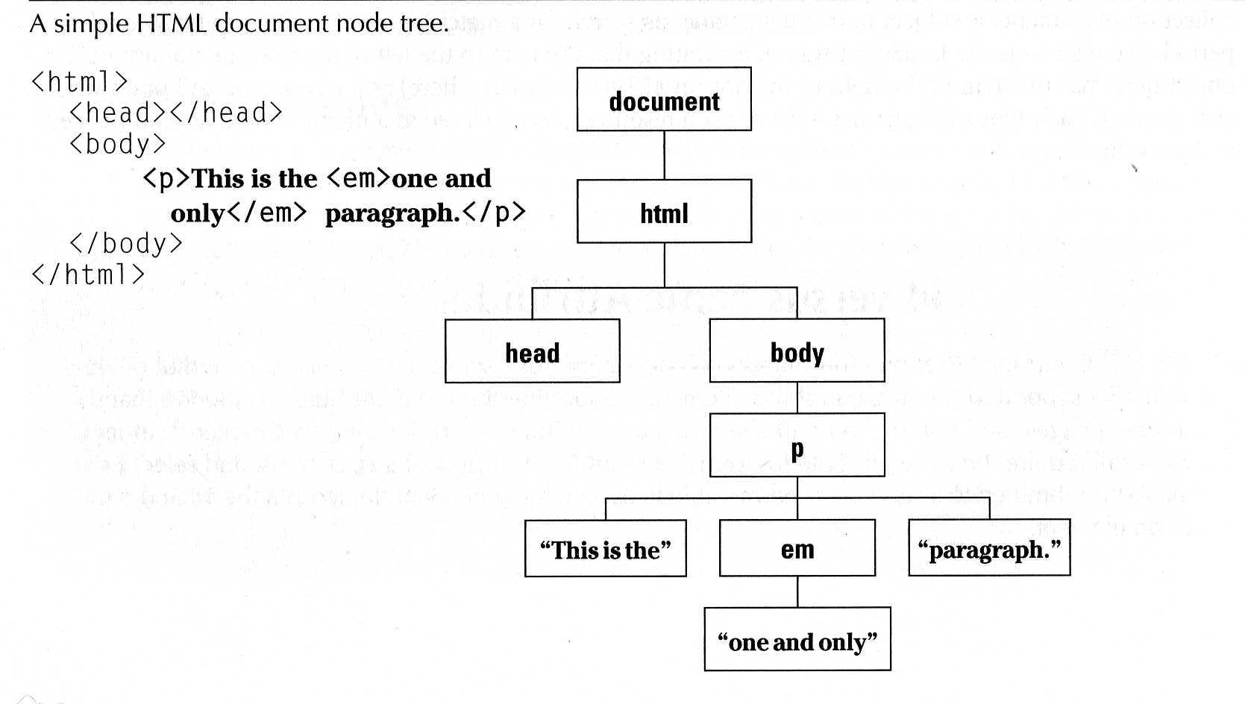
The DOM
“a cross-platform and language-independent convention for representing and interacting with objects in HTML, XHTML and XML documents. Aspects of the DOM (such as its "Elements") may be addressed and manipulated within the syntax of the programming language in use.” Wikipedia

Slide 13
The jQuery Function
jQuery() = $()
$(function) The “Ready” handler
$(‘selector’) Element selector expression
$(element) Specify element(s) directly
$(‘HTML’) HTML creation
$.function() Execute a jQuery function
$.fn.myfunc(){} Create jQuery function

Slide 14
The Ready Function
Set up a basic HTML page and add jQuery
Create a “ready” function
Call a function
5 ways to specify the ready function
  jquery(document).ready(function(){…};);
  jquery().ready(function(){…};)
  jquery(function(){…};)
  jquery(dofunc);
  $(dofunc);

Slide 15
Selecting Elements - Creating a “wrapped set”
$(selector)
selector:
  $(‘#id’) id of element
  $(‘p’) tag name
  $(‘.class’) CSS class
  $(‘p.class’) <p> elements having the CSS class
  $(‘p:first’) $(‘p:last’) $(‘p:odd’) $(‘p:even’)
  $(‘p:eq(2)’) gets the 2nd <p> element (1 based)
  $(‘p’)[1] gets the 2nd <p> element (0 based)
  $(‘p:nth-child(3)) gets the 3rd <p> element of its parent.
  $(‘p:nth-child(odd)) gets the odd <p> element of its parent.
  $(‘p:nth-child(5n+1)’) gets the 1st element after every 5th one
  $(‘p a’) <a> elements, descended from a <p>
  $(‘p>a’) <a> elements, direct child of a <p>
  $(‘p+a’) <a> elements, directly following a <p>
  $(‘p, a’) <p> and <a> elements
  $(‘li:has(ul)’) <li> elements that have at least one <ul> descendent
  $(‘:not(p)’) all elements but <p> elements
  $(‘p:hidden’) only <p> elements that are hidden
  $(‘p:empty’) <p> elements that have no child elements

Slide 16
Selectors Live
https://www.tutorialspoint.com/jquery/jquery-selectors.htm

Slide 17
Selecting Elements, cont.
$(‘img’[alt]) <img> elements having an alt attribute
$(‘a’[href^=http://]) <a> elements with an href attribute starting with ‘http://’
$(‘a’[href$=.pdf]) <a> elements with an href attribute ending with ‘.pdf’
$(‘a’[href*=ntpcug]) <a> elements with an href attribute containing ‘ntpcug’

Slide 18
Useful jQuery Functions
.each() iterate over the set
.size() number of elements in set
.end() reverts to the previous set
.get(n) get just the nth element (0 based)
.eq(n) get just the nth element (0 based) also .lt(n) & .gt(n)
.slice(n,m) gets only nth to (m-1)th elements
.not(‘p’) don’t include ‘p’ elements in set
.add(‘p’) add <p> elements to set
.remove() removes all the elements from the page DOM
.empty() removes the contents of all the elements
.filter(fn/sel) selects elements where the func returns true or sel
.find(selector) selects elements meeting the selector criteria
.parent() returns the parent of each element in set
.children() returns all the children of each element in set
.next() gets next element of each element in set
.prev() gets previous element of each element in set
.siblings() gets all the siblings of the current element
https://www.tutorialspoint.com/jquery/jquery-utilities.htm

Slide 19
Formatting Elements
.css(property, value)
  https://www.tutorialspoint.com/jquery/jquery-css.htm
.html()
  https://www.tutorialspoint.com/jquery/jquery-dom.htm
.val() (form elements)
.text()
.addClass(‘class’)
.removeClass(‘class’)

Slide 20
Add Page Elements
$(‘#target’).before(‘<p>Inserted before #target</p>’);
$(‘#target’).after(‘<p>This is added after #target</p>’);
$(‘#target’).append(‘<p>Goes inside #target, at end</p>’);
$(‘#target’).wrap(‘<div></div>’);

Slide 21
Adding Events
Mouseover events – bind, hover, toggle
Button click events
Keystrokes

Slide 22
Event Background
DOM Level 2 Event Model
  Multiple event handlers, or listeners, can be established on an element
  These handlers cannot be relied upon to run an any particular order
  When triggered, the event propagates from the top down (capture phase) or bottom up (bubble phase)
  IE doesn’t support the “capture phase”

Slide 23
Basic Syntax of Event Binding
$(‘img’).bind(‘click’, function(event){alert(‘Howdy’;});
$(‘img’).bind(‘click’, imgclick(event));
  Allows unbinding the function
$(‘img’).unbind(‘click’, imgclick());
$(‘img’).unbind(‘click’);
$(‘img’).one(‘click’, imgclick(event));
  Only works once
$(‘img’).click(imgclick);
$(‘img’).toggle(click1, click2);
$(‘img’).hover(mouseover, mouseout);
https://www.tutorialspoint.com/jquery/jquery-events.htm

Slide 24
Element Properties – “this”
this
this.id
this.tagName
this.attr
this.src
this.classname
this.title
this.alt
this.value (for form elements)

Slide 25
‘Event’ properties
event.target ref to element triggering event
Event.target.id id of element triggering event
event.currentTarget
event.type type of event triggered
event.data second parm in the bind() func
Various mouse coordinate properties
Various keystroke related properties

Slide 26
Event Methods
.stopPropagation() no bubbling
.preventDefault() no <a> link, no <form> submit
.trigger(eventType) does not actually trigger the event, but calls the appropriate function specified as the one tied to the eventType
.click(), blur(), focus(), select(), submit()
    With no parameter, invokes the event handlers, like trigger does, for all the elements in the wrapped set

Slide 27
Shortcut Event Binding
.click(func)
.submit(func)
.dblclick(func)
.mouseover(func)
.mouseout(func)
.select(func)

Slide 28
Useful Event Functions
.hide() display:none
.show() display:true
.toggle(func1, func2) first click calls func1, next click executes func2
.hover(over, out) mouseover, mouseout
https://www.tutorialspoint.com/jquery/jquery-effects.htm

Slide 29
Examples of Events
Toggle.html Opacity of picture
Hover1.html Hover using .bind
Events.html Expanding a DIV
TableStripes.html Table highlighting
Collapsible.list.html Expandable List
Custom.effects.html Animations

Slide 30
Other examples
Table stripes
Animations
Expanding Lists
ASP.NET Gridview

Slide 31
Extending jQuery
Creating a jQuery function
https://www.tutorialspoint.com/jquery/jquery-plugins.htm

Slide 32
jQuery Plugins (UI Library)
Tab example
Slider example
  https://www.tutorialspoint.com/jquery/jquery-slidebar.htm
Carousel example
  https://www.tutorialspoint.com/jquery/jquery-slideshow.htm
Photomatic example
  http://www.isquery.com/devel/jqueryinaction/second/chapter7/photomatic/photomatic.html

Slide 33
Widgets
Accordion
  Enable to collapse the content, that is broken into logical sections.
Autocomplete
  Enable to provides the suggestions while you type into the field.
Datepicker
  It is to open an interactive calendar in a small overlay.
Progressbar
  It shows the progress information.
Tabs
  It is used to swap between content that is broken into logical sections.

Slide 34
jQuery Core
jQuery(selector, [ context ]): Accepts a string containing a CSS selector which is then used to match a set of elements and returns a jQuery object.
  jQuery(element)
  jQuery(elementArray)
  jQuery(jQuery object)
  jQuery()
can be written as $()

Slide 35
jQuery Events
.ready(handler) : execute handler when the DOM is fully loaded.
js
js
function printhello(){
$(“#hello”).html(“Hello, jQuery!”);
}
$(document).ready(printhello());
$(document).ready(function(){
$(“#hello”).html(“Hello, jQuery!”);
});
Same as window.onload???

Slide 36
jQuery Events
.bind()
.blur()
.change()
.click()
.focus()
.hover()
.select()
.toggle()
.trigger()
.submit()
.mousedown()
.mouseenter()
.mouseleave()
.keypress()
.keyup()

Slide 37
jQuery Events
$(document).keyup(function(event) {
switch(event.which) {
case 32:
alert(“32 pressed”);
break;
}
});
event.preventDefault()
event.stopPropagation()

Slide 38
jQuery Selectors
follows CSS1~3 Selectors
http://www.w3.org/TR/css3-selectors
:animated
:has()
:gt()

Slide 39
jQuery Attributes
.addClass()
.removeClass()
.hasClass()
.toggleClass()
.attr()
.removeattr()
.val()
.html()

Slide 40
jQuery Each
.each() : Iterate over a jQuery object, executing a function for each matched element.
html
js
<ul>
<li>garbage</li>
<li>food</li>
<li>abroad</li>
</ul>
$(document).ready(function(){
$('li').each(function(index) {
alert(index + ': ' + $(this).text());
});
});

Slide 41
jQuery Traversing
.add()
.children()
.contents()
.filter()
.find()
.next()
.not()
.prev()

Slide 42
jQuery Manipulations
.append()
.appendTo()
.clone()
.detach()
.insertAfter()
.insertBefore()
.remove()

Slide 43
jQuery CSS
.css()
.height()
.width()
.position()
.offset()
.scrollTop()
.scrollLeft()

Slide 44
jQuery Effect
js
.animate()
$(document).ready(function(){
$(".block").css({
'position': 'absolute',
'backgroundColor': "#abc",
'left': '100px',
'width': '90px',
'height': '90px',
'margin': '5px' });
$("#left").click(function(){
$(".block").animate({left: "-=50px"}, "slow");
});
$("#right").click(function(){
$(".block").animate({left: "+=50px"}, "slow");
});
});
html
<button id="left">left</button>
<button id="right">right</button>
<div class="block"></div>

Slide 45
jQuery Effect
.fadeIn()
.hide()
.show()
.toggle()

Slide 46
AJAX
Asynchronous JavaScript And XML
The basic AJAX function – XMLHttpRequest
Initiating a request
Getting the response

Slide 47
jQuery AJAX
jQuery.get(url, [data], [callback(data, textStatus, XMLHttpRequest)], [dataType])
Returns: XMLHttpRequest
jQuery.post()
jQuery.getJSON()
jQuery.load()
jQuery.getScript()

Slide 48
AJAX Example
Does ‘username’ exist?
yes/no
jQuery
username
print
server
check…
HTML

Slide 49
jQuery AJAX
html
CGI
<div id="user_check">
<input id="username" type="text"></input>
<input id="username_submit" type="button" value="submit"></input>
<p id="check_result"></p>
</div>
#! /usr/bin/python
import cgi
import os
form = cgi.FieldStorage()
print "Content-Type: text/html\n\n“
name = form.getvalue('username', '1')
if os.path.exists("/home/“ + name + "/"):
print "exists"
else:
print "not exists"
js
$(document).ready(function(){
$("#username_submit").click(function(){
$.get('jqtest.cgi', {"username" : $("#username").val()}, function(data){
$('#check_result').html(data);
});
});
});

Slide 50
JSONP
Avoids limitation of same origin requests
Trick: <script> elements are not constrained
Use <script> to retrieve JavaScript code that operates on dynamically generated JSON-formatted data from other origins

Slide 51
JSONP Mechanism
Suppose a request to http://server/User?Id=1234
returns
{"Name": “Pippo", "Id" : 1234, "Rank": 7}
Add parameter to request
<script type="text/javascript" src="http://server/User?UserId=1234&jsonp=parseResponse"> </script>
So that the answer becomes:
parseResponse({"Name": "Foo", "Id" : 1234, "Rank": 7})

Slide 52
JSONP Example
jQuery.getJSON("http://search.twitter.com/search.json?callback=?",
{ q: "Arsenal“ },
function(tweets) {
// Handle response here
console.info("Twitter returned: ", tweets);
});

Slide 53
CORS
Cross-Origin Resource Sharing
W3C specification
Allows cross-domain communication from the browser
Uses XMLHttpRequest
Supported by some browsers

Slide 54
CORS Example
// Create the XHR object.
function createCORSRequest(method, url) {
var xhr = new XMLHttpRequest();
if ("withCredentials" in xhr) {
// XHR for Chrome/Safari/Firefox.
xhr.open(method, url, true);
} else if (typeof XDomainRequest != "undefined") {
// XDomainRequest for IE.
xhr = new XDomainRequest();
xhr.open(method, url);
} else // CORS not supported.
xhr = null;
return xhr; }

Slide 55
var xhr = createCORSRequest('GET', url);
if (!xhr) { throw new Error('CORS not supported'); }
xhr.onload = function() {
var responseText = xhr.responseText; console.log(responseText);
// process the response.
};
xhr.onerror = function() {
console.log('There was an error!');
};

Slide 56
Embedding a Map
<iframe width="425" height="350" frameborder="0" scrolling="no" marginheight="0" marginwidth="0" src="http://maps.google.com/maps?f=q&amp;source=s_q&amp;hl=en&amp;geocode=&amp;q=largo+pontecorvo+3,+pisa,+italy&amp;aq=&amp;sll=37.0625,-95.677068&amp;sspn=33.901528,36.474609&amp;vpsrc=0&amp;ie=UTF8&amp;hq=&amp;hnear=Via+Pellegrino+Pontecorvo,+3,+56121+Pisa,+Toscana,+Italy&amp;t=m&amp;z=14&amp;ll=43.682725,10.428894&amp;output=embed">
</iframe>
https://www.tutorialspoint.com/jquery/src/whatsnearby/index.htm

