Slide 1
JSON
The Data Transfer Format of the Stars
Douglas Crockford
Yahoo! Inc.

Slide 2
Data Interchange
The key idea in Ajax.
An alternative to page replacement.
Applications delivered as pages.
How should the data be delivered?

Slide 3
History of Data Formats
Ad Hoc
Database Model
Document Model
Programming Language Model

Slide 4
JSON
JavaScript Object Notation
Minimal
Textual
Subset of JavaScript

Slide 5
JSON
A Subset of ECMA-262 Third Edition.
Language Independent.
Text-based.
Light-weight.
Easy to parse.

Slide 6
JSON Is Not...
JSON is not a document format.
JSON is not a markup language.
JSON is not a general serialization format.
  No recursive/recurring structures.
  No invisible structures.
  No functions.

Slide 7
History
1999 ECMAScript Third Edition
2001 State Software, Inc.
2002 JSON.org
2005 Ajax

Slide 8
Object Quasi-Literals
JavaScript
Python
NewtonScript

Slide 9

Languages
Chinese
English
French
German
Italian
Japanese
Korean

Slide 10
Languages
ActionScript
C / C++
C#
Cold Fusion
Delphi
E
Erlang
Java
Lisp
Perl
Objective-C
Objective CAML
PHP
Python
Rebol
Ruby
Scheme
Squeak

Slide 11
Values
Strings
Numbers
Booleans
Objects
Arrays
null

Slide 12
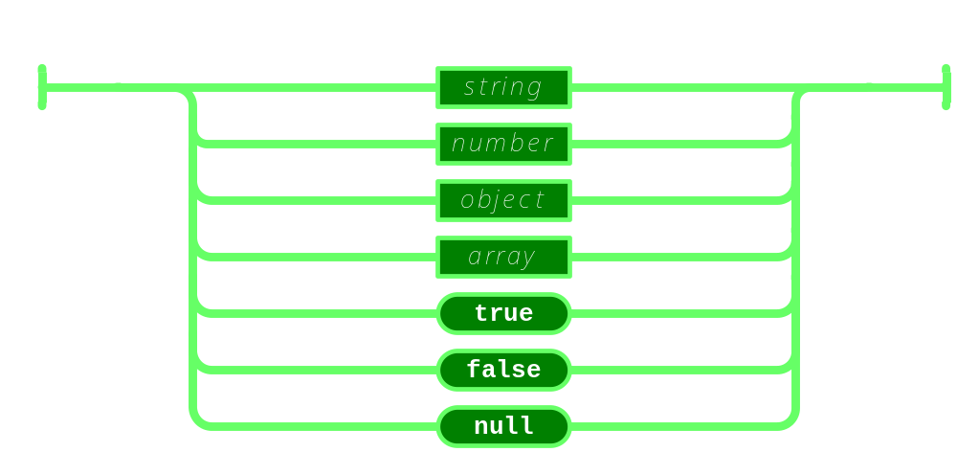
Value

Slide 13
Strings
Sequence of 0 or more Unicode characters
No separate character type
  A character is represented as a string with a length of 1
Wrapped in "double quotes"
Backslash escapement

Slide 14
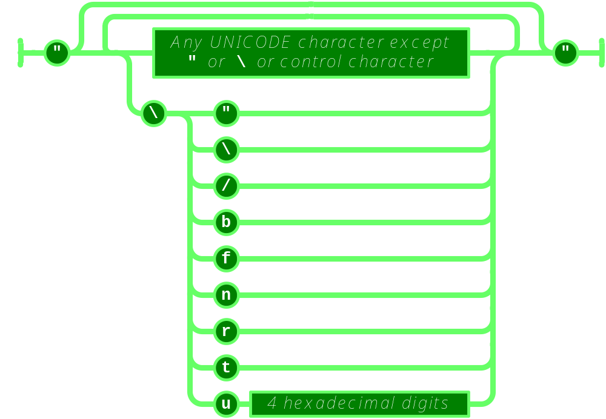
String

Slide 15
Numbers
Integer
Real
Scientific
No octal or hex
No NaN or Infinity
  Use null instead

Slide 16
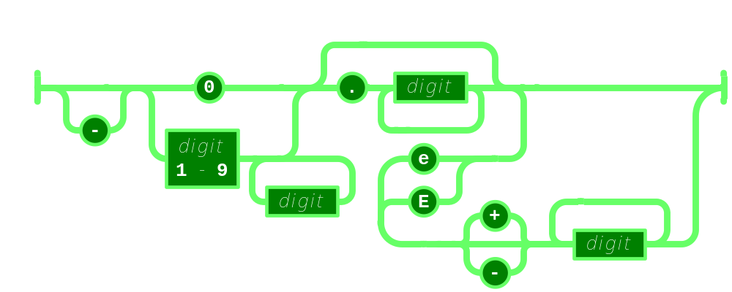
Number

Slide 17
Booleans
true
false

Slide 18
null
A value that isn't anything

Slide 19
Object
Objects are unordered containers of key/value pairs
Objects are wrapped in { }
, separates key/value pairs
: separates keys and values
Keys are strings
Values are JSON values
  struct, record, hashtable, object

Slide 20
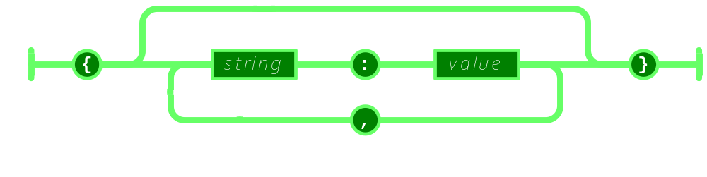
Object

Slide 21
Object
{
"name": "Jack B. Nimble",
"at large": true,
"grade": "A",
"format": {
"type": "rect",
"width": 1920,
"height": 1080,
"interlace": false,
"framerate": 24
}
}

Slide 22
Array
Arrays are ordered sequences of values
Arrays are wrapped in []
, separates values
JSON does not talk about indexing.
  An implementation can start array indexing at 0 or 1.

Slide 23
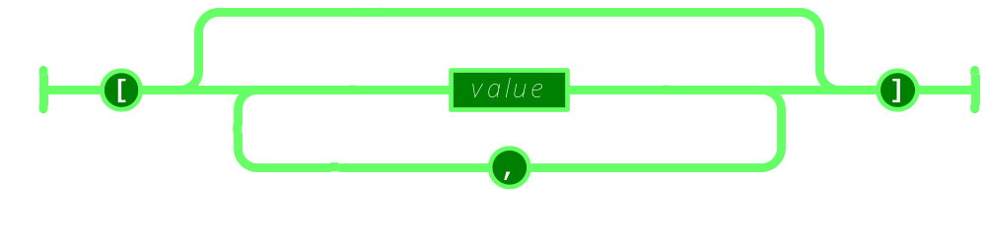
Array

Slide 24
Array
["Sunday", "Monday", "Tuesday", "Wednesday", "Thursday", "Friday", "Saturday"]
[
  [0, -1, 0],
  [1, 0, 0],
  [0, 0, 1]
]

Slide 25
Arrays vs Objects
Use objects when the key names are arbitrary strings.
Use arrays when the key names are sequential integers.
Don't get confused by the term Associative Array.

Slide 26
Rules
A JSON decoder must accept all well-formed JSON text.
A JSON decoder may also accept non-JSON text.
A JSON encoder must only produce well-formed JSON text.
Be conservative in what you do, be liberal in what you accept from others.

Slide 27
MIME Media Type
application/json

Slide 28
JSON in Ajax
HTML Delivery.
JSON data is built into the page.
  <html>...
  <script>
  var data = { ... JSONdata ... };

Slide 29
JSON in Ajax
XMLHttpRequest
  Obtain responseText
  Parse the responseText
    responseData = eval(
    '(' + responseText + ')');
    responseData =
    responseText.parseJSON();

Slide 30
JSON in Ajax
Secret <iframe>
Request data using form.submit to the <iframe> target.
The server sends the JSON text embedded in a script in a document.
  <html><head><script>
  document.domain = 'penzance.com';
  parent.deliver({ ... JSONtext ... });
  </script></head></html>
The function deliver is passed the value.

Slide 31
JSON in Ajax
Dynamic script tag hack.
Create a script node. The src url makes the request.
The server sends the JSON text embedded in a script.
  deliver({ ... JSONtext ... });
The function deliver is passed the value.
The dynamic script tag hack is insecure.

Slide 32
JSONRequest
A new facility.
Two way data interchange between any page and any server.
Exempt from the Same Origin Policy.
Campaign to make a standard feature of all browsers.
http://www.JSON.org/JSONRequest.html

Slide 33
ECMAScript Fourth Ed.
New Methods:
  Array.prototype.toJSONString
  Object.prototype.toJSONString
  String.prototype.parseJSON
Available now: JSON.org/json.js

Slide 34
Security
Is it safe to use eval with XMLHttpRequest?
The JSON data comes from the same server that vended the page. eval of the data is no less secure than the original html.
If in doubt, use string.parseJSON instead of eval.

Slide 35
Never trust the client
The client cannot and will not keep our secrets and cannot and will not protect our interests.
Do not trust machines not under your absolute control.
The server must validate everything the client tells it.

Slide 36
supplant
var template = '<table border="{border}">' +
'<tr><th>Last</th><td>{last}</td></tr>' +
'<tr><th>First</th><td>{first}</td></tr>' +
'</table>';
var data = {
"first": "Carl",
"last": "Hollywood",
"border": 2
};
mydiv.innerHTML = template.supplant(data);

Slide 37
supplant
String.prototype.supplant = function (o) {
return this.replace(/{([^{}]*)}/g,
function (a, b) {
var r = o[b];
return typeof r == 'string' ?
r : a;
}
);
};

Slide 38
JSONT
var rules = {
  self:
'<svg><{closed} stroke="{color}" points="{points}" /></svg>',
  closed: function (x) {return x ? 'polygon' : 'polyline';},
  'points[*][*]': '{$} '
};
var data = {
  "color": "blue",
  "closed": true,
  "points": [[10,10], [20,10], [20,20], [10,20]]
};
jsonT(data, rules)
<svg><polygon stroke="blue"
points="10 10 20 10 20 20 10 20 " /></svg>

Slide 39
http://goessner.net/articles/jsont/
function jsonT(self, rules) {
var T = {
output: false,
init: function () {
for (var rule in rules) if (rule.substr(0,4) != "self") rules["self." + rule] = rules[rule];
return this;
},
apply: function(expr) {
var trf = function (s) {
return s.replace(/{([A-Za-z0-9_\$\.\[\]\'@\(\)]+)}/g, function ($0, $1){
return T.processArg($1, expr);
})
}, x = expr.replace(/\[[0-9]+\]/g, "[*]"), res;
if (x in rules) {
if (typeof(rules[x]) == "string") res = trf(rules[x]);
else if (typeof(rules[x]) == "function") res = trf(rules[x](eval(expr)).toString());
} else res = T.eval(expr);
return res;
},
processArg: function (arg, parentExpr) {
var expand = function (a, e) {
return (e = a.replace(/^\$/,e)).substr(0, 4) != "self" ? ("self." + e) : e;
}, res = "";
T.output = true;
if (arg.charAt(0) == "@") res = eval(arg.replace(/@([A-za-z0-9_]+)\(([A-Za-z0-9_\$\.\[\]\']+)\)/, function($0, $1, $2){
return "rules['self." + $1 + "'](" + expand($2,parentExpr) + ")";
}));
else if (arg != "$") res = T.apply(expand(arg, parentExpr));
else res = T.eval(parentExpr);
T.output = false;
return res;
},
eval: function (expr) {
var v = eval(expr), res = "";
if (typeof(v) != "undefined") {
if (v instanceof Array) {
for (var i = 0; i < v.length; i++) if (typeof(v[i]) != "undefined") res += T.apply(expr + "[" + i + "]");
} else if (typeof(v) == "object") {
for (var m in v) if (typeof(v[m]) != "undefined") res += T.apply(expr+"."+m);
} else if (T.output) res += v;
}
return res;
}
};
return T.init().apply("self");
}

Slide 40
Some features that make it well-suited for data transfer
It's simultaneously human- and machine-readable format;
It has support for Unicode, allowing almost any information in any human language to be communicated;
The self-documenting format that describes structure and field names as well as specific values;
The strict syntax and parsing requirements that allow the necessary parsing algorithms to remain simple, efficient, and consistent;
The ability to represent the most general computer science data structures: records, lists and trees.

Slide 41
JSON Looks Like Data
JSON's simple values are the same as used in programming languages.
No restructuring is required: JSON's structures look like conventional programming language structures.
JSON's object is record, struct, object, dictionary, hash, associate array...
JSON's array is array, vector, sequence, list...

Slide 42
Arguments against JSON
JSON Doesn't Have Namespaces.
JSON Has No Validator.
JSON Is Not Extensible.
JSON Is Not XML.

Slide 43
JSON Doesn't Have Namespaces
Every object is a namespace. Its set of keys is independent of all other objects, even exclusive of nesting.
JSON uses scope to avoid ambiguity, just as programming languages do.

Slide 44
Namespace
http://www.w3c.org/TR/REC-xml-names/
In this example, there are three occurrences of the name title within the markup, and the name alone clearly provides insufficient information to allow correct processing by a software module.
<section>
<title>Book-Signing Event</title>
<signing>
<author title="Mr" name="Vikram Seth" />
<book title="A Suitable Boy" price="$22.95" />
</signing>
<signing>
<author title="Dr" name="Oliver Sacks" />
<book title="The Island of the Color-Blind"
price="$12.95" />
</signing>
</section>

Slide 45
Namespace
{"section":
"title": "Book-Signing Event",
"signing": [
{
"author": { "title": "Mr", "name": "Vikram Seth" },
"book": { "title": "A Suitable Boy",
"price": "$22.95" }
}, {
"author": { "title": "Dr", "name": "Oliver Sacks" },
"book": { "title": "The Island of the Color-Blind",
"price": "$12.95" }
}
]
}}
section.title
section.signing[0].author.title
section.signing[1].book.title

Slide 46
JSON Has No Validator
Being well-formed and valid is not the same as being correct and relevant.
Ultimately, every application is responsible for validating its inputs. This cannot be delegated.
A YAML validator can be used.

Slide 47
JSON is Not Extensible
It does not need to be.
It can represent any non-recurrent data structure as is.
JSON is flexible. New fields can be added to existing structures without obsoleting existing programs.

Slide 48
Versionless
JSON has no version number.
No revisions to the JSON grammar are anticipated.
JSON is very stable.

Slide 49
Supersets
YAML is a superset of JSON.
  A YAML decoder is a JSON decoder.
JavaScript is a superset of JSON.
  A JavaScript compiler is a JSON decoder.
JSONIC is a programming language based on JSON.

Slide 50
JSON Is Not XML
objects
arrays
strings
numbers
booleans
null
element
attribute
attribute string
content
<![CDATA[ ]]>
entities
declarations
schema
stylesheets
comments
version
namespace

Slide 51
Data Interchange
JSON is a simple, common representation of data.
Communication between servers and browser clients.
Communication between peers.
Language independent data interchange.

Slide 52
Why the Name?
XML is not a good data serialization format, but it is a document standard.
Having a standard to refer to eliminates a lot of squabbling.

Slide 53
JSLint
JSLint can help improve the robustness and portability of your programs.
It enforces style rules.
It can spot some errors that are very difficult to find in debugging.
It can help eliminate implied globals.
Currently available on the web and as a Konfabulator widget.
Soon, in text editors and Eclipse.

Slide 54
JSLint
Warning: JSLint will hurt your feelings.
If you follow its advice, JSLint will make your programs better.
http://www.JSLint.com/

Slide 55
www.JSON.org

