Slide 1
Advanced Programming
Names, Scopes and Bindings

Slide 2
Binding Time
The binding of a program element to a particular property is the choice of the property from a set of possible properties
The time during program formulation or processing when this choice is made is the binding time
There are many classes of bindings in programming languages as well as many different binding times
Included within the concepts of binding and binding times are the properties of program elements that are determined by the definition of the language or its implementation

Slide 3
Binding Time (Cont.)
Binding times include:
Run time (execution time):
  On entry to a subprogram or block
    Binding of formal to actual parameters
    Binding of formal parameters to storage locations
  At arbitrary points during execution
    binding of variables to values
    binding of names to storage location in Scheme.
      e.g. (define size 2)

Slide 4
Binding Time (Cont.)
Compile time (translation time)
  Bindings chosen by the programmer
    Variable names
    variable types
    program statement structure
  Chosen by the translator
    Relative location of data objects
  Chosen by the linker
    Relative location of different object modules

Slide 5
Binding Time (Cont.)
Language Implementation time (i.e. when the compiler or interpreter is written)
    Representation of numbers. Usually determined by the underlying computer, but not always (e.g. Java defines the representation to guarantee portability)
    Use of implementation-specific features preclude portability
      e.g. in Fortran’s expression x*f(y), function f does not have to be called when x is 0. If the function has side effects, different implementations produce different results.
Language definition time
    Alternative statement forms
    Data structure types
    Array storage layout

Slide 6
Binding Time (Cont.)
Consider x=x + 10
  Names: ‘x=’, ‘x=x’, ‘x +’, ‘x’, ‘+’, ’10’
  Type of x
    At translation time in C
    At run time in Scheme/JavaScript
  Set of possible values of x
    At implementation time. If x is real it could be
      the IEEE floating point standard (almost always the choice)
      the implementation of a specific machine
      a software-based “infinite precision” representation
  Value of x
    Changed at run time

Slide 7
char bar[] = { ‘a’, ‘b’, ‘c’, 0};
char* foo = “abc”;
char* x = foo + 2;
char* y = bar + 2;
bar = bar + 2;
int* g = {1, 2, 3, 0};
g += 2;
g[2]= 4;

Slide 8
Binding Time (Cont.)
  Properties of operator +
    At compilation time (depending on the type of the operands because of overloading)
      If x is declared integer + means one thing
      if x is declared real means something else
      + can also be overloaded by the programmer.
      In C++ it is possible to specify that + operates on strings:
      string operator +(string& a, string& b) {
        return a.append(b);
        }

Slide 9
Binding Time (Cont.)
Many of the most important and subtle differences between languages involve differences in binding time
The trade off is between efficient execution and flexibility
  When efficiency is a consideration (Fortran, C) languages are designed so that as many bindings as possible are performed during translation
  Where flexibility is the prime determiner, bindings are delayed until execution time so that they may be made data dependent

Slide 10
Objects lifetime
Key events in the life of an object:
Creation of an object
Creation of a binding
Binding lifetime
Object lifetime
Program execution time
Destruction of a binding
Dangling reference
if these two are
interchanged
Destruction of an object
Memory Leak if forgotten

Slide 11
Example: object and binding creation/destruction
struct foo { int x, y };
…
foo* z;
{
int a = 1; // stack allocated
foo aFoo; // stack allocated
aFoo.x = 7;
z = &aFoo;
z->x = 9; (*z).x = 9; // equivalent statements
//delete z; // wrong
…
}
z->x; // access a location no longer available
Vector<int> v = new Vector<int>(5); // Java
//Vector<int> v1 = v; // another binding for the vector
v = null; // after use or it will leak

Slide 12
Storage Management
Three storage allocation mechanisms
  Static
  Stack
  Heap

Slide 13
Static allocation

Slide 14
Static Allocation
Global variables
Constants
  manifest, declared (parameter variables in Fortran) or identified by the compiler
Variables identified as const in C can be a function of non constants and therefore cannot be statically allocated
Constant tables generated by the compiler for debugging and other purposes

Slide 15
C: static variables
int global;
int increment () {
static int count = 0;
return count ++;
}
foo(int x) {
double count = 3.14;
…
}

Slide 16
FORTRAN COMMON
dimension x(2)
common /group1/ x, y, i

Slide 17
Static Allocation (Cont.)
In the absence of recursion, all variables can be statically allocated
Also, can be statically allocated:
  Arguments and return values (or their addresses). Allocation can be in processor registers rather than in memory
  Temporaries
  Bookkeeping information
    return address
    saved registers
    debugging information

Slide 18
f(x) [x in loc 37]
g(x+1)
z: …
g(x) [x in loc 345]
[retLoc in loc 346 = w]
g(x+2)
w: …

Slide 19
int f(int x) {
if (x == 0) return 0;
int z = 2 * x;
//return z;
return g(z, z) * z;
}
int g(int x, int y) {
int w = x * y;
return f(x) * w;
}

Slide 20
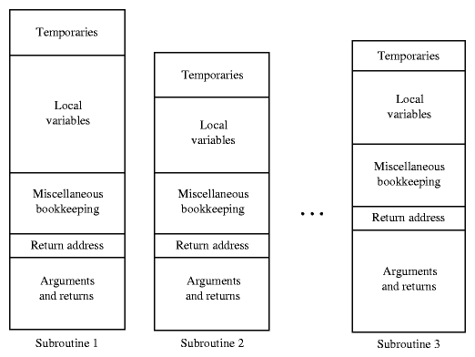
Static Allocation (Cont.)

Slide 21
Stack allocation

Slide 22
Stack-based Allocation
Needed when language permits recursion
Useful in languages without recursion because it can save space
Assumptions:
  last function invoked will be the first to return
  variables allocated in the function are not referenced outside the function
  when these assumptions do not hold?

Slide 23
Stack-based Allocation
Each subroutine invocation creates a frame or activation record
  arguments
  return address
  local variables
  temporaries
  bookkeeping information
Stack maintained by
  calling sequence
  prologue
  epilogue

Slide 24
Implementation: Stack Frames

Slide 25
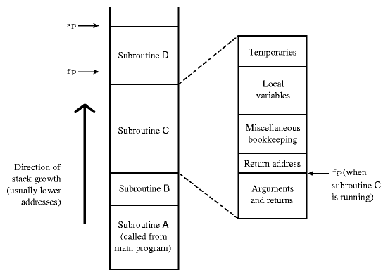
Stack-based Allocation Scheme

Slide 26
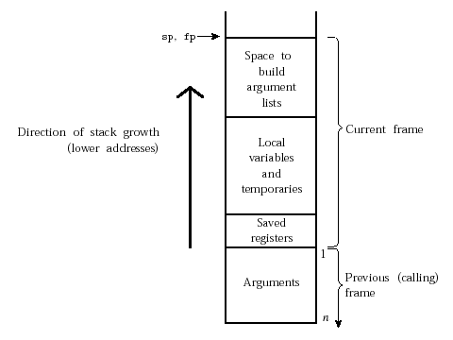
GNU MIPS

Slide 27
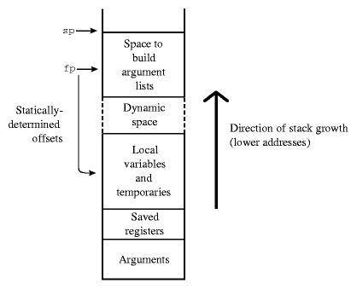
gcc MIPS

Slide 28
gcc x86
local m
local m-1
...
local 1
Direction of stack growth
lower addresses
old fp
return addr
arg1
arg2
...
argn
sp
fp
Notes:
Question: perché non basta solo FP?
Ordine argomenti su stack? Ordine di valutazione C?
Cosa comporta la possibilità di avere argomenti variabili?
Chi faa il pop argomenti.

Slide 29
Example: x86
int foo(int x, int y)
{
return x
+ y;
}
push %ebp
mov %esp,%ebp
mov 0x8(%ebp),%eax
add 0xc(%ebp),%eax
mov %ebp,%esp
pop %ebp
ret

Slide 30
x86-64 uses registers for arguments
int foo(int x, int y)
{
return x
+ y;
}
push %rbp
mov %rsp,%rbp
mov %edi, -0x4(%rbp)
mov %esi, -0x8(%rbp)
mov -0x8(%rbp),%eax
add -0x4(%rbp),%edx
mov %edx,%eax
pop %rbp
retq

Slide 31
Example: invocation
int a = 3;
int i;
i = foo(a, 256);
push $0x100
push $0x3
call 0x0 <foo>
mov %ebp,%esp

Slide 32
Example
int baz(int x, int y)
{
char buf[256];
{
int z = y + 1;
x += z;
}
return x + y;
}
push %ebp
mov %esp,%ebp
sub $0x108,%esp
mov 0xc(%ebp),%edx
lea 0x1(%edx),%eax
add 0x8(%ebp),%eax
add %edx,%eax
mov %ebp,%esp
pop %ebp
ret

Slide 33
Variable arguments
foo(int n, …) {
va_start(n, args);
va_arg(int, args, x); int x = *args++;
va_arg(int, args, y); int y = *args++;
…
}

Slide 34
Order of evaluation
foo(read(s), read(s));
Suppose:
read(s) = a
read(s) = b
Left-to-right evaluation: foo(a, b)
Right-to-left evaluation: foo(b, a) // used by C/C++

Slide 35
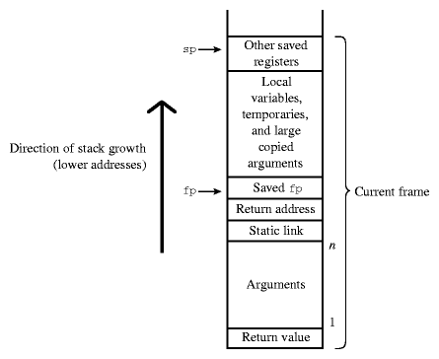
Pascal 68000

Slide 36
Dynamic Allocation

Slide 37
Heap-based Allocation
Region of storage in which blocks of memory can be allocated and deallocated at arbitrary times
Because they are not allocated in the stack, the lifetime of objects allocated in the heap is not confined to the subroutine where they are created
  They can be assigned to parameters (or to components of objects accessed via pointers by parameters)
  They can be returned as value of the subroutine/function/method

Slide 38
Quiz
Who manages the heap?
  Operating system
  User application

Slide 39
Find the errors in this code
int* foo(int size)
{
float z;
int a[size];
char* z;
a[0] = 666;
z = “abc”;
return &a;
}

Slide 40
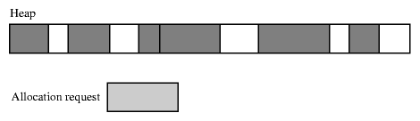
Fragmentation
Several strategies to manage space in the heap
Fragmentation
  Internal fragmentation when space allocated is larger than needed
  External fragmentation when allocated blocks are scattered through the heap. Total space available might be more than requested, but no block has the needed size

Slide 41
Free List
One approach to maintain the free memory space is to use a free list
Two strategies to find a block for a give request
  First fit: use first block in the list large enough to satisfy the request
  Best fit: search the list to find the smallest block that satisfy the request
The free list could be organized as an array of free lists where each list in the array contain blocks of the same size
  Buddy system
  Fibonacci heap (better internal fragmentation)

Slide 42
Garbage collection
Programmers can manage memory themselves with explicit allocation/deallocations
However, garbage collection can be applied automatically by the run-time system to avoid memory leaks and difficult to find dangling references
  Lisp
  Java
The disadvantage is cost

Slide 43
Scope

Slide 44
Variable
A variable is a location (AKA reference) that can be associated with a value.
Obtaining the value associated with a variable is called dereferencing, and creating or changing the association is called assignment.

Slide 45
Formal Model
Store: Var → Val
Env: Name → Denotation
Eval: Exp × Env × Store → Val
Typically:
Val = Int + Real + …
Denotation = Val + Var + Fun + …
Exp = Id + Const + Arith + …

Slide 46
Formal Model: Graphical View
Names
Env
Store
x
y
z
3.14
“abc”
s
fun
x
y
123
43.21
z
x
s
fun
“abc”

Slide 47
Scope and Extent
The scope is the textual region of a program (aka scope block) in which a binding for a name is active
The extent (or lifetime) of a variable describes when in a program's execution a variable exists
The scope of a variable is a property of the name of the variable, and the extent is a property of the variable itself
Referencing environment: the set of binding active at a given point in a program execution

Slide 48
Scope Rules
Scope rules of a programming language define the scope of bindings, i.e. the region of program text in which a name binding is active

Slide 49
Scope Rules: Examples
Early Basic: all variables are global and visible everywhere
Fortran 77: the scope of a local variable is limited to a subroutine; the scope of a global variable is the whole program text unless it is hidden by a local variable declaration with the same variable name
Algol 60, Pascal and Ada: these languages allow nested subroutines definitions and adopt the closest nested scope rule with slight variations in implementation

Slide 50
Static vs Dynamic Scope
Statically scoped language: the scope of bindings is determined at compile time from the text of the prgoram
  Used by almost all but a few programming languages
  More intuitive to user compared to dynamic scoping
Dynamically scoped language: the scope of bindings is determined at run time
  Used in Lisp (early versions), APL, Snobol, and Perl (selectively)

Slide 51
Typed Variables
In statically-typed languages, a variable also has a type, meaning that only values of a given type can be stored in it
In dynamically-typed languages, values, not variables, have types

Slide 52
Model from course: Fondamenti Programmazione
From: http://www.di.unipi.it/~paolo/FP/materiale.html
State: Frame → Env
σ ∈ State
φ ∈ Frame
x ∈ Id
X | 31
y | 12
φ₂
σ
Z | 8
x | 25
φ₁
σ(φ)(x) = v
⟨x, σ.φ⟩ →_{exp} v

Slide 53
Python
def main():
if True:
a = 0
else:
a = 1
print a
0

Slide 54


Slide 55
Go Language
func main() {
if true {
a := 0
} else {
a := 1
}
fmt.Println(a)
}
======================
prog.go:11: undefined: a

Slide 56
Go Programming Language
programming language created at Google in 2007 by Robert Griesemer, Rob Pike, and Ken Thompson
compiled, statically typed language in the tradition of Algol and C, with
  garbage collection
  limited structural typing
  memory safety
  CSP-style concurrent programming

Slide 57
Nested Scope Rule
In most languages any constant, type, variables or subroutines declared within a subroutine are not visible outside the subroutine
Closest nested scope rule:
  a name is known in the scope in which it is declared unless it is hidden by a declaration of the same name in a nested scope

Slide 58
Static Scope - Nested Blocks
{ // B1
{ // B2
{ // B3
{ // B4
}
}
}
}
AR_{B4}
AR_{B3}
AR_{B2}
AR_{B1}

Slide 59
Static Scope - Nested Subroutines (Pascal)
procedure P1(A1: T1);
var X: real;
…
procedure P2(A2: T2);
…
procedure P3(A3: T3);
…
begin
… (*body of P3 *)
end;
…
begin
… (* body of P2 *)
end;
…
procedure P4(A4: T4);
…
function F1(A5: T5) : T6;
var X: integer;
…
begin
… X … (* body of F1 *)
end;
…
begin
… X … (* body of P4 *)
end;
…
begin
… X … (* body of P1 *)
end;

Slide 60
Nested Functions: Scala
object FilterTest extends App {
def filter(xs: List[Int], threshold: Int) = {
def process(ys: List[Int]): List[Int] =
if (ys.isEmpty) ys
else if (ys.head < threshold) ys.head :: process(ys.tail)
else process(ys.tail)
process(xs)
}
println(filter(List(1, 9, 2, 8, 3, 7, 4), 5))
}
List(1, 2, 3, 4)

Slide 61
Scala Programming Language
Scala is object-oriented language evolved from Java
Scala has many features of functional programming languages like Scheme, Standard ML and Haskell, including
  Currying
  type inference
  Immutability
  lazy evaluation
  pattern matching
advanced type system supporting
  algebraic data types
  covariance and contravariance
  higher-order types
  anonymous types
Other features
  operator overloading, optional parameters, named parameters, raw strings, and no checked exceptions.

Slide 62
Static Scope - Nested Subroutines (3)
To find the frames of surrounding scopes where the desired data is a static link could be used

Slide 63
Static Link
procedure A
procedure B
procedure C begin end;
procedure D
begin
E();
end;
begin
D();
end;
procedure E
begin
B();
end;
begin
E();
end.

Slide 64
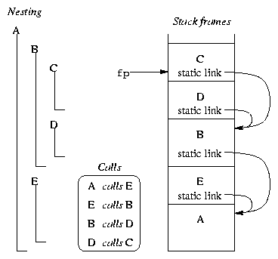
Static Scope - Nested Subroutines (4)
Subroutines C and D are declared nested in B
  B is static parent of C and D
B and E are nested in A
  A is static parent of B and E
The fp points to the frame at the top of the stack to access locals
The static link in the frame points to the frame of the static parent

Slide 65
Static Chain
How do we access non-local objects?
The static links form a static chain, which is a linked list of static parent frames
When a subroutine at nesting level j has a reference to an object declared in a static parent at the surrounding scope nested at level k, then j-k static links forms a static chain that is traversed to get to the frame containing the object
The compiler generates code to make these traversals over frames to reach non-local objects

Slide 66
Static Chain: Example
Subroutine A is at nesting level 1 and C at nesting level 3
When C accesses an object of A, 2 static links are traversed to get to A's frame that contains that object

Slide 67
Static Scope - Nested Subroutines
P1()
{ x : real;
{ // B1
P2()
{ x : int;
P3()
}
{ // B2
{ // B3
P2()
}
}
}
P3()
{ x := ..;
P3()
}
}
Static links
Dynamic links
AR_{P3}
AR_{P3}
x
AR_{P2}
AR_{B3}
AR_{B2}
AR_{B1}
x
AR_{P1}

Slide 68
Closures
First Class function objects

Slide 69
Closures i.e. Functional results
P1()
{ x : real;
{ // B1
P2()
{ x : int;
P3()
}
{ // B2
{ // B3
P2()
}
}
}
P3()
{ x := ..;
P3()
}
return P3;
}
AR_{P3}
AR_{P3}
AR_{P2}
x
AR_{B3}
AR_{B2}
AR_{B1}
AR_{P1}
P3
x

Slide 70
Lexical Environment of Functions
Pascal allows passing functions
Because of nested lexical scope, even passing functions in Pascal requires passing the enclosing lexical environment
AKA downward closures

Slide 71
Closures in Python
def makeAdd(x):
def add(y):
return y + x
return add
> add3 = makeAdd(3)
> add10 = makeAdd(10)
> add3(5)
8
> add10(5)
15

Slide 72
Python Closures
  def makePair(x, y):
  def getx(): return x
  def gety(): return y
  def setx(v): return x = v
  def sety(v): return y = v
  return {‘x’: getx, ‘y’: gety, ‘setx’: setx, ‘sety’: sety}
  > p = makePair(3, 4)
  > p[‘x’]() # kind of p.x()
  3

Slide 73
But …
> p[‘setx’](7)
> p[‘x’]()
3
Reason: any assignment to a name implicitly declares that name to be local, except when a global declaration is present
Python 3 introduces declaration nonlocal
  def makePair(x, y):
  def setx(v): nonlocal x = v
…

Slide 74
Syntax Sugar
class Empty(): pass
def makePair(x, y):
def getx(): return x
def gety(): return x
def setx(v): return x = v
def sety(v): return y = v
r = Empty()
setattr(r, ‘x’, getx)
setattr(r, ‘y’, gety)
setattr(r, ‘X’, setx)
setattr(r, ‘Y’, gety)
return r
> p = makePair(3, 4)
> p.x()

Slide 75
Closures as Objects
def makePair(x, y):
nonlocal x, y
def get(arg):
if arg == ‘x’:
return x
elif arg == ‘y’
return y
return get
p = makePair(3, 5)
p(‘x’) -> 3
P(‘y’) -> 5

Slide 76
Closures as Objects
(defun pair (x y)
(lambda (op)
(if (= op ‘first) x y)))
(setq p (pair 3 4))
((lambda (op)…) . ((x . 3) (y . 4)))
(p ‘first) ;; like p.first

Slide 77
Java Nested Classes as Closures (?)
class Outer {
final int x; // must be final
class Inner {
//int x; // cannot be bound in foo
void foo() { x; }
}
void bar() {
Inner i = new Inner();
i.foo();
}
}

Slide 78
Closures in JavaScript
Lexical variables declared with var
  function makePair(x, y) {
  function getx() { return x }
  function setx(v) { x = v }
  return {'x': getx, 'setx': setx }
  }
  > p = makePair(3, 4);
  > p.x()
  3
  > p.setx(7);
  > p.x()
  7

Slide 79
Languages supporting Closures
Full closures:
  Lisp, Scheme, Haskell and functional languages
  JavaScript, Perl, Ruby, Python 3
  Smalltalk
  C#
Limited closures:
  Python 2 (cannot assign captured variables)
  C++11 (must have same extent of captured variables)
  Java 8 (captures only immutable variables)

Slide 80
C++11: downward closures
vector<string> find_if(vector<string>& v, Pred pred) {
vector<string> results;
for (auto& x: v) {
if (pred(x)) results.push_back(x);
}
return results;
}
vector<string> names;
names.push_back(“Pippo”);
string name = “Beppe”;
find_if(names, [&] (string& x) { return x == name; })

Slide 81
Delegates in C++
struct MailBox {
void receive(string& msg) {
for (auto& n: notifiers)
n(msg);
}
vector<Fun> notifiers;
};
struct Phone {
void notify(string& msg) …
};
Mailbox mailbox; // instance of Mailbox
Phone myphone; // instance of Phone
mailbox.subscribe([&] (string& msg) { myphone.notify(msg); });

Slide 82
C# Delegates
delegate void Notify(string msg); // Delegate declaration
class MailBox {
void receive(string msg) {
notifiers(msg); // invokes all notifiers
}
void subscribe(Notify n) { notifiers += n; }
private Notify notifiers; // Multiclass delegate
}
class Phone {
void alert(string msg) …
}
var myPhone = new Phone();
mailbox.subscribe(new Notify(myphone.alert));

Slide 83
Lambda as Delegate
(string msg) => myphone.alert(msg);
same as anonymous delegate
delegate(string msg) { return myphone.alert(msg); }

Slide 84
C# Events
Special kind of delegates
delegate void EventHandler(object sender, RoutedEventArgs );
class Button {
public event EventHandler Click;
public void OnClick(s, args) { Click(s, arg); }
...
}
Only callable from inside the class

Slide 85
Application Code
private void Button_Click(object sender, RoutedEventArgs e)
{
//...
}
Button b = new Button();
form.Add(b); // place it on a window
b.Click += new EventHandler(this.Button_Click);

Slide 86
Uses of Closures
Callbacks for:
  Event-driven programming
    GUI event handling
  Asynchronous programming:
    AJAX callbacks

Slide 87
Syntax for Lambda Expressions
Python:
  lambda params : expr
Java (only final variables):
  (params) -> expr
C#:
  (params) => expr
JavaScript:
  (params) => expr
PHP (not first class):
  function (params) use(vars) { body }
C++11:
  [capture list](params) -> ret { body }
  [&] captures all automatic variables by reference

Slide 88
Functional Languages
Lisp:
  (function (lambda (params) body))
ML:
  fn params => expr
Clojure:
  (fn [params] epr)

Slide 89
First Class Closures
First class closures requires solving the Funarg problem:
  https://en.wikipedia.org/wiki/Funarg_problem
  first discussed in the paper:
    J. Moses (1970) The function of FUNCTION in Lisp
    http://portal.acm.org/citation.cfm?id=1093411
For a full list of languages supporting full closures, see:
  https://en.wikipedia.org/wiki/First-class_function

Slide 90
Dynamic scope

Slide 91
Dynamic Scope
In early Lisp systems variables were bound dynamically rather than statically
In a language with dynamic binding, free variables in a procedure get their values from the environment in which the procedure is called rather than the environment in which the procedure is defined

Slide 92
Lisp: implementation of dynamic scope
(defun foo (y) (if (= y 0) (print x) (foo (1- y))
(defun bar (x) (foo x))
(bar 3)
(defun eval (e env)
(if (symbolp e) (env e)
….
)
(setq x 10)
(defun zed (f) (let (x 8) (bar 3) (f 0)))
(zed (function foo))
env = ((x1 . v1) (x2. v2) ….)
((y . 0) (y. 1) (y . 2) (y . 3) (x . 3))
(x 3)
(y 0 1 2 3)

Slide 93
Perl
$x = 0;
sub f { return $x; }
sub stat { my $x = 1; return f(); }
print “static: “.stat()."\n";
sub dyn { local $x = 1; return f(); }
print “dynamic: “.dyn()."\n";

Slide 94
Dynamic Scope Problems
Consider the program
(define (sum-powers a b n)
(define (nth-power x)
(expt x n))
(sum nth-power a b))
Where sum is defined as follows
(define (sum functor a b)
(if (> a b)
0 (+ (functor a)
(sum functor (1+ a) b))))

Slide 95
> (sum-powers 0 3 2)
14

Slide 96
Dynamic scope (Cont.)
The free variable n in nth-power would get whatever n had when sum called it
Since sum does not rebind n, the only definition of n is still the one from sum-powers

Slide 97
Exchanging variable names
(define (sum-powers a b n)
(define (nth-power x)
(expt x n))
(sum nth-power a b))
(define (sum functor a n)
(if (> a n)
0 (+ (functor a)
(sum functor (1+ a) n))))

Slide 98
Dynamic scope (Cont.)
But if we had used n instead of b in the definition of sum, then nth-power’s free variable would refer to sum’s third argument, which is not what we intended
Dynamic binding violates the principle that a procedure should be regarded as a “black box”
Changing the name of a parameter throughout a procedure’s definition should not change the procedure behavior

Slide 99
Dynamic scope (Cont.)
In a statically bound language, the sum-powers program must contain the definition of nth-power as a local procedure.
If nth-power represents a common pattern of usage, its definition must be repeated as an internal definition in many contexts.

Slide 100
Dynamic scope (Cont.)
It should be attractive to be able to move the definition of nth-power to a more global context, where it can be shared by many procedures
(define (sum-powers a b n) (sum nth-power a b))
(define (product-powers a b n) (product nth-power a b))
(define (nth-power x)
(expt x n))
The attempt to make this work is what motivated the development of dynamic binding discipline

Slide 101
Dynamic scope (Cont.)
Dynamically bound variables can be helpful in structuring large programs
They simplify procedure calls by acting as implicit parameters
For example, a low-level procedure nprint called by the system print procedure for printing numbers might reference a free variable called radix that specifies the base in which the number is to be printed
Procedures that call nprint, need not to know about this feature

Slide 102
Dynamic scope (Cont.)
On the other hand, a user might want to temporarily change the radix
In a statically bound language, radix would have to be a global variable
After setting radix to a new value, the user would have to explicitly reset it
The dynamic binding mechanism could accomplish this setting and resetting automatically, in a structured way
(define print-in-new-radix number radix)
(print number))
(define (print frob)
< expressions that involve nprint>)
(define (nprint number)
...
radix
...)

Slide 103
Modules

Slide 104
Static Scope - Modules
Modularization depends on information hiding
Functions and subroutines can be used to hide information. However, this is not flexible enough.
One reason is that persistent data is usually needed to create abstraction. This can be addressed in some cases using statically allocated values

Slide 105
Homework 1
Design an implementation of malloc/free
  The implementation should not use any extra memory than the block used for the heap itself.
Efficient implementation of shared strings
Mark a binary tree:
  Without using the stack or other additional structures

Slide 106
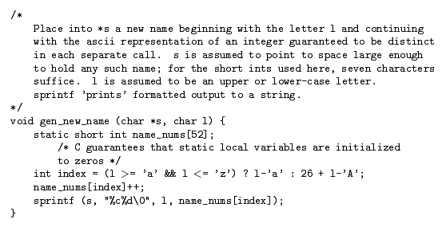
Static Scope - Modules (Cont.)

Slide 107
Static Scope - Modules (Cont.)
But modularization often requires a variety of operations on persistent data.

Slide 108
Static Scope - Modules (Cont.)
Objects inside a module are visible to each other
Objects inside can be hidden explicitly (using a keyword like private) or implicitly (objects are only visible outside if they are exported)
In some language objects outside need to be imported to be visible within the module

Slide 109
Static Scope – Modules. Modula-2 examples
VAR a,b: CARDINAL;
MODULE M;
IMPORT a; EXPORT w,x;
VAR u,v,w; CARDINAL;
MODULE N;
IMPORT u; EXPORT x,y;
VAR x,y,z: CARDINAL;
(* x,u,y,z visible here *)
END N;
(* a,u,v,w,x,y visible here *)
END M;
(* a,b,w,x visible here *)
MODULE M;
VAR a: CARDINAL;
MODULE N1;
EXPORT b;
VAR b: CARDINAL;
(* only b visible here *)
END N1;
MODULE N2;
EXPORT c;
VAR c: CARDINAL;
(* only c visible here *)
end N2;
MODULE N3;
IMPORT b,c;
(* b,c visible here *)
END N3;
END M;

Slide 110
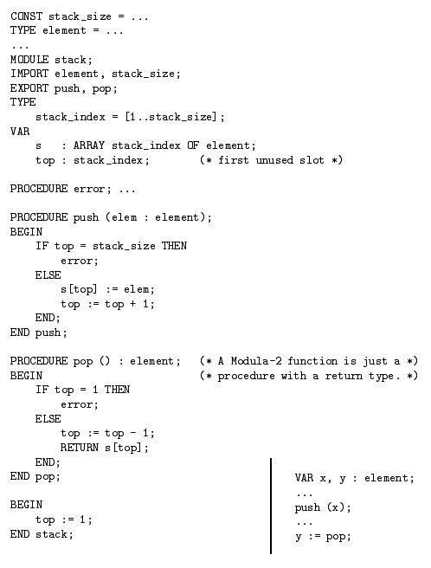

Slide 111
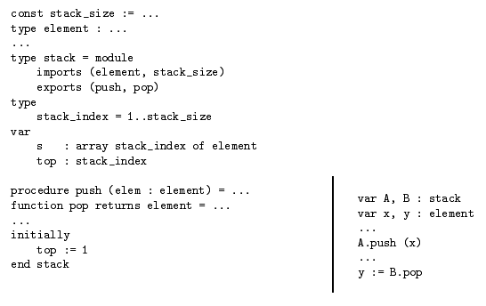
Modules as types

Slide 112
Symbol Tables
Symbol tables are used to keep track of scope and binding information about names.
The symbol table is searched every time a name is encountered in the source text
Changes occur when a new name or new information about a name is discovered
The abstract syntax tree will contain pointers to the symbol table rather than the actual names used for objects in the source text

Slide 113
Symbol Tables (Cont.)
Each symbol table entry contains
  the symbol name
  its category (scalar variable, array, constant, type, procedure, field name, parameter, etc.)
  scope number
  type (a pointer to another symbol table entry)
  and additional, category specific fields (e.g. rank and shape for arrays)
To keep symbol table records uniform, it may be convenient for some of the information about a name to be kept outside the table entry, with only a pointer to this information stored in the entry

Slide 114
Symbol Tables (Cont.)
The symbol table may contain the keywords at the beginning if the lexical scanner searches the symbol table for each name
Alternatively, the lexical scanner can identify keywords using a separate table or by creating a separate final state for each keyword

Slide 115
Symbol Tables (Cont.)
One of the important issues is handling static scope
A simple solution is to create a symbol table for each scope and attach it to the node in the abstract syntax tree corresponding to the scope
An alter native is to use a additional data structure to keep track of the scope. This structure would resemble a stack:

Slide 116
procedure new_id(id)
for index=top to scope_marker(LL - 1) by -1
if id == symbol_table(additional(index)).name then error()
k = new_symbol_table_index()
symbol_table(k).name=id
additional(top++) = k
procedure old_id(id)
for index= top to 0 by -1
if id == symbol_table(additional(index)).name then return additional(index)
error()
procedure scope_entry ()
scope_marker(LL++)=top
procedure scope_exit()
top = scope_marker(--LL)
4
top
A
2
LL
2
C
0
additional
scope_marker
B
A
symbol table

Slide 117
Symbol Tables (Cont.)
A hash table can be added to the previous data structure to accelerate the search.
Elements with the same name are linked from top to bottom.
Search start at the entry of the hash table and proceeds through the linked list until the end of the list is reached (old_id) or until the link list refers to an element below scope_marker(LL - 1) (new_id)

Slide 118
Symbol Tables (Cont.)
This approach does not work in some cases
Consider the with statement of Pascal and Modula 2:
  Date = RECORD day: [1..31];
  mo: month;
  yr: CARDINAL
  END
  d1: Date;
  WITH d1 DO
  day:=10; mo:=Sep; yr:=1981
  END
  is equivalent to
  d1.day:=10; d1.mo:=Sep; d1.yr:=1981

Slide 119
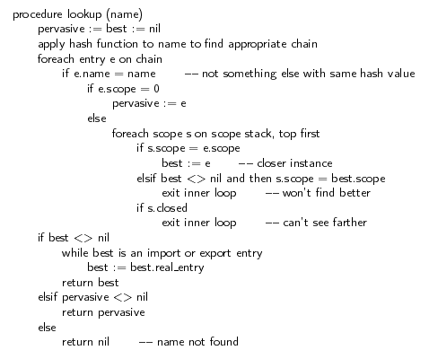
Symbol Tables

Slide 120
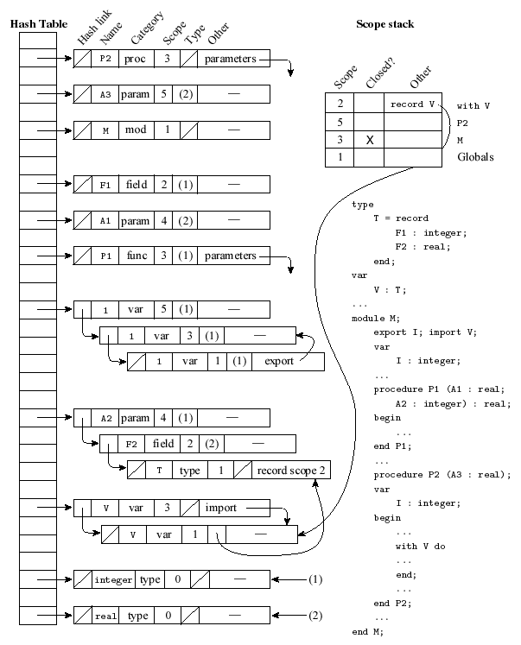
Symbol Tables (Cont.)

Slide 121
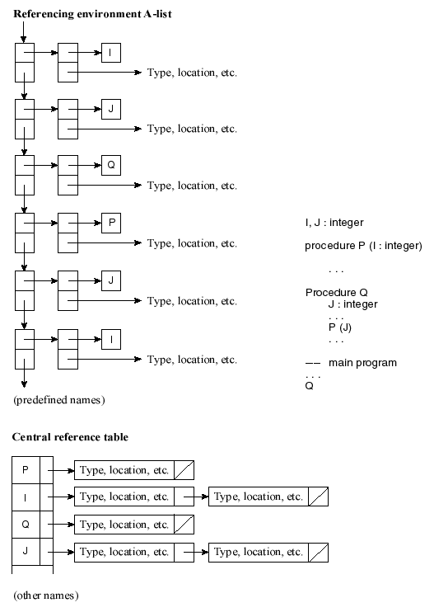
Association Lists and Central Reference Tables

Slide 122
The binding of referencing environments
Shallow binding: the referencing environment of a routine is not created until the subroutine is actually called
Deep binding: the program binds the environment at the time the subroutine is passed as a parameter
Deep binding is implemented by creating an explicit representation of a referencing environment and bundling it together with a reference to the subroutine.

Slide 123
P1()
{ REAL X
{ /* B1 */
{ /* B2 */
{ /* B3 */
P2(P3)
}
P3()
{
x
}
}
P2(PX)
{
PX()
}
}
}
AR_{P3}
PX
AR_{P2}
AR_{B3}
AR_{B2}
AR_{B1}
AR_{P1}

