Slide 1

Symfony Tutorial
Giuseppe Attardi
Alexios Tzanetopoulos

Slide 2
What is Symfony?
PHP Web Application Framework that provides:
Object Oriented programming style through ORM
a MVC GUI
Automatic code generation
a collection of components and third-party libraries
configuration and a "glue" library that ties all of these pieces together

Slide 3
Difference between Web Framework and CMS
A web (application) framework is a lower level, generic toolkit for the development of web applications
A web application exposes its data and services to users and machines via the http protocol
A CMS is one type of such applications: a system to manage content shown in websites
CMS are built on top of a WAF
Drupal 7 has its own CMS, Drupal 8 uses Symfony

Slide 4
Problems Solved by Symfony
Data persistence (via Doctrine)
Security
Forms
Validation
Templating
Autoloading
Logging
Asset Management
Routing
File+Dir Traversing
Translation
Dependency Injection
Image Manipulation
Console Tasks
Caching

Slide 5
Performance
Symfony is about 3 times faster than Zend Framework 1.10, while taking up 2 times less memory

Slide 6
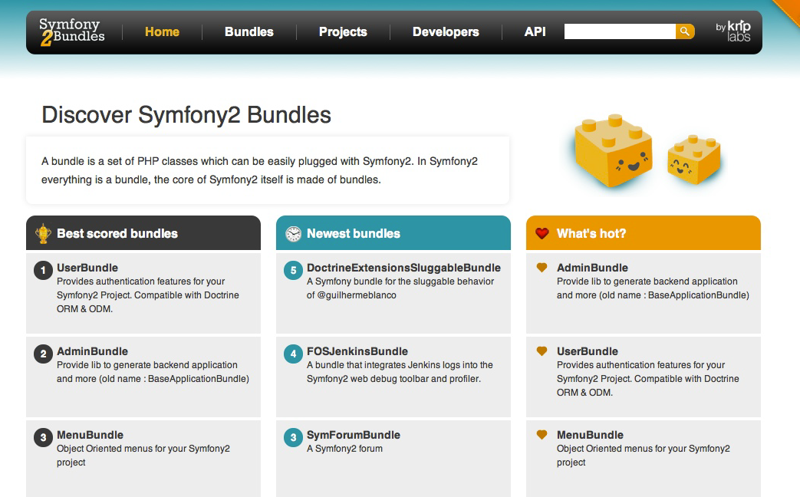
Symfony Bundles

Slide 7
What is Model-View-Controller?
MVC is a software architecture that separates the representation of information from the user’s interaction with it
the model represents the state of the application
a view displays a representation of the model
the controller mediates input, converting it to commands for the model or view

Slide 8

Interactions

Slide 9
Component Interactions
A controller sends commands:
to the model to perform actions that may update the model state
to the view to change the view’s presentation of the model (e.g., by scrolling through a document).
After a model update the model notifies its associated views and controllers, so that the views can produce updated output, and the controllers to change the available set of commands
A view requests from the model information needed to generate an output representation

Slide 10
ORM (Object Relational Mapping)
A technique for converting data in a Relational DB into Objects and vice versa
The program manipulates objects which are persisted typically as a row in a table and read back from the table
The attributes of an object correspond to columns
A table is mapped to a repository object that represent the collection of objects
Queries are submitted to a repository and return a list of objects or a cursor on such list

Slide 11
Symfony Benefits
A Framework simplifies development by providing structure and reusable modules
Fast and less greedy
Allows choosing which ORM to use
Web Debug Toolbar
Plentiful documentation and tutorials
Drupal uses Symfony instead of its own framework

Slide 12
Cons
Requires command line (troll)
Not easy to learn

Slide 13
Flat PHP (blog posts page)
<?php // index.php
$link = mysql_connect('localhost', 'myuser', 'mypassword');
mysql_select_db('blog_db', $link);
$result = mysql_query('SELECT id, title FROM post', $link); ?>
<!DOCTYPE html>
<html><head>
<title>List of Posts</title> </head> <body>
<h1>List of Posts</h1>
<ul>
<?php while ($row = mysql_fetch_assoc($result)): ?>
<li><a href="/show.php?id=<?php echo $row['id'] ?>">
<?php echo $row['title'] ?> </a>
</li>
<?php endwhile; ?>
</ul>
</body> </html>
<?php mysql_close($link); ?>

Slide 14
Result?
No error-checking
Poor organization
Difficult to reuse code

Slide 15
Hands on Symfony

Slide 16
1st step - Installation
Download from http://symfony.com/download (standard version)
Follow instructions
Test it @ http://localhost:8000/web/app_dev.php
Go to folder
> cd Symfony

Slide 17
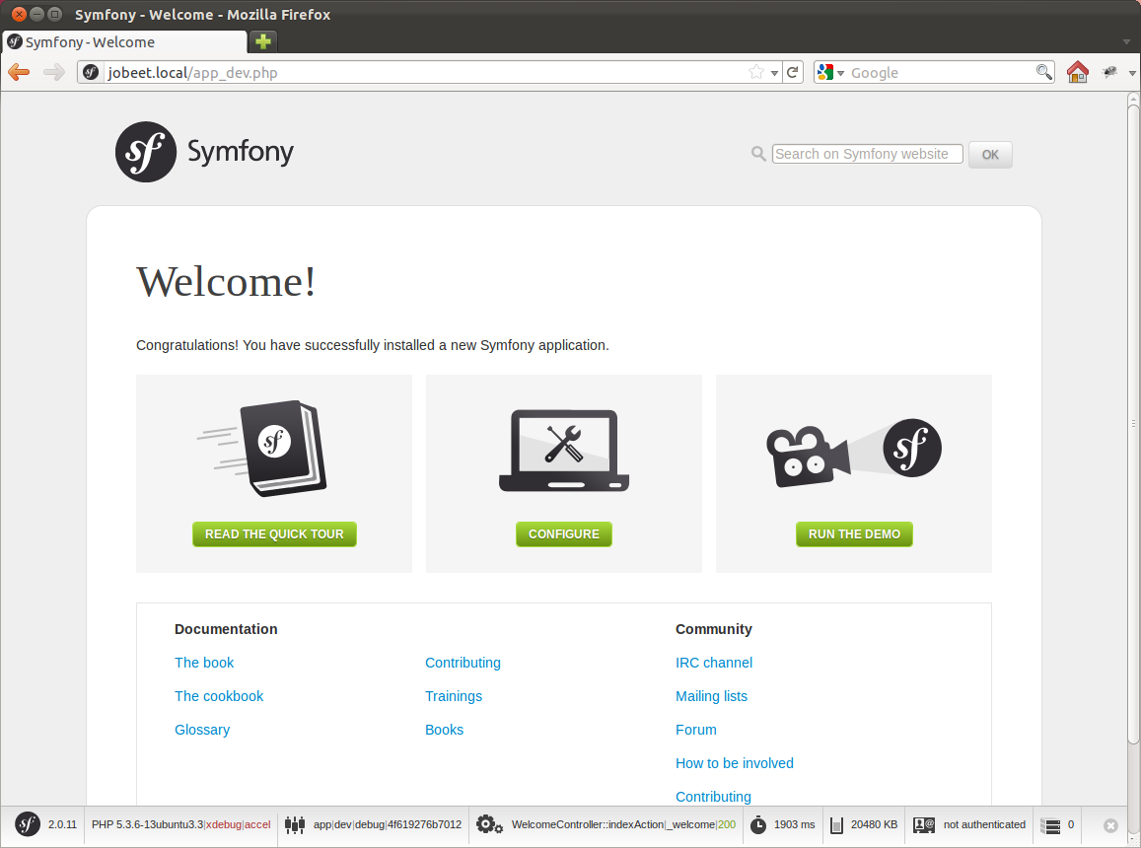

Slide 18
Folder Structure
  Symfony
  app
  bin
  src
  vendor
  web
  bundles
 app.php
 app_dev.php
 config.php

Slide 19
2nd step - Create Application Bundle
A Symfony3 project is made up of bundles
Create bundle:
> bin/console generate:bundle --namespace=PA16/PeopleBundle
--format=annotation
Generates code in directory
src/PA16/PeopleBundle

Slide 20
Folder Structure
  Entity
 Person.php
 PersonRepository.php
 Category.php
  Controller
 PersonController.php
  Form
 PersonType.php
  Resources
  views
  Person
 new.html.twig
 edit.html.twig
 index.html.twig
Model
Controller
Views

Slide 21
Folder Structure
  Resources
  public
  css
  images
  js
 config
 routing.yml
 services.xml
 validation.yml

Slide 22
3rd step - The Data Model
Edit the parameters file
;app/config/parameters.yml
parameters:
database_driver: pdo_mysql
database_host: localhost
database_name: symfony
database_user: user
database_password: password
Use doctrine in command line to auto-create the database in mySql:
bin/console doctrine:database:create

Slide 23
3rd step - The Data Model
Mapping to column
class Person {
/** @ORM\Column(name="id", type="integer")
* @ORM\Id
* @ORM\GeneratedValue(strategy="AUTO")
*/
private $id;
/** @ORM\Column(name="Name", type="string", length=30) */
public $name;
/** @ORM\Column(name="room", type="string", length=30) */
public $room;
…
}

Slide 24
3rd step - The Data Model - Repository
class PersonRepository extends EntityRepository {
public function findAllOrderedByName() {
return $this->getEntityManager()
->createQuery(
'SELECT p FROM Person p
ORDER BY p.Name ASC‘)
->getResult();
}

Slide 25
3rd Step – Data Model - Query
/**
* Delete person with id $id.
*/
public function remove($id)
{
$this->createQueryBuilder('p')
->delete(‘PA16PeopleBundle:Person', 'p')
->where('p.id = :id')
->setParameter('id', $id)
->getQuery()
->execute();
}

Slide 26
3rd step - The Data Model - Associations
/**
* @ORM\ManyToOne(targetEntity="Category", inversedBy="members")
* @ORM\JoinColumn(name="category_id",
referencedColumnName="id")
*/
public $category;
/** @ORM\ManyToOne(targetEntity="Department",
inversedBy="members")
* @ORM\JoinColumn(name="department_id",
referencedColumnName="id")
*/
public $department;

Slide 27
3rd step - The Data Model - Associations
class Department {
…
/**
* @ORM\OneToMany(targetEntity="Person",
mappedBy="department")
*/
private $members;

Slide 28
3rd step - The Data Model
Doctrine generates the accessor methods:
> bin/console doctrine:generate:entities RosiPeopleBundle
public function getName() {
return $this->name;
}

Slide 29
3rd step - The ORM
We can ask Doctrine to create our database tables (or to update them to reflect our setup) with the command:
> bin/console doctrine:schema:update --force
Updating database schema...
Database schema updated successfully! "7" queries were executed

Slide 30
4th step - Initial Data
> mysql –u root -p
use symfony;
INSERT into Category VALUES ("PO");
INSERT into Category VAUES ("PA");
INSERT into Person VALUES ("Albano", "2743");
INSERT into Person VALUES ("Attardi”, "2744");

Slide 31
Request Processing
Request
Bootstrap
Kernel
Controller
Response
/blog/life /blog/{title} BlogController: Rendered view
/blog/friends showAction($title)
/blog/about

Slide 32
5th Step – Generate CRUD
> bin/console doctrine:generate:crud
--entity=“PA16PeopleBundle:Person“
--with-write
Generates controller PersonController that provides methods:
indexAction
newAction
showAction
editAction
deleteAction

Slide 33
Generated PersonController
class PersonController extends Controller {
/** @Route("/", name="dept_persona")
* @Method("GET")
* @Template() */
public function indexAction() {
$em = $this->getDoctrine()->getManager();
$repo = $em->getRepository(‘RosiBundle:Person');
$entities = $repo->findAll();
return array('entities' => $entities);
}

Slide 34
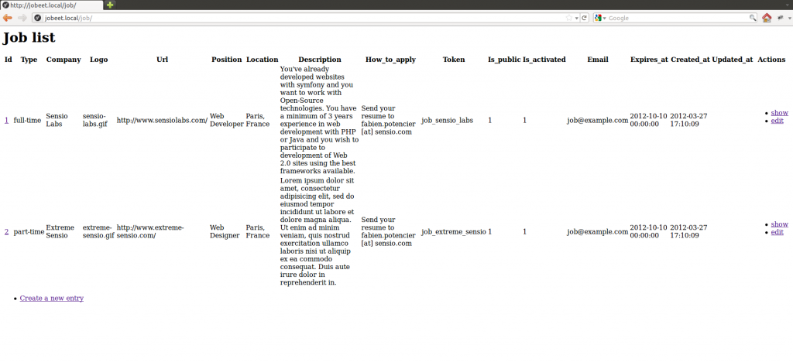

Slide 35
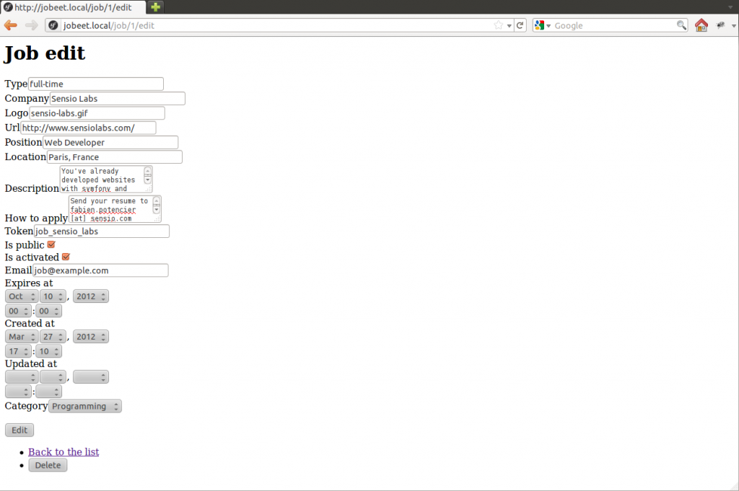

Slide 36
6th step - The Routing
Associates URLs to controller methods
Example:
symfony/app.php/person/123/edit
; Rosi/PeopleBundle/Resource/config/routing.yml
rosi_person_edit:
pattern: /person/{id}/edit
defaults: { _controller: RosiPeopleBundle:Person:edit }

Slide 37
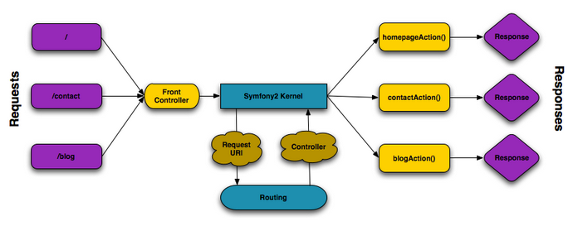
Symfony Application Flow

Slide 38
Routing Annotation
Can be provided in annotation to the method
Modifying app/config/routing.yml
/**
* Displays a form to edit an existing Person entity.
*
* @Route("/{id}/edit", name=“rosi_person_edit")
* @Method("GET")
* @Template()
*/
public function editAction($id) { }
rosi_persona:
resource: "@RosiPeopleBundle/Controller/PersonController.php"
type: annotation

Slide 39
5th step - The Routing
Edit the rosi_person_show route from the rosi.yml file:
#src/RosiPeopleBundle/Resources/config/routing/rosi.yml
rosi_person_show:
pattern: /rosi/person/{id}
defaults: { _controller:
"RosiPeopleBundle:Person:show" }

Slide 40
6th step - Route Debugging
See every route in your application:
Or a single route:
> bin/console router:debug
> bin/console router:debug rosi_person_show

Slide 41
router:debug
> bin/console router:debug
[router] Current routes
Name Method Scheme Host Path
_wdt ANY ANY ANY /_wdt/{token}
rosi_people ANY ANY ANY /people
people_add_person ANY ANY ANY /person/add
people_person_delete ANY ANY ANY /person/delete
people_person_edit ANY ANY ANY /person/edit/{id}
people_person_grid ANY ANY ANY /person/grid
people_person_main ANY ANY ANY /person/main

Slide 42
So far?
Barely written PHP code
Working web module for the job model
Ready to be tweaked and customized Remember, no PHP code also means no bugs!

Slide 43
7th step - The View
Create the file layout.html.twig in the directory:
src/Rosi/PeopleBundle/Resources/views/

Slide 44
7th Step – Twig Templates
Variables:
Blocks
{{ var }}
{{ var | upper }}
{{ var | raw }}
{{ object.property }}
{{ true ? ‘yes’ : ‘no’ }}
{% if foo is ‘bar’ %}
...
{% else %}
...
{% endif %}

Slide 45
Twig Templates
Extends:
Notice: there is no PHP code in Twig
Full separation between logic and presentation
{% extends "Bundle::layout.html.twig" %}

Slide 46
Twig Layouts
A base layout defines blocks
Each block can have a default value
{% block header %}
<h1>Welcome!</h1>
{% endblock %}
header
side
bar
content

Slide 47
Twig Layouts
A child layout extends the parent
And overrides its blocks
{% block header %}
{{ parent() }} back
{% endblock %}
header
side
bar
content

Slide 48
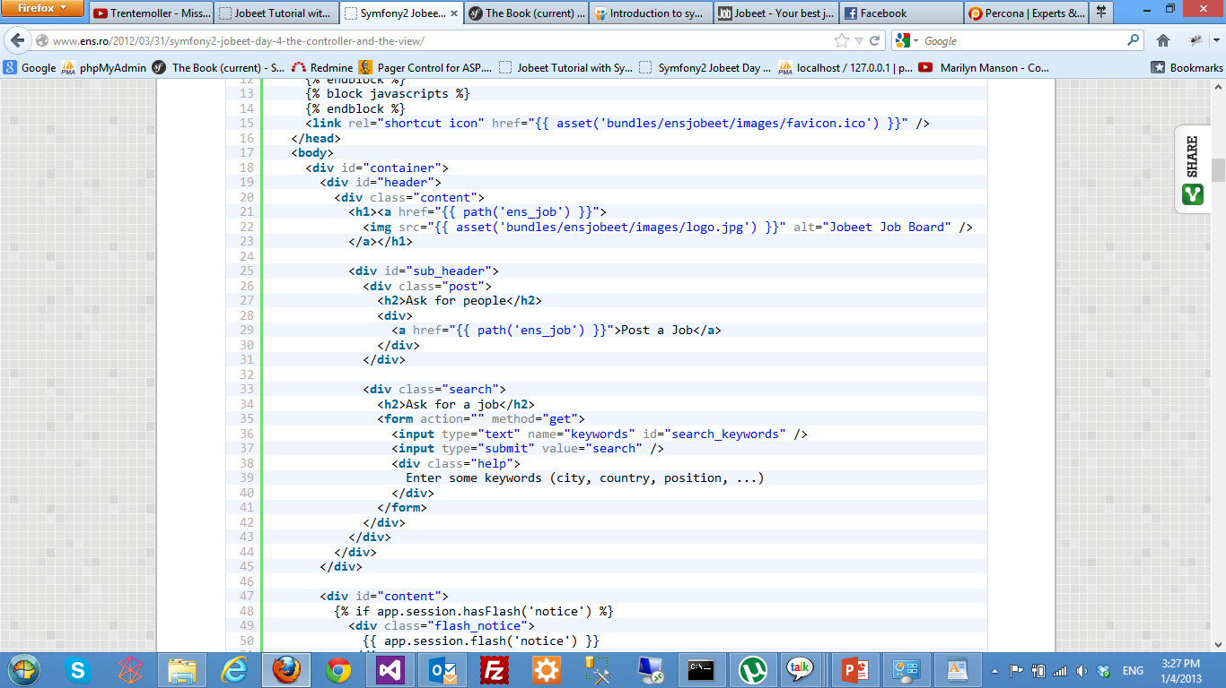

Slide 49
7th step - The View
Tell Symfony to make them publicly available:
Creates symlink:
> bin/console assets:install web --symlink
web/bundles/rosi -> src/Rosi/PeopleBundle/Resources/public

Slide 50
8th step - Testing
2 methods: Unit tests and Functional tests
Unit tests verify that each method and function is working properly
Functional tests verify that the resulting application behaves correctly as a whole

Slide 51
9th and last step - Bundles
Bundles are like modules in Drupal
Even symfony3 is a bundle itself
Many useful bundles such as
FOSUserBundle (user management)
SonataAdminBundle (Admin Generator)
FOSFacebookBundle (Integrate the Facebook)
PagefantaBundle (paginate)

Slide 52
Composer and Bundles
Install composer:
https://symfony.com/doc/master/cookbook/composer.html

Slide 53
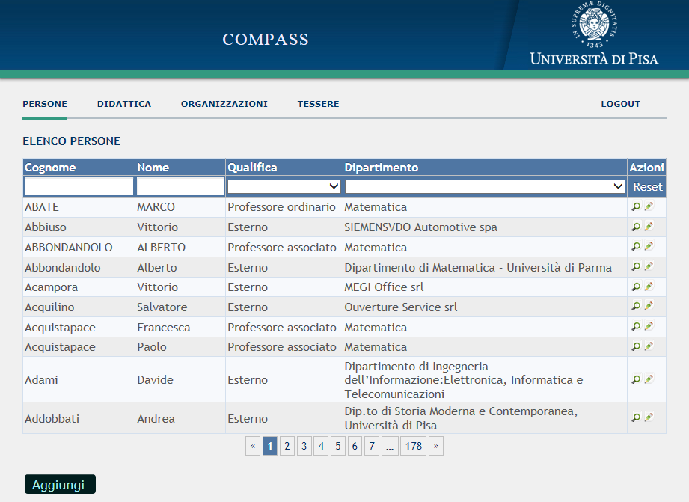
DataGrid with PagerFanta

Slide 54
Composer
Manage bundle installation and update
Example:
Include bundle in composer.json:
"require": {
"apy/datagrid-bundle": "dev-master“
Invoke composer:
> composer require apy/datagrid-bundle

Slide 55
Dependency Injection
Aka Control Inversion
Quite simply:
Pass an object to a class instead of letting class create its own instance
Typically used for services. An instance of the service is supplied to an application
Allows customization
Typically from configuration files
Increases flexibility

Slide 56
Services
Service
objects that provide particular functions, e.g.
DB, mailer
Configuration file:
Resources/config/services.yml
Example:
doctrine:
dbal:
driver: pdo_mysql
host: localhost
Use:
$db = $this->get('doctrine');

Slide 57
Import from DB

Slide 58
SqlServer driver
; app/config/parameters.yml
parameters:
database_driver: pdo_dblib
database_host: 131.114.3.27
database_port: null
database_name: Dipartimento
database_user: username
database_password: password

Slide 59
Install driver
See https://github.com/intellectsoft-uk/MssqlBundle
> php composer.phar require "isoft/mssql-bundle:master-dev"
> sudo apt-get install php5-sybase
Add to vendor/doctrine/dbal/lib/Doctrine/DBAL/DriverManager.php
'pdo_dblib' => 'Realestate\DBAL\Driver\PDODblib\Driver',

Slide 60
Generate Bundle
> app/console generate:bundle
--namespace=Compass/DipBundle
--bundle-name=Compass\DipBundle
Fixes to MssqlBundle
Rename uniqueidentifier -> timestamp in:
vendor/isoft/mssql-bundle/Realestate/MssqlBundle/RealestateMssqlBundle.php
vendor/isoft/mssql-bundle/Realestate/MssqlBundle/Types/UniqueidentifierType.php

Slide 61
Generate Classes
Step 1
> app/console doctrine:mapping:import --em=compass2 –force CompassDipBundle annotation
Step 2
> app/console doctrine:generate:entities CompassDipBundle

Slide 62
CRUD for imported tables
> app/console doctrine:generate:crud --entity="CompassDipBundle:GenPersone“ --with-write --route-prefix=/dept/person
> app/console doctrine:generate:crud --entity="CompassDipBundle:GenOrganizzazione“ --with-write --route-prefix=/dept/organization

Slide 63
Write Entity for Views
Views are not imported
Write class Person, corresponding to view PTS_V_PersoneDipartimento

Slide 64
Doctrine ORM

Slide 65
Querying
By Primary Key
$user = $repo->find($id);
By Simple Conditions
$users = $repo->find(array('id' => $id));
$users = $repo->findBy(array(
'name' => $name));
Find all
$users = $repo->findAll();

Slide 66
Query Builder
$qb = $em->createQueryBuilder();
$qb->select('u')
->from('User', 'u')
->where('u.id = :id)
->orderBy('u.name', 'ASC');
$query = $qb->getQuery();
$result = $query->getResult();
$single = $query->getSingleResult();

Slide 67
Joins
$query = $em->createQuery(
"SELECT u FROM User u JOIN u.address a
WHERE a.city = 'Berlin'");
$query = $em->createQuery(
'SELECT u FROM ForumUser u
WHERE u.username = :name');
$query->setParameter('name', 'Bob');
$users = $query->getResult();

Slide 68
Hydration
The process of transforming a SQL result set into objects
Hydration modes:
Collection of objects
Single object
Nested array
Set of scalar values

Slide 69
Result iterator
Avoid hydration of a large result set
$q = $em->createQuery(
'select u from Model\User u');
$iterable = $q->iterate();
foreach ($iterable as $row) {
$user = $row[0];
$user->increaseCredit();
}

Slide 70
Annotations

Slide 71
Security
/**
* @extra:Route("/hello/admin/{name}")
* @extra:Secure(roles="ROLE_ADMIN")
* @extra:Template()
*/
public function helloadminAction($name)
{
return array('name' => $name);
}

Slide 72
Caching
/**
* @extra:Route("/hello/{name}“)
* @extra:Template()
* @extra:Cache(maxage="86400")
*/
public function helloAction($name) {
return array('name' => $name);
}

Slide 73
Validation
RosiPeopleBundle\Entity\Person:
properties:
name:
- Length: {max:30, maxMessage: “Il nome non può superare 30 caratteri."}
- NotBlank: {message: "Inserire il nome."}
category:
- NotBlank: {message: "Indicare una categoria."}

Slide 74
Summary
Generate bundle
Register bundle
Create model (entities, ORM)
Establish routing
Implement actions in controller
Use Forms for interaction
Use Twig for presentation

Slide 75
IDE
NetBeans IDE plugin
http://download.netbeans.org/netbeans/7.4/final/bundles/netbeans-7.4-php-windows.exe

Slide 76
Embedded Forms
Handle a collection objects

Slide 77
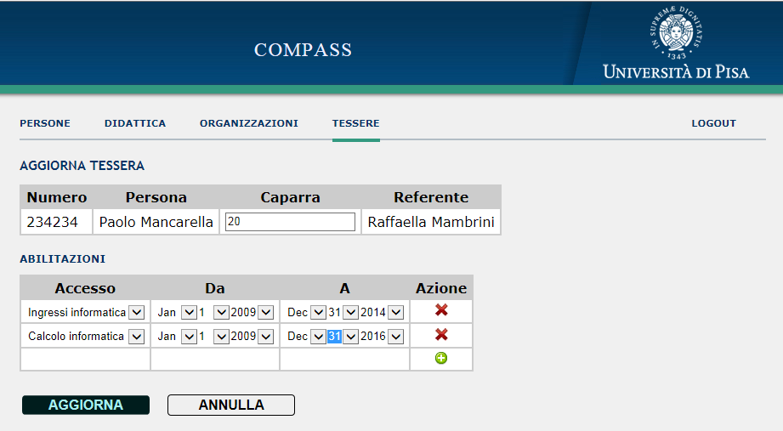
Bagdes

Slide 78
Example: Badges
class Bagde {
private $id;
private $code;
private $person;
/* @ORM\OneToMany(targetEntity="AccessPermit",
mappedBy="badge",
cascade={"persist", "remove"}) */
protected $permits;
}

Slide 79
Badge Permit
class BadgePermit {
private $id;
/* @ORM\ManyToOne(targetEntity="Badge",
inversedBy="permits")
@ORM\JoinColumn(name="badge", referencedColumnName="ID") */
private $badge;
/* @ORM\OneToOne(targetEntity="Access")
@ORM\JoinColumn(name="access", referencedColumnName="ID") */
private $access;
private $start;
}

Slide 80
Form for editing Badges
Problem:
User submits form, Symfony turns form data into an object
Controller action deals with the object
Easy when form corresponds to a single Entity
Fairly easy if number of items is fixed
Complicated if user is allow to add/remove items
Solution:
Modify DOM in the client adding new fields to the form
New fields must have proper names

Slide 81
Fields
<select id="badge_permits_1_access"
name="badge[permits][1][permit]"> …
<select id="badge_permits_2_access"
name="badge[permits][2][permit]"> …

Slide 82
Details
jQuery(document).ready(function() {
collectionHolder = $('tbody.permits:first');
// Save the last row, so that it can be replicated
var lastRow = collectionHolder.children().last();
prototype = lastRow[0].outerHTML;
// clear fields
lastRow.find('td').not('.actions').each(function() { $(this).html(''); });
rows = collectionHolder.find('tr.permit').length;
if (rows == 1)
addRow();
});

Slide 83
Prototype trick
function addRow() {
// Replace '__name__' in the prototype's HTML with a progressive number
var newRow = prototype.replace(/__name__/g, rows);
var lastRow = collectionHolder.children().last();
lastRow.before(newRow);
newRow = lastRow.prev();
// set an id
id = '__accesso_row_' + rows + '__';
newRow.attr('id', id);
// change action
var action = newRow.find('.actions:first');
var a = action.find('a:first');
a.attr('onclick', 'delRow("#' + id + '"); return false;');
// replace icon, title, etc.
rows++;
}

Slide 84
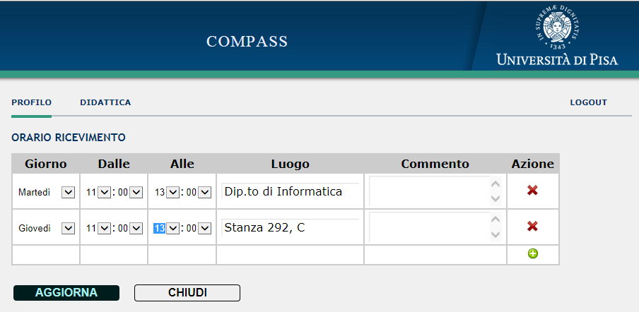
Appointments

Slide 85
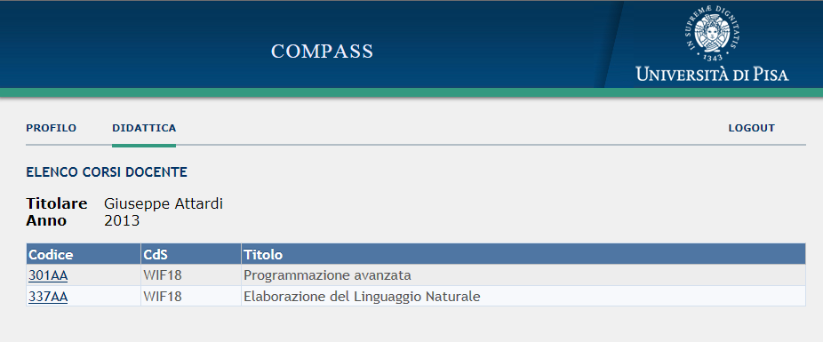
Filter data by user

Slide 86
Benefits
Code reduction:
From 200 lines of ASP to 30 lines

Slide 87
Further Reading
Manual
http://symfony.com/doc/current/book/index.html
Tutorials
http://tutorial.symblog.co.uk/
http://www.ens.ro/2012/03/21/jobeet-tutorial-with-symfony2/
http://juandarodriguez.es/tutoriales/inyeccion-de-dependencias-en-symfony2/

