Slide 1
What is Web 2.0?
By Eunkyu Lee, Alireza Bigdeli, and Rita Chiu
Expert Topic Presentation
Trends in Middleware Systems
January 29, 2007

Slide 2
Agenda
Understanding Web 2.0
  Origins and Concepts
  Compact Definition
Design Patterns and Business Models
  Axes of Design Patterns and Business Models
  Four plus one in Hierarchy of Web2.0 ness
Web 1.0 vs. Web 2.0
Mashups & Web 2.0 + SOA
Controversial Questions

Slide 3
Understanding Web 2.0 - Agenda
Web 2.0?
  Origin
  What Web 2.0 is and is not…
Web 2.0 Compact Definition
  Web 2.0
  Web 2.0 Applications
    Four properties
Web 2.0 Revisit
* From Prak’s posts at http://www.fortytwo.co.kr/

Slide 4
Web 2.0?
Origins of Web 2.0
  Coined by Dale Dougherty in 2004
    VP of O’Reilly Media
  People
    Collaborate and share information in new ways such as social networking and wikis
Web 2.0 is not
  A specific technology or a standard
It is said that
  A set of principles and practices
    Making existing web technologies more people-centric
  Something visible and tangible
    a collection of related tools, design patterns, and business models
      that encourage collaboration and participation to work more efficiently
* From lecture notes of Prof. David Shrimpton at Kent Univ.

Slide 5
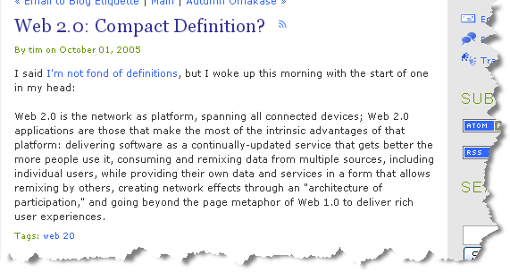
Web 2.0: Compact Definition?
Web 2.0 compact definition (by Tim O’Reilly)
Web 2.0 is the network as platform
  spanning all the connected devices
Web 2.0 applications
  are those that make the most of the intrinsic advantages of that platform

Slide 6
Web 2.0
Web 2.0 is the network as platform, spanning all the connected devices
“The Web as Platform”
  The Web is the unique platform
    OS or Web browser is not a platform any more
Hardware devices
  + all the connected devices
  Including mobile Internet
    UCC (User Created Contents) & Podcasting (iPod)
Web 2.0
  A collection of platforms which is interconnected by underlying network regardless of their hardware devices

Slide 7
Web 2.0 Applications
Web 2.0 applications are those that make the most of the intrinsic advantages of that platform
Four properties to use the intrinsic advantages of the platform
Delivering software as a continually-updated service that gets better the more people use it,
Consuming and remixing data from multiple sources, including individual users, while providing their own data and services in a form that allows remixing by others,
Creating network effects through an "architecture of participation,"
And going beyond the page metaphor of Web 1.0 to deliver rich user experiences.

Slide 8


Web 2.0 Applications (1)
Delivering software as a continually-updated service that gets better the more people use it
Continually-updated service
  Perpetual beta
  Continuous improvement
Delivering software
  Similar to Application Service Provider (ASP)
  Software as a service (SaaS) in web platform
    AJAX (Asynchronous Java and XML)
Gets better the more people use it
  UCC (User Created Contents)
    Decentralization of resources
      Such as BitTorrent and Napster

Slide 9
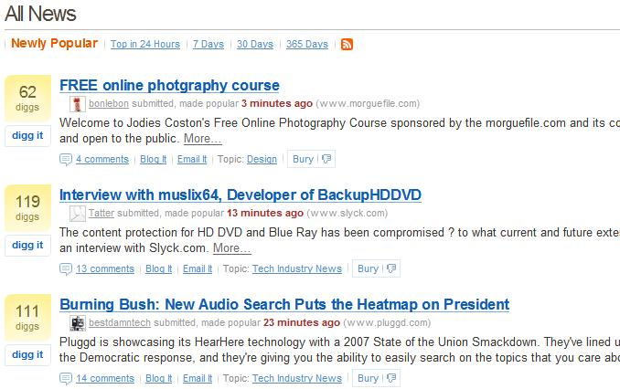
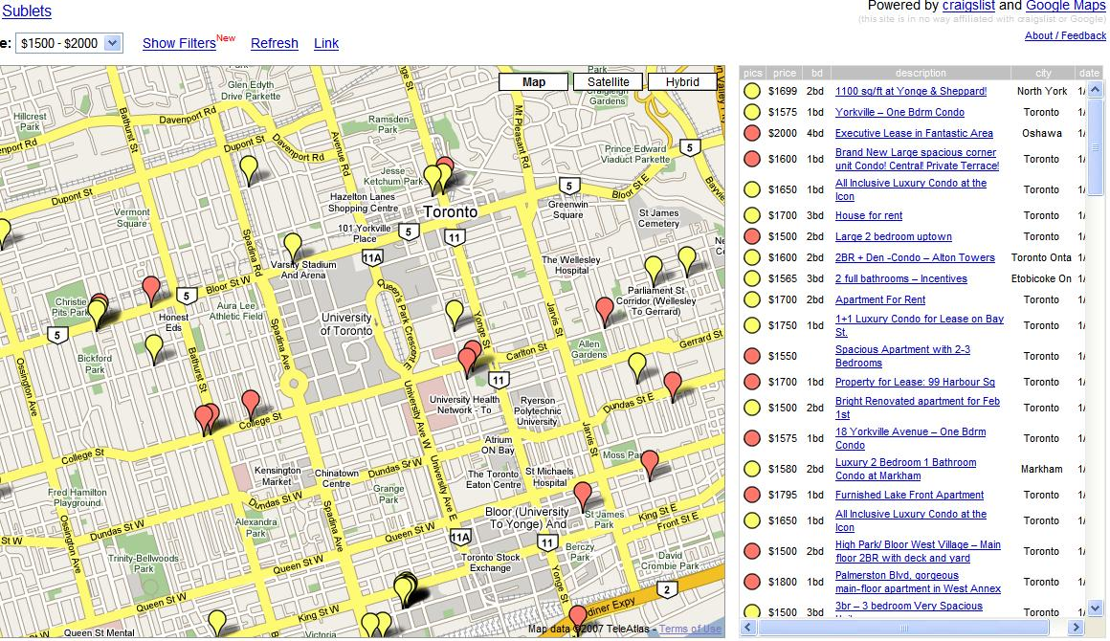
Web 2.0 Applications (2)
Consuming and remixing data from multiple sources, including individual users, while providing their own data and services in a form that allows remixing by others
Consuming and remixing data
  News aggregator and meta blog
    Add values not just showing as it is
    Digg.com (vote for priority)
  Mash-up
    New contents or services from multiple sources
    Housingmap.com and ChicagoCrime.com
In a form that allows remixing by others
  Open API
    Connecting services via share and open
    Google and Yahoo APIs

Slide 10
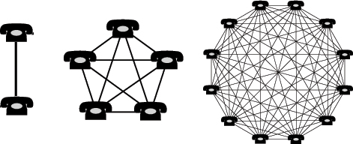
Web 2.0 Applications (3)
Creating network effects through an "architecture of participation”
Architecture of participation
  More important…
    A property inherited within the business system
    A architecture where self-interested behaviors of users (in)directly or automatically benefit the whole users
      New biz: Napster and Wikipedia
      Existing biz: Flickr (foksonomy tool) and Amazon
Network effects
  Telephone
    More benefit when more people use it
  Internet is a winner-take-all market
    Creating network effects -> Harnessing collective intelligence

Slide 11
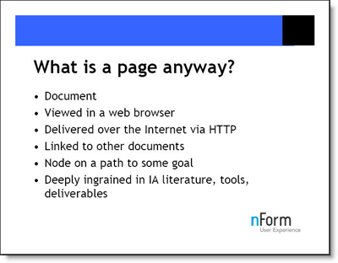
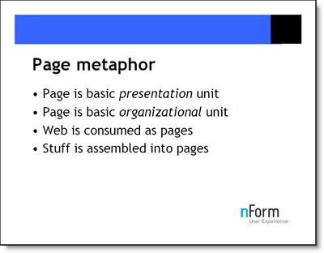
Web 2.0 Applications (4)
And going beyond the page metaphor of Web 1.0 to deliver rich user experiences
Page and Page metaphor
* Gene Smith, “Beyond the Pages,” Info. Architecture Summit, July 2005.

Slide 12
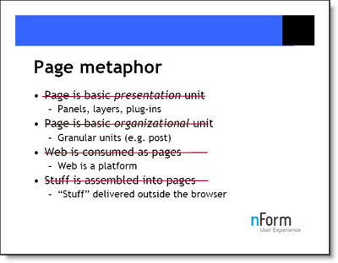
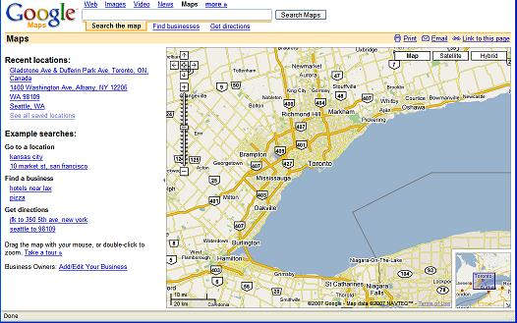
Web 2.0 Applications (4)
And going beyond the page metaphor of Web 1.0 to deliver rich user experiences
Beyond the page metaphor
* Microcontent: Richard MacManus, Web 2.0 Design: Bootstrapping the Social Web

Slide 13
Web 2.0 – Revisit
Web 2.0 & Web 2.0 applications
  Understand the meaning of Web 2.0 by looking at the properties of its applications
Describe the web 2.0 with various viewpoints
  Delivering software as a continually-updated service…
    Implementation and management of applications
  Consuming and remixing data from multiple sources…
    Philosophy of openess
  Creating network effects…
    Business model and system architecture
  Going beyond the page metaphor of Web 1.0…
    User interfaces and operations of applications

Slide 14
Agenda (2)
Understanding Web 2.0
  Origins and Concepts
  Compact Definition
Design Patterns and Business Models
  Axes of Design Patterns and Business Models
  Four plus one in Hierarchy of Web2.0 ness
Web 1.0 vs. Web 2.0
Mashups & Web 2.0 + SOA
Controversial Questions

Slide 15
Axes of Design Patterns and Biz Models
1. The Web As Platform
2. Harnessing Collective Intelligence
3. Data as the Next Intel Inside
4. End of Software Release Cycle
5. Lightweight Programming Models
6. Software Above The Level of Single Device
7. Rich User Experience

Slide 16

The Web As Platform(1)
Web 2.0 as a set of principles
  Each web 2.0 site has part of core principles
  Netscape vs. Google
Netscape picked old software paradigm
  Web browser as flagship product
  use dominance in browser market to sell high-priced server products
  Try to control over standards for displaying content
  Both web browsers and web servers turned out to be commodities
  Value moved up stack to services

Slide 17

The Web As Platform(2)
  Google delivered as a service
    A native web language; never sold or packaged
    No scheduled release; just continuous improvement
    Customers pay directly or indirectly for the use of that service
    Google is a specialized database
    Value of the software is proportional to the scale and dynamism of the data it helps to manage
    Google's service is not a server nor a browser
    It happens in the space between browser, search engine and destination content server

Slide 18


The Web As Platform(3)
Akamai vs. BitTorrent
  Akamai; easy access to high demand sites
    Do business with the head not the tail
    Collect revenue from central sites
  BitTorrent, radical approach to internet decentralization
    More use gets the service better
    Every consumer brings his own resources to the party
    Architecture of participation

Slide 19



Harnessing Collective Intelligence(1)
Embrace the power of web to harness collective intelligence → secret of survive
  Google use PageRank instead of using only documents characteristics
  Yahoo! → directory of best links 2
  eBay’s advantage → mass of buyers and sellers
  Amazon vs. Barnesandnoble.com
    An order of magnitude more user reviews
    Lead to most popular, based on “flow” around products (sales and other factors)

Slide 20
Harnessing Collective Intelligence(2)
Newer applications
  Wikipedia → a radical experiment in trust
    “With enough eyeballs, all bugs are shallow”
  Cloudmark → Collaborative spam filtering
    Outperform products based on message analysis
  Peer-production methods of open source
    Much of the structure of web like Linux, Apache, MySQL and Perl, PHP or Python
    More than 100,000 open source software project on SourceForge.net

Slide 21

Harnessing Collective Intelligence(3)
  Blogging and wisdom of crowds
    RSS much stronger than link or bookmark
    Permalink → brigde between blogs
    An important role in shaping search engine results
    Blogosphere → a constant mental chatter of global brain
    A media in which former media’s audience decide what’s important

Slide 22

Data is Next Intel Inside
Every significant internet application is backed by a specialized database
Owning an application core data is very important
Race in on to own certain classes of data
Significant cost to create data → Intel Inside play style
In others, the winner is the company first reaches critical mass via user aggregation

Slide 23

Data is the Next Intel Inside
Example: MapQuset vs. Amazon
  NavTeq → Owner of maps data
  MapQuest → Pioneer in webmapping 1995
  Google and yahoo licensed the same data from NavTeq
  Bowker → Primary source of bibliographical data
  Amazon relentlessly enhanced the data
    Cover images, table of contents, index
    Harness users to annotate the data
    after ten years Amazon is the primary source for bibliographic data on books

Slide 24
End of Software Release Cycle
software delivered as a service, not a product
fundamental changes in the business model of companies
  Operations must become a core competency
    Google →continuously crawl the web, update its indices, filter out link spam, respond to million user queries
    simultaneously matching them with context-appropriate advertisements
  Users must be treated as co-developers
    perpetual beta → the product is developed in the open, with new features in a weekly, or even daily basis
    Real time monitoring of user behavior to see which new features are used

Slide 25
Lightweight Programming Models
Support lightweight programming models that allow for loosely coupled systems
  Use simple web services like RSS and REST
    Amazon → 5% SOAP for B2B, 95% REST
Think syndication, not coordination
  syndicating data outwards, not controlling what happens when it gets to the other end of the connection → Reflection of end-to-end principle
Design for "hackability" and remixability
  Google Maps using AJAX (Javascript and Xml) left the data for taking
  Barriers to reusability are low
  Innovation in assembly is the result of this principle → mashups

Slide 26
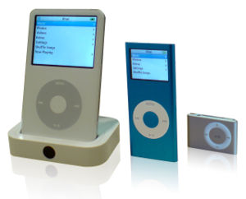

Software Above The Level of Single Device
Design applications and services for new platforms other than PC
  iPod/iTunes and Tivo → use PC as a local cache and control station
  Google services for mobile devices → Maps, Gmail, SMS, Search and News
  Dodgeball → social networking for mobile users

Slide 27
Rich User Experience
User interfaces and PC-equivalent interactivity
  Gmail and Google Maps first web based applications with rich user interface
AJAX a key component of Web 2.0
  standards-based presentation using XHTML and CSS
  dynamic display and interaction using the Document Object Model
  data interchange and manipulation using XML and XSLT
  asynchronous data retrieval using XMLHttpRequest
  and JavaScript binding everything together

Slide 28
Four plus one in Hierarchy of Web2.0 ness
Level 3 Applications → The most Web 2.0
  deriving their power from the human connections and network effects
  growing in effectiveness the more people use them
  eBay, craigslist, Wikipedia, del.icio.us, Skype, dodgeball, and Adsense
Level 2 Applications
  can operate offline but gain advantages from going online → Flickr
Level 1 Applications
  Available offline but gain features online → writely, iTunes
Level 0 Applications → Google Maps, MapQuest
Non-web Applications
  Communication Applications → email, instant messaging

Slide 29
Core Competencies of Web 2.0 Companies
Services, not packaged software, with cost-effective scalability
Control over unique, hard-to-recreate data sources that get richer as more people use them
Trusting users as co-developers
Harnessing collective intelligence
Leveraging the long tail through customer self-service
Software above the level of a single device
Lightweight user interfaces, development models, AND business models

Slide 30
Agenda (3)
Understanding Web 2.0
  Origins and Concepts
  Compact Definition
Design Patterns and Business Models
  Axes of Design Patterns and Business Models
  Four plus one in Hierarchy of Web2.0 ness
Web 1.0 vs. Web 2.0
Mashups & Web 2.0 + SOA
Controversial Questions

Slide 31


Web 1.0 VS Web 2.0 Examples
Web 1.0
Web 2.0
VS
DoubleClick:
  Serve web for publishing but not for participating
    Only advertisers control what to publish, no participation from customers
  Not harnessing collective intelligence and service is not updated automatically
    No enhancement in service if the database is not updated by its employees
  Service does not serve the long tail
    Formal contract required
Notes:
In this part, we are going to give specific examples on why certain sites are consider Web 1.0 and Web 2.0

Slide 32
Web 1.0 VS Web 2.0 Examples
Web 1.0
Web 2.0
VS
Google AdSense:
  Serve web for participating
    Everyone (either advertisers / publishers) can participate. Publishers publish ads that are related to their content.
  Harnessing collective intelligence
    As the Google Network grows, Google advertisers can seamlessly get a better advertising service because their ads will be able to reach more end users as more sites can match keywords provided by the advertisers
  Service is updated automatically
    Update seamlessly (Keyword-based Ad Filtering)
  Service serves the long tail
    Everyone can participate
Notes:
Whereas in Google AdSense, it serves web for participation.
Everyone (either advertisers / publishers) can participate. In addition, publishers controls what ads to be published on their site because AdSense embed advertisements to the web page based on the content of the page not based on the control of the advertisers.
It harnesses collective intelligence because as the Google Network grows, Google advertisers can seamlessly get a better advertising service because their ads will be able to reach to more end users as more sites can match they keywords provided by the advertisers.

Slide 33

Web 1.0 VS Web 2.0 Examples
Web 1.0
Web 2.0
VS
Ofoto (Kodak Gallery):
  Serve web for publishing but not for participating
    Users upload pictures to web but visitors cannot “find” / “tag” individual pictures in an album
  Not harnessing collective intelligence
    Share albums cannot be viewed easily by search
  Static user experience
    Cannot integrate the creativities from publishers / visitors
Notes:
Ofoto
====
Continually-updated service with automation?
NO. Based on cookies that track content previously viewed by the computer to determine which ads to pop up. Require people to program the database to map between ads and target computers. No enhancement in service if the database is not updated by employees in DoubleClick.
Serving the long tail?
NO. Formal contracts required.

Slide 34
Web 1.0 VS Web 2.0 Examples
Web 1.0
Web 2.0
VS
flickr
  Serve web for participating
    Everyone can participate
      “Flickr is what butters the borders between your photos to the people you want to see them.” – www.flickr.com
  Harness collective intelligence
    Tags are used for searching
    New tag feature: machine tags
      namespace:predicate=value
      Able to query for wildcards in namespace, predicate, and value
  Rich user experiences
    Dynamic, encourage creativity
    Everyone is a developer

Slide 35



Web 1.0 VS Web 2.0 Examples
Web 1.0
Web 2.0
WIKIPEDIA
VS
Personal Websites
<<OUT>> | <<IN>>
Serve web for publishing | Serve web for participating
Not harnessing collective intelligence | Harnessing collective intelligence
Simply use data from data suppliers | Enhancing the data from data suppliers
It is a product | It is a service
N/A | Lightweight programming models Easy to reuse and innovate mashups
Static user experiences | Rich user experiences
Notes:
Personal webpage – own editor on own machine
Blog – web is the platform where create/edit/comment (peer-review) on.

Slide 36
Web 2.0 continues … (Mashups)
Mashup
  A website or application that integrates content from more than one source into an entirely new innovative experience
Idea
  Content provider provides API to allow others to build and integrate its content
Mashups gendres
  Mapping
  Video and photo
  Search and shopping
  News
Mashups examples
  http://www.programmableweb.com/
Notes:
Combining information from the server side has been done for a long time
Mashups are combining information from the client side.

Slide 37
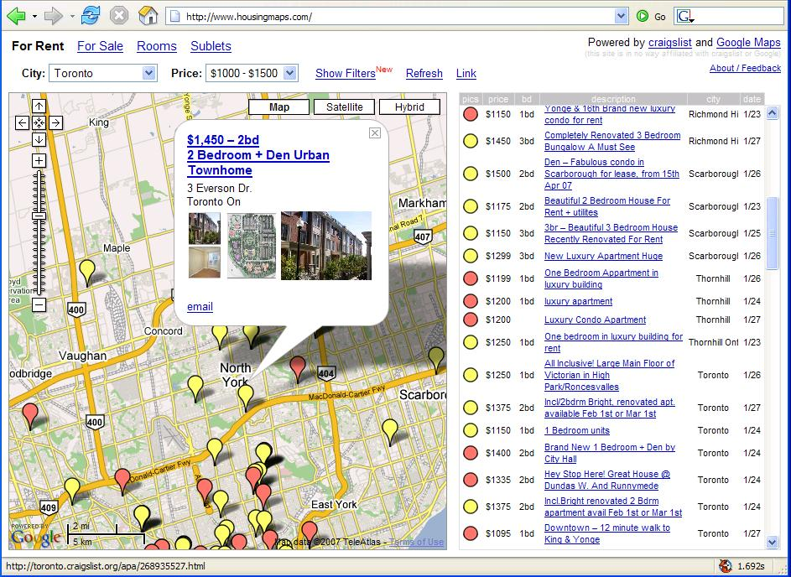
Web 2.0 continues … (Mashups)
Mapping Mashups
  housingmaps.com
    Mashup of two open source on web
      Craigslist
      Google Maps
    Extract from Craiglist the all of rental classified and mixed them up with Google Maps
  Google Maps API
    Embeds Google Maps in your web page with JavaScripts
    Allows overlays (e.g. markers) and customized descriptions boxes

Slide 38
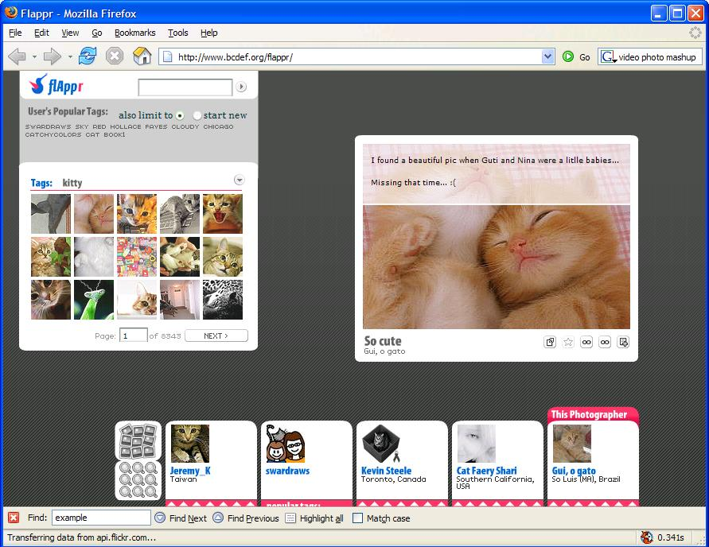
Web 2.0 continues … (Mashups)
Video and photo mashups
  flappr (www.bcdef.org/flappr/)
    Mashup of flickr
    Lets you do everything that you can from flickr but all in one window without refreshing the window
  flickr API
    Request and response using
      REST
      XML-RPC
      SOAP
    Application needs to parse the resulting response
Notes:
Other third party flickr API wrappers
Ruby
Perl
Easy to use interface to the flickr photo-sharing services

Slide 39



Web 2.0 continues … (Mashups)
Search and shopping mashups
  Examples
    Mashups of eBay, Amazon
    Comparison of best prices, best coupons
  eBay API
    SOAP
  Amazon API (AWS)
    REST
    SOAP

Slide 40
Web 2.0 continues … (Mashups)
News mashups
  Optevi News Tracker
    Mashups of news feeds and semantic web services
  RSS Feeds
  Reuters Semantic Web Services
    Natural language processing such as text extraction and event detection in a standard web service
    Input to the web service is text
    Output format is XML or a formatted web page
      The result shows relationships from the input text can be integrated into another application or a web site
Notes:
Text is submitted to the web service where semantic analysis is applied to it, identifying all people, organizations, and geographies located within the text. The service returns the results as XML or as a formatted web page. The API enables Web site developers, software programmers, enterprise information managers and others to identify concepts and relationships contained in text and the results can be incorporated directly in user applications or as a component of web sites.

Slide 41
Web 2.0 + SOA
Web 2.0
  Mashup
    A website or application that integrates content from more than one source into an entirely new innovative experience.
  Social concept (call for participation)
  Processing data mostly on client side (e.g. AJAX)
SOA
  A collection of services that communicate with each other to support the requirement of business processes.
  Processing data mostly on server side
Common concept:
  Relies on common “APIs” to integrate information / services together to produce an entirely new service.
Differences:
  Client side processing VS server side processing
  Web 2.0 mostly done by non-enterprise (cool toys)
  SOA has a stricter rules for service communications

Slide 42
Web 2.0 + SOA
Key components required by enterprise to adopt to Web 2.0 concepts are:
  Higher governance in data usage and data transfer
    AJAX
      Client side processing
      No governance when the logic is done on client side
    API provider has no knowledge on how data is begin used
  Higher trust in data quality and reliable services

Slide 43
Agenda (4)
Understanding Web 2.0
  Origins and Concepts
  Compact Definition
Design Patterns and Business Models
  Axes of Design Patterns and Business Models
  Four plus one in Hierarchy of Web2.0 ness
Web 1.0 vs. Web 2.0
Mashups & Web 2.0 + SOA
Controversial Questions

Slide 44
Controversial Questions
How do we implement Web 2.0?
How do we determine whether one is Web 2.0 or not?
In Web 2.0, the wealth of information is largely composed by the concept of open contribution. Can these information be trusted?
What are some of the mashup challenges developers are facing today?
What is Web 3.0?

Slide 45
References
Tim O’Reilly’s blog “Web 2.0: Compact Definition?”
  http://radar.oreilly.com/archives/2005/10/web_20_compact_definition.html
Web 2.0 Conference
  http://web2con.com
Lecture “Mobile and Ubiquitous Computing”. Kent University.
  https://www.cs.kent.ac.uk/teaching/06/modules/CO/8/31/index.html
Merrill D. “Mashups: The new breed of Web app.” Aug 2006.
  http://www-128.ibm.com/developerworks/library/x-mashups.html?ca=dgr-lnxw16MashupChallenges
Programmableweb. Available asl of Jan 2007
  http://www.programmableweb.com/
Chase D. “The ulitmate mashup – Web services and the semantic Web, Part 1: Use and combin Web services.” Aug 2006.
  http://www-128.ibm.com/developerworks/edu/x-dw-x-ultimashup1.html
Crupi, J. “AJAX + SOA: The Next Killer App.” AJAXWorld Magazine. Jan 2007.
  http://ajax.sys-con.com/read/276358.htm
Markoff, J. “Entrepreneurs See a Web Guided by Common Sense.” The New York Times. Nov 2006.
  http://www.nytimes.com/2006/11/12/business/12web.html?ex=1320987600&en=254d697964cedc62&ei=5088
Tim O’Reilly’s website “What Is Web 2.0; Design Patterns and Business Models for the Next Generation of Software”
  http://oreillynet.com/pub/a/oreilly/tim/news/2005/09/30/what-is-web-20.html
Wikipedia, Web 2.0 http://en.wikipedia.org/wiki/Web_2
CTD Report “Rise of the Participation Culture”
  http://www.wsjb.com/RPC/V1/Home.html

Slide 46
Controversial Question (1)
How do we implement Web 2.0?
  Implementation technology is not a big deal !
  The problem is whether your page can encourage people to collaborate efficiently

Slide 47
Controversial Question (2)
How do we determine whether one is Web 2.0 or not?
  From Tim’s article, the properties are interconnected with ‘and’ command
  Only when your page meet the ALL requirements, it can be Web 2.0
    Delivering software as a continually-updated service…
      Implementation and management of applications
    Consuming and remixing data from multiple sources…
      Philosophy of openess
    Creating network effects…
      Business model and system architecture
    Going beyond the page metaphor of Web 1.0…
      User interfaces and operations of applications

Slide 48
Controversial Question (3)
In Web 2.0, the wealth of information is largely composed by the concept of open contribution. Can these information be trusted?
  The level of integrity of data is “use at your own risk”
  Need to increase in alertness on the information retrieved from the web
  Example:
    Wikipedia
      Information largely composed by unregulated and anonymous contributors worldwide
      Only a good starting point for information

Slide 49
Controversial Question (4)
What are some of the mashup challenges developers are facing today?
  Use of AJAX leads to
    Browser compatibility issue
      DOM support on IE does not always conform to W3C
    JavaScript enabled browser
      Affects a minority number of users or automated tools (e.g. Web crawlers)
    JavaScript can update content asynchronously
      Content does not link to a specific URL
      Same content might not be retrieved/viewed again with the BACK button or BOOKMARK feature
Notes:
AJAX allows content be updated on the client side without the entire page being refreshed, but the use of AJAX leads to:

Slide 50
Controversial Question (5)
What is Web 3.0?
  Semantic Web
    “The Semantic Web is a vision: the idea of having data on the web defined and linked in a way that it can be used by machines not just for display purposes, but for automation, integration and reuse of data across various applications. “ -- Berners-Lee
  Web 2.0 + Semantic Web Services (or AI)
    Web 2.0 is the mashups which brings new and more useful service / service experience by combining two or more different services
    Semantic Web Services which machines can interconnect and combine services automatically and seamlessly
  Search engine should no longer return a long list of links that do no answer your question directly but rather gives you direct answer to your question.
Notes:
Tim Berners-Lee, the inventor of the World Wide Web, and now the director of W3C

