Slide 1

JavaScript
Università di Pisa
Davide Morelli
Giuseppe Attardi
Dipartimento di Informatica

Slide 2

Motivation for JavaScript
Netscape, 1995
> 90% browser market share
“I hacked the JS prototype in ~1 week in May and it showed! Mistakes were frozen early. Rest of year spent embedding in browser” -- Brendan Eich, ICFP talk, 2006
Design goals
Make it easy to copy/paste snippets of code
Tolerate “minor” errors (missing semicolons)
Simplified onclick, onmousedown, etc., event handling
Pick a few hard-working, powerful primitives
First-class functions, objects everywhere, prototype-based
Leave all else out!

Slide 3
History
LiveScript (1995) in Netscape
javascript is a misleading name
started as a scripting counterpart for java in Netscape
battle vs Microsoft
ECMAscript
current is 7, aka ES2016
coming ES 2017
server side (already present in 1994, now usable)
source: wikipedia

Slide 4
History: WEB
HTML/CSS
JavaScript
source: http://blog.bitops.com/assets/GDC2013_HTML5_Games.pdf

Slide 5
History: the platform grew
HTML/CSS
JavaScript
Canvas2D
SVG
HTML5Audio
source: http://blog.bitops.com/assets/GDC2013_HTML5_Games.pdf

Slide 6
History: grew some more
HTML/CSS
JavaScript
Canvas2D
SVG
HTML5Audio
WebGL
Typed Array
Web Workers
Web Sockets
Fullscreen
source: http://blog.bitops.com/assets/GDC2013_HTML5_Games.pdf

Slide 7
History: let’s get crazy
HTML/CSS
JavaScript
Canvas2D
SVG
HTML5Audio
WebGL
Typed Array
Web Workers
Web Sockets
Fullscreen
WebRTC
2-way low latency audio, video and data
Web Audio
source: http://blog.bitops.com/assets/GDC2013_HTML5_Games.pdf

Slide 8
History: everything merges together
emscripten
LLVM to JavaScript
compile C/C++ into JS that runs on the web
https://github.com/kripken/emscripten/wiki
example: http://gnuplot.respawned.com
ASM.JS
near native JavaScript performance
http://asmjs.org
source: http://blog.bitops.com/assets/GDC2013_HTML5_Games.pdf

Slide 9
History: server side JavaScript
recent trend in SW
very effective coupled with nosql
example: nodejs + mongodb

Slide 10
Features of the language
imperative
if, loops, etc..
loosely typed
dynamic
everything is an object
eval
functions are objects
prototype based

Slide 11
JavaScript in two slides
Objects map strings to values (properties):
var obj = new Object;
obj["prop"] = 42; => obj.prop
obj["0"] = “hello”; => obj[0]
Functions are first-class objects:
function fact(n) {
return (n == 0) ? 1 : n * fact(n-1);
}
fact.desc = "Factorial function";

Slide 12
JS in two slides (2)
So methods are function-valued properties:
obj.frob = function(n) {
this.prop += n;
};
obj.frob(6); => obj.prop == 48
Permissiveness throughout. Oops.
grob = obj.frob; => var not necessary
grob(6); => undefined + 6 == NaN
prop = “hello”; => reset global prop
grob(6); => prop == “hello6”

Slide 13
Example 1: Browser Events
<script type="text/JavaScript">
function onMouseDown(event) {
if (event.button==1) {
alert("You clicked the right mouse button!") }
else {
alert("You clicked the left mouse button!")
}}
</script>
…
<body onmousedown="onMouseDown(event)">
…
</body>
Mouse event causes handler function to be called
Other events: onLoad, onMouseMove, onKeyPress, onUnLoad

Slide 14
Document Object Model (DOM)
HTML page is structured data
DOM provides representation of this hierarchy
Examples
Properties: document.alinkColor, document.URL, document.forms[ ], document.links[ ], document.anchors[ ], …
Methods: document.write(document.referrer)
These change the content of the page!
Also Browser Object Model (BOM)
Window, Document, Frames[], History, Location, Navigator (type and version of browser)

Slide 15
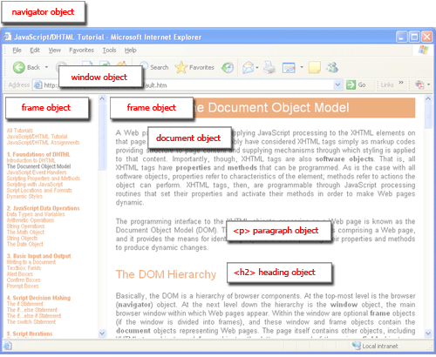
Browser and Document Structure
W3C standard differs from models supported in existing browsers

Slide 16
Reading Properties with JavaScript
Sample script
Example 1 returns "ul"
Example 2 returns "null"
Example 3 returns "li"
Example 4 returns "text"
A text node below the "li" which holds the actual text data as its value
Example 5 returns " Item 1 "
Sample HTML
1. document.getElementById('t1').nodeName
2. document.getElementById('t1').nodeValue
3. document.getElementById('t1').firstChild.nodeName
4. document.getElementById('t1').firstChild.firstChild.nodeName
5. document.getElementById('t1').firstChild.firstChild.nodeValue
<ul id="t1">
<li> Item 1 </li>
</ul>

Slide 17
Example 2: Page Manipulation
Operating on the browser Document Object Model (DOM)
createElement(elementName)
createTextNode(text)
appendChild(newChild)
removeChild(node)
Example: add a new list item
var list = document.getElementById('list1')
var newitem = document.createElement('li')
var newtext = document.createTextNode(text)
list.appendChild(newitem)
newitem.appendChild(newtext)

Slide 18
Example 3: Using Cookies
Create cookies:
document.cookie = "myContents=Quackit JavaScript cookie experiment; expires=Fri, 19 Oct 2007 12:00:00 UTC; path=/";
Reading cookies:
document.write(document.cookie);
Deleting cookies:
document.cookie = "myContents=Quackit JavaScript cookie experiment; expires=Fri, 14 Oct 2005 12:00:00 UTC; path=/";
Notes:
http://www.quackit.com/javascript/tutorial/javascript_cookies.cfm

Slide 19
Language Basics

Slide 20
Types
string
number
booelan
Date
arrays
objects
undefined
null
RegExp, Math, DOM

Slide 21
Logical Operators
==, !=
===, !==
>, >=, <, <=
&&, ||, !
? :

Slide 22
var
dynamic typing
types associated with values, not variables
var a = 1;
console.log(a);
a = "ciao";
console.log(a);

Slide 23
Statements
blocks
scoping: javascript does NOT have block scope
var a = 1;
{
var a = 2;
}
console.log(a);

Slide 24
Flow Control
if
switch
for
for (var i=0; i<arrayname.length; i++) {}
for (var itemkey in obj) {}
for each (var itemvalue in obj) {}
while
do

Slide 25
try catch
try … catch
throw
finally

Slide 26
Exceptions
Throw an expression of any type
throw "Error2";
throw 42;
throw {toString: function() { return "I'm an object!"; } };
Catch
try {
} catch (e if e == “FirstException") { // do something
} catch (e if e == “SecondException") { // do something else
} catch (e){ // executed if no match above
}
Reference: http://developer.mozilla.org/en/docs/
Core_JavaScript_1.5_Guide :Exception_Handling_Statements

Slide 27
Functions
recursion
functions are objects
var foo = function(a) { return a + 1; }
var a = foo;
console.log(a(1));
closures
var a = 1;
function foo() { return a; }
console.log(foo());

Slide 28
More about functions
Declarations can appear in function body
Local variables, “inner” functions
Parameter passing
By value
Value model for basic types, reference model for objects
Call can supply any number of arguments
functionname.length : # of arguments in definition
functionname.arguments.length : # args in call
“Anonymous” functions (expressions for functions)
(function (x,y) { return x+y }) (2,3);
Closures and Curried functions
function CurAdd(x){ return function(y) { return x+y } };

Slide 29
Function Examples
Anonymous functions in callbacks
setTimeout(function() { alert("done"); }, 10000)
Curried function
function CurriedAdd(x) { return function(y) { return x+y} };
g = CurriedAdd(2);
g(3)
Variable number of arguments
function sumAll() {
var total=0;
for (var i=0; i< sumAll.arguments.length; i++)
total+=sumAll.arguments[i];
return(total); }
sumAll(3,5,3,5,3,2,6)

Slide 30
Use of anonymous functions
Anonymous functions very useful for callbacks
setTimeout(function() { alert("done"); }, 10000)
// putting alert("done") in function delays evaluation until call
Simulate blocks by function definition and call
var u = { a:1, b:2 }
var v = { a:3, b:4 }
(function (x,y) {
var tempA = x.a; var tempB = x.b; // local variables
x.a = y.a; x.b = y.b;
y.a = tempA; y.b = tempB
}) (u,v)
// This works because objects are represented by references

Slide 31
Detour: lambda calculus
Expressions
x + y x + 2*y + z
Functions
λx. (x+y) λz. (x + 2*y + z)
Application
(λx. (x+y)) (3) = 3 + y
(λz. (x + 2*y + z))(5) = x + 2*y + 5

Slide 32
Higher-Order Functions
Given function f, return function f ° f
λf. λx. f (f x)
How does this work?
(λf. λx. f (f x)) (λy. y+1)
= λx. (λy. y+1) ((λy. y+1) x)
= λx. (λy. y+1) (x+1)
= λx. (x+1)+1
In pure lambda calculus, same result if step 2 is altered.

Slide 33
Full Lexical Closures
Lambda calculus Y combinator
function Y(f) {
return function(x) { return x(x); }(
function(x) {return f(function(v) {
return x(x)(v);
});
});
}
fact = Y(function(f) {
return function(n) {
return (n == 0) ? 1 : n * f(n-1);
}
});
fact(5); => 120
Y = λf. (λx. x x) (λx. f(λv. (x x) v)
Y f v = f(Y f) v

Slide 34
Proof
f = function(y) {
return function(n) {
return (n == 0) ? 1 : n * y(n-1); }
Y(f(x))(2) = f(Y(f(x))(2) =
(2 == 0) ? 1 : 2 * Y(f(x))(2-1) =
2 * (1 == 0) ? 1 : 1 * Y(f(x))(1-1) =
2 * 1 * (0 == 0) ? 1 : 0 * Y(f(x))(0-1)
2 * 1 * 1 =
2

Slide 35
Same procedure, Lisp syntax
Given function f, return function f ° f
(lambda (f) (lambda (x) (f (f x))))
How does this work?
((lambda (f) (lambda (x) (f (f x)))) (lambda (y) (+ y 1))
= (lambda (x) ((lambda (y) (+ y 1))
((lambda (y) (+ y 1)) x))))
= (lambda (x) ((lambda (y) (+ y 1)) (+ x 1))))
= (lambda (x) (+ (+ x 1) 1))

Slide 36
Same procedure, JavaScript syntax
Given function f, return function f ° f
function (f) { return function (x) { return f(f(x)); }; }
How does this work?
function (x) { return f(f(x)); }; )
(function (y) { return y + 1; })
function (x) { return (function (y) { return y + 1; })
((function (y) { return y + 1; }) (x)); }
function (x) { return (function (y) { return y + 1; })
(x + 1); }
function (x) { return x + 1 + 1; }

Slide 37
Basic object features
Use a function to construct an object
function car(make, model, year) {
this.make = make;
this.model = model;
this.year = year;
}
Objects have prototypes, can be changed
var c = new car(“Ford”,”Taurus”,1988);
car.prototype.print = function () {
return this.year + “ “ + this.make + “ “ + this.model;}
c.print();

Slide 38
Objects (1)
several ways to create objects
var a = new Object();
var b = {};
var c = {
foo: 1,
bar:2
}
several ways to add properties
b.foo = 1;
a['foo'] =1;
properties: function are values

Slide 39
Functions as constructors
All functions can construct:
function Car(make, model) {
this.make = make, this.model = model;
}
myCar = new Car("Porsche”, "Boxster");
All functions have a prototype property:
Car.prototype.color = "black"; => default color
myCar.color; => black
old = new Car("Ford", ”T"); => black Model T
old.color = "silver"; => my override
A constructor function sets a prototype object for newly created objects, from its prototype property

Slide 40
Classes vs Prototype
Class instances are all similar:
same attributes from class definition
if class changes, old objects will not change
Prototype:
each object is independent
has its own properties
properties can be added/deleted
if prototype changes, old objects will see new properties

Slide 41
Without Prototype
var Color = function (r, g, b) { this.red = r;
this.green = g;
this.blue = b;
this.toCSS = function () { return "rgb(" + this.red + "," +
this.green + "," + this.blue + ")”;
}
}
green = new Color(0, 255, 0);
green.toCSS();
each color has its own copy of method toCSS

Slide 42
With Prototype
var Color = function (r, g, b) { this.red = r;
this.green = g;
this.blue = b; }
Color.prototype.toCSS = function () { return "rgb(" + this.red + ",”
+ this.green + "," + this.blue
+ ")"; }
green = new Color(0, 255, 0);
green.toCSS();

Slide 43
Objects (2)
functions as object constructors.. new, this
var Person = function(name) {
this.name = name;
};
var davide = new Person('Davide');
console.log(davide.name);
not classes… prototype based
Person.prototype.getName = function() {
return this.name;
};
var davide = new Person('Davide');
davide.getName();

Slide 44
Inheritance
var Person = function(name) {
this.name = name;
};
Person.prototype.getName = function() {
return this.name;
};
var Student = function(name, matricolaID) {
this.name = name;
this.matricola = matricolaID;
}
Student.prototype = new Person();
var davide = new Student('Davide', 1);
davide.getName();

Slide 45
Inspect
> console.dir(davide);
Student
matricola: 1
name: "Davide"
__proto__: Person
name: undefined
__proto__: Object
constructor: function (name)
getName: function ()
__proto__: Object

Slide 46
Object structure
objects are associative arrays
augmented with prototypes

Slide 47
> red = {"red": 255, "green": 0, "blue": 0}
> console.dir(red)
Object
blue: 0
green: 0
red: 255
__proto__: Object
__defineGetter__: function __defineGetter__()
__defineSetter__: function __defineSetter__()
__lookupGetter__: function __lookupGetter__()
__lookupSetter__: function __lookupSetter__()
constructor: function Object()
hasOwnProperty: function hasOwnProperty()
isPrototypeOf: function isPrototypeOf()
propertyIsEnumerable: function propertyIsEnumerable()
toLocaleString: function toLocaleString()
toString: function toString()
valueOf: function valueOf()
get __proto__: function get __proto__()
set __proto__: function set __proto__()
> red.hasOwnProperty(“blue”)
true

Slide 48
get/set along prototype chain
var Color = function(r, g, b) { this.red = r;
this.green = g;
this.blue = b; }
Color.prototype = {bits: 24};
green = new Color(0, 255, 0);
get: up chain until match
set: always immediate object
shadowing if names match

Slide 49
Modifying vs Setting Prototype
how do these differ?
Color.prototype.bits = 24;
Color.prototype = {bits: 24};
need to track sharing between object and constructor
> red = new Color(255, 0, 0)
Color
> Color.prototype = {bits: 24}
Object
> green = new Color(0, 255, 0)
Color
> Color.prototype.space = "RGB"
"RGB"
> red.bits
undefined
> green.bits
24
> red.space
undefined
> green.space
"RGB"

Slide 50
Object.create
var tim = {
name: "Tim Caswell",
age: 28,
isProgrammer: true,
likesJavaScript: true
}
// Create a child object
var jack = Object.create(tim);
// Override some properties locally
jack.name = "Jack Caswell";
jack.age = 4;
// Look up stuff through the prototype chain
jack.likesJavaScript;

Slide 51
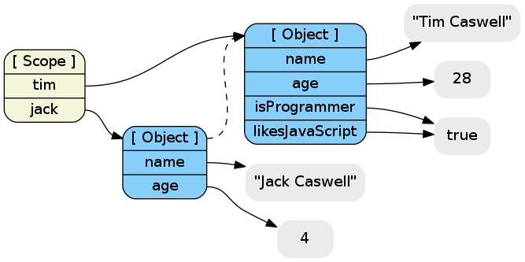
New object’s prototype is old one

Slide 52
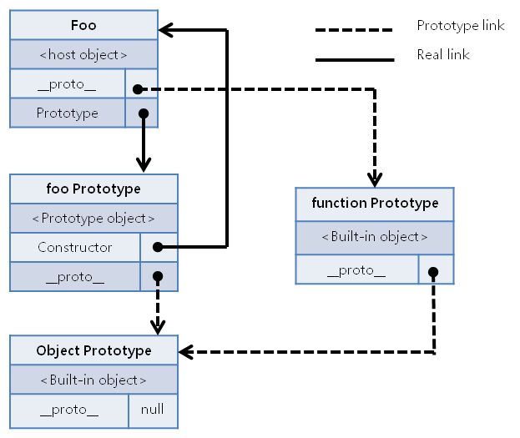
Prototype Chain

Slide 53
ES2015 Classes
Sugar for prototype based OO pattern
class Point {
constructor(x, y) {
this.x = x;
this.y = y;
}
toString() {
return '(' + this.x + ', ' + this.y + ')’; }
}
class ColorPoint extends Point {
constructor(x, y, color) {
super(x, y);
this.color = color;
}
toString() {
return super.toString() + ' in ' + this.color; }
}
}

Slide 54
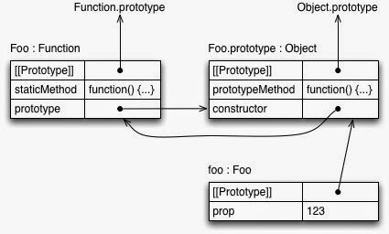
Method Kinds
class Foo {
constructor(prop) { this.prop = prop; }
static staticMethod() { return 'classy’; }
prototypeMethod() { return 'prototypical‘; }
let foo = new Foo(123);

Slide 55
JavaScript Functions and this
var x = 5; var y = 5;
function f() { return this.x + y; }
var o1 = {x : 10}
var o2 = {x : 20}
o1.g = f; o2.g = f;
o1.g()
15
o2.g()
25
Both o1.g and o2.g refer to the same function object
Why are the results for o1.g() and o2.g() different ?

Slide 56
More about this
Property of the activation object for function call
In most cases, this points to the object which has the function as a property (or method).
Example:
var o = {x : 10, f : function() { return this.x }}
o.f();
10
this is resolved dynamically when the method is executed

Slide 57
Special treatment for nested methods
x = 3;
var o = { x: 10,
f : function() {
function g() { return this.x } ;
return g();
}
};
o.f()
3
Function g gets the global object as its this property!

Slide 58
Function.prototype.bind
Problem:
var myObj = {
myMethod: function () { },
callback: function (cb) {
cb();
},
render: function () {
this.callback(function () {
this.myMethod();
});
}
};
myObj.render();
Using this.innerFunction() raises error:
Uncaught TypeError: Object [object global] has no method ‘myMethod'

Slide 59
Solution 1
Turn this into a normal lexically scoped variable:
render: function () {
var that = this;
this.callback(function () {
that.myMethod();
});
}

Slide 60
Solution 2
bind() creates a new function that, when called, has its this keyword set to the provided value
We pass our desired context, this (which is myObj), to method bind()
When the callback function is executed, this references myObj:
render: function () {
this.callback(function () {
this.myMethod();
}.bind(this));
}

Slide 61
Language features
Stack memory management
Parameters, local variables in activation records
Garbage collection
Automatic reclamation of inaccessible memory
Closures
Function together with environment (global variables)
Exceptions
Jump to previously declared location, passing values
Object features
Dynamic lookup, Encapsulation, Subtyping, Inheritance
Concurrency
Do more than one task at a time (JavaScript is single-threaded)

Slide 62
Lexical Scope
Local variables in activation record of function
function f(x) {
var y = 3;
function g(z) { return y+z;};
return g(x);
}
var x = 1; var y = 2;
f(x) + y;
6

Slide 63
Garbage collection
Automatic reclamation of unused memory
Navigator 2: per page memory management
Reclaim memory when browser changes page
Navigator 3: reference counting
Each memory region has associated count
Count modified when pointers are changed
Reclaim memory when count reaches zero
Navigator 4: mark-and-sweep, or equivalent
Garbage collector marks reachable memory
Sweep and reclaim unreachable memory
Reference http://www.unix.org.ua/orelly/web/jscript/ch11_07.html
Discuss garbage collection in connection with Lisp

Slide 64
Closures
Return a function from function call
function f(x) {
var y = x;
return function (z){y += z; return y;}
}
var h = f(5);
h(3);
Can use this idea to define objects with “private” fields
Description of technique
http://www.crockford.com/JavaScript/private.html
http://developer.mozilla.org/en/docs/Core_JavaScript_1.5_Guide:Working_with_Closures
But there are subtleties (look for __parent__)

Slide 65
Object features
Dynamic lookup
Method depends on run-time value of object
Encapsulation
Object contains private data, public operations
Subtyping
Object of one type can be used in place of another
Inheritance
Use implementation of one kind of object to implement another kind of object

Slide 66
Concurrency
JavaScript itself is single-threaded
How can we tell if a language provides concurrency?
AJAX provides a form of concurrency
Create XMLHttpRequest object, set callback function
Call request method, which continues asynchronously
Reply from remote site executes callback function
Event waits in event queue…
Closures important for proper execution of callbacks
Another form of concurrency
use SetTimeout to do cooperative multi-tasking

Slide 67
JavaScript eval
Evaluate string as code
The eval function evaluates a string of JavaScript code, in scope of the calling code
Examples
var code = "var a = 1";
eval(code); // a is now '1‘
var obj = new Object();
obj.eval(code); // obj.a is now 1
Most common use
Efficiently deserialize a large, complicated JavaScript data structures received over network via XMLHttpRequest
What does it cost to have eval in the language?
Can you do this in C? What would it take to implement?

Slide 68
Unusual features of JavaScript
Some built-in functions
Eval, Run-time type checking functions, …
Regular expressions
Useful support of pattern matching
Add, delete methods of an object dynamically
Seen examples adding methods. Do you like this? Disadvantages?
myobj.a = 5; myobj.b = 12; delete myobj.a;
Redefine native functions and objects (incl. undefined)
Iterate over methods of an object
for (variable in object) { statements }
With statement (“considered harmful” – why??)
with (object) { statements }

Slide 69
Array
is an object, with properties and methods added to the prototype (you can add your own)
constructor
length
push()
pop()
reverse()
join()
…

Slide 70
Array Indices
Are strings:
var a = [1, 4, 9, 16]
a[0]
a['0']
a[7]
a[7] = 49
a[6]
for (i in a) { console.log(i); }

Slide 71
Extending built-ins
Array.prototype.map = function(f) {
var result = [];
this.each(function (e) {
result.push(f(e));
});
return result;
}
> [1,2,3].map(function(x) {return x * x;});
[1, 4, 9]

Slide 72
References
Brendan Eich, slides from ICFP conference talk
www.mozilla.org/js/language/ICFP-Keynote.ppt
Tutorial
http://www.w3schools.com/js/
JavaScript Guide
https://developer.mozilla.org/he/docs/Web/JavaScript/Guide
Douglas Crockford site
http://www.crockford.com/JavaScript/
http://20bits.com/2007/03/08/the-philosophy-of-JavaScript/

