Slide 1

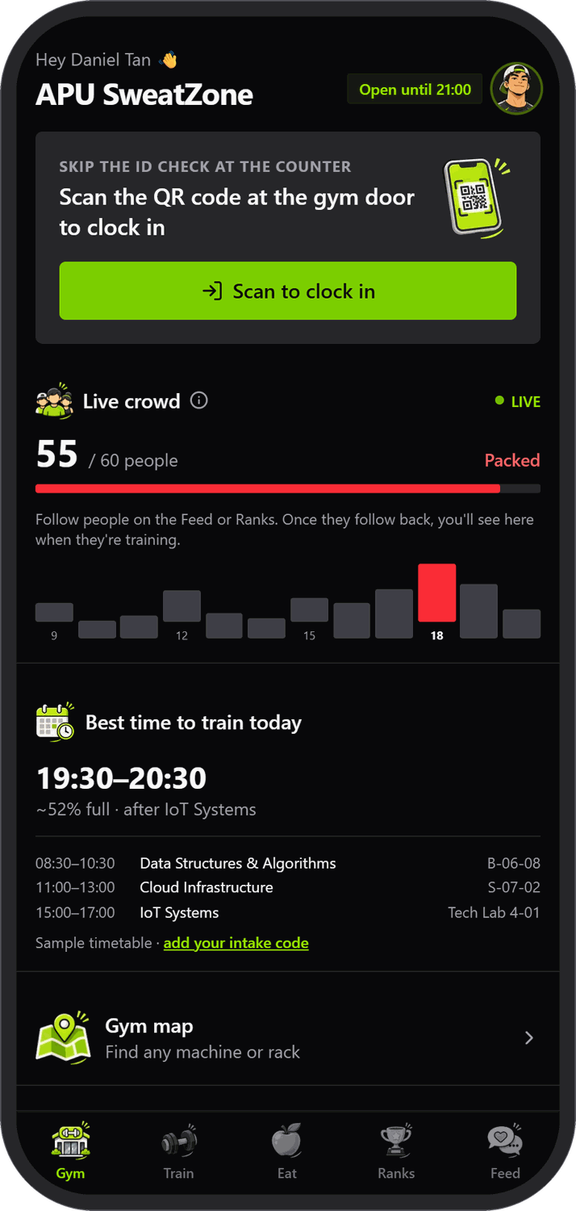
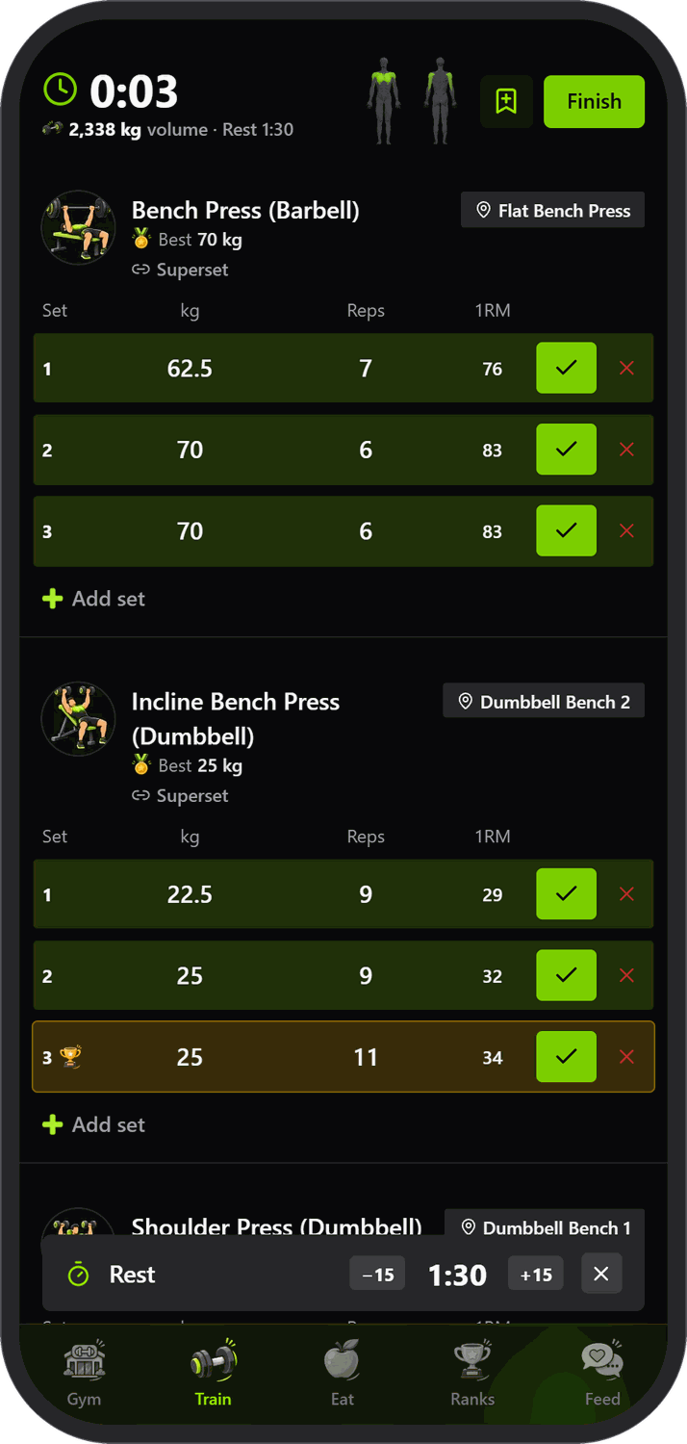
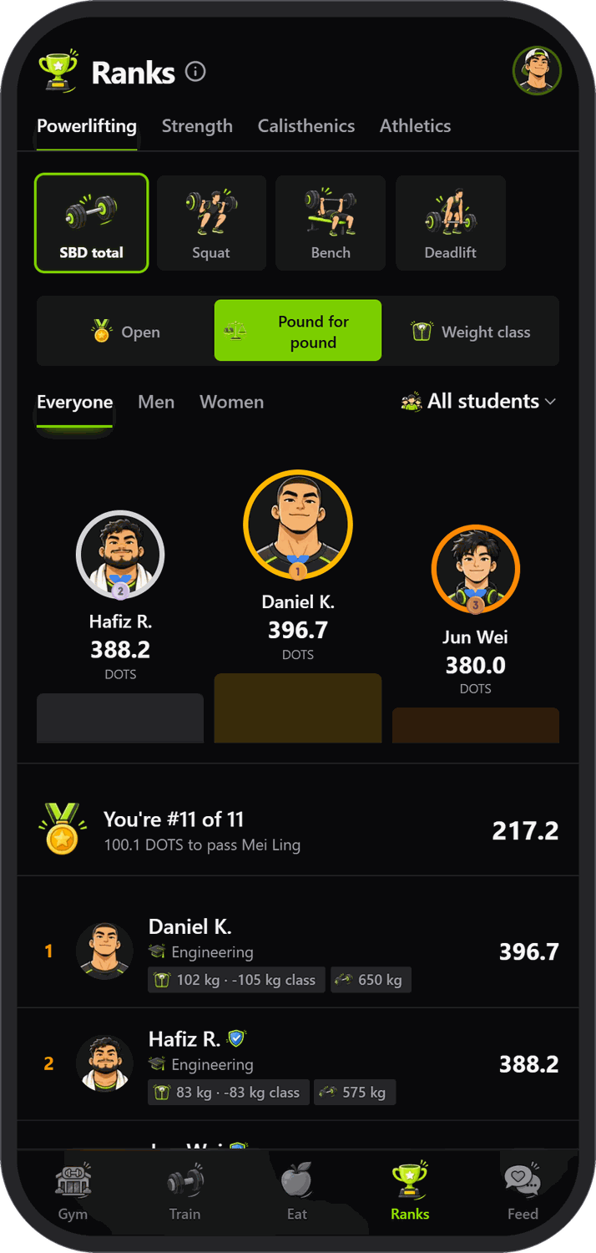
Spotter
APU CLOUD INNOVATION HACKATHON 2026
SMART CAMPUS TRACK
The APU SweatZone, connected.
Clock in with a scan, log every lift, eat smart from the campus cafeteria and climb the ranks. One app for every student at the gym.
Notes:
Spotter is the APU SweatZone gym app: one place to clock in, see how busy it is, find any machine, train, eat and rank. Built for the APU Cloud Innovation Hackathon 2026, Smart Campus track.

Slide 2




Gym life still runs on guesswork
THE GAP
Nobody knows who trains, who lifts what, or who could represent APU.
The SweatZone has no shared record of its students: no head count, no lift history, no way to spot talent.
Check-in on paper
Students queue at the counter to show an ID card.
Arriving blind
No way to know how packed the SweatZone is before walking over.
Lifts in a notebook
Routines, PRs and progress live in notes apps and memory.
Calories by guesswork
Cafeteria dishes have no macros, so eating for a goal is a guess.
Notes:
Before Spotter: you queue to show an ID at the counter, walk over without knowing how busy it is, keep lifts in a notebook, and guess at the calories in a cafeteria meal. And APU has no record of any of it.

Slide 3
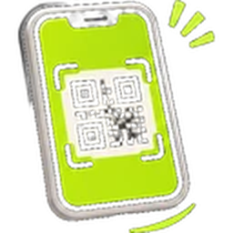

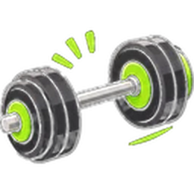



From the door to your last set
Clock in with a scan
The door QR replaces the ID check
Live crowd
Head count and the quietest hour
3D gym map
Find any machine in the SweatZone
Train
Routines, sets, rest timer and PRs
Muscles hit
A 3D body model of what you trained
Eat smart
43 APU cafeteria dishes with macros
Ranks
13 events, DOTS and weight classes
Social feed
Share, like, comment and follow
Notes:
Eight things in one app: clock in, live crowd, the 3D map, training, the muscle model, the cafeteria, ranks and the social feed.

Slide 4
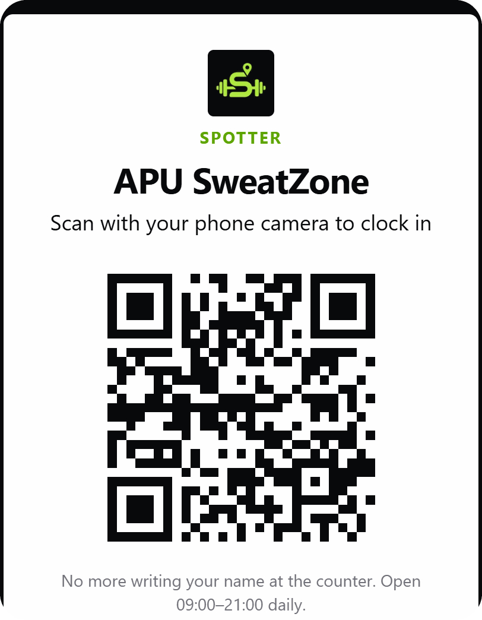
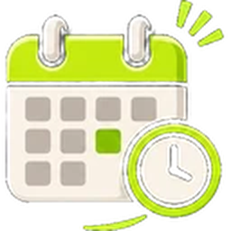
Clock in with a scan
Scan the door QR
A poster on the SweatZone door; one scan clocks you in. No more ID check at the counter.
A live head count
Every clock-in and clock-out feeds a live count out of 60 people.
Opening hours built in
Shows Open until 21:00, or when it opens, so nobody walks over to a closed gym.
Notes:
The door poster has a QR code. Scanning it opens the check-in page and clocks the student in. That replaces showing an ID at the counter, and gives the gym a live head count out of its 60-person capacity.

Slide 5
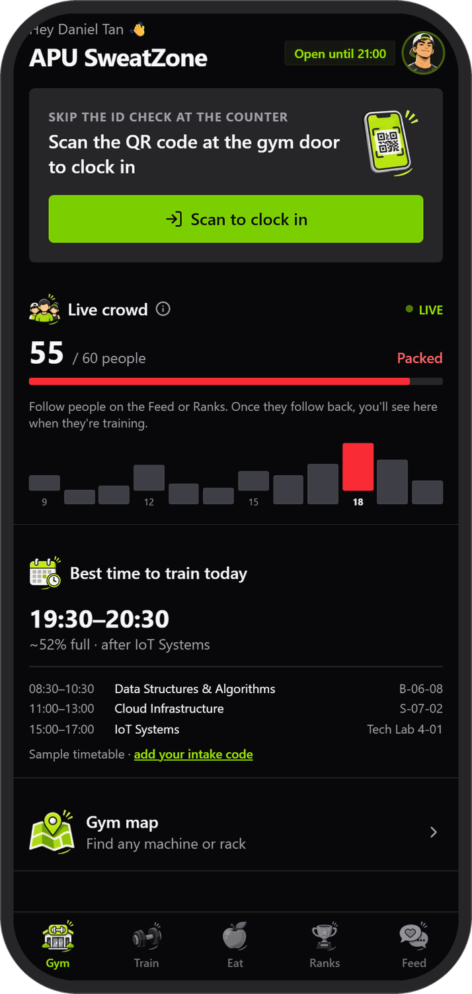
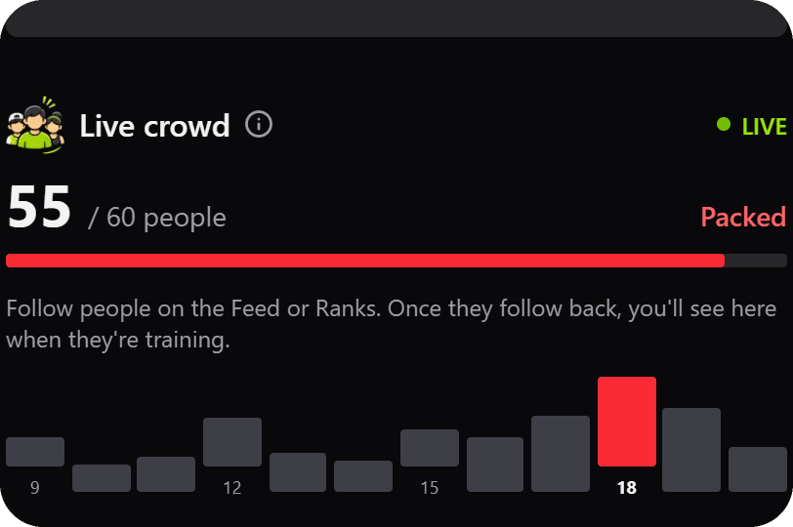

Know how busy it is, and when to go
Live crowd
A running count out of 60 and an hourly chart, labelled Quiet, Busy or Packed.
Best time to train
Picks the quietest free hour between your classes, from APU's public timetable feed.
Just add your intake code
Your classes and rooms appear on the home screen next to the free slot.
Notes:
The home screen shows the live crowd and an hourly chart. 'Best time to train' looks at your own timetable, using APU's public timetable feed and your intake code, and finds the quietest hour that is free.

Slide 6
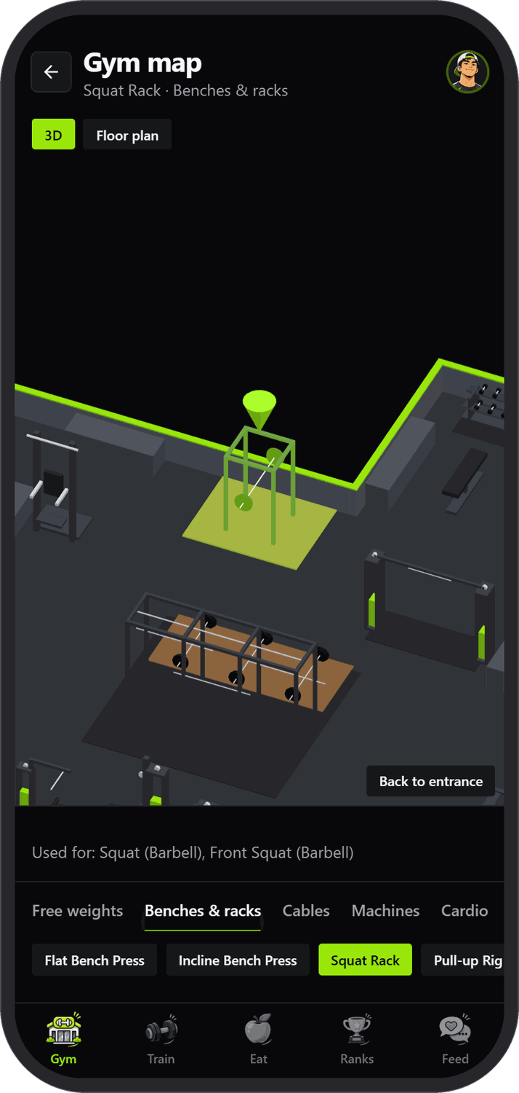
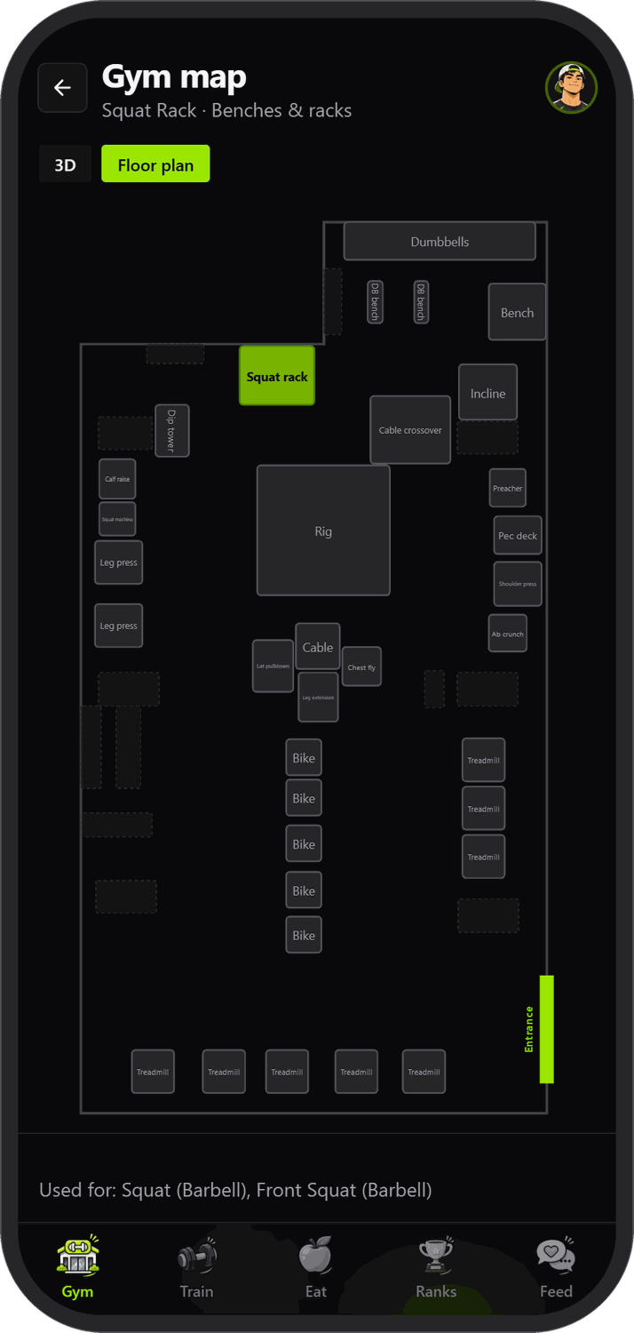


Find any machine on a 3D map
The whole SweatZone in 3D
All 34 machines, racks and benches, modelled in Blender and placed where they stand.
Tap or pick a machine
Choose by zone (free weights, racks, cables, machines, cardio) and the camera glides to it.
Exercises point to machines
Every exercise shows the machine that does it, one tap from your workout.
Floor plan view
Switch to a flat plan with the entrance marked.
Notes:
The whole gym is a 3D model built in Blender from the real floor plan and used in both the website and the Android app. Tap a machine or pick one by zone and the camera glides to it. Each exercise links to the machine you need.

Slide 7
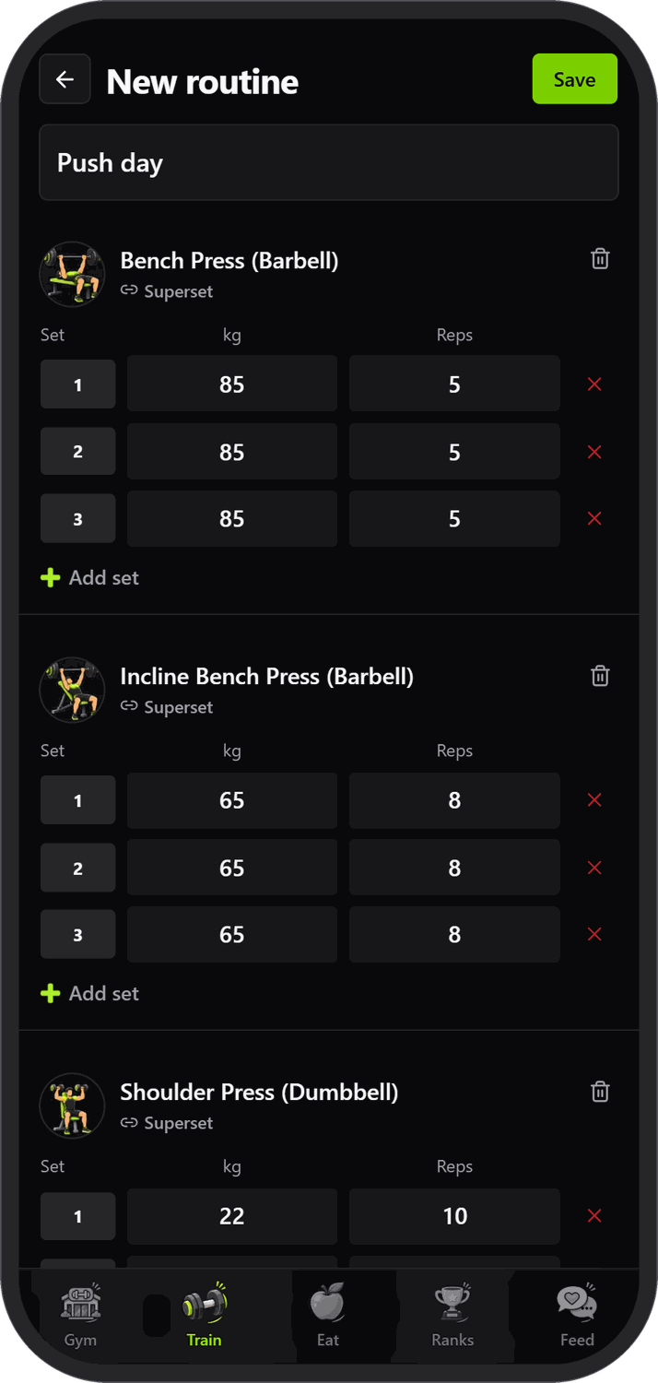
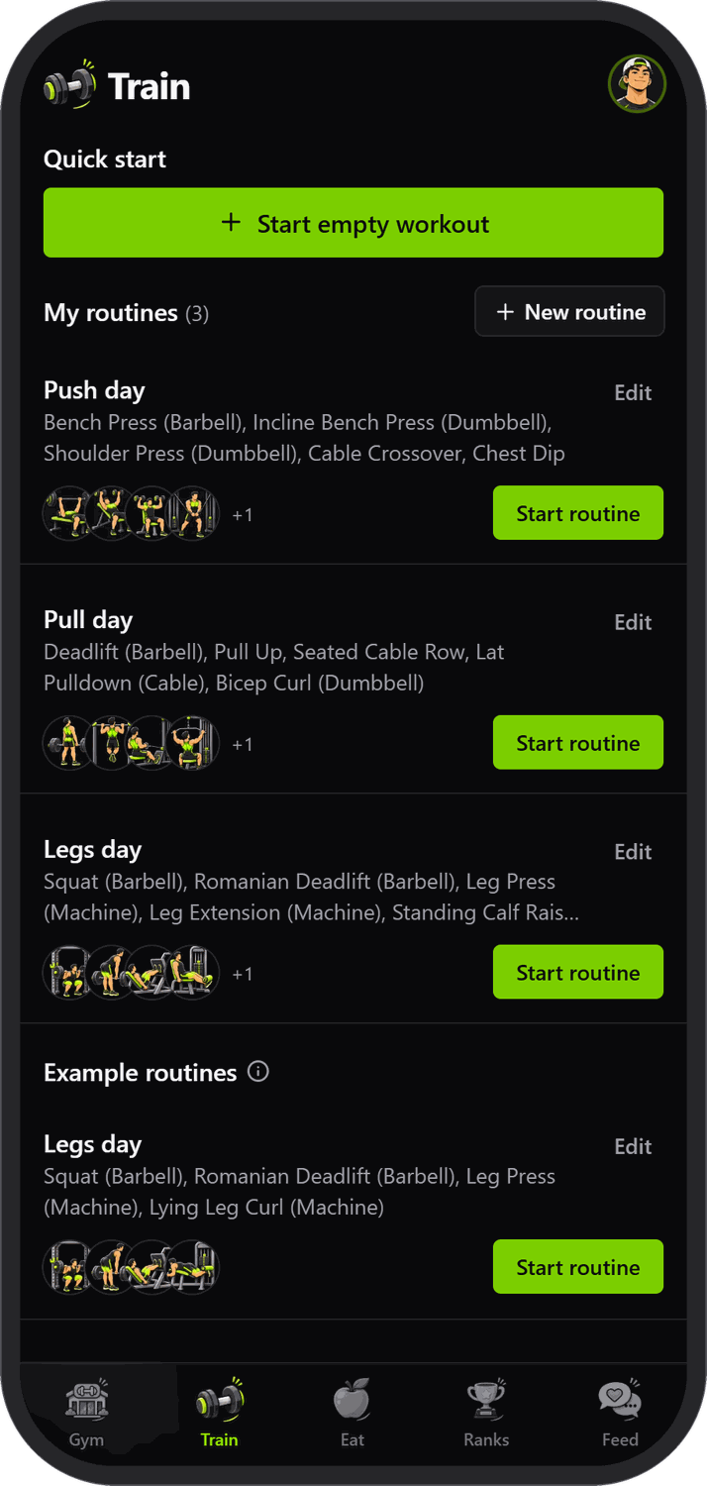
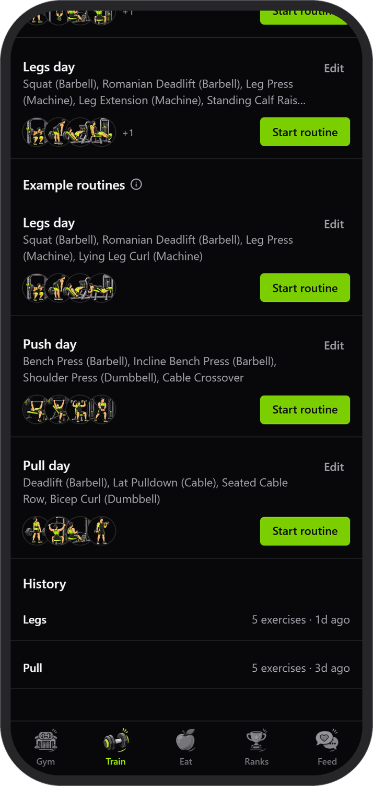

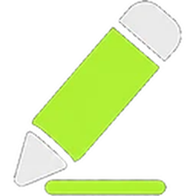
Routines that start in one tap
Quick start
Start an empty workout, or pick a routine and go.
Build your own
Add exercises, sets, weights and supersets, then save the routine.
Examples to start from
Push, Pull and Legs templates you can edit and make your own.
History
Your last two sessions at a glance; the rest lives in your profile.
Notes:
The Train tab: start an empty workout or one of your routines. Routines can be built from scratch or from the Push, Pull and Legs examples. History shows the last two sessions.

Slide 8
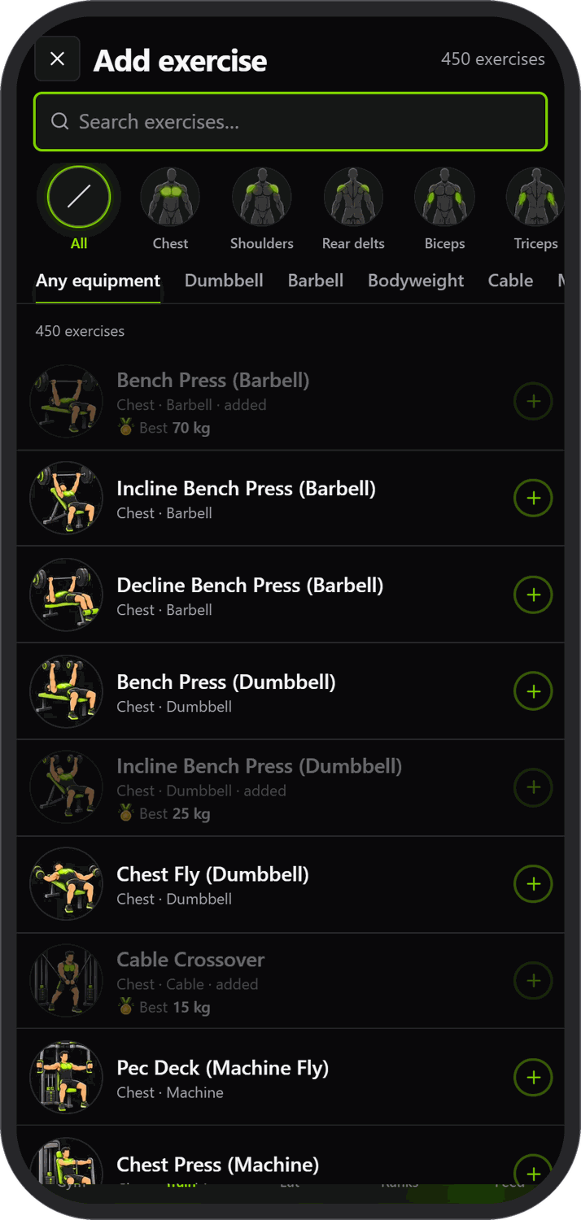

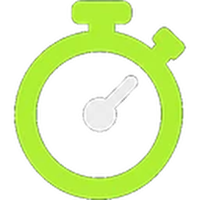



Log every set
Sets with kg, reps and 1RM
Tick a set to log it; each one shows an estimated one-rep max.
Rest timer and supersets
The timer starts when you tick a set (±15 s). Link exercises into supersets.
Seven set types
Warm-up, failure, drop set, rest-pause, deload, assisted and partial reps.
PR detection
Beat your history and a fanfare, a vibration and a gold badge celebrate it.
Finish and share
Add a title, photo or video, pick who sees it, and it posts to the feed.
Notes:
During a workout every set has kg, reps and an estimated 1RM. Ticking a set starts the rest timer. There are seven set types, supersets, and PR detection with a fanfare. Finishing lets you add a title, photo or video and share it to the feed.

Slide 9
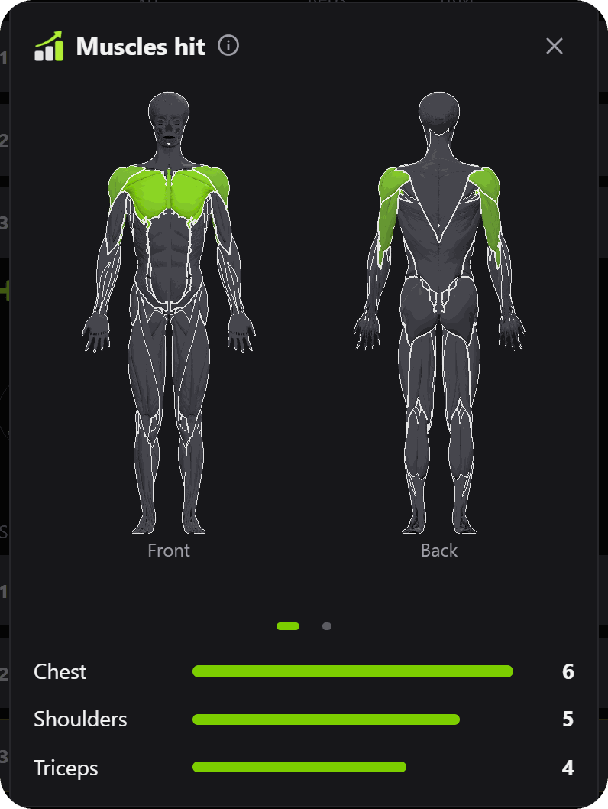
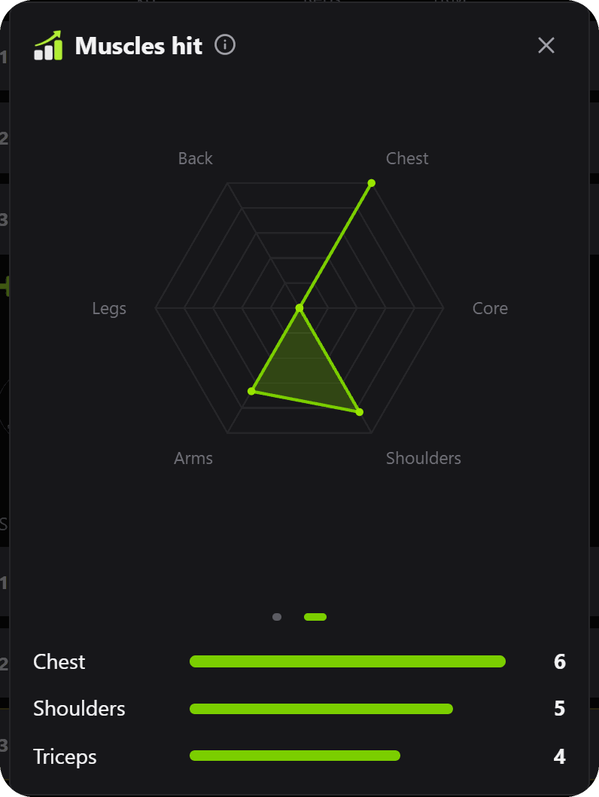
See exactly what you trained
A 3D body model
Front and back views light up the muscles you worked, brighter for more sets.
Balance radar
Swipe to a radar chart to see which areas you are neglecting.
Trends over time
Muscle distribution over a week, a month, three months or a year in your stats.
Muscles hit from a live workout: the model, then the radar
Notes:
Tap the small body in the workout header to see which muscles you have hit so far. The 3D model glows lime on the worked muscles, brighter for more sets; a radar chart shows balance. Your stats show the same over a week, month, three months or a year.

Slide 10
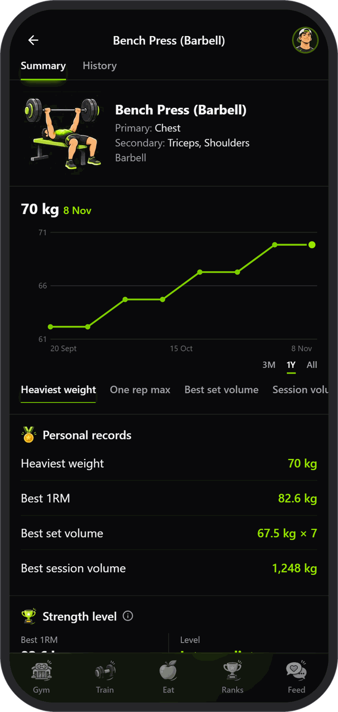
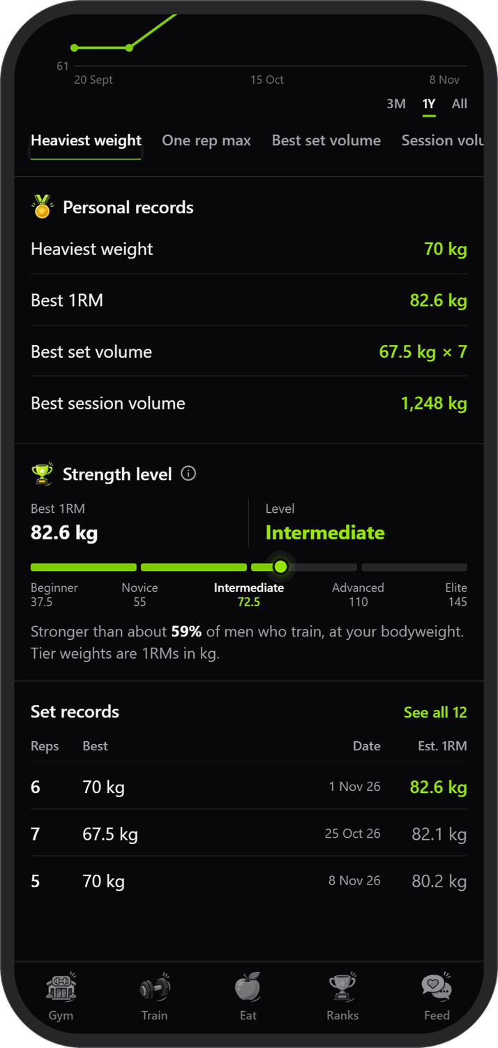



450 exercises, built from scratch
Our own dataset
Every exercise written up and illustrated for Spotter, with its primary and secondary muscles.
Filter by muscle and equipment
Search by muscle group or equipment: barbell, dumbbell, cable, machine, bodyweight.
Progress per exercise
Charts of heaviest weight, estimated 1RM and volume, plus personal and set records.
Strength level
Compares your best 1RM with your bodyweight, from Beginner to Elite.
Notes:
The exercise library is our own dataset: 450 exercises, each written up and illustrated for Spotter. Each exercise has its own page with a progress chart, personal records, set records and a strength level compared with your bodyweight.

Slide 11
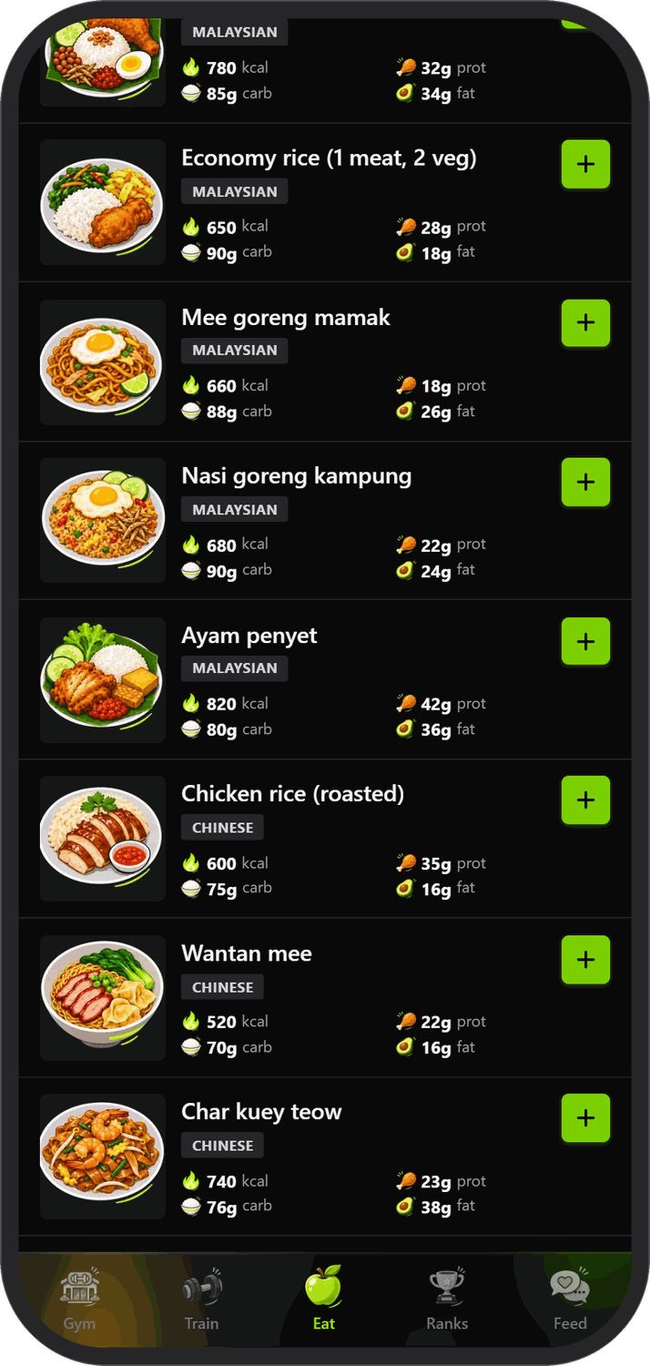
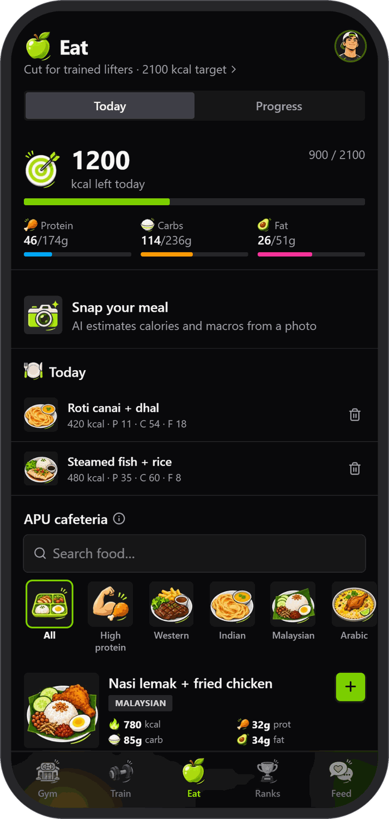
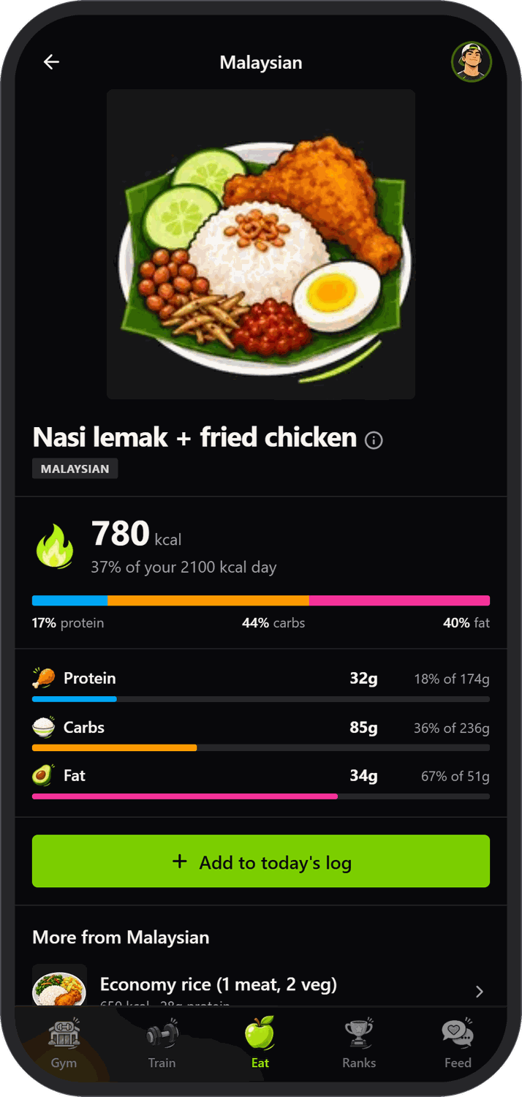


Eat smart from the APU cafeteria
43 dishes from 9 stalls
Western, Indian, Malaysian, Arabic, Japanese, Kopitiam, Chinese and Burger, with calories and macros.
Search and filter
Find a dish by name or stall, or filter for high protein.
Snap your meal
Photograph your plate and AI (Gemini) estimates the calories and macros.
One tap to log
Add it to today and watch your calories and macros fill up.
Notes:
Every dish in the APU cafeteria, from nine stalls, with calories and macros in our own food dataset. You can search, filter for high protein, or photograph your meal and let AI estimate it. One tap adds it to today.

Slide 12
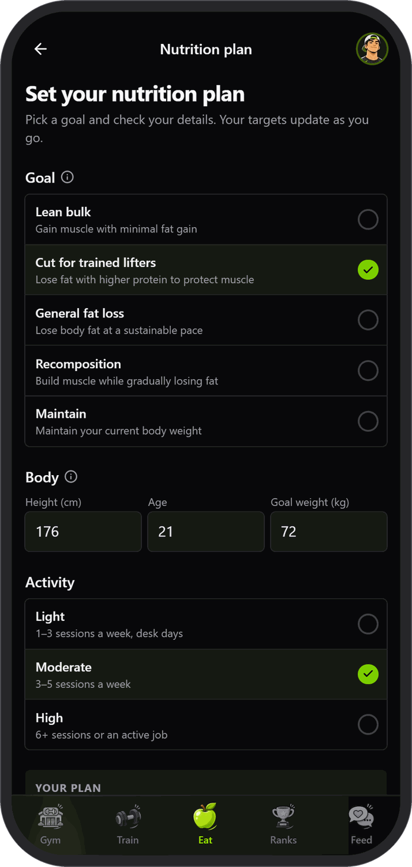
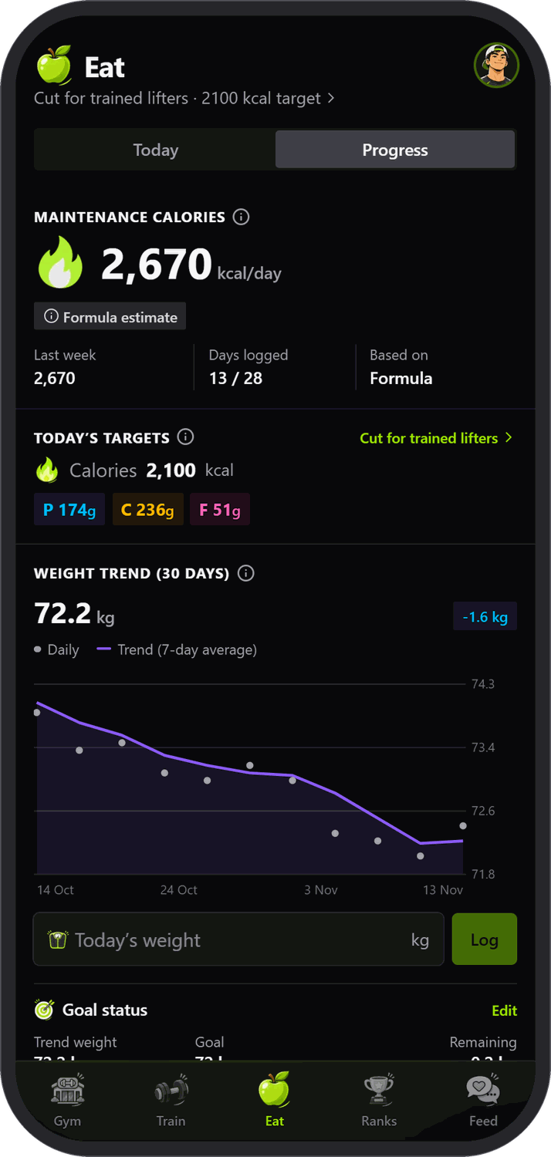
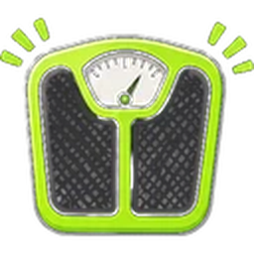

Nutrition that follows your goal
Pick your mission
Lean bulk, cut for trained lifters, general fat loss, recomposition or maintain.
Body and activity
Height, age, weight and a light, moderate or high activity level set your daily targets.
Maintenance calories
Estimated from your own food and weight logs, with a formula as the fallback.
Weight trend and goal
A daily weight log with a seven-day trend line and a goal weight.
Notes:
You choose a mission, enter your body and activity, and the app sets daily calorie and macro targets. The Progress tab estimates your maintenance calories from what you actually log, and tracks weight against your goal.

Slide 13
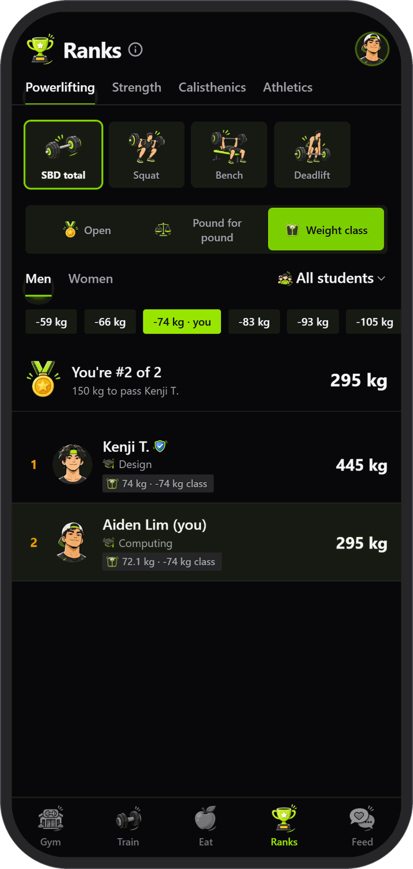
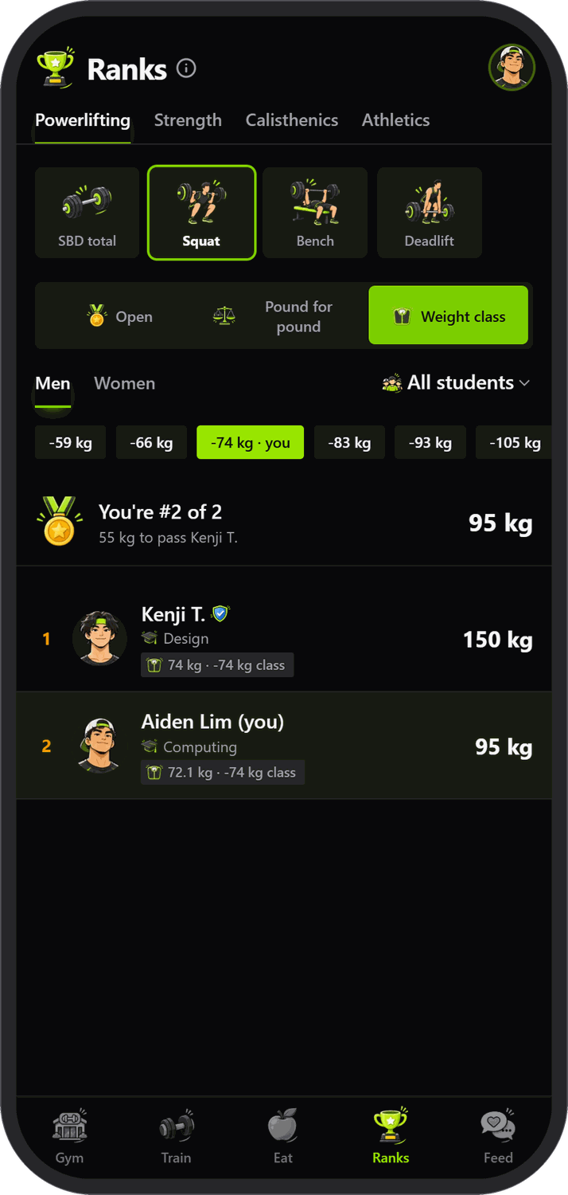
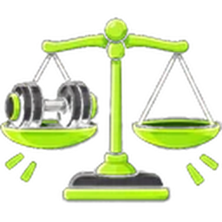

Climb the ranks
13 events
Powerlifting (squat, bench, deadlift, total), strength, calisthenics and athletics.
Fair for everyone
Rank open, pound for pound (DOTS) or by IPF weight class, men and women separately.
By faculty
Filter the board to a faculty and see who is strongest across campus.
How far to the next rank
A line like '150 kg to pass Kenji T.' shows exactly what it takes.
Notes:
Thirteen events across powerlifting, strength, calisthenics and athletics. Rank open, pound for pound using DOTS, or by IPF weight class, filter by faculty, and see exactly how far you are from the next place.

Slide 14

What APU gets from Spotter
Records of every lifter
Who trains, how often and what they lift, kept per student with their course, faculty and intake.
Competition selection
Rank by event, weight class and faculty to pick lifters for inter-university competitions.
Representation and reach
Students are seen and recognised, and APU can reach and represent more of them.
Plus a live head count of the SweatZone, for planning opening hours and equipment.
Notes:
This is what Spotter gives APU: a record of every student who trains and what they lift, a way to select lifters for competitions by event, class and faculty, and better representation and reach for students. The live head count also helps plan the facility.

Slide 15
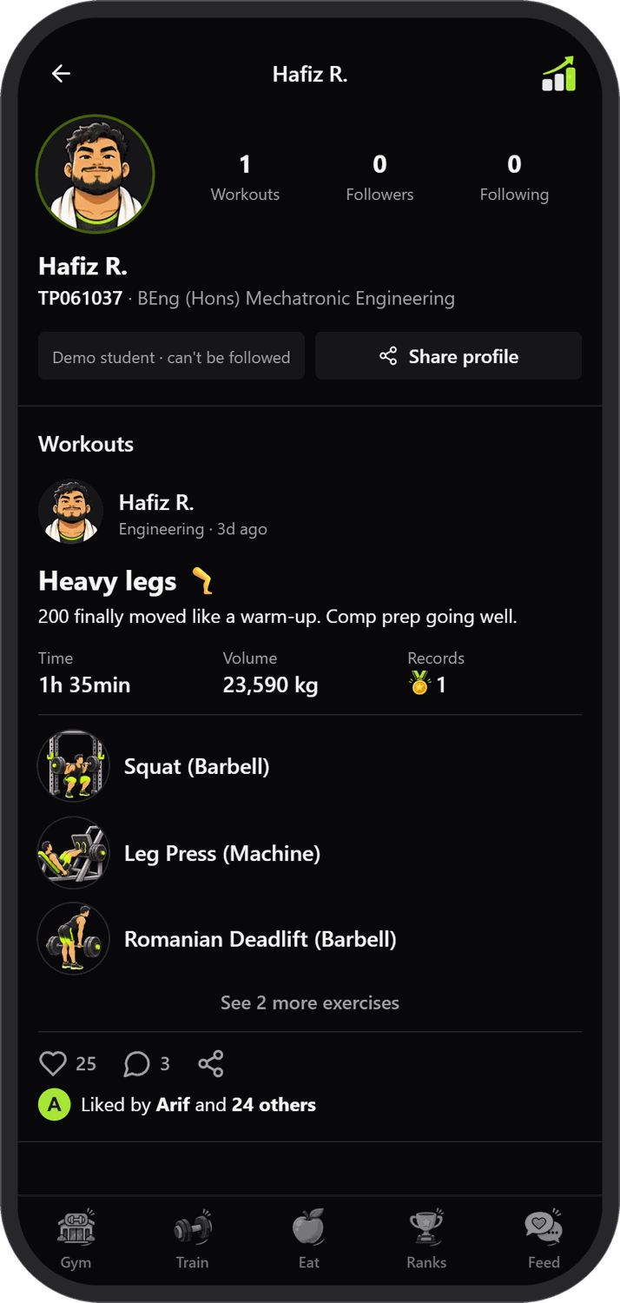
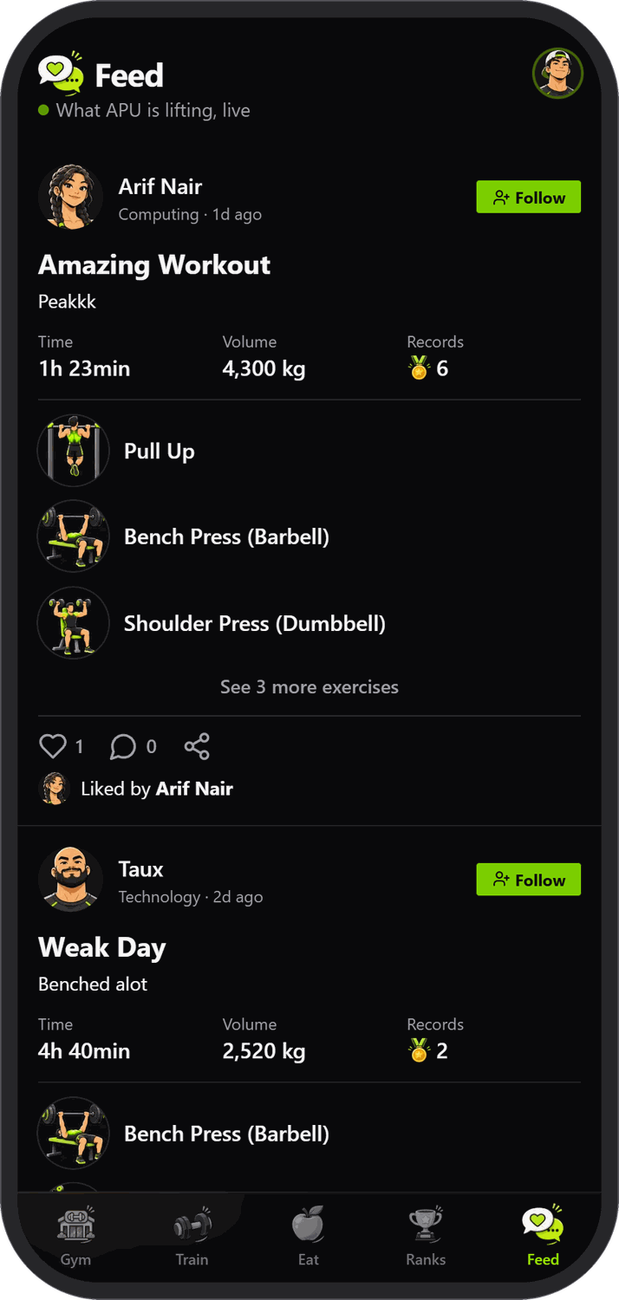
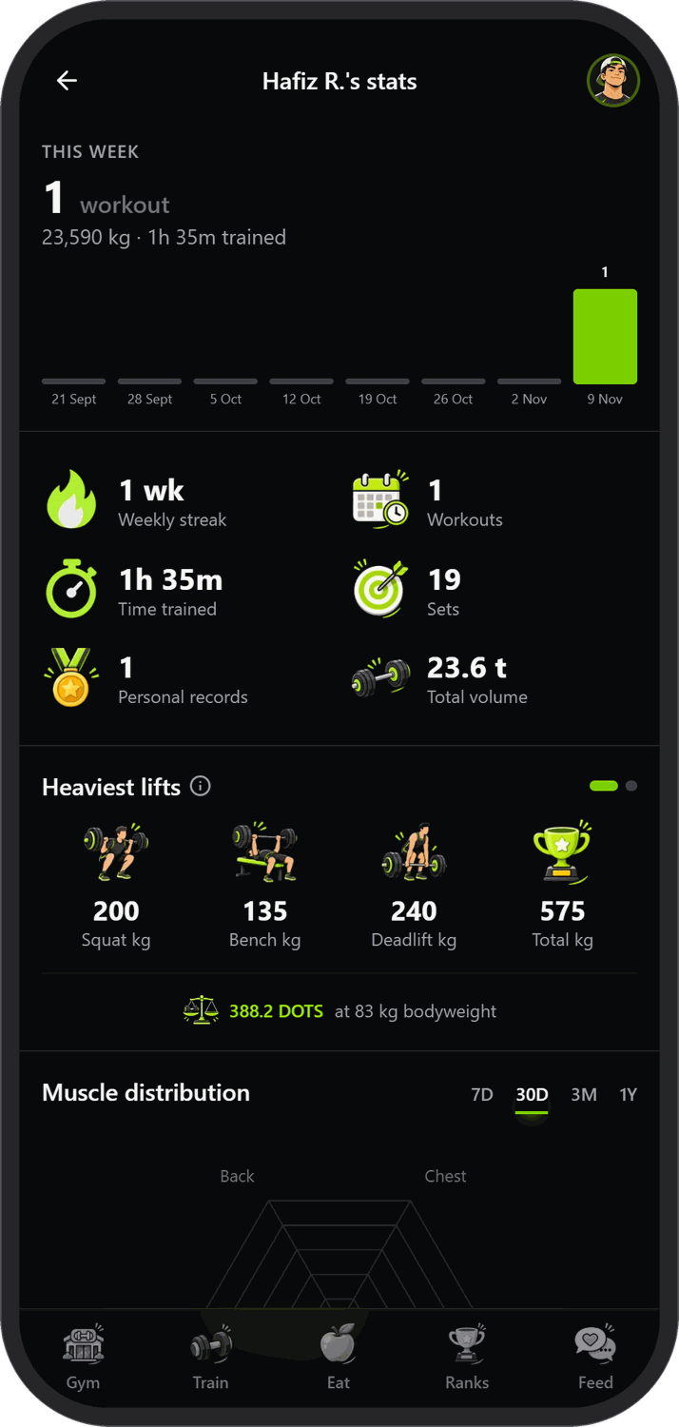

A gym with a social side
A live feed
Finished workouts post with volume, time, PR count and the exercises, as they happen.
Likes and comments
React to friends' sessions; likes and comments appear in real time.
Follow and follow back
Follow classmates; once they follow back you can see when they are training.
Profiles with real stats
Workouts, weekly streak, time trained, total volume, heaviest lifts and DOTS.
Notes:
Finished workouts are shared to a live feed with likes and comments in real time. You can follow classmates, and once they follow back you can see when they are training. Each profile shows workouts, streak, volume, heaviest lifts and DOTS.

Slide 16
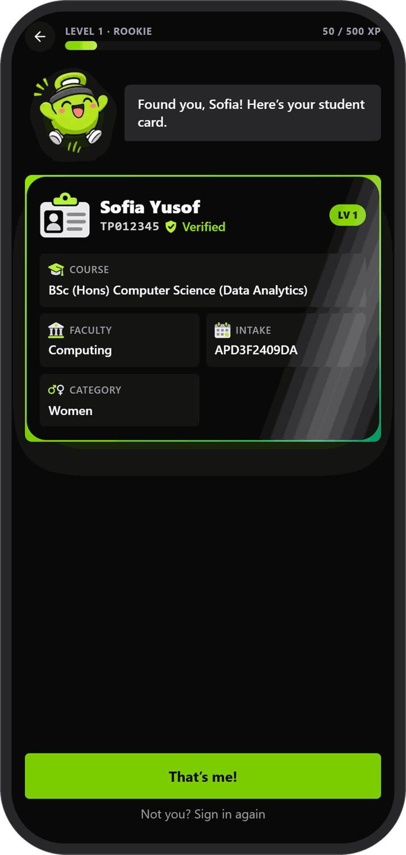
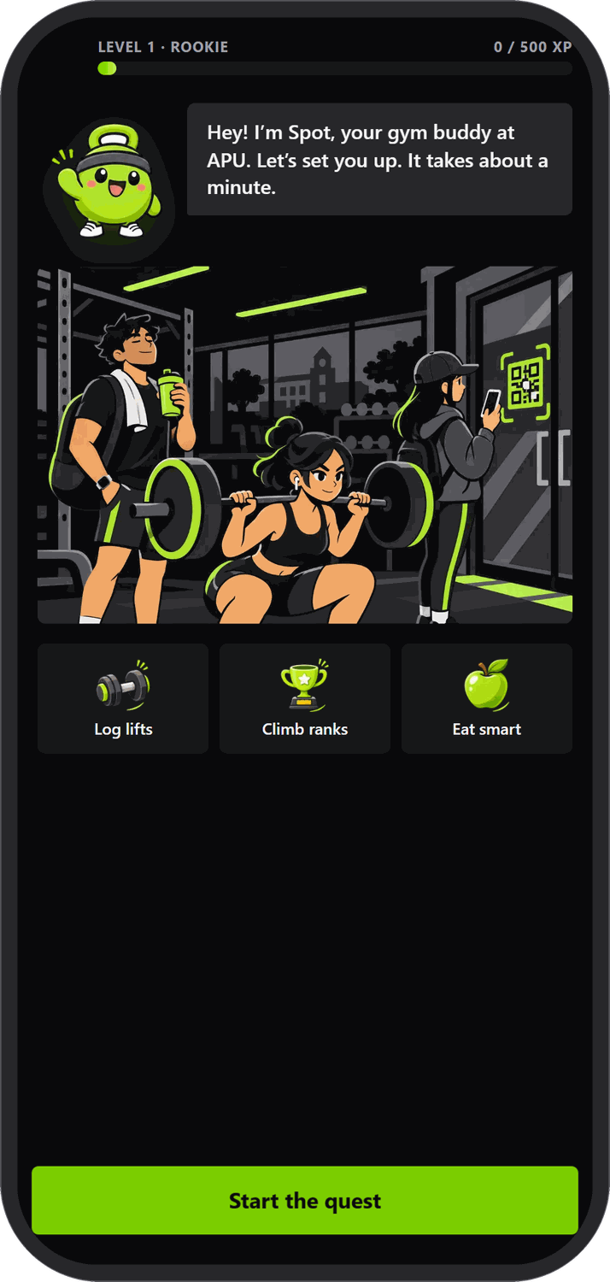
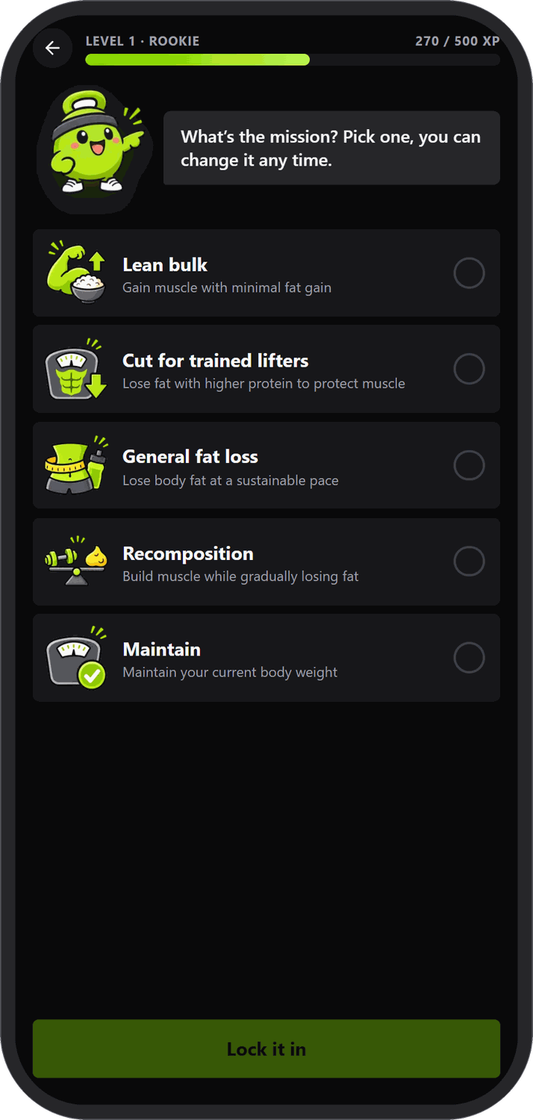

Onboarding is a quest
Spot, your gym buddy
A friendly mascot talks you through setup one step at a time, with XP for each step.
Sign in with APU
Enter your TP number and your student card appears with course, faculty and intake.
Set your mission
Body weight, PRs, goal and activity turn into a daily nutrition plan.
Change it any time
Edit your profile, units (kg or lb) and plan from Settings.
Notes:
First launch is a quest with Spot the mascot. Sign in with an APU TP number and the student card appears with course, faculty and intake, then weight, PRs, goal and activity become a daily plan. The demo build accepts any TP number and password.

Slide 17
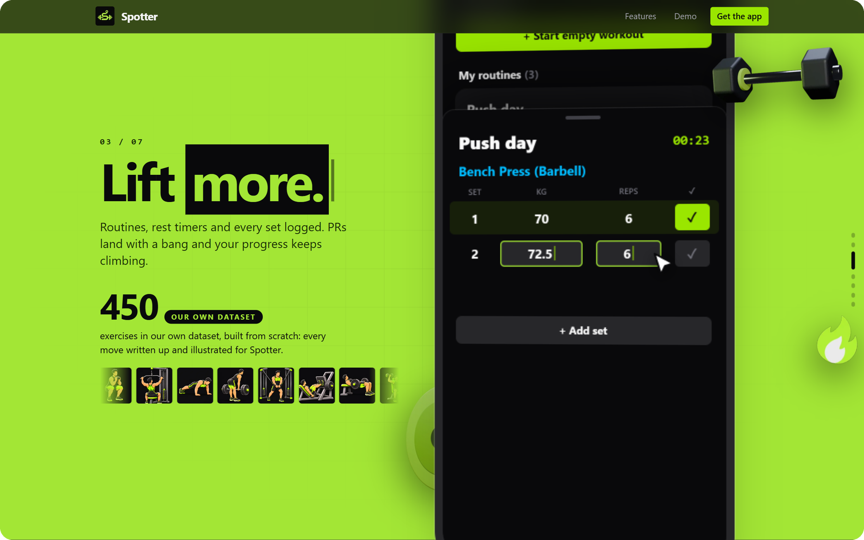

On the web and on Android
Website
A Next.js app that works in any phone browser, with a landing page and a live demo.
Android app
A native Expo app with camera QR clock-in and haptics, from the same shared logic.
Shared logic
Lifting maths, DOTS, nutrition and the 3D gym live in one TypeScript library.
Demo mode
Try the whole app on a made-up student account; nothing is saved.
Notes:
The same product ships as a website and a native Android app. They share one TypeScript library for lifting maths, DOTS, nutrition and the 3D gym. The landing page has a scroll-driven tour and a live demo on a made-up account.

Slide 18
How it is built
CLIENTS
SHARED LIBRARY
SERVICES
Website
Next.js 15 (App Router) and Tailwind v4
One TypeScript library
Lifting maths and PR rules
Strength standards, DOTS, IPF classes
Nutrition plans and targets
The 3D gym scene (three.js)
The onboarding quest
Supabase
Postgres with row-level security, anonymous auth, Realtime
Gemini
Meal photo to calories and macros
Android app
Expo and React Native, with camera QR and haptics
APU timetable feed
Public feed, looked up by intake code
Blender to glTF
The 3D SweatZone model, drawn with three.js
Notes:
Two clients, the Next.js website and the Expo Android app, share one TypeScript library with the app's logic. Supabase stores the data and powers real-time feeds; Gemini reads meal photos; the timetable comes from APU's public feed; the 3D gym is a Blender model drawn with three.js.

Slide 19
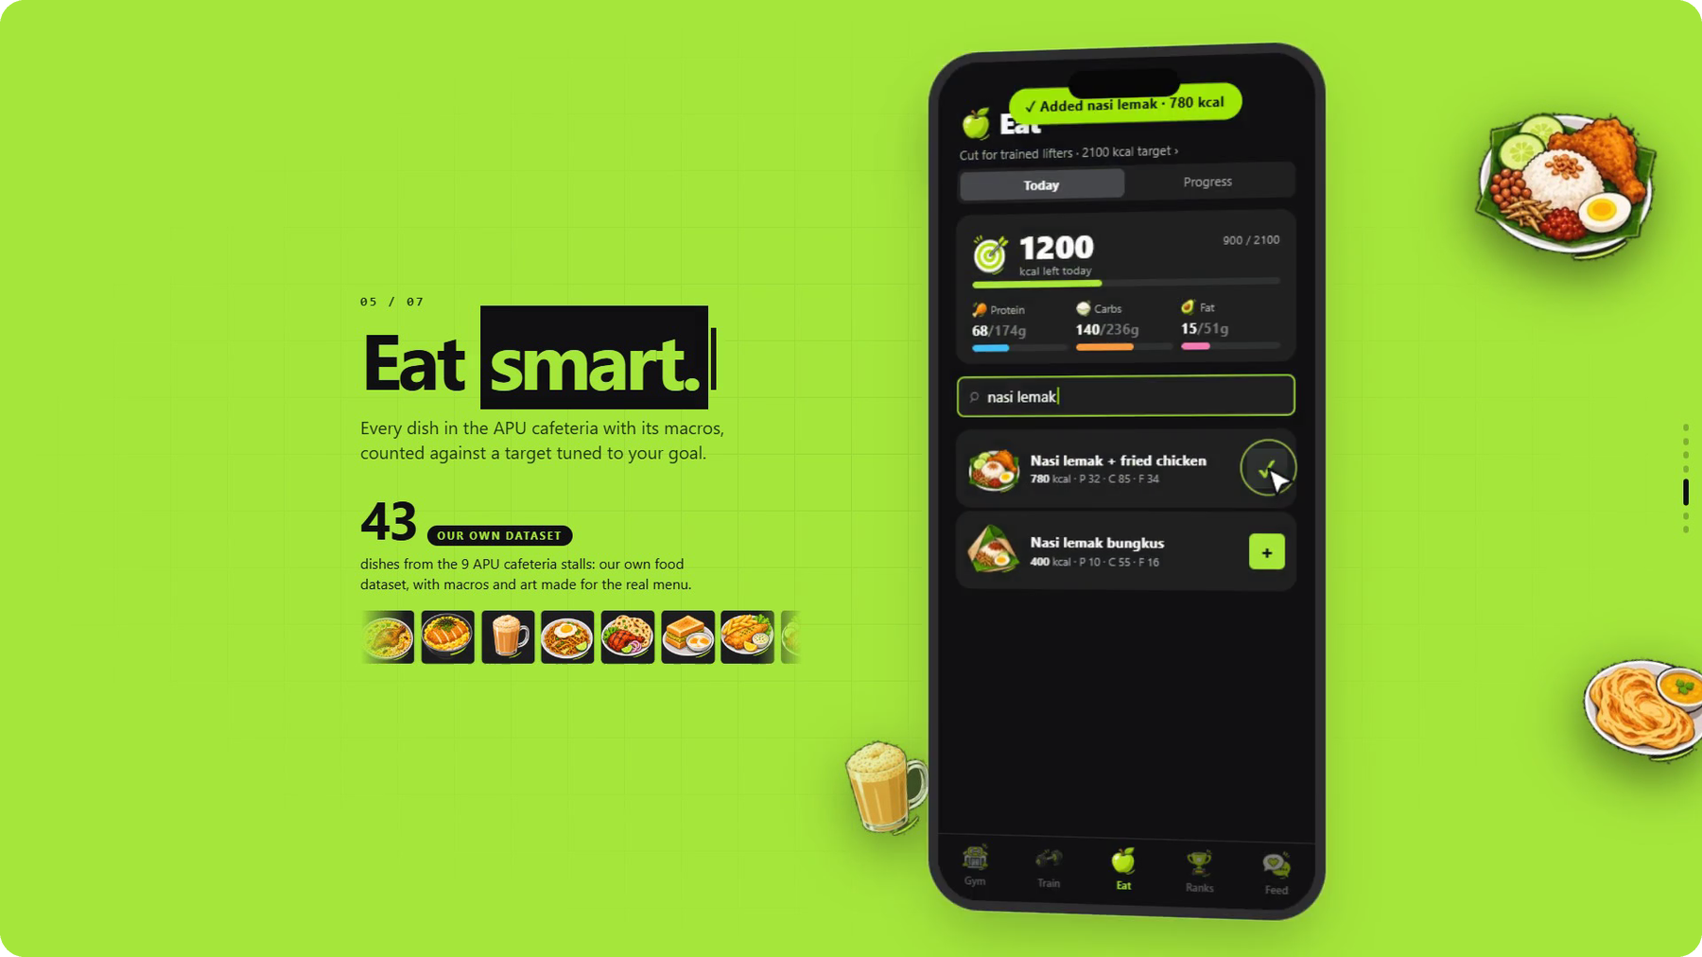
Spotter in numbers
450
exercises we wrote and illustrated
43
dishes from 9 APU cafeteria stalls
34
machines placed in the 3D gym
13
events on the leaderboards
2
platforms: website and Android
Watch the 49-second demo video
Every screen in this deck is the real app, running on a demo account.
Built for the APU Cloud Innovation Hackathon 2026, Smart Campus track
github.com/tauxhd/spotter
Notes:
Spotter in numbers: 450 exercises, 43 cafeteria dishes across nine stalls, 34 machines in the 3D gym, 13 leaderboard events and two platforms. The demo video shows the whole app in 49 seconds.

