Slide 1
CDISC ANALYSIS RESULTS STANDARDS
From Annotated Shells
to Automated TLFs
How ARS and ARD turn familiar reporting artifacts into a machine-readable,
reusable specification layer for clinical reporting automation
Annotated Shell
→
ARS JSON
→
ARD
→
Automated TLFs
Hamid Tavakoli · Clinical Reporting & Data Standards · 15-minute briefing
Notes:
Welcome. Today: how CDISC Analysis Results Standards (ARS) and Analysis Results Data (ARD) let us automate TLF production. Key framing: we start from something every team already has - the annotated shell - and end with automated, traceable outputs. The four pills are the story arc: shell (human intent), ARS JSON (machine-readable spec), ARD (structured results), automated TLFs. ~45 seconds.

Slide 2
THE PROBLEM
Why Clinical Reporting Automation Matters
The document-based workflow today
300–800
SAP + Word/Excel shells
Output-specific SAS / R code
TLFs in a single submission, delivered as static RTF / PDF
Rework after every SAP / data change
RTF / PDF drafts + manual QC
4+
manual touchpoints per output: program, validate, review, update
every update loops back — rework, re-QC, re-review
Specifications live in documents, disconnected from executable code
Reporting logic is rewritten study after study — little structured reuse
Reviewers trace numbers back to code and SAP text by hand
Every change
to the SAP or data restarts the program–QC–review cycle
Notes:
Scale the problem: hundreds of TLFs per submission, each touched multiple times by programmers, validators, statisticians. The workflow is document-based: shells in Word/Excel, output-specific code, manual QC. Any SAP or data change restarts the cycle. Point to make: this is not a talent problem, it is a metadata problem - reporting intent is locked in documents machines cannot read. ~60 seconds.

Slide 3
BACKGROUND
History and Purpose of CDISC ARS and ARD
2012–2018
2010s
Apr 2024
Feb 2025
Today
ARM v1.0
Define-XML 2.x
ARS v1.0
CDISC 360i
Pilots & tooling
Metadata about displays; no results model, uneven adoption
Describes input datasets and variables — not analysis results
Machine-readable model for analysis specs and results
“i” = implementation: standards-driven, end-to-end automation
R Consortium pilots, pharmaverse packages, FDA interest
PURPOSE
ARS standardizes how reporting specifications and analysis intent are represented — populations, methods, groupings, displays — as structured metadata. ARD standardizes the analysis results themselves: one structured record per computed value, traceable to its specification.
Notes:
Brief history: ARM v1.0 described displays but had no results model. Define-XML documents input data, not results. The gap persisted until CDISC released ARS v1.0 in April 2024 - the first machine-readable model for both the analysis plan layer and the results layer. CDISC 360i (launched Feb 2025) makes ARS central to its end-to-end automation vision. Define the two terms clearly here: ARS = the standard (specification + metadata model); ARD = the standardized results data. ~60 seconds.

Slide 4
THE GAP
Between Analysis Datasets and Final Outputs
TODAY — disconnected artifacts
ADaM
datasets
Word / Excel
shells
Manual
programming
Output-specific
code
RTF / PDF
TLFs
dashed = human interpretation at every hand-off — intent is re-read, re-typed, re-coded
WITH ARS / ARD — one structured, machine-readable chain
ADaM
datasets
ARS metadata
(reporting intent)
Automated
execution
ARD
(structured results)
TLFs +
reusable results
solid = every hand-off is data — reporting intent and results are machine-readable end to end
ARS / ARD close the gap by making reporting intent itself a data artifact — not a document.
Notes:
The gap: between clean ADaM data and final outputs sits a wall of documents - shells, specs, output-specific code. Each dashed arrow is a human re-interpreting intent. With ARS, the same chain is connected by data: ARS metadata captures reporting intent, execution produces ARD, and displays render from ARD. Closing line on the slide is the core message. ~50 seconds.

Slide 5






THE PAYOFF
Why ARS and ARD Are Worth It
Traceability
Standardization
Reproducibility
Every value links back to its dataset, method, population, and SAP reference
One model across studies, sponsors, and tools — less bespoke variation
Specification + data + method are explicit, so results can be re-derived
Reuse
Automation
Reviewability
Populations, methods, and display patterns are defined once, referenced by ID
Machine-readable specs can drive code generation and rendering
Reviewers query structured results instead of paging through PDFs
More than a technical standard: ARS is the foundation for a scalable reporting ecosystem — and a measurable reduction in repetitive programming effort.
Notes:
Six practical benefits - keep it quick, one line each. Emphasize traceability (regulators can follow any number back to spec) and reuse (define a population once, reference everywhere). Closing point: this is an ecosystem play, not just a file format. ~45 seconds.

Slide 6
THE STARTING POINT
Annotated Shells: Familiar, and Already Rich
Table 14.1.1: Demographic Characteristics
One shell already specifies:
Safety Population ADSL.SAFFL='Y'
Output identifier, title, and subtitle
Population and analysis set
Source dataset and variables
Statistics and analysis method
Grouping and display structure
Formats, footnotes, SAP references
… in short: the analysis intent
Drug A
N=XXX
Placebo
N=XXX
Age (years) ADSL.AGE
n
xxx
xxx
Mean (SD)
xx.x (xx.xx)
xx.x (xx.xx)
Median
xx.x
xx.x
Grouping: TRT01A Format: XX.X Per SAP §8.1
footnote: analysis population per protocol section 3.2
Shells capture business and reporting intent in a form clinical teams already trust.
Notes:
Ground the audience in the familiar. Walk the shell: red annotations carry population (SAFFL='Y'), variable (ADSL.AGE), grouping (TRT01A), format, SAP reference. Point: nearly everything ARS needs is already written down here - just not in a structured form. This is why shells are the right on-ramp to ARS. ~45 seconds.

Slide 7
THE MAPPING
Every Shell Concept Has an ARS Home
ANNOTATED SHELL SAYS …
… ARS / ARD REPRESENTS IT AS
Table / listing / figure ID · title & subtitle
Output · display sections
“Safety Population (SAFFL='Y')”
AnalysisSet + WhereClause
Record-level filters (e.g. RANDFL='Y')
DataSubset
Column annotation “Grouping: TRT01A”
GroupingFactor · groups
Row stats “n, Mean (SD), Median”
AnalysisMethod · operations
Dataset.variable notes “ADSL.AGE”
Analysis · dataset & variable
Formats “xx.x” · footnotes · SAP §refs
resultPattern · documentRefs
The numbers, once produced
OperationResult (ARD)
The shell is a human-readable serialization of the same concepts ARS makes machine-readable.
Notes:
This is the conceptual bridge slide. Read two or three rows aloud, not all eight: population annotation becomes an AnalysisSet with a WhereClause; the grouping annotation becomes a GroupingFactor; the row statistics become an AnalysisMethod's ordered operations; and once results exist they are OperationResults - the ARD. Message: nothing exotic is being invented; ARS names and structures what shells already say. ~60 seconds.

Slide 8


THE HONEST TRADE-OFF
Why an Additional Metadata Layer Is Still Needed
Annotated shells are readable by humans — but not by machines. End-to-end automation needs reporting intent expressed explicitly, unambiguously, and in a standard structure.
The upfront investment
The long-term return
Building study metadata takes real time and effort at first
Complex reporting requirements must be represented explicitly — no implicit conventions
The standard needs enough detail to support automated execution, not just documentation
Metadata is reused across outputs, studies, and programs — the cost amortizes fast
Traceability and consistency come for free once intent is structured
Automation scales: each new study starts from a library, not a blank page
Pay once to structure the intent — then reuse it across every output that shares it.
Notes:
Be candid: ARS adoption is not free. Authoring detailed metadata up front is slower than sketching a shell. But the comparison isn't one shell vs one JSON file - it's one reusable specification vs re-programming the same intent for every output of every study. Acknowledging the cost honestly builds credibility for the payoff argument. ~45 seconds.

Slide 9
CURRENT STATE
In Practice, ARS Metadata Lives as JSON
One file = one ReportingEvent
reporting_event.json — excerpt (simplified)
ReportingEvent · RE001
{
"analysisSets": [{
"id": "AS002",
"name": "Safety Population",
"condition": { "dataset": "ADSL",
"variable": "SAFFL", "comparator": "EQ",
"value": ["Y"] }
}],
"methods": [{ "id": "M001",
"operations": [
{ "name": "Mean", "resultPattern": "XXX.X" },
{ "name": "SD", "resultPattern": "XXX.XX" }
]}]
}
analysisSets who is analyzed
dataSubsets which records
analysisGroupings split by what
methods which statistics
analyses the runs + results (ARD)
outputs the displays
Don't lead with raw JSON. Teach the six-branch picture first — then JSON excerpts read like a table of contents, not a wall of text.
Notes:
Current state: ARS v1.0 ships as a LinkML model, and in practice a reporting event is one JSON document with six main branches. Left: the mental model. Right: a real (simplified) excerpt - an AnalysisSet with its WhereClause condition, and a method's operations with result patterns. Advice to the audience: always teach the structure visually before showing raw JSON. That's exactly what the two demos next do. ~55 seconds.

Slide 10

INTERACTIVE DEMONSTRATION
Two HTML Walkthroughs — What to Watch For
DEMO 1
DEMO 2
ars_reportingevent_structure_animation.html
demog_to_ard_animation.html
Annotated shell → the six branches of an ARS ReportingEvent, built step by step
Demographic table cells → ARD rows, one record per computed value
As the animations play, watch for:
Output metadata — IDs, titles, populations
Analysis specifications — methods, groupings
Result metadata — patterns, formatted values
Dataset & variable relationships
Structured representation of TLF requirements
Traceability: shell → metadata → output
File names are clickable when this deck sits in the project folder — or open them from the repo directly.
Notes:
Set up the demo before switching to the browser. Two HTML animations, both step-through with Play/Step controls. Demo 1 decomposes an annotated shell into the six ReportingEvent branches. Demo 2 melts a demographic table into ARD rows. Give the audience the checklist so they watch actively: metadata, specifications, results, relationships, and above all the traceability chain. ~40 seconds.

Slide 11
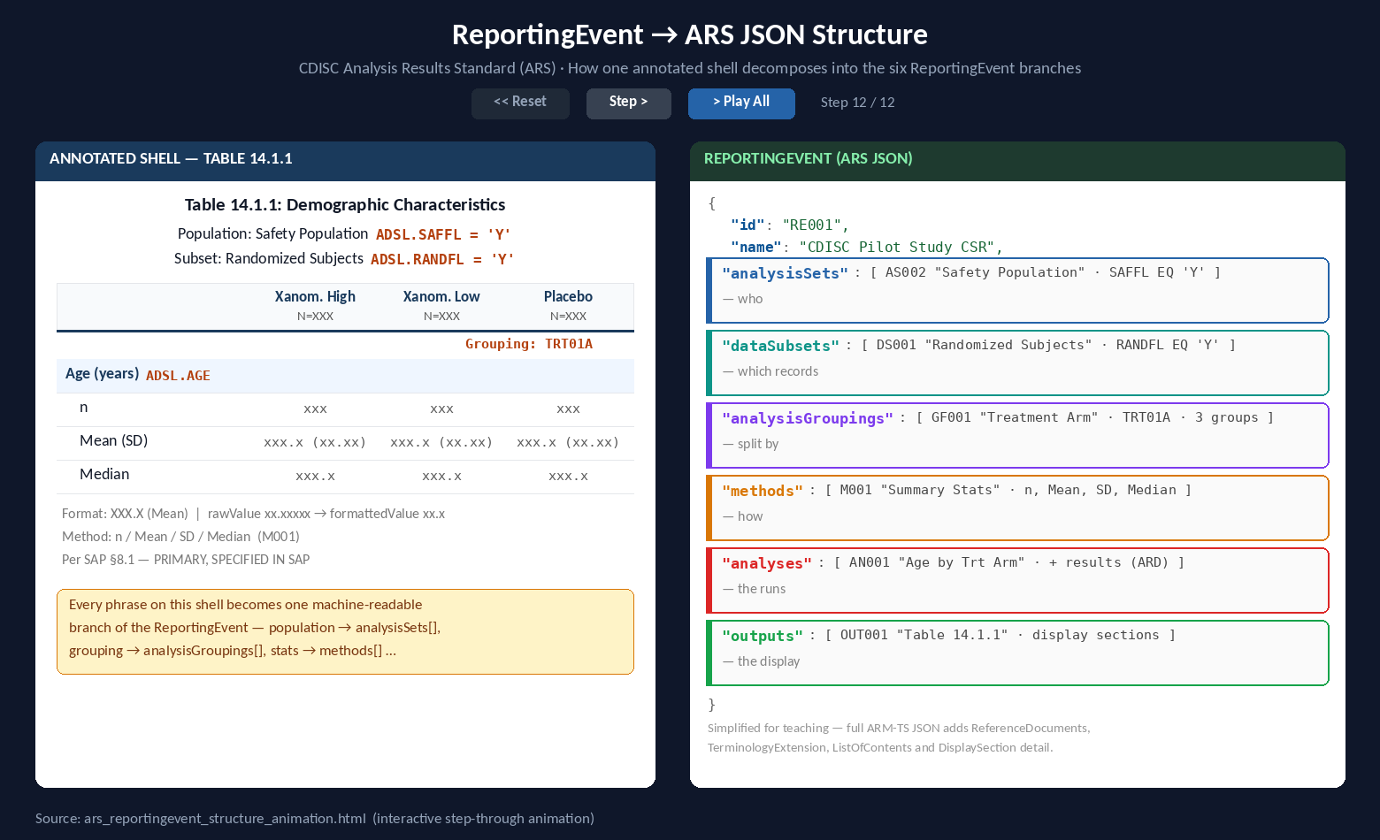
DEMO 1 Annotated Shell → ARS ReportingEvent
▶ open interactive version
Notes:
Live demo if bandwidth allows; otherwise walk this final frame. Left: the annotated shell for Table 14.1.1 with its red annotations. Right: the six branches filling in - the Safety Population becomes analysisSets[AS002], the randomized-subjects filter becomes a DataSubset, TRT01A becomes a GroupingFactor with three groups, the row statistics become method M001's operations, the analysis run lands in analyses (where ARD results nest), and Table 14.1.1 itself is outputs[OUT001]. Emphasize each JSON entry is traceable to a phrase on the shell. ~75 seconds including click-through.

Slide 12
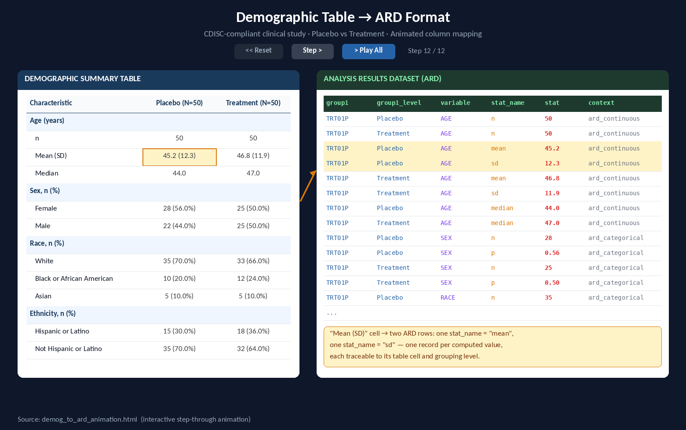
DEMO 2 Demographic Table → ARD, Cell by Cell
▶ open interactive version
Notes:
Second demo: the ARD side. Each animation step picks one cell of the demographic table and appends structured ARD rows: treatment column → group1/group1_level, row label → variable, statistic → stat_name/stat_label, the number → stat. Highlight the 'Mean (SD)' cell: one display cell = two ARD records - one record per computed value is the core ARD principle, and it is exactly the shape the {cards} package produces. ~60 seconds.

Slide 13
UNDER THE HOOD
Core Components of ARS
ReportingEvent the root: one study reporting effort, one file
Traceability & provenance
AnalysisSet
DataSubset
GroupingFactor
AnalysisMethod
documentRefs link every analysis to SAP pages
WhereClauses make filters explicit & testable
resultPattern separates raw from displayed value
IDs connect spec → execution → result → display
populations (who)
record filters (which)
arms, subgroups (split)
statistics (how)
defined once · referenced by ID
Analysis binds population + subset + grouping + method to one dataset & variable — parameters, purpose, reason, and results (ARD) nest here
Output the rendered display: file type, display sections, ordered result presentation, formatting requirements
Together these define a reportable analysis result — machine-readably, and only once.
Notes:
Architecture in four layers: the ReportingEvent root; reusable building blocks (populations, subsets, groupings, methods) that are defined once and referenced by ID; the Analysis object that binds them to a dataset and variable and holds parameters, purpose, and - once executed - the ARD results; and the Output that defines the rendered display. Right rail: the traceability machinery - document references to the SAP, explicit WhereClauses, result patterns. ~60 seconds.

Slide 14
THE RESULTS LAYER
Core Components of ARD
Annotated
Shell
ARS
Metadata
Analysis
Execution
ARD
Results
TLFs · Dashboards
Submission outputs
One record per computed value
What structured results enable
group
variable
stat_name
stat
Exchange — results move between tools and partners, no RTF re-parsing
Placebo
AGE
mean
45.2
Review — query every analysis using a population or method in seconds
Placebo
AGE
sd
12.3
Treatment
AGE
mean
46.8
Traceability — each value carries its specification lineage
+ links back to the analysis, method operation, and grouping IDs that produced it
Rendering — the same ARD feeds tables, figures, dashboards, submissions
ARS describes what should be computed; ARD is the standardized record of what was computed.
Notes:
ARD is the results layer: long-format, one record per computed value, with standard columns for group, variable, statistic name and value. In ARS v1.0 these results nest inside each Analysis as OperationResults; as a working dataset, the {cards} ARD data frame is the same idea. Walk the flow at top: shell to ARS metadata to execution to ARD to any downstream output. The one-liner at the bottom is the cleanest ARS-vs-ARD definition to leave them with. ~55 seconds.

Slide 15





REALITY CHECK
Why Adoption Is Hard — Despite the Value
JSON complexity
Limited familiarity
Spec translation
Deeply nested, ID-referenced metadata is intimidating to author by hand
ARS v1.0 is young; few teams have hands-on experience yet
Existing SAPs and shells don't convert themselves into structured metadata
Perceived upfront effort
Immature authoring tools
Cross-functional lift
The first study costs more before the reuse dividend arrives
No widely adopted editor for building and reviewing ARS metadata
Statisticians, programmers, standards and reporting teams must align
None of these are reasons to wait — they are requirements for the tooling we build next.
Notes:
Return to adoption honestly. Six barriers, and most teams hit all of them: raw JSON is hard to author; the standard is young; nobody's SAP converts itself; the first study is the expensive one; authoring tools are immature; and it takes statisticians, programmers, and standards teams moving together. Pivot line at the bottom: treat the barriers as a tooling requirements list. That sets up the rest of the talk. ~45 seconds.

Slide 16


THE CRUX
The Key Gap: Annotated Shell → ARS JSON
Annotated Shell
ARS JSON
Human-readable
Familiar to every clinical team
Flexible and quick to draft
Review-friendly for statisticians
Machine-readable
Standardized across studies
Automation- and validation-ready
Traceable by construction
?
the
gap
but machines can't execute it
but complex to author by hand
Manual translation is time-consuming, error-prone, and does not scale. The industry needs tooling that bridges the two worlds — not programmers hand-writing JSON for every output.
Notes:
This is the crux slide of the talk. Programmers are fluent in shells; automation needs ARS JSON; and today the path between them is manual. Hand-authoring nested, ID-referenced JSON for 500 outputs is not a job anyone wants, and it is where errors creep in. Frame the conclusion explicitly: the bottleneck is not the standard, it is the missing translation tooling. ~50 seconds.

Slide 17
BRIDGING THE GAP
Translation Tooling — and the arsbridge Concept
What good translation tools must do
Validation against the ARS model
Standard templates for common TLFs
Metadata reuse across outputs & studies
Visual authoring — no raw JSON required
Automated JSON generation
Review workflows clinical teams accept
{arsbridge}
an R package concept: bridge annotated shells and ARS — bidirectionally
shell_to_ars() annotated shell → ARM-TS JSON
ars_to_shell() ARS metadata → reviewable shell
parse_ars() read a ReportingEvent into R
validate_ard() check ARD results against the spec
An enabling framework — it reduces the burden of hand-authoring ARS JSON; it does not remove the need for review.
Notes:
Two beats. First: the requirements list for any serious translation tool - validation, templates, reuse, visual authoring, generated JSON, review workflows. Second: arsbridge, an R package concept designed against exactly that list: parse and summarize ARS files, convert shells to ARS JSON and back, and validate ARD against the spec. Set expectations carefully: this is an enabling approach under active development, not a finished product - humans still review the generated metadata. ~55 seconds.

Slide 18
THE AUTOMATION VISION
From ARS JSON to Generated TLF Code
Annotated
Shell
{arsbridge}
ARS
JSON
{siera}
generates R scripts
{cards}
computes ARD
Tables
Listings · Figures
{siera} — spec → programs
{cards} — data → results
Reads ARS metadata (JSON or xlsx) and auto-generates one R program per defined output — run against ADaM to produce ARDs.
CDISC-aligned ARD engine: ard_continuous(), ard_categorical() and friends produce one structured record per computed value.
Strategic point: ARS provides the standardized specification; R tools execute and render against it. When the metadata is comprehensive, a substantial share of TLF programming can be generated.
Notes:
The payoff workflow. Once a comprehensive ARS JSON exists, it becomes a reusable specification layer: siera reads the metadata and generates one R program per output; those programs call cards to compute the ARD; formatting engines render the displays. Keep expectations balanced: 'a substantial share' of TLF programming - the standard bread-and-butter outputs - not 100% of every bespoke analysis. Strategic framing: the spec is the standard; execution tools are swappable. ~60 seconds.

Slide 19
PUTTING IT TOGETHER
The End-to-End Future-State Workflow
review intent
review spec
Reporting
requirements
Annotated
Shell
Structured authoring
+ validation
ARS
JSON
SAP · protocol
reporting intent
{arsbridge}
the specification
QC + sign-off
stat review
Reviewable, reproducible
clinical outputs
Automated TLF
generation
ARD
Metadata-driven
execution
TLFs · CSR · submission
code + rendering
structured results
{siera} + {cards}
Humans stay where they add value: specification, statistical review, and quality control — the repetitive translation and programming in between is automated.
Notes:
The whole architecture on one slide, snaking left to right then back. Requirements feed shells; arsbridge turns shells into validated ARS JSON; siera and cards execute the metadata into ARD; rendering produces reviewable, reproducible outputs. Point at the amber badges: human review is designed in - at intent, at specification, at statistical review, at final QC. Automation removes retyping, not judgment. ~55 seconds.

Slide 20
FINAL TAKEAWAYS
1
ARS and ARD give clinical reporting a standardized, traceable, reusable foundation.
2
Annotated shells remain the right starting point — they already capture reporting intent in a familiar form.
3
The key adoption challenge is translating human-readable shells into machine-readable ARS JSON.
4
Tools like {arsbridge} can bridge that gap; {siera} and {cards} can then generate and compute TLF code from the metadata.
5
The goal is not to replace programmers or statisticians — it is to remove repetitive effort so teams focus on quality, interpretation, and review.
Learn more: cdisc.org/standards/foundational/analysis-results-standard · github.com/cdisc-org/analysis-results-standard · project repo: ARS_Training
Thank you — questions welcome.
Notes:
Close on the five messages, slowly. One: ARS/ARD are the standardized foundation. Two: shells stay - they are the on-ramp, not the enemy. Three: the real gap is shell-to-JSON translation. Four: arsbridge bridges it, siera and cards execute it. Five - land this one: this is about removing repetitive effort, not people. Invite questions. ~45 seconds, finishing at 15 minutes.

