Slide 1
GraphQL

Slide 2
Agenda
Introduction
Why use GraphQL
Core concepts
SDL

Slide 3
Introduction
GraphQL is a query language designed to build client applications by providing an intuitive and flexible syntax and system for describing their data requirements and interactions
GraphQL is not a programming language capable of arbitrary computation
Database agnostic

Slide 4
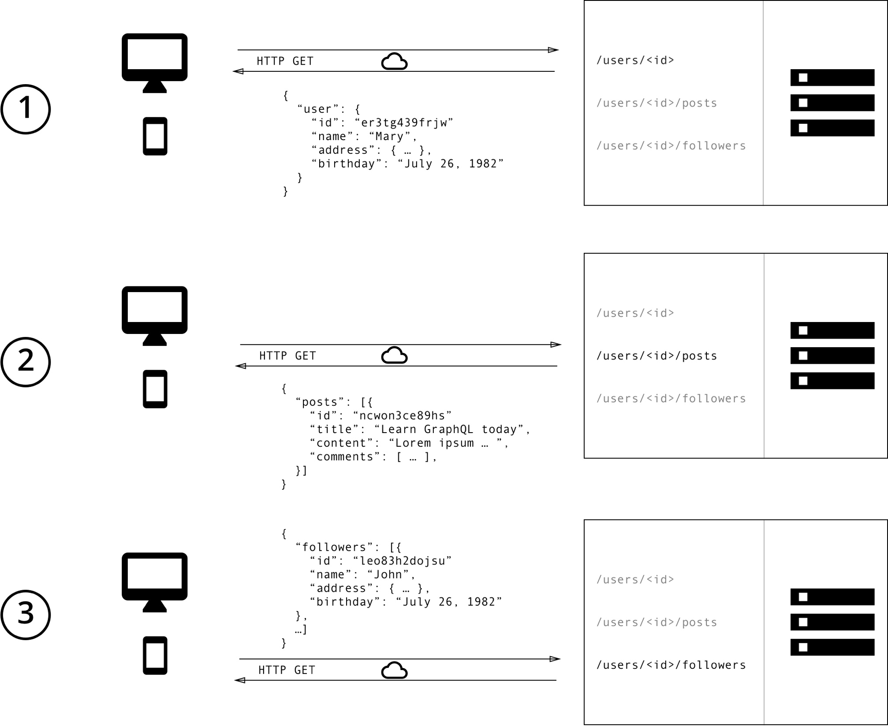
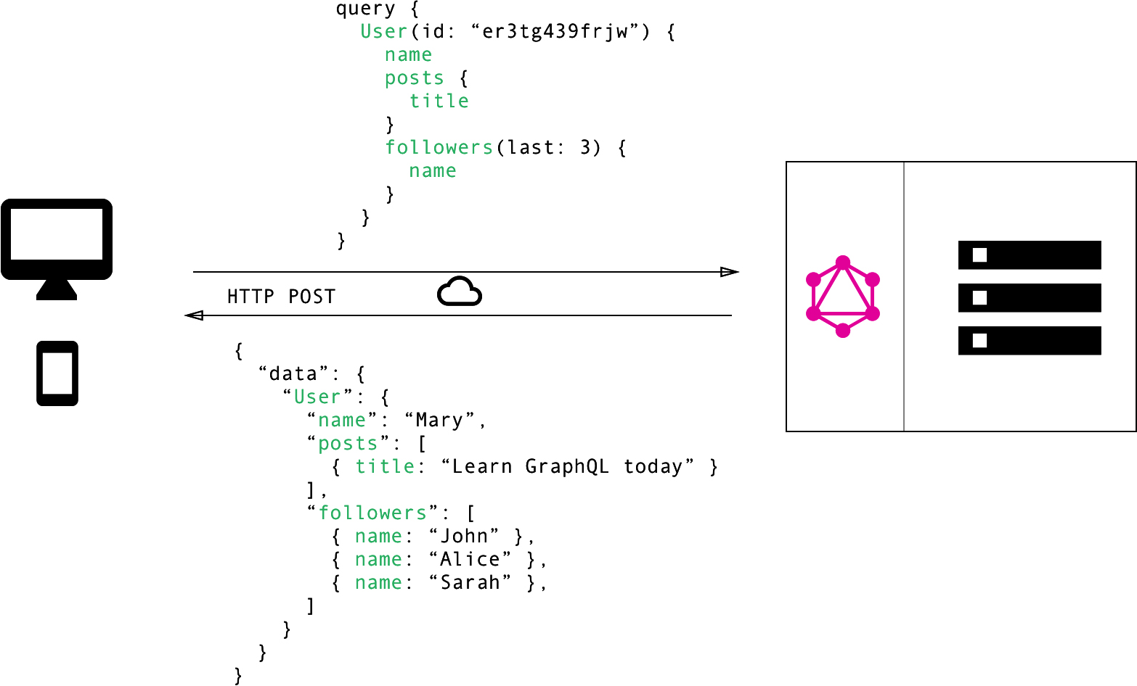
REST
GraphQL

