Slide 1

Building workflows with
Apache Taverna
Stian Soiland-Reyes
University of Manchester
Including materials by Katy Wolstencroft,
Aleksandra Pawlik, Christian Brenninkmeijer
http://orcid.org/0000-0001-9842-9718
http://orcid.org/0000-0002-2937-7819
http://orcid.org/0000-0002-1279-5133
http://orcid.org/0000-0001-8418-6735
Barcelona, 2016-10-20
http://taverna.incubator.apache.org/
This work is licensed under a
Creative Commons Attribution 4.0 International License

Slide 2
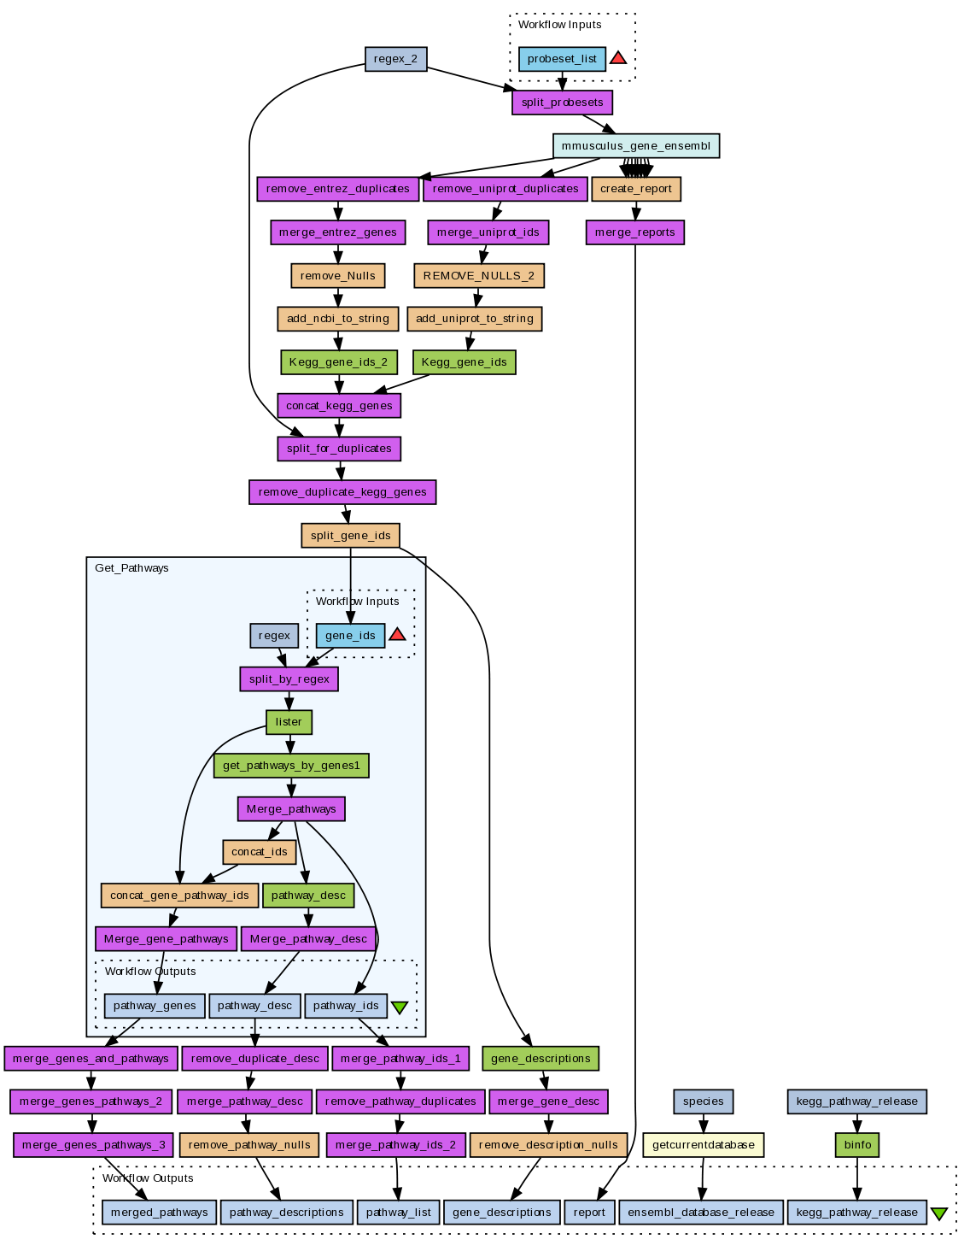
Taverna workflows
Sophisticated analysis pipeline
Graphical representation of executable analysis
Combine a set of services to analyse or manage data (local or remote)
Data flow from one service (boxes) to the next (connected with arrows)
Iteration – process multiple data items
Automation – rerun workflow

Slide 3
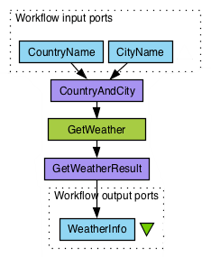
Example Taverna Workflow
Workflow: Get the weather forecast of the day given the city and the country
Green box is a Web Service
Purple boxes are local XML services to assemble/ extract XML
Blue boxes are workflow input and output ports
Arrows define the direction of data flow

Slide 4
Workflows as a solution
Flow of data from one tool to the next is automatic – just connect inputs and outputs
Incompatibilities overcome in the workflow with helper services (shims)
  Allowing new tool combinations
Workflow engine records parameter values and algorithms – provenance
Workflows can include data integration and visualization
Iteration over large data sets automatic – ideal for high throughput analysis (e.g. omics)

Slide 5
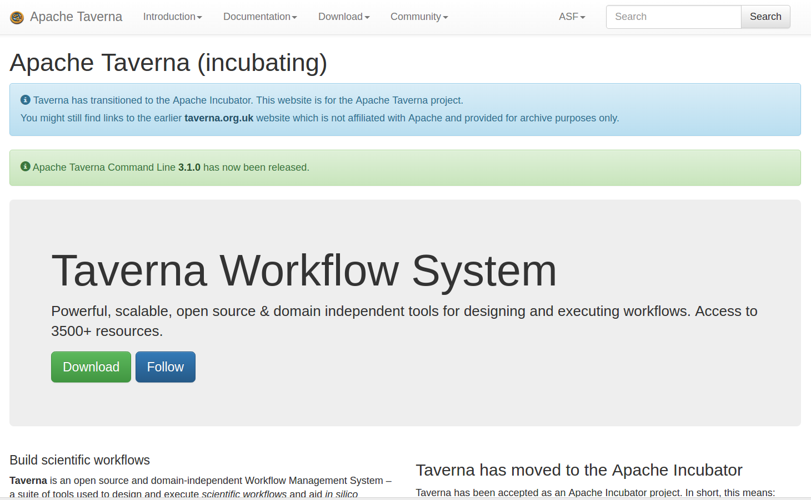
Taverna Workbench
https://taverna.incubator.apache.org/
Freely available,
open source
57,000+ downloads
(workbench 2.5.0)
Installers for Windows,
Mac OS X, Linux
Versions:
2.5.0 (workbench)
3.1.0 (command line)
2.5.4 (server)
Wolstencroft et al. (2013): The Taverna workflow suite: designing and executing
workflows of Web Services on the desktop, web or in the cloud”,
Nucleic Acids Research, 41(W1): W557-W561. doi:10.1093/nar/gkt328
Notes:
2001, run by manchester and oxford

Slide 6
Taverna Workflow System
History:
2003: Taverna 0.1
2014: Taverna 2.5.0
2016: Apache Taverna 3.1.0
Products:
Apache Taverna Command- line
Apache Taverna Engine / Language (API)
Taverna Workbench
Taverna Server
Taverna Player
Taverna Mobile
Plugins and integrations

Slide 7
Taverna editions and extensibility
Taverna is a generic workflow system that can be extended by plugins and customized for use in different domains.
The Taverna editions are pre-built downloads of Taverna with plugins for the most popular domains.
Core
Astronomy
Bioinformatics
Biodiversity
Digital Preservation
Enterprise
http://www.taverna.org.uk/download/workbench/2-5/

Slide 8
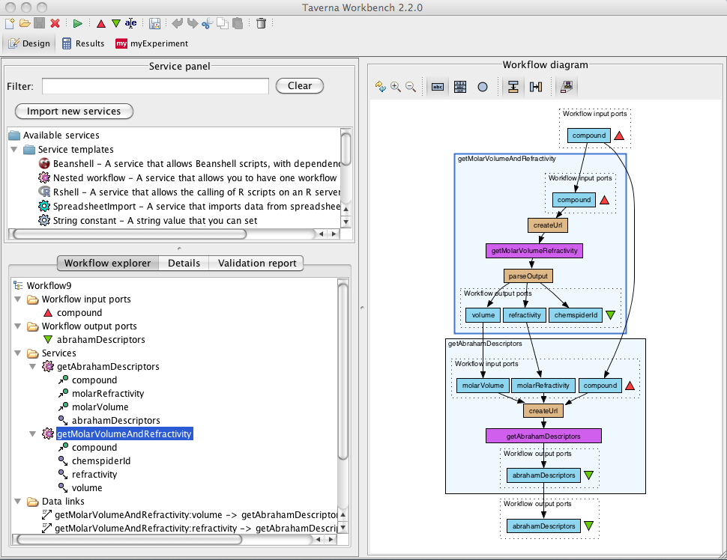
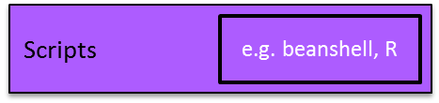
Taverna Workbench
Workflow engine
to run workflows
List of services
Construct and
visualise workflows
Web Services
e.g. KEGG
Programming
libraries
e.g. libSBML

Slide 9


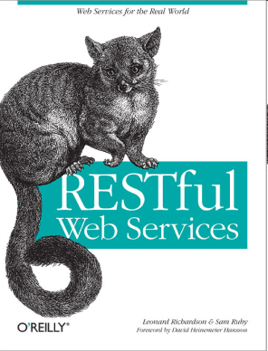
Using Tools and Services
from Taverna workflows
Web Services
  WSDL
  REST
Data services
  BioMart
Local scripts:
  R
  Beanshell
  Command line (e.g. Python, Perl)
Other workflows
And more..... Add your own!

Slide 10
Web Services
Web Services: HTTP-based programmatic access (API).
Similar to “GET me the web page http://example.com/cat-pics”,
but Web Services allow “GET me a genome sequence http://www.uniprot.org/uniprot/WAP_RAT.xml”
Use remote services (typically free) from your computer in an automated way
Not the same as services on the web (i.e. forms that shows results as a web page)
Two flavours: REST (light-weight) and SOAP (“rich”)

Slide 11
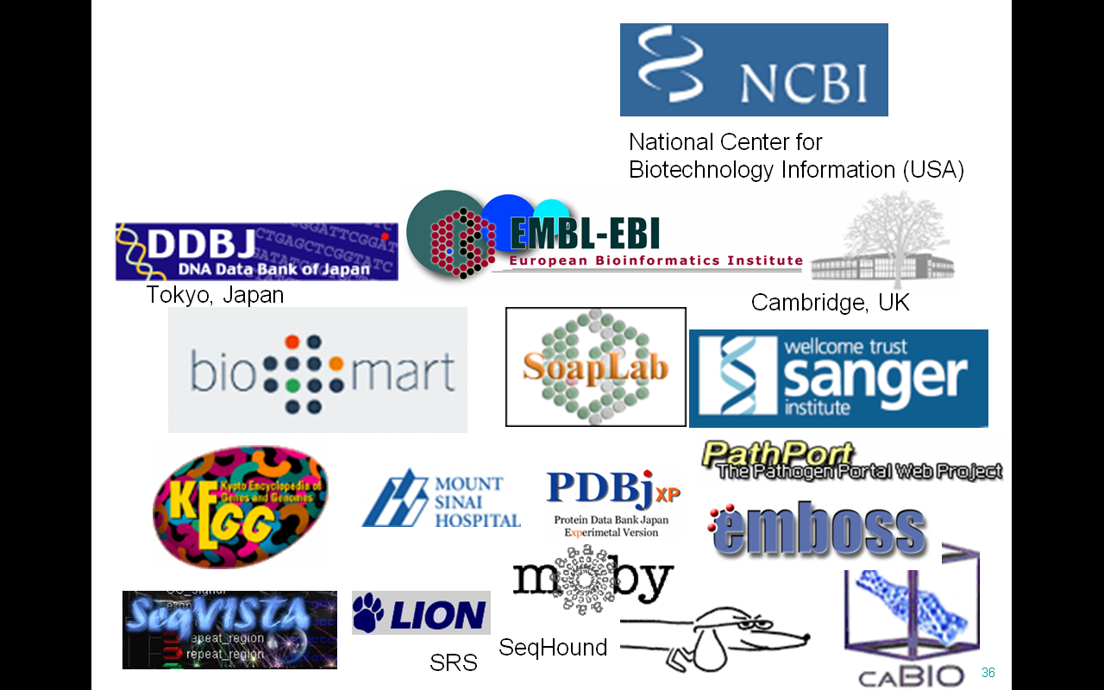
Who Provides the Services?
Open domain services and resources
Taverna accesses thousands of services
Third party – we don’t own them – we didn’t build them
All the major providers
  NCBI, DDBJ, EBI …
..but no common data model.

Slide 12
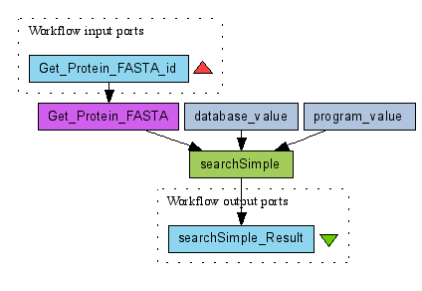
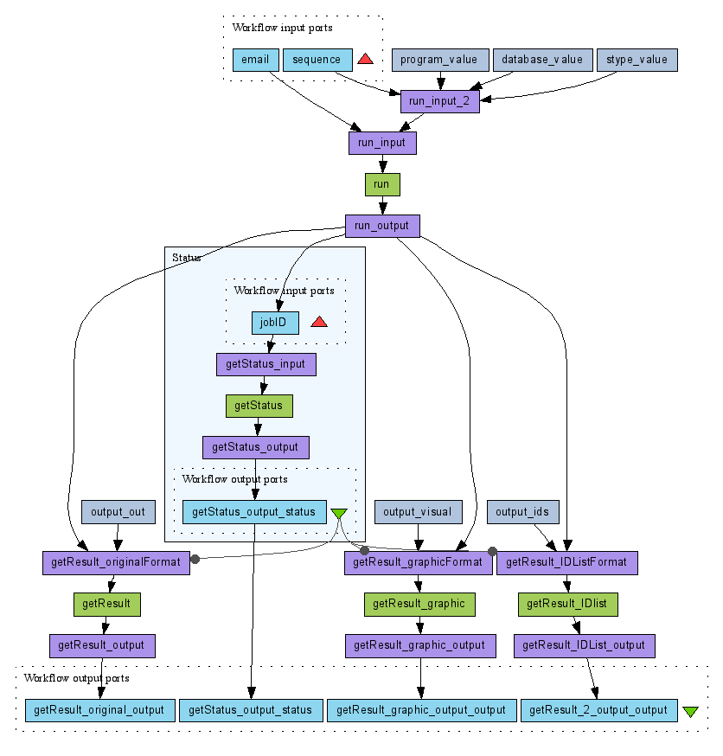
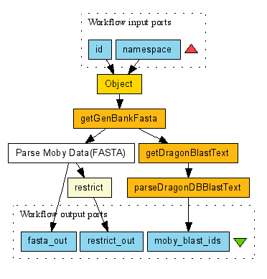
How do you use the services?
WSDL/SOAP
services
BioMoby Semantic
Services
Asynchronous services
(Submit, Wait, Fetch)
Notes:
## change biomoby for sadi

Slide 13
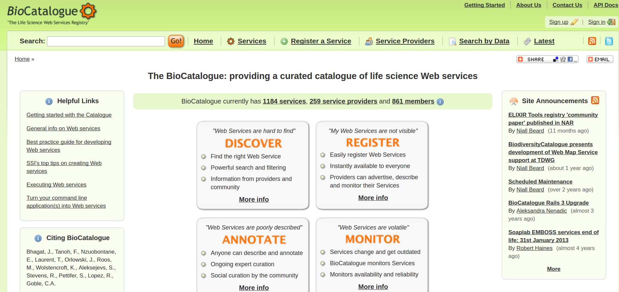
https://www.biocatalogue.org/

Slide 14
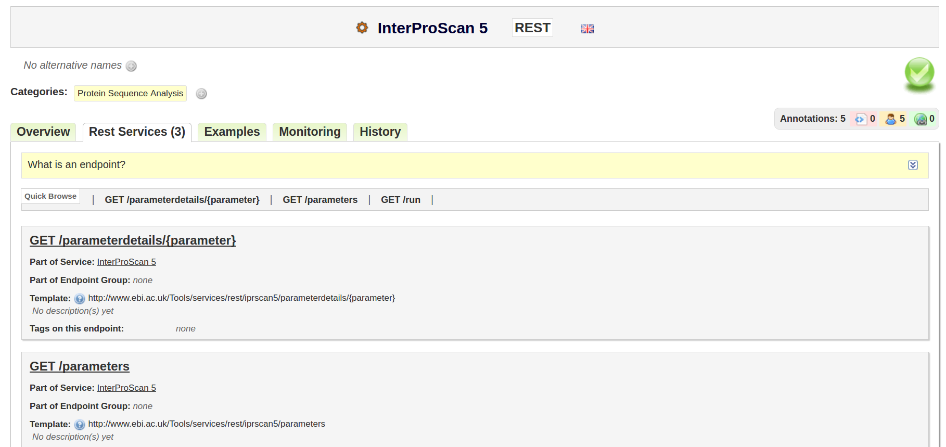
https://www.biocatalogue.org/services/3766/

Slide 15
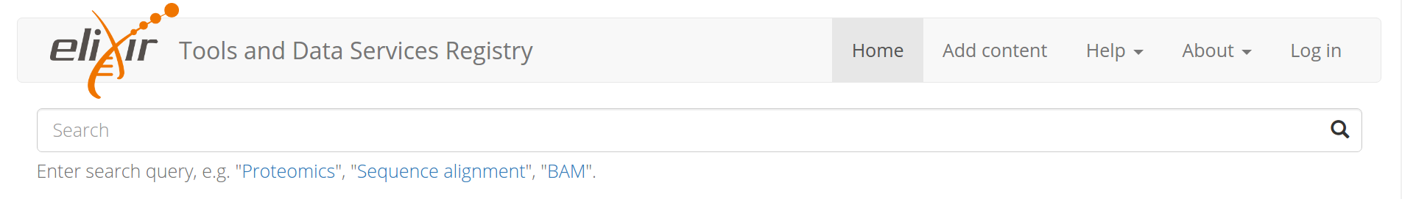
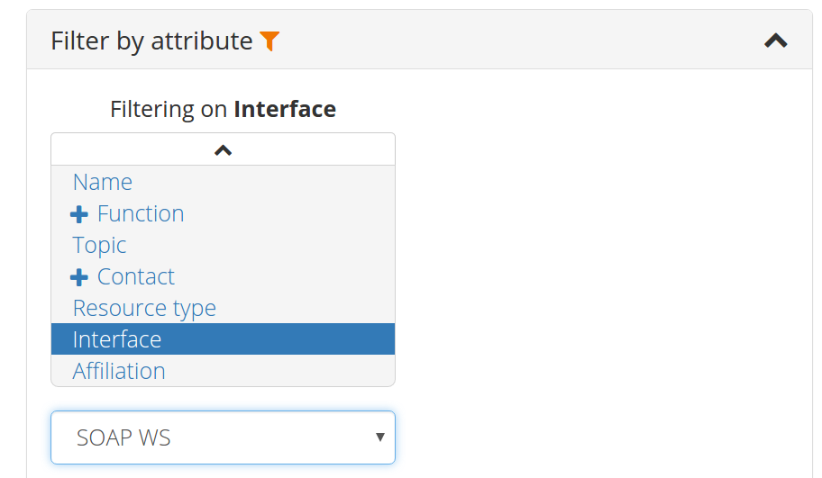
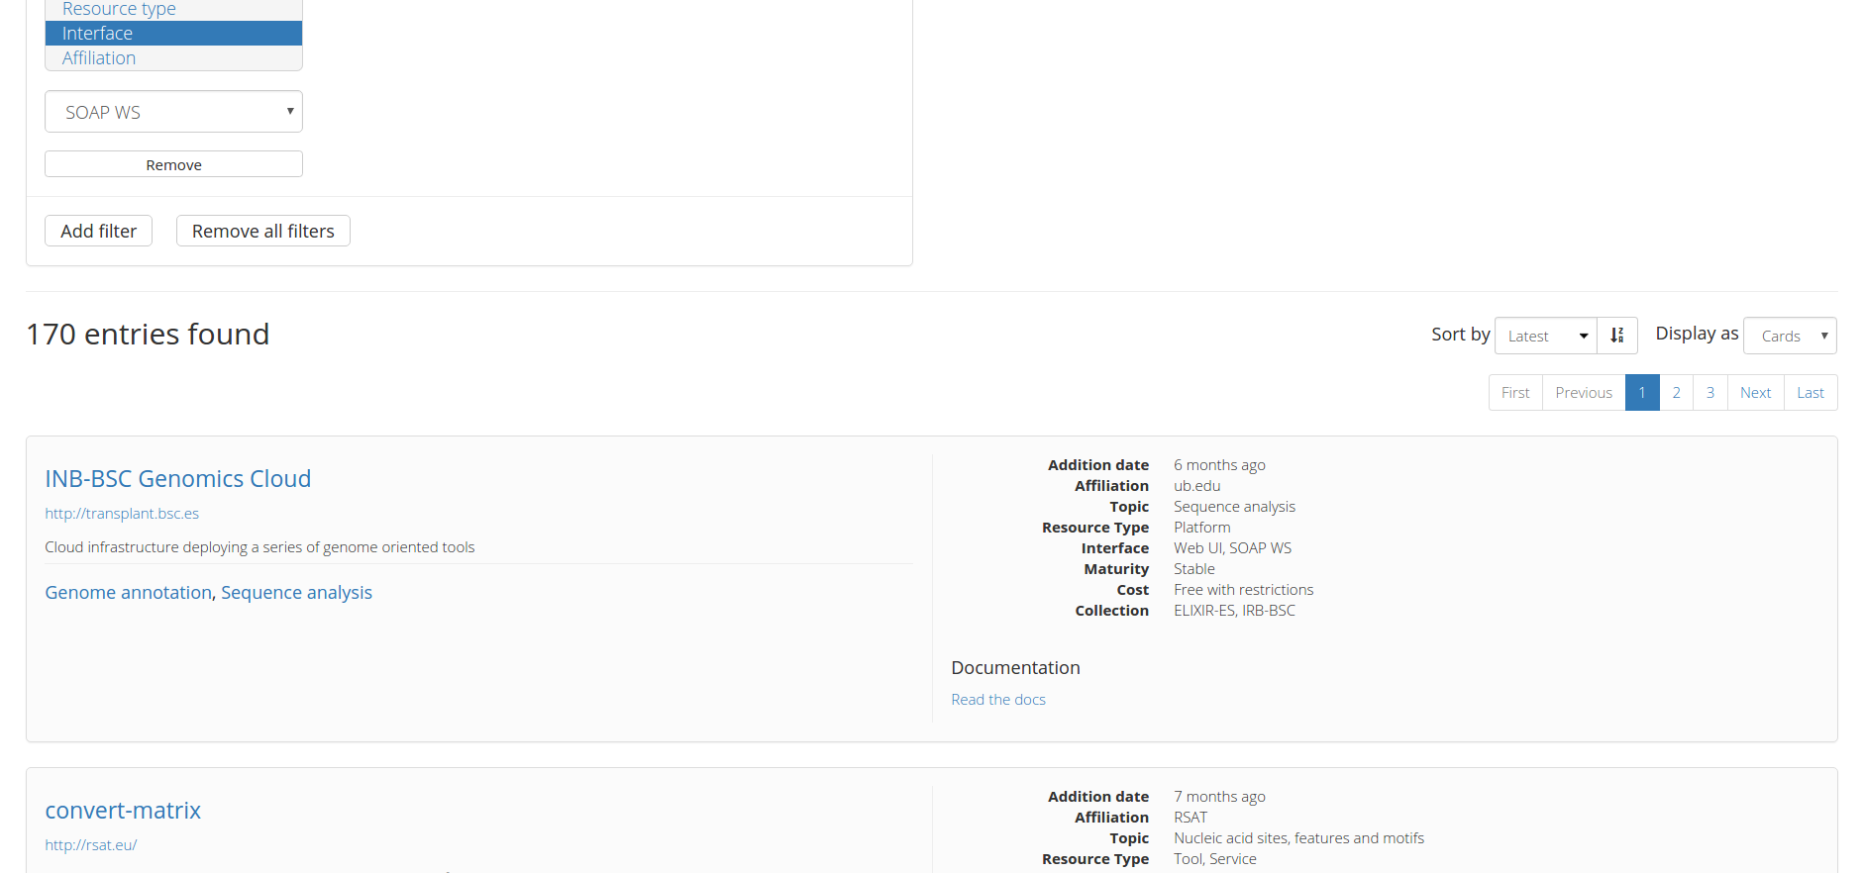
https://bio.tools/

Slide 16
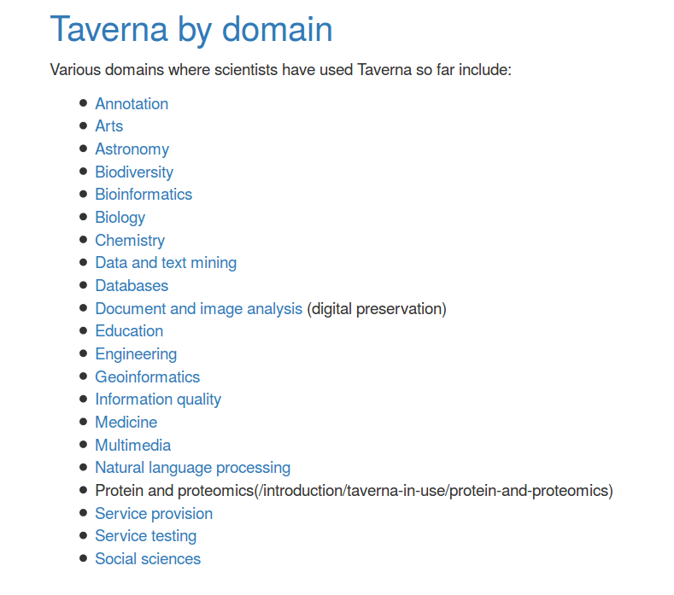
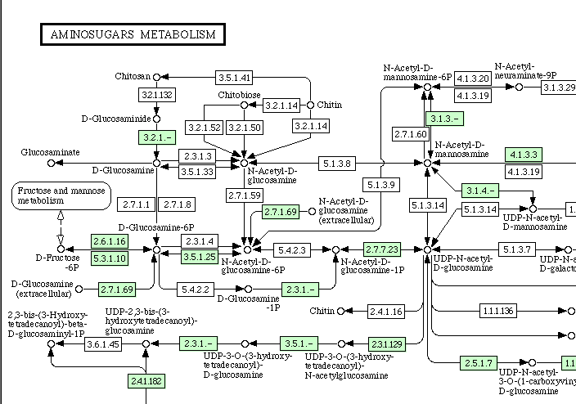
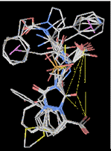
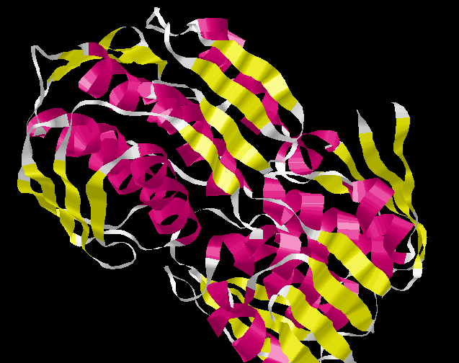
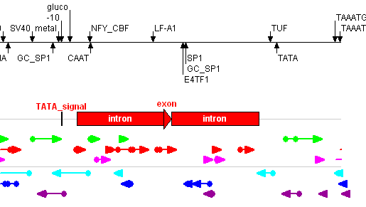
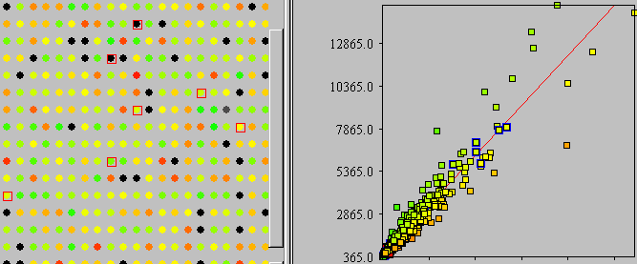
What do Scientists use Taverna for?
http://taverna.apache.org/introduction/taverna-in-use/

Slide 17

Workflows are …
... records and protocols (i.e. your in silico experimental method)
... know-how and intellectual property
... hard work to develop and get right
…..re-usable methods (i.e. you can build on the work of others)
So why not share and re-use them

Slide 18
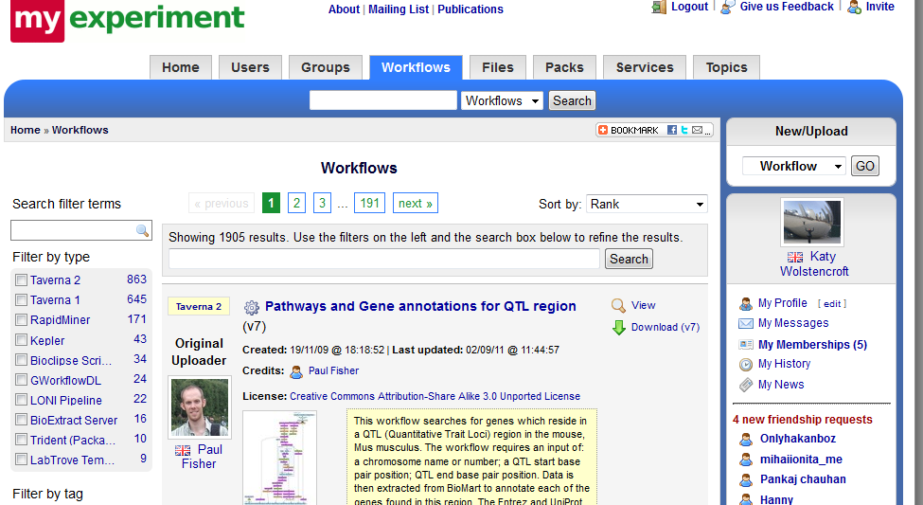
Workflow Repository
Notes:
### new screenshot required

Slide 19
Just Enough Sharing….
myExperiment can provide a central location for workflows from one community/group
myExperiment allows you to say
  Who can look at your workflow
  Who can download your workflow
  Who can modify your workflow
  Who can run your workflow
Ownership and attribution

Slide 20

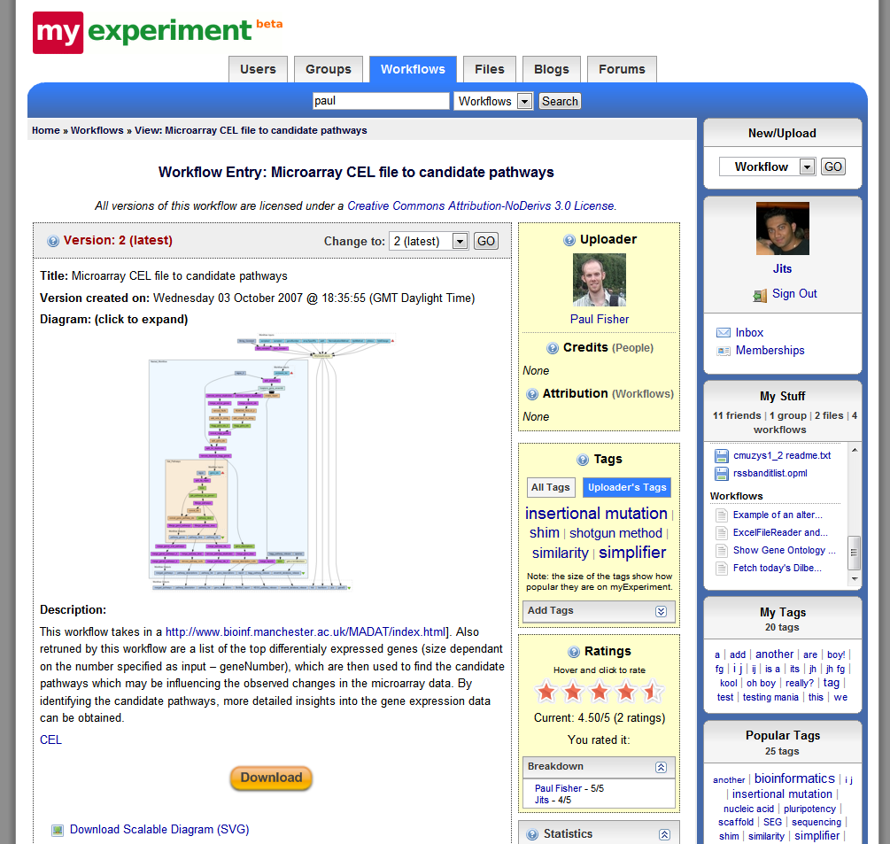
Spectrum of Users
Advanced users design and build workflows (informaticians)
Intermediate users reuse and modify existing workflows or components
Others “replay” workflows through web page
Notes:
Local or remote enactment

Slide 21



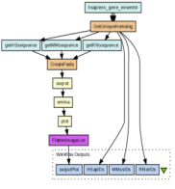
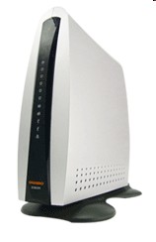

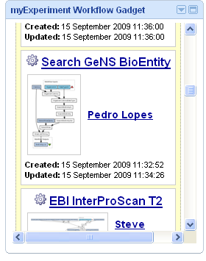
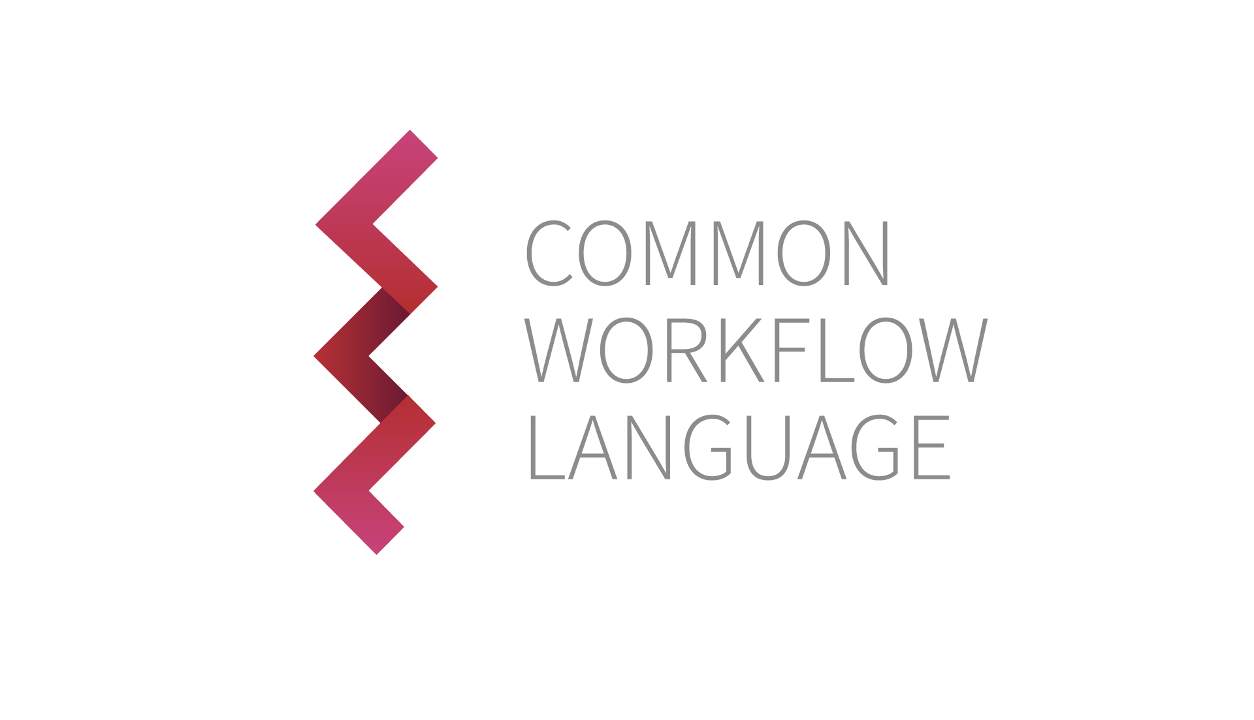




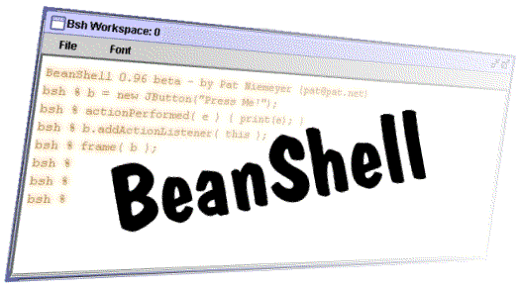

A Collection of Tools
Workflow Repository
Workflow GUI Workbench
and 3rd party plug-ins
Client User Interfaces
Taverna Player
Custom Web Portals
Service Catalogue
Mobile App
Taverna
Provenance Store
Workflow Server
Programming and
APIs
Activity and Service Plug-in Manager
W3C
PROV
Secure Service Access, and Programming APIs

Slide 22

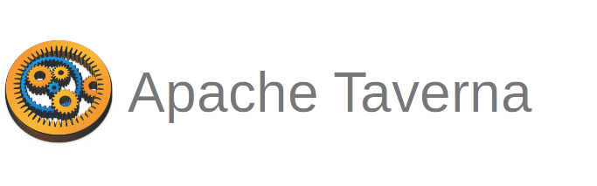
What’s next?

Slide 23
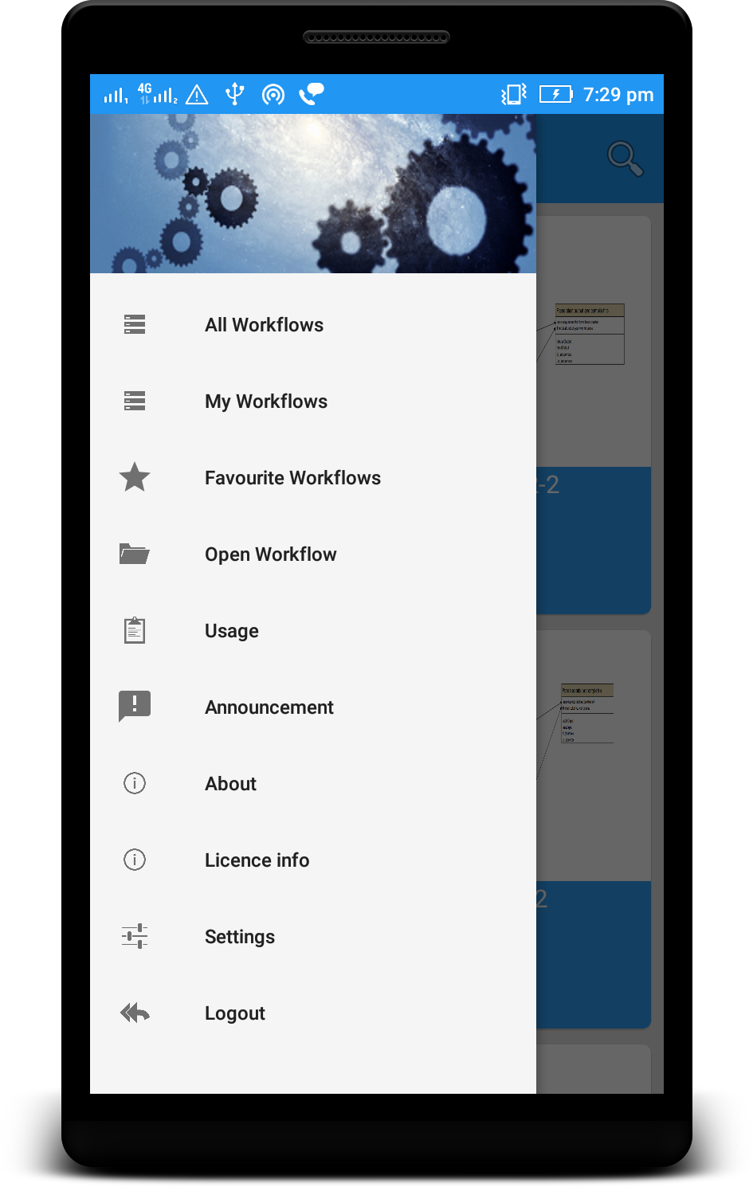
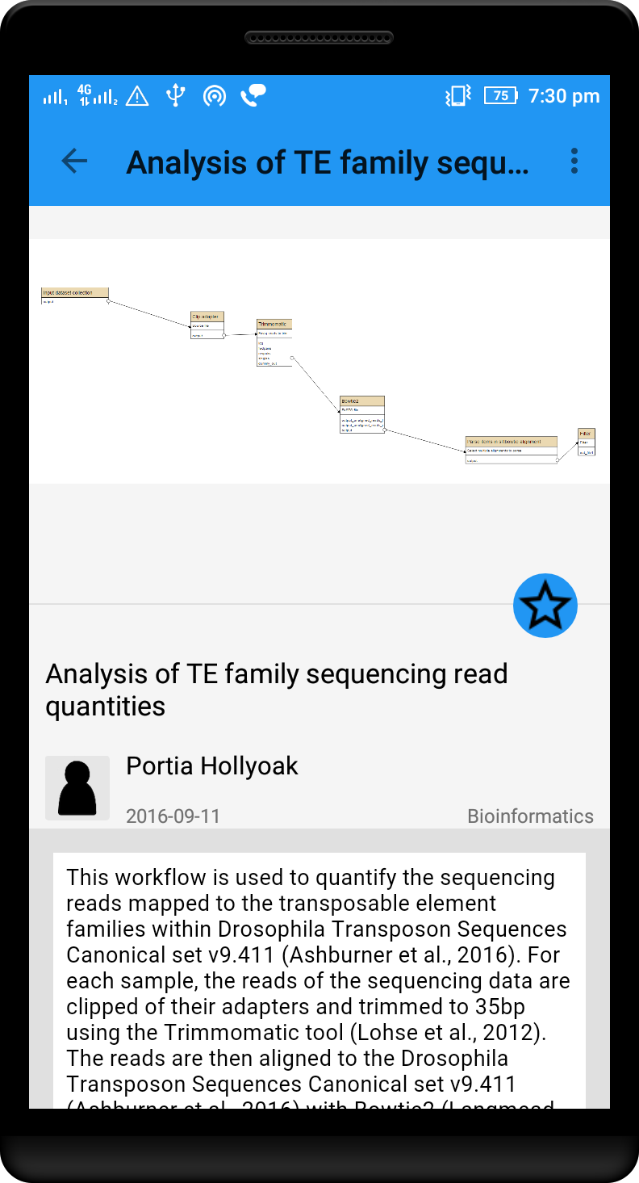
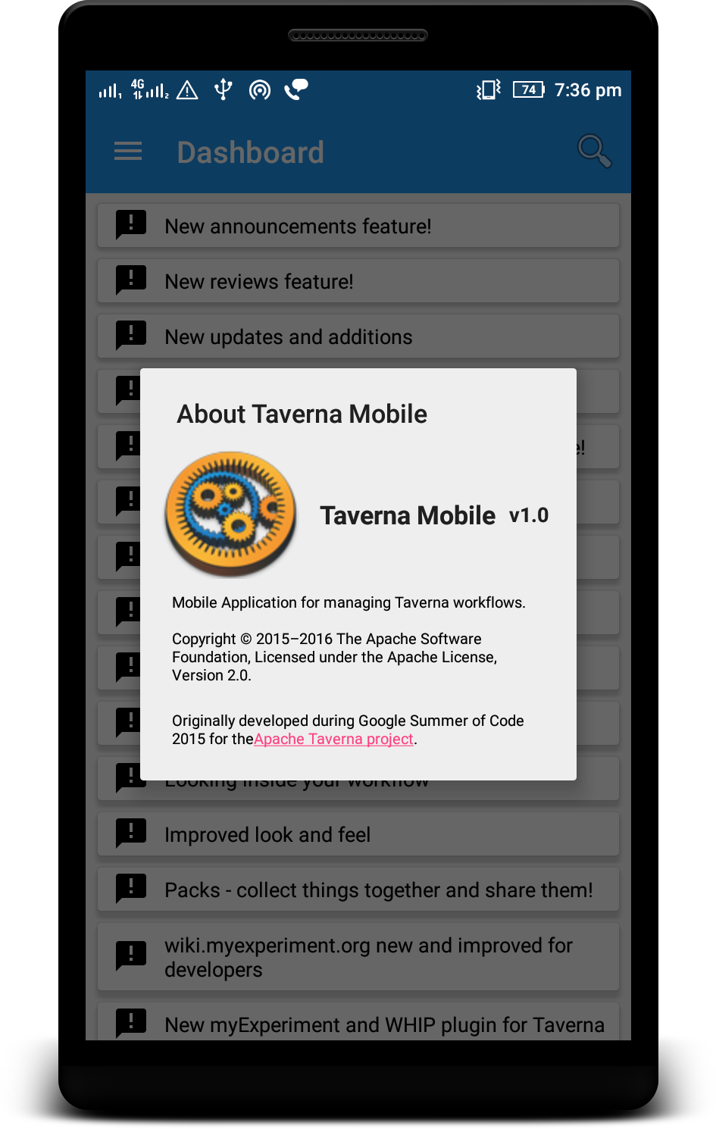
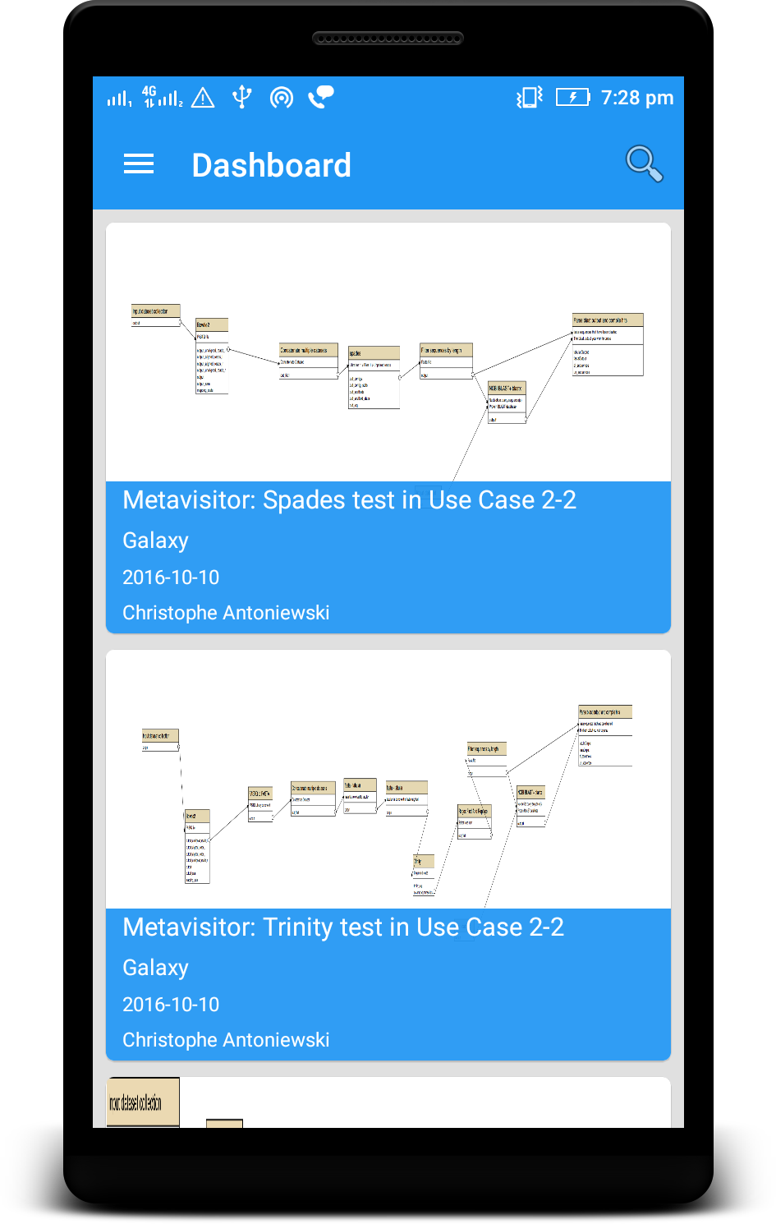
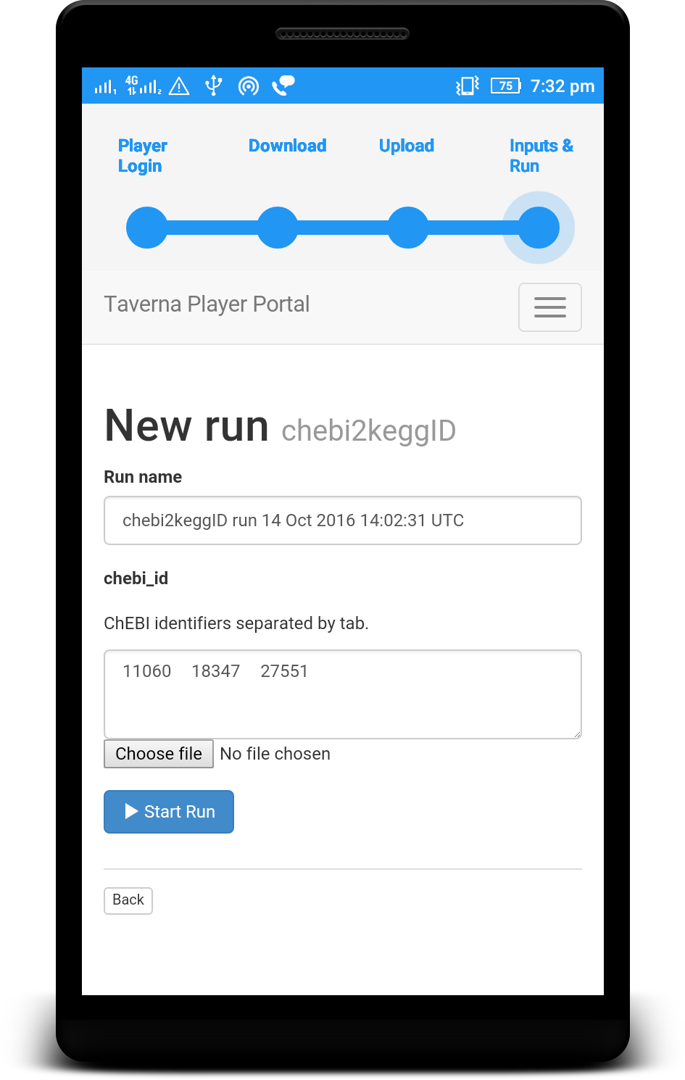



Slide 24
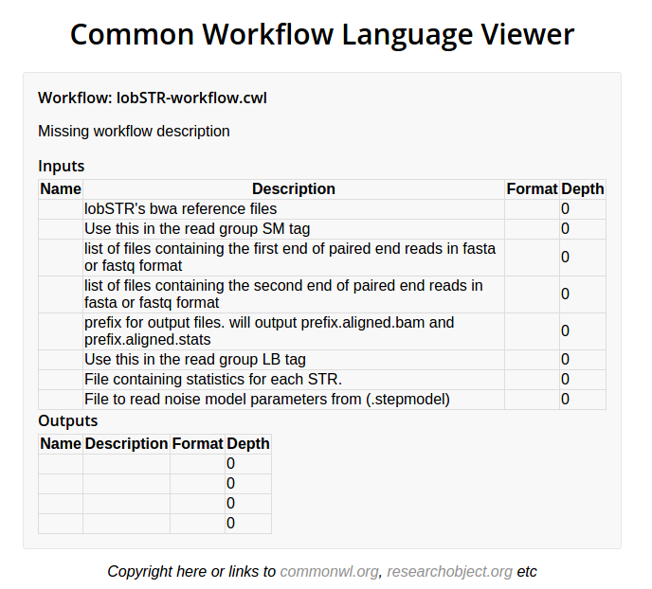

Slide 25
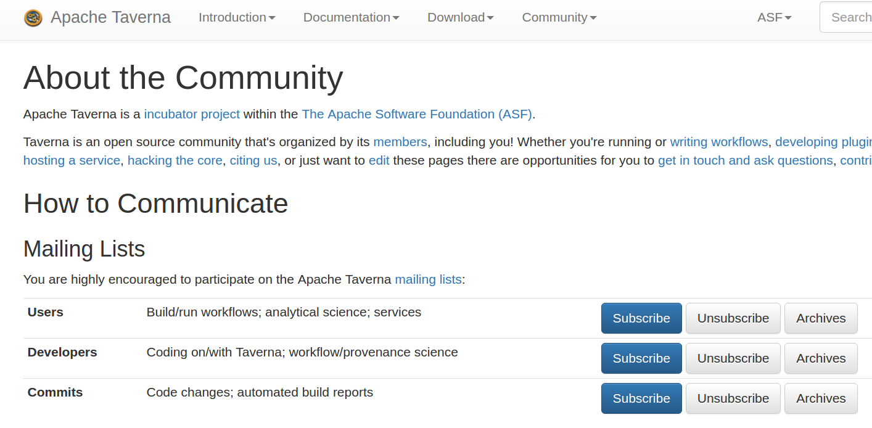
http://taverna.apache.org/community/

Slide 26

More Information
Apache Taverna (incubating)
  http://taverna.apache.org/
myExperiment
  http://www.myexperiment.org
BioCatalogue
  http://www.biocatalogue.org

Slide 27
Tutorials
Download Taverna Workbench 2.5
for Bioinformatics (~230 MiB):
https://s.apache.org/taverna-bio
or: Core edition (~190 MB): https://s.apache.org/download-taverna
then skip “Service Catalogue” in tutorial
Then follow “day1” in tutorial:
https://s.apache.org/taverna-tutorial

