Slide 1


An Introduction to Designing and Executing Workflows with Taverna
Stian Soiland-Reyes and Christian Brenninkmeijer
University of Manchester
materials by Dr Katy Wolstencroft and Dr Aleksandra Pawlik
http://orcid.org/0000-0001-9842-9718
http://orcid.org/0000-0002-2937-7819 http://orcid.org/0000-0002-1279-5133
http://orcid.org/0000-0001-8418-6735
Bonn University, 2014-09-01
http://www.taverna.org.uk/
This work is licensed under a
Creative Commons Attribution 3.0 Unported License

Slide 2
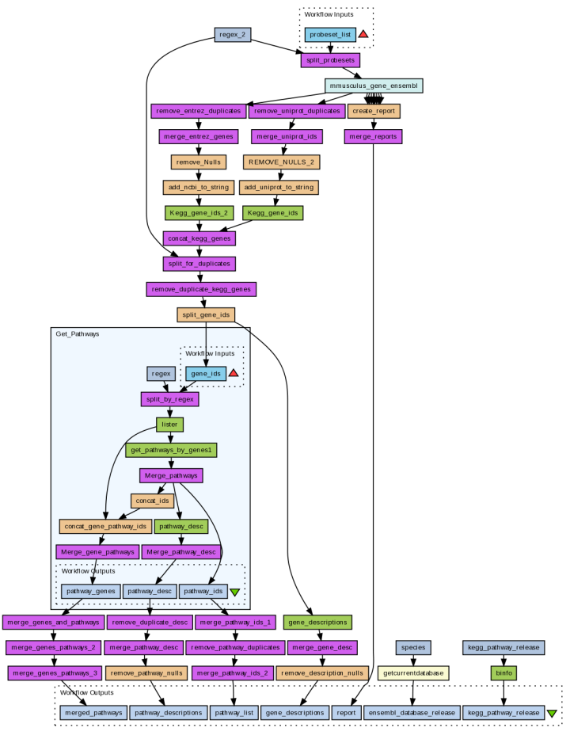
Workflows
Sophisticated analysis pipelines
A set of services to analyse or manage data (either local or remote)
Data flow through services
Control of service invocation
Iteration
Automation
Access to intermediate results

Slide 3
Workflows in Taverna
This tutorial will give you a basic introduction to designing, and reusing workflows in Taverna and some of its main features.
Workflows in this practical use small data-sets and are designed to run in a few minutes. In the real world, you would be using larger data sets and workflows would typically run for longer

Slide 4
Taverna: Download and installation
Taverna can be downloaded from
http://www.taverna.org.uk/
Go to the page and find the latest (2.5)
Follow the instructions on the website to install Taverna for your operating system (this is a simple one-click install for windows and Mac. For Linux, you may also need the GraphViz program. Follow the link on the Taverna download page if so)
The following page shows a screenshot of Taverna and the different panels that make up the workbench

Slide 5
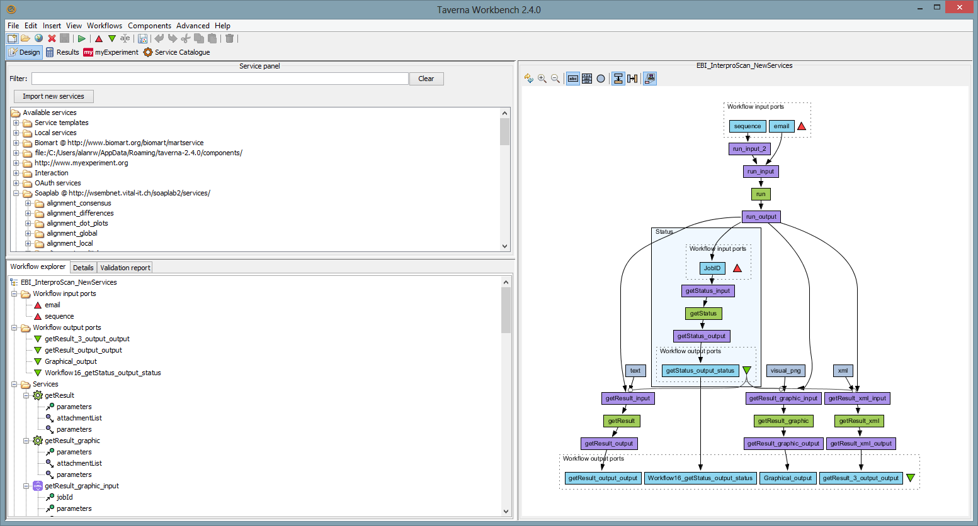
Taverna Workbench
Workflow Diagram
Services Panel
Workflow Explorer

Slide 6
Workflow Diagram
The workflow diagram is the visual representation of the workflow, it:
Shows inputs, outputs, services and data flows
Allows editing of the workflow by dragging and dropping and connecting services together
Enables saving of workflow diagrams for publishing and sharing

Slide 7
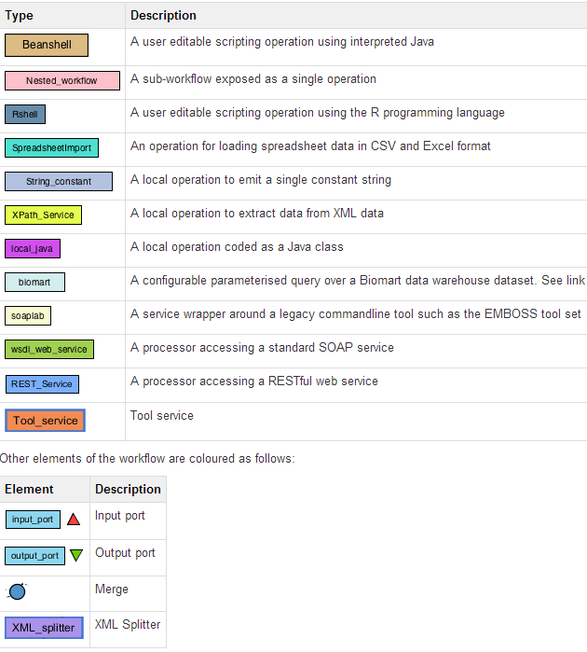
Workflow Diagram

Slide 8
Workflow Explorer
The Workflow Explorer shows the detailed view of your workflow. It shows default values and descriptions for service inputs and outputs and it shows where remote services are located. It also shows configuration details, such as iteration and looping
Workflow validation details can also be found here. Before a workflow is run, Taverna checks to see if it is connected correctly and if its services are available.

Slide 9
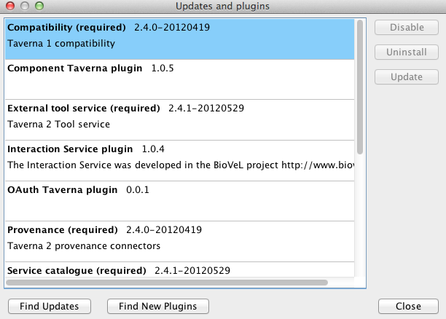
Updates and Plugin Installation
Taverna updates are issued on the regular basis
There is also a number of plugins which are developed for Taverna
To get the updates and plugins select “Advanced -> Updates and plugins”

Slide 10
Available Services Panel
Lists services available by default in Taverna
Local java services
WSDL Web Service – secure and public
RESTful Services
R Processor services (for statistical analyses)
Beanshell scripts
Xpath scripts
Spreadsheet import service
The services panel also allows you to add new services or workflows from the web or from file systems – there are loads more available!

Slide 11
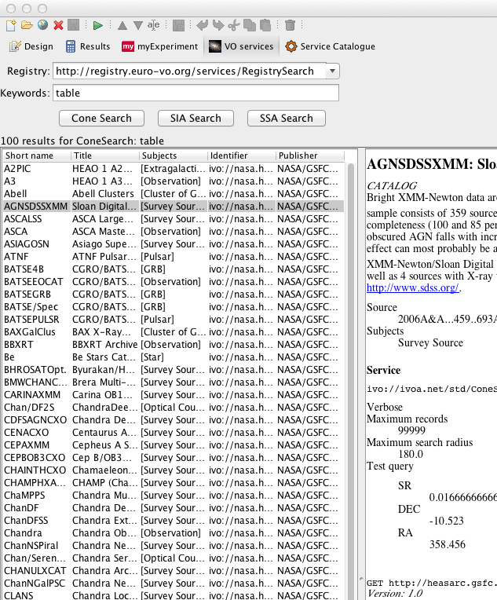
Taverna Workflow Management Open extensibility
Plug-in framework
Command line tool
Data Services: VOTables for AstroTaverna
Optimisations: E.g. Holl. model parameter sweeps
Infrastructures: Grid, HPC, Web Services
Domains: CDK, BioMart, VOTable
Commodities: Excel Spreadsheets, Open Refine, R
Plug into other frameworks & platforms
Portals: Scratchpads
Interactive platforms: iPython Notebook
Wfms: KNIME Node, Galaxy tool, Kepler Actor
Third party applications
Taverna Online
XworX
OGC chainer
Notes:
Custom resources and platforms
Components
Plug-in Framework
Infrastructures: Grid, HPC, Web Services (SOAP, REST)
Domain: CDK, BioMart, VOTable, SADI
Common Tools: Excel Spreadsheets, Open Refine, R

Slide 12
Next
First tutorials:
Downloading/installing Taverna
Building a simple workflow
Finding services in BioCatalogue

