Slide 1


Installing Taverna
Stian Soiland-Reyes and Christian Brenninkmeijer
University of Manchester
http://orcid.org/0000-0001-9842-9718
http://orcid.org/0000-0002-2937-7819
Bonn University, 2014-09-01 / 2014-09-03
http://www.taverna.org.uk/
This work is licensed under a
Creative Commons Attribution 3.0 Unported License

Slide 2
Taverna homepage
Google Taverna or Taverna workflow
Alternatively, http://www.taverna.org.uk/
Hover Download, click Workbench
Alternatively, http://www.taverna.org.uk/download/workbench/2-5/
Choose the Bioinformatics edition
http://www.taverna.org.uk/download/workbench/2-5/bioinformatics/
Download for your operating system, e.g. Taverna Workbench 2.5 for Windows (64-bit)
If it does not work, try 32-bit

Slide 3
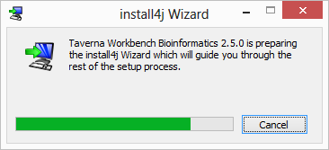
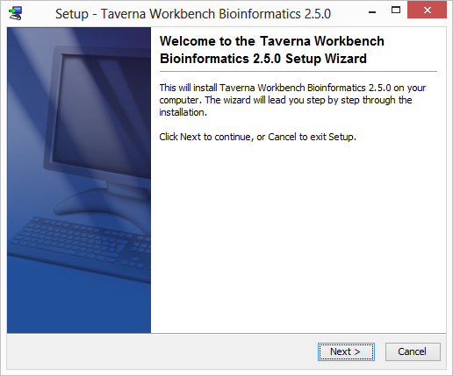
Click through Taverna’s installer

Slide 4
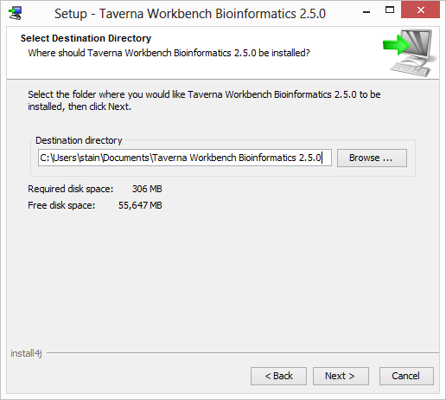
Install directory (Windows only)
If you are an administrator on the computer, install to the default C:\Program Files
Otherwise, install to My Documents, e.g. C:\Users\stain\Documents

Slide 5
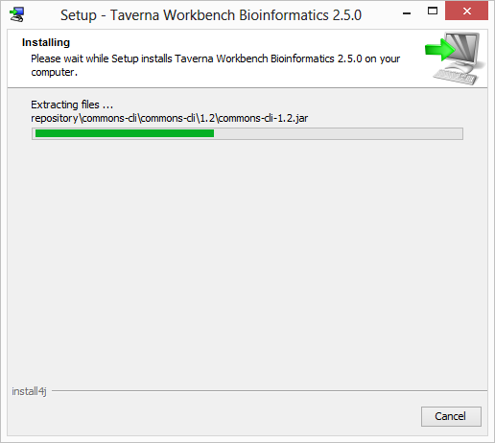
Click Next, Next to continue installation

Slide 6
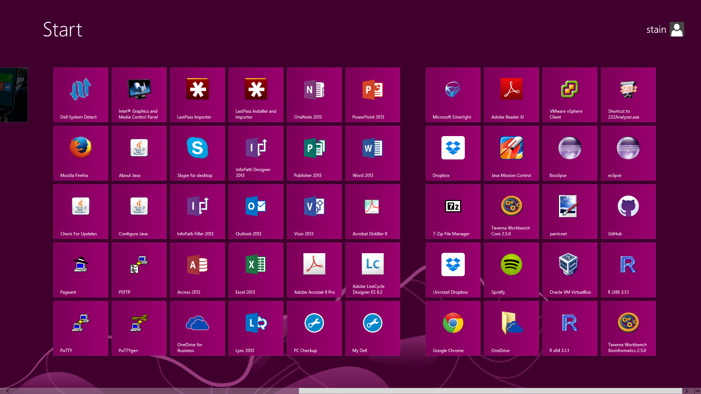
After installation, Taverna Workbench Bioinformatics 2.5.0 will be in the Start menu

Slide 7
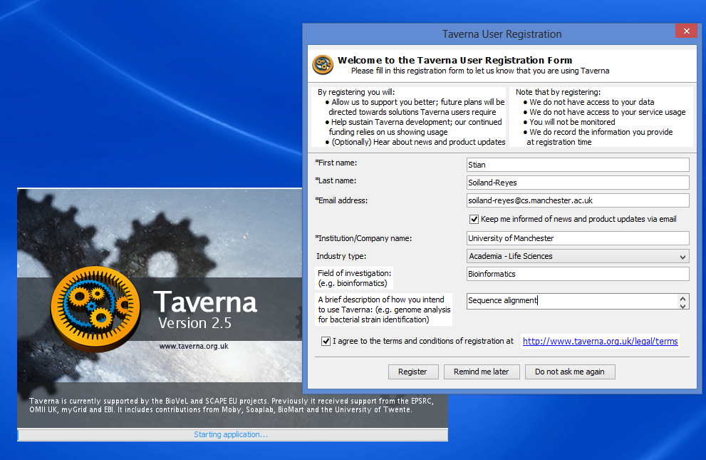
Starting Taverna for the first time

Slide 8
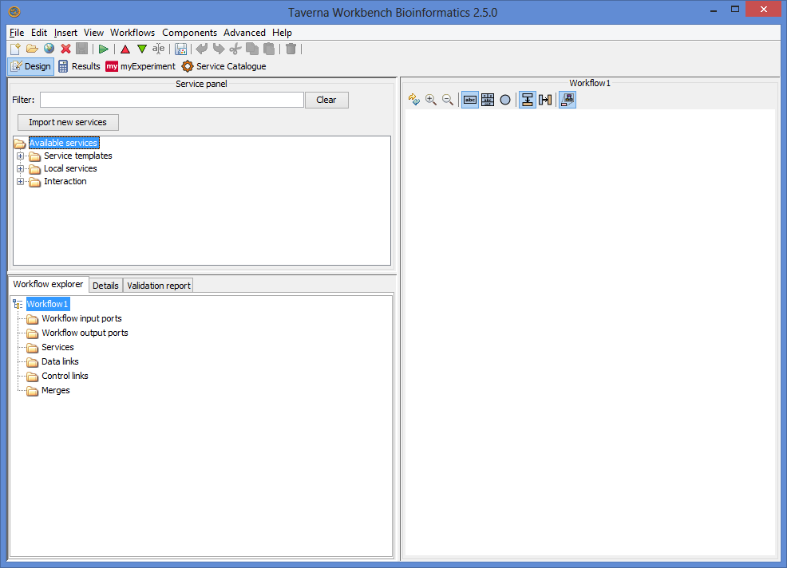

Slide 9
Standalone Taverna
Alternative to installer
Recommended for advance computer users only
There is also a smaller “platform-neutral binaries”
This will require unzipping
This will require you to have a Java installed and in your file path
Requires dot to be installed.
You may need to set this up in Taverna as well.
You may also need to change the Java cryptography policy
Bat and sh files are provided for running the tavern jar

