Slide 1


Taverna Tutorial Building a simple workflow
Stian Soiland-Reyes and Christian Brenninkmeijer
University of Manchester
materials by Katy Wolstencroft and Aleksandra Pawlik
http://orcid.org/0000-0001-9842-9718
http://orcid.org/0000-0002-2937-7819
http://orcid.org/0000-0002-1279-5133 http://orcid.org/0000-0001-8418-6735
Bonn University, 2014-09-01
http://www.taverna.org.uk/
This work is licensed under a
Creative Commons Attribution 3.0 Unported License

Slide 2
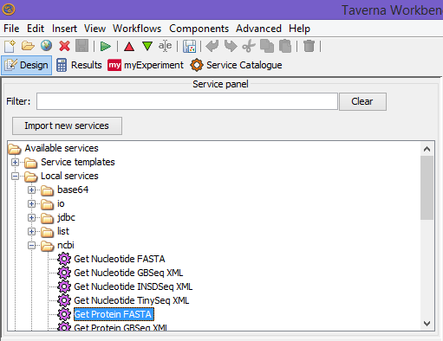
Available Service
We will start with something easy - retrieving a protein sequence from a remote database and identifying functional motifs
Expand the list
Available Services
Local Services
ncbi
Select ‘Get Protein FASTA’ and drag-and-drop it into the empty workflow diagram

Slide 3
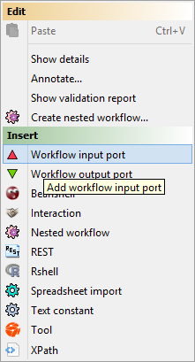
Workflow input/output ports
In a blank space in the workflow diagram, Right-click and select Workflow input port from the Insert section
Type in a name for this input (e.g. ID) and click ok
Do the same to create a new Workflow Output Port. Call this output Sequence
Notes:
3

Slide 4
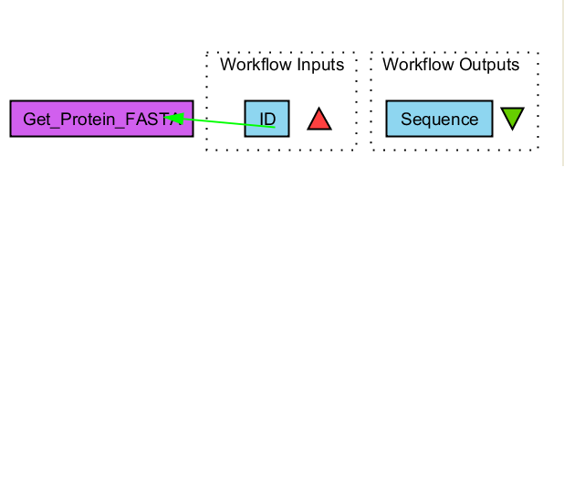
Connecting ports
You now have 3 boxes in the diagram and we need to connect them up to build our workflow
Click on the input box ID and drag towards Get_Protein_Fasta and let go. An arrow will connect the two boxes.

Slide 5
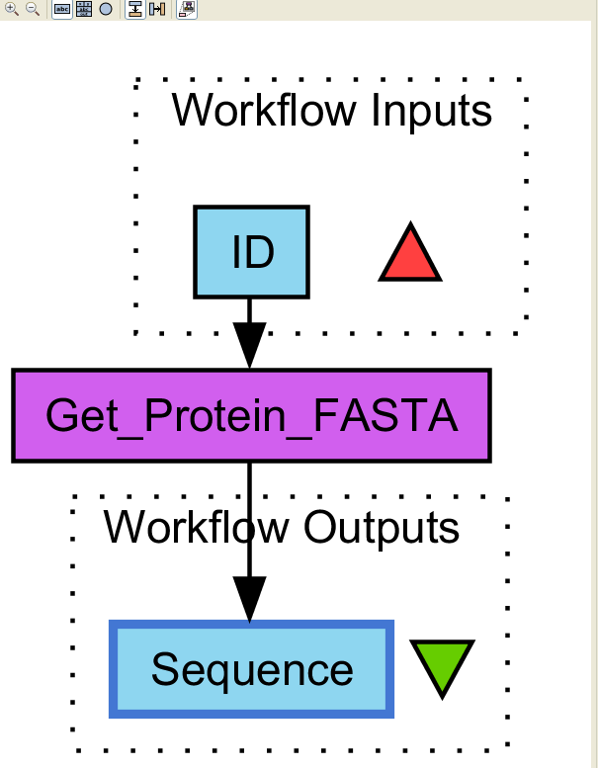
Your first workflow
Click on the output box Sequence, drag towards “Get_protein_fasta”, and let go. An arrow will connect the two boxes.
You have now built your first workflow!

Slide 6
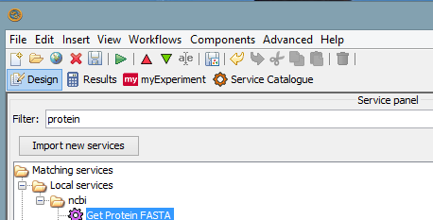
Running workflow
In the menu, select “File -> Run workflow”, or click on the green play button at the top of the workbench

Slide 7
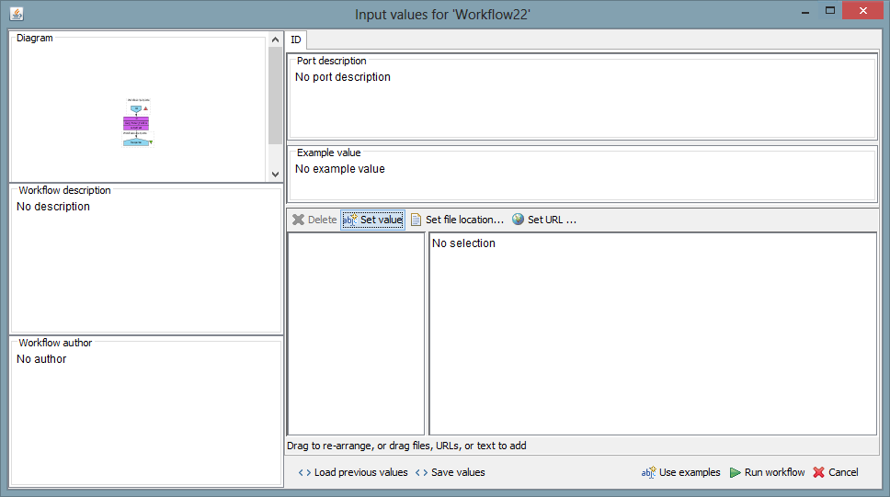
Providing workflow inputs
An input window will appear. We have not yet added a description of the workflow or the input.
Click on ‘Set Value’ in the input window and add a Uniprot protein identifier (e.g. P15409) where it says “some input data goes here”

Slide 8
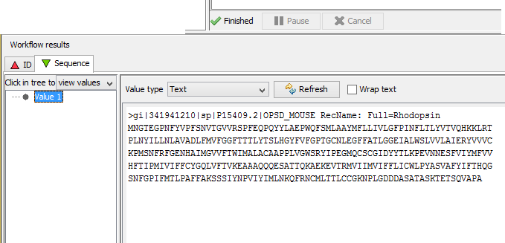
Workflow results
Click Run workflow
The workbench changes to the Results perspective
In the bottom left, click on Value 1
You will now see a protein sequence from Uniprot

Slide 9
Validate your Workflow
Taverna can check to see that everything is connected properly and that all the services in your workflow are available
Go to the workflow explorer (“Design” button) and click on ‘Validation report’ tab
See if Taverna has found any problems with the workflow. Errors will be displayed in red, warnings in yellow. Workflows with warnings often still run.
If there are problems, follow the instructions to resolve them by clicking on the ‘Solution’ tab
Are you able to create a workflow that gives warnings or errors?
Tip: Try deleting the data link to the workflow output port

