Slide 1


Taverna Tutorial exercise 2: REST services from BioCatalogue
Stian Soiland-Reyes and Christian Brenninkmeijer
University of Manchester
materials by Katy Wolstencroft and Aleksandra Pawlik
http://orcid.org/0000-0001-9842-9718
http://orcid.org/0000-0002-2937-7819 http://orcid.org/0000-0002-1279-5133
http://orcid.org/0000-0001-8418-6735
Bonn University, 2014-09-01
http://www.taverna.org.uk/
This work is licensed under a
Creative Commons Attribution 3.0 Unported License

Slide 2
REST services from BioCatalogue
Start with the Get Protein FASTA workflow from Exercise 1.
Now we will find out what functional motifs the protein contains, but first we have to tell Taverna about some new services

Slide 3
Service Catalogue tab
Taverna can invoke any WSDL and REST web services
The Service Catalogue http://biocatalogue.org/ has registered over 1500 bioinformatics web services
Go to the Service Catalogue perspective of Taverna
The Service Catalogue tab is included in the Bioinformatics, Biodiversity and Enterprise editions of Taverna Workbench.
For other editions, install Service Catalogue plugin from Advanced -> Updates and plugins -> Find new plugins
Note: Biodiversity edition is configured to use biodiversitycatalogue.org instead of biocatalogue.org and won’t find dbfetch. See File - >Preferences -> Service Catalogue.
Search for dbfetch

Slide 4
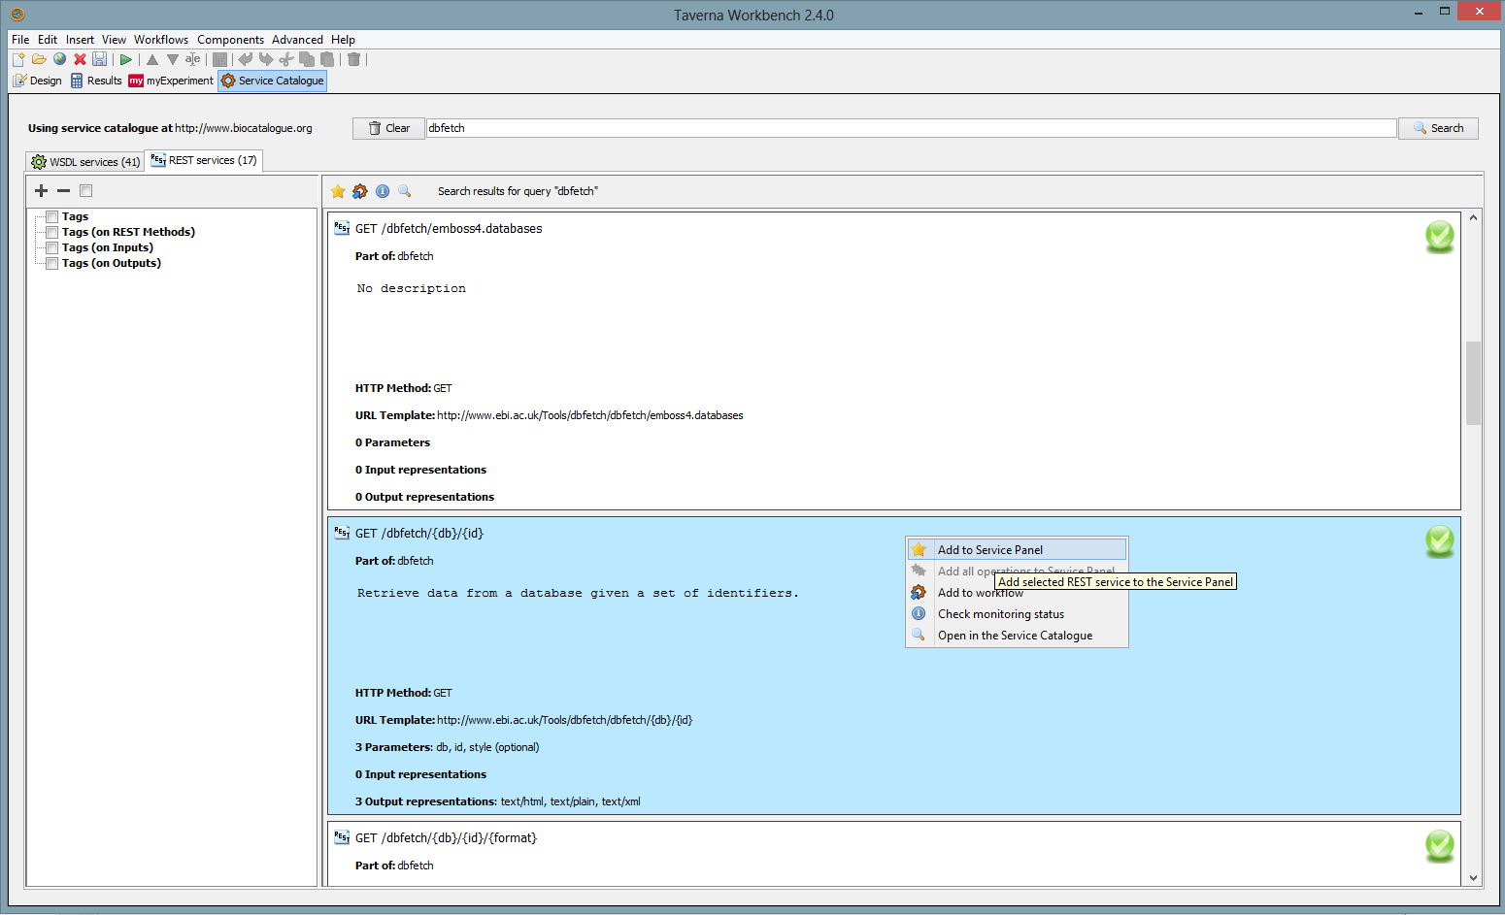
Searching for REST services
In the REST Service tab, select GET /dbfetch/{db}/{id}
Retrieve data from a database given a set of identifiers
Right-click on the service and Add to Service Panel

Slide 5
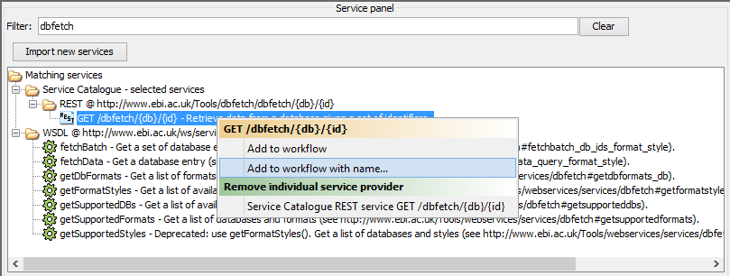
Adding service to workflow
Back in the Design perspective, in the Available Services search panel:
Search for dbfetch
Right-click on the GET service and choose “Add to workflow with name…”
Enter a name such as dbfetch and click OK

Slide 6
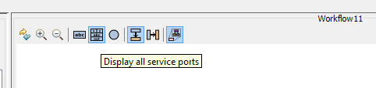
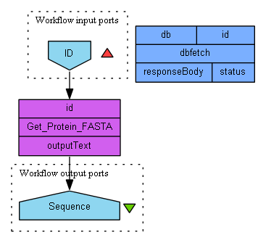
E2: REST service in workflow
The workflow now has a new REST service dbfetch
Click the Display all service ports button to see service inputs and outputs

Slide 7
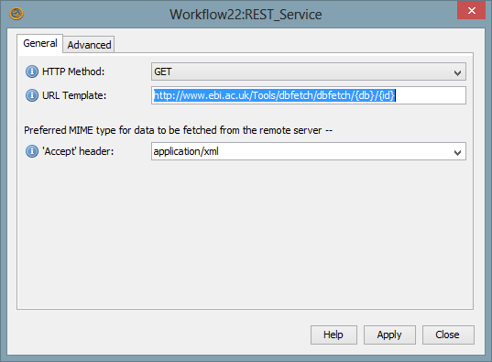
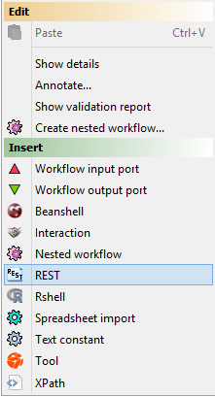
REST service using URI templates
Alternatively, you can add a REST service manually:
Right-click on an empty area of the workflow and select “REST” from the “Insert” section
Enter the URL Template, (see below), click Close
A new REST service with inputs db and id is added
http://www.ebi.ac.uk/Tools/dbfetch/dbfetch/{db}/{id}
Notes:
http://www.ebi.ac.uk/Tools/dbfetch/dbfetch/{db}/{id}

Slide 8
Details about REST service
For this service, we need to supply the input ports db and a protein id.
We are not sure what database names to use, so let’s go back to Service Catalogue perspective
Right-click on the dbfetch/{db}/{id} entry and Open in the Service Catalogue

Slide 9
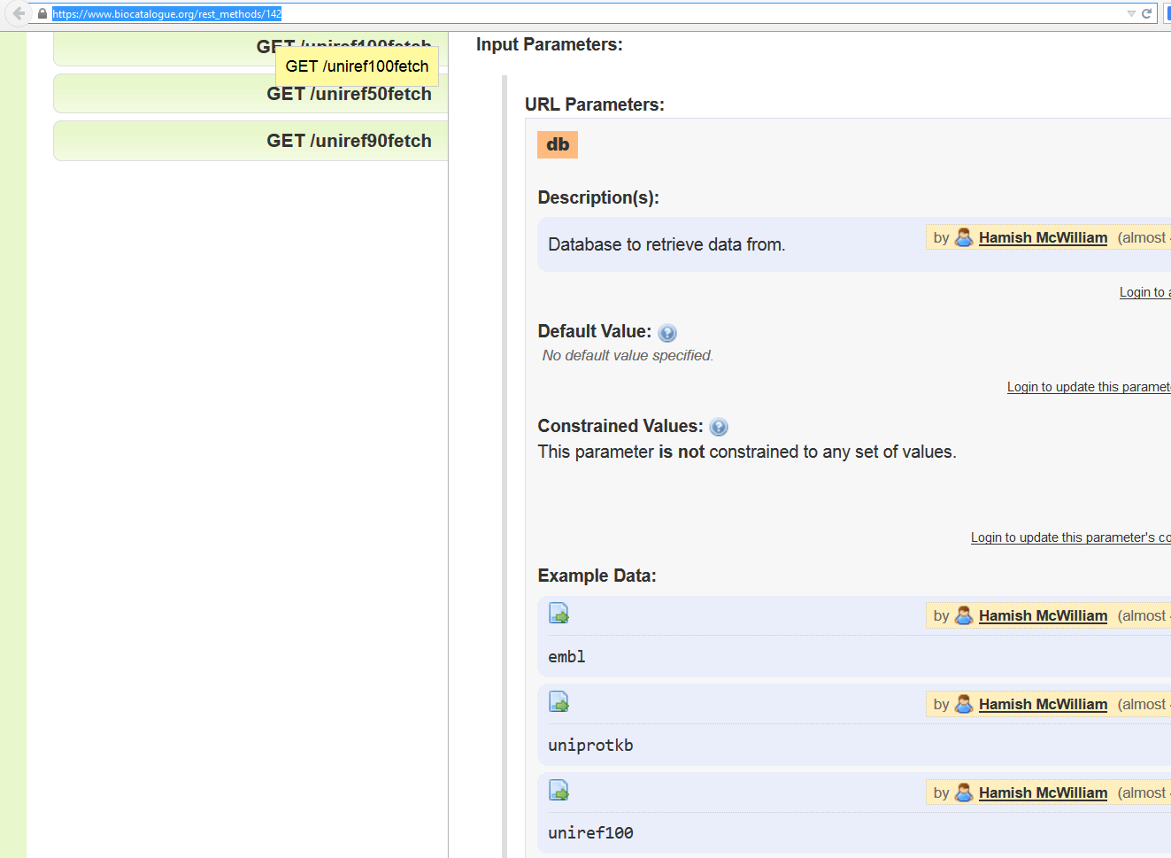
BioCatalogue
This service has extensive documentation in BioCatalogue
Input parameter db is described with example values
We will pick uniprotkb
https://www.biocatalogue.org/rest_methods/142

Slide 10
Connecting REST service
Right-click on the REST service input id to Connect with output from the Workflow Input Port id
Right-click on the db input port on the REST service and select ‘Constant value’.
Add the constant value ‘uniprotkb’ and click “OK”
A new Text Constant service is added and connected
Add a Workflow Output Port and connect it to the REST Output Port responseBody

Slide 11
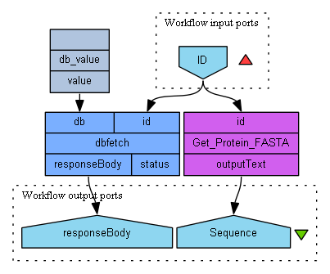
Finished workflow

Slide 12
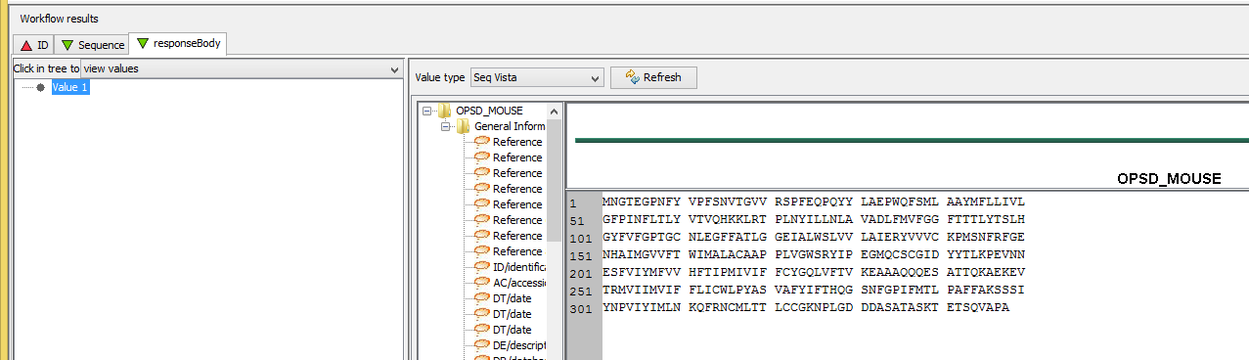
Workflow results
Save and run your workflow with the input value from exercise 1, P15409
Now your Results will include the Uniprot entry for your protein on the responseBody output port.
Tip: Slide up the separator line above Workflow Results to see more of the values
Try also Value type Text

