Slide 1


Shim (Helper) Services and Beanshell Services
Stian Soiland-Reyes and Christian Brenninkmeijer
University of Manchester
materials by Katy Wolstencroft and Aleksandra Pawlik
http://orcid.org/0000-0001-9842-9718
http://orcid.org/0000-0002-2937-7819
http://orcid.org/0000-0002-1279-5133 http://orcid.org/0000-0001-8418-6735
Bonn University, 2014-09-01
http://www.taverna.org.uk/
This work is licensed under a
Creative Commons Attribution 3.0 Unported License

Slide 2
Taverna Tutorial Building a simple workflow
Stian Soiland-Reyes and Christian Brennikmeijer
University of Manchester
materials by Katy Wolstencroft and Aleksandra Pawlik
http://orcid.org/0000-0001-9842-9718
http://orcid.org/0000-0002-2937-7819
http://orcid.org/0000-0002-1279-5133 http://orcid.org/0000-0001-8418-6735
Bonn University, 2014-09-01
http://www.taverna.org.uk/
This work is licensed under a
Creative Commons Attribution 3.0 Unported License

Slide 3
Taverna / Web Services
Taverna is good way to access lots of globally distributed services out there on the Web
This saves you the considerable trouble of installing stuff (e.g. databases, tools etc) on your personal machine or laboratory server

Slide 4
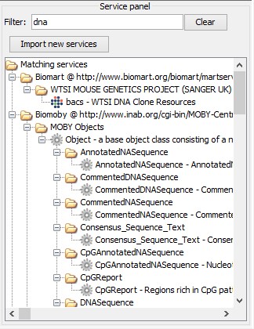
Lots of services…
Provided by third parties:
EMBOSS / SOAPlab - UK
BioMOBY - Canada/Germany/Australia etc
BioMART / EBI - UK
NCBI and PathPort - US
KEGG - Japan
SeqHound / BIND – Canada
The catch – services are not designed to work together

Slide 5
Building Workflows
A two-stage process
Assembly – identifying services that perform the scientific functions needed for the experiment
Gluing – identifying how (or more usually, if) theses services are compatible
If they are incompatible – we need services that convert data formats and act as connectors – we call these services Shims (or helper services)

Slide 6



The Reality
Lots of services don’t match: A into B doesn’t go
Lots of services are poorly described – can you even tell if A goes into B?

Slide 7
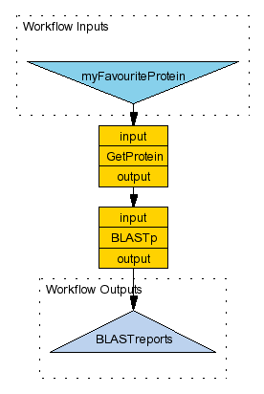
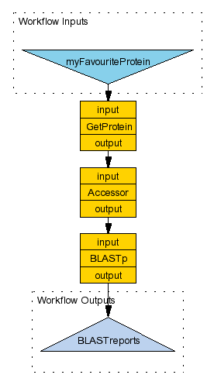
e.g. 1
UniProt record
Shim
protein_sequence
Mismatch
Match

Slide 8
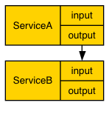
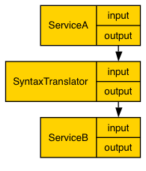
e.g. 2: syntax
DNA fasta
Shim
DNA embl
Mismatch
Match
Notes:
###add another

Slide 9
What if the service doesn’t exist?
If you’re lucky someone will have already created a service that does what you want and will have described / annotated it in a way that lets you find it
…if no service exists, one way to solve the problem is to create a lightweight BeanShell script (essentially a “lighter” version of Java) that runs on your local machine (not on a server like the services do)
These come in two flavours: Ready made “Local Java Widgets” and roll-your-own “Local Services’’,

Slide 10
Finding Shims
BioCatalogue – some shims are regular WSDL or REST services
myExperiment – look for all workflows containing the scientific services. Has anyone linked them together before?

Slide 11
Exploring Shims
A shim is a service that doesn’t perform an experimental function, but acts as a connector, or glue, when 2 experimental services have incompatible outputs and inputs
A shim can be any type of service – WSDL, soaplab etc. Many are simple Beanshell scripts
We have already used many shims in these exercises
Notes:
11

Slide 12
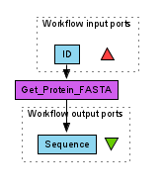
Shims for Data Input
We will use the simple workflow that we build in the introductory tutorial
So far, we have only added a few input values to our workflows. Normally, you would have a much larger data set. The “GetProteinFasta” activity can only handle one ID at a time.

Slide 13
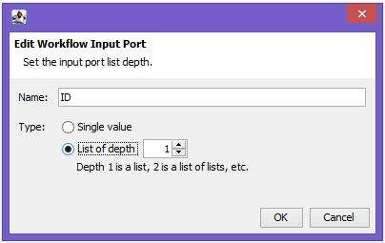
Shims for Data Input
You can add a list of IDs by configuring the input port
Right-click on the ID input and select ‘Edit workflow input port’ and change the depth to 1 (a list).
Now, when you run the workflow, you can add multiple ID values

Slide 14
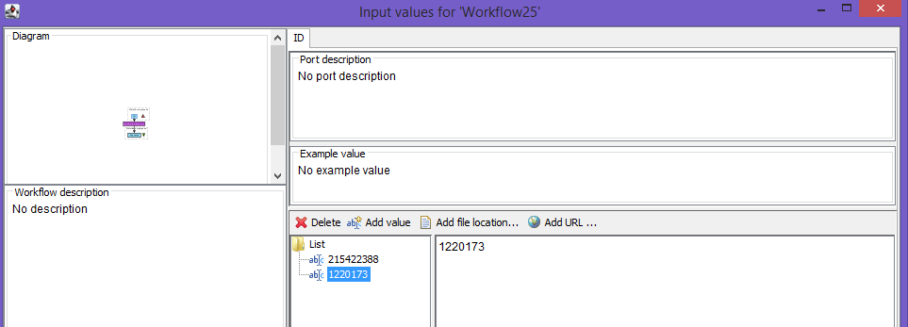
Shims for Data Input
Try running it with 215422388 and 1220173
Press “Add value” to add each new value.
If you have hundreds of IDs, however, this is not very practical. Instead, we need an extra service to split a list of data items into individual values

Slide 15
Shims for Data Input
In the services panel, search for “split”
Select “Split string into string list by regular expression” (a purple local java service) and drag it into the workflow
Delete the data link between the “ID” input and “GetProteinFasta” by selecting and right-clicking on the diagram
Connect “ID” to the “string” port of the new “split” activity
Hint: Press To Display all Service ports
Add “\n” as a constant value to the “regex” input on “split…” by right-clicking and selecting “Set constant value”
Notes:
15

Slide 16
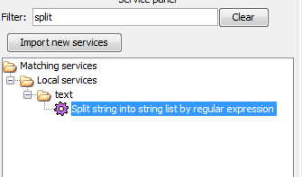
Shims for Data Input
In the services panel, search for “split”
Select “split_string_into_string_list_by_regular_expression” (a purple local java service) and drag it into the workflow
Notes:
16

Slide 17
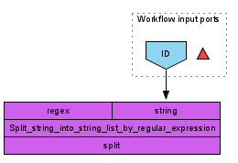

Shims for Data Input
Delete the data link between the “ID” input and “GetProteinFasta” by selecting and right-clicking on the diagram
Connect “ID” to the “string” port of the new “split” activity
Hint: If you don’t see the “string” port press the “Display all Service ports” button
Notes:
17

Slide 18
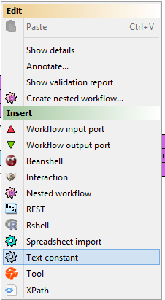
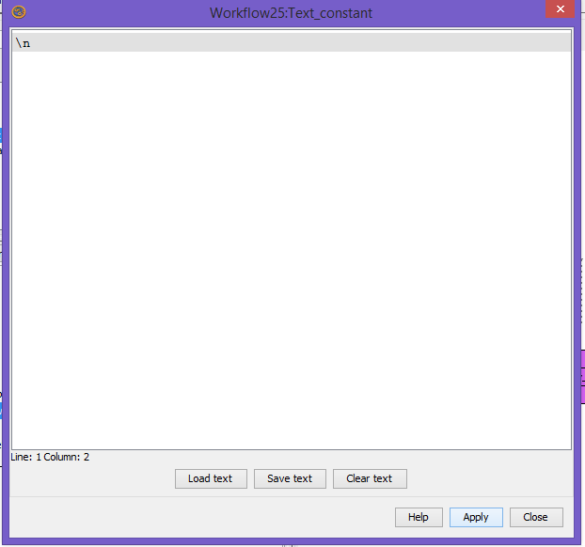
Shims for Data Input
Add a text constant. (Hint rightclick a blank part of the workflow and select “Text constant”)
Set the value to “\n” and press “Apply” and “Close”
Rename the service “regex_value” (Hint: rightclick the Text_constant” service and select Rename Service)
Notes:
18

Slide 19
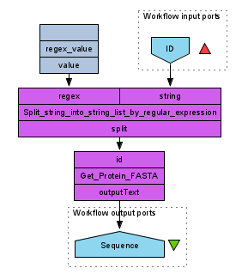
Shims for viewing data
Connect the “regex_value” to the “regex” port.
Connect the “split” output port to Get_protein_Fasta (“ID” input port)

Slide 20
Shims for Data Input
Run the workflow
This time, instead of adding individual IDs add a file of IDs. If you don’t have one to hand, there is one to download here:
http://www.myexperiment.org/files/1267/download
You can download and add the file, or you can add the URL from the input window
As the workflow runs, you will see it iterate over the IDs in the file

Slide 21
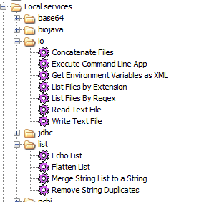
Pre-configured Shims
The local workers are ‘pre-configured’ shims. Have a look at the different categories on offer.

Slide 22
Writing your own shim services - Beanshells
Many shims are actually Beanshell scripts.
Beanshell scripts allow you to add simple data transformation steps into your workflow in an easy way.
We will take a brief look at writing Beanshells

Slide 23
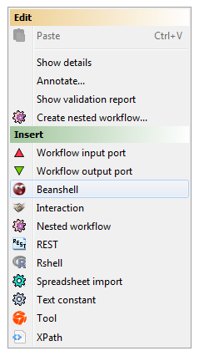
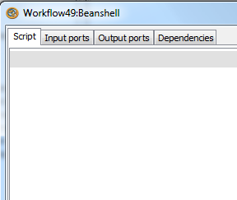
Writing your Own Beanshell
Create a new workflow by selecting ‘file’ and ‘New Workflow’
Add a new Beanshell
Hint (right click on blank part of the workflow)
A configure window will pop-up

Slide 24
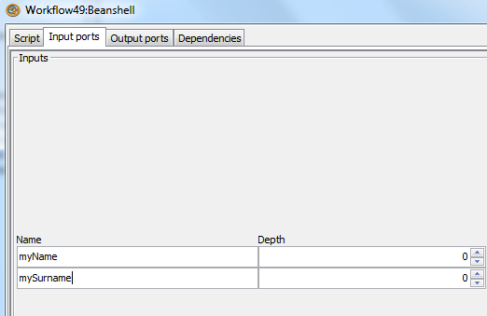
Writing your Own Beanshell
Create 2 input ports named: “myName” and mySurname
Hint: Press “Add Port” after selecting the ‘Input Ports’ tab
Cretate 1 output port named: myFullname

Slide 25
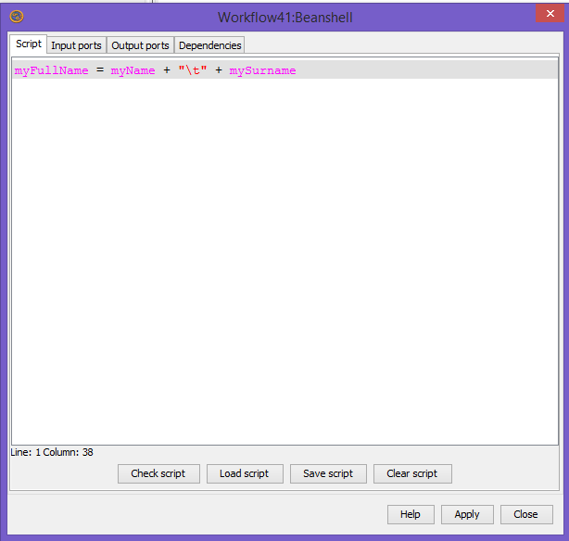
Writing your Own Beanshell
Select the script tab and Paste the following script
myFullname = myName + "\t" + mySurname
The variable names must match exactly the names of the input and output ports
Hint: They are shown in purple when correctly matching
Then “Apply” and “Close” the “Beanshell” Window

Slide 26
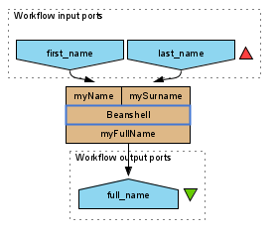
Writing your Own Beanshell
Create 2 workflow inputs and 1 workflow output and connect them to the configured beanshell service.
Hint: The names of the input and output ports do not need to be the same as the names used in the script.

Slide 27
Writing your Own Beanshell
Run the workflow
You should get your full name printed in the output.
This is a very simple example of using helper services to format results from your workflow

