Slide 1


Taverna Tutorial Importing data from a spreadsheet
Stian Soiland-Reyes and Christian Brenninkmeijer
University of Manchester
http://orcid.org/0000-0001-9842-9718
http://orcid.org/0000-0002-2937-7819
Bonn University, 2014-09-01
http://www.taverna.org.uk/
This work is licensed under a
Creative Commons Attribution 3.0 Unported License

Slide 2
Importing data from a spreadsheet
So far we used simple text files but it is also possible to use spreadsheets as sources of input data. In order to do that we will need to add a Spreadsheet tool to our workflow.
Down load the “Example Fasta Ids CVS” file from MyExperiment
Have a look at the file using Excell (or a text editor)
Notice the Fasta IDs are in Column B rows 2 to 6

Slide 3
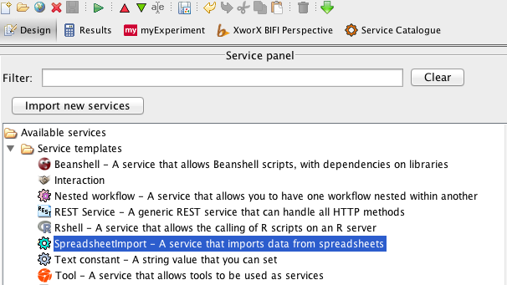
Importing data from a spreadsheet
From the Service Templates select SpreadsheetImport right-click on it and add it to the workflow

Slide 4
Importing data from a spreadsheet
From the Service Templates select SpreadsheetImport right-click on it and add it to the workflow

Slide 5
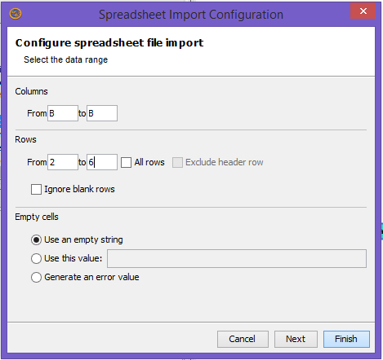
Importing data from a spreadsheet
In the pop up window set the correct range for columns and rows (untick the box “all rows”)
Set the values
Columns B to B
Rows 2 to 6
Select Next
Look at the options
But leave the defaults
Select Finish

Slide 6
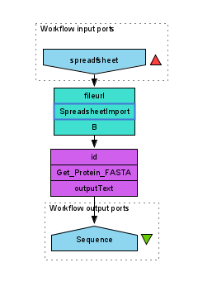
Create a simple workflow
Add
Get_Protein_FASTA service
Input port
Output port
Connect the service as shown
Notes:
6

Slide 7
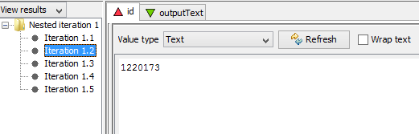
Importing data from a spreadsheet
Run the workflow and look at the results
Set file location to the file you downloaded.
Click on the “Get_Protein_Fasta service
In the Graph tab of the Results View
Select Id to see the Data being sent into this service

Slide 8
Importing data from a spreadsheet
In this tutorial you saw another method of import data into Taverna.
Just remember to save you spreadsheets in csv (Comma separated format)
Csv spreadsheets can also be read directly from a URI using the “Set URL” rather than “Set file location”

