Slide 1


An Introduction to REST Services in Taverna
Stian Soiland-Reyes and Christian Brenninkmeijer
University of Manchester
materials by Katy Wolstencroft and Aleksandra Pawlik
http://orcid.org/0000-0001-9842-9718
http://orcid.org/0000-0002-2937-7819
http://orcid.org/0000-0002-1279-5133 http://orcid.org/0000-0001-8418-6735
Bonn University, 2014-09-01
http://www.taverna.org.uk/
This work is licensed under a
Creative Commons Attribution 3.0 Unported License

Slide 2
REST Services
Data and tools on the Web have been exposed in a RESTful manner. Taverna provides a custom processor for accessing such services.
REST stands for REpresentational State Transfer
Web services with this type of interface typically expose some of the following four types of operations:
GET - to get a resource
POST - to make a new resource or to perform a request (such as search)
PUT - to update a resource
DELETE - to delete a resource
Notes:
2

Slide 3
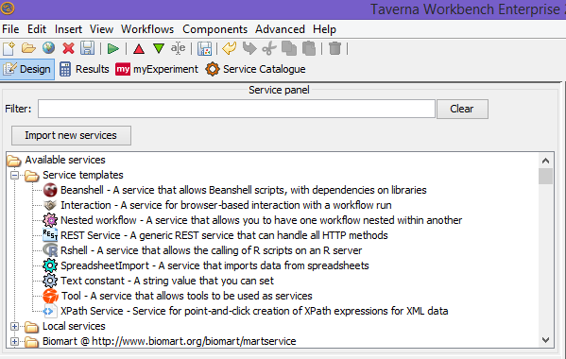
Adding a REST web service
Expand the Service templates folder under Available services in the Service Panel. Select the REST service template and drag n drop it into the Workflow Diagram
Notes:
3

Slide 4
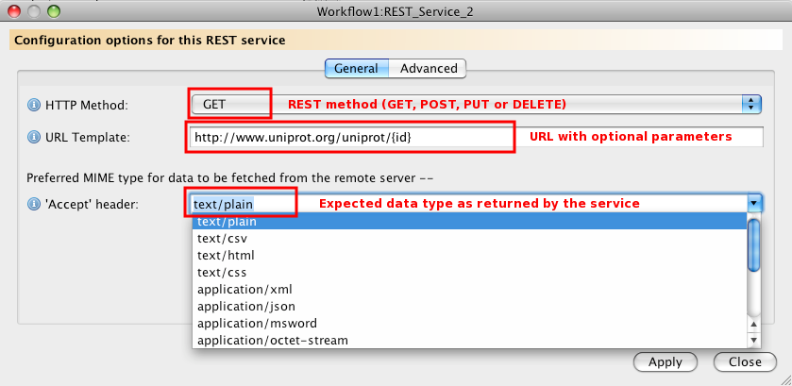
Configuring a REST Service
In a dialog box that pops up, configure the use of a REST service by adding the:
URL of the service, e.g. http://www.uniprot.org/uniprot/{id}
Type of the operation you want to perform on the service, e.g. GET
The expected MIME data type as returned by the services. Select text/plain in this case.
Notes:
4

Slide 5
Configuring a REST Service
The URL of the service you enter is actually a template that can take configurable parameters
In the current example, the name of the parameter is ‘id’ which is enclosed within a pair of braces
Parameters are used when you do not know their value in advance, i.e. at the time of adding the service to the workflow diagram, and they depend on some of the previous services in the workflow.
The value in braces will then be replaced with the actual value when the workflow is executed.

Slide 6
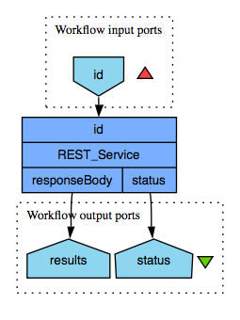
Building a simple workflow using a REST service
To complete the building of a simple workflow using the Uniprot REST web service, add:
a workflow input for the REST service input port named ‘id’
workflow outputs for the responseBody and status output ports of the REST service activity
The workflow should now look as follows:
Notes:
6

Slide 7
Building a simple workflow using a REST service
Now try running the workflow using an example Uniprot identifier such as Q99102.fasta
Note that the presence of the .fasta suffix enables the protein sequence to be returned as text
What happens when you don’t use the .fasta suffix?
Try using other suffixes, e.g. xml, txt, rdf and gff
Further information about the Uniprot REST service is available from http://www.uniprot.org/faq/28

Slide 8
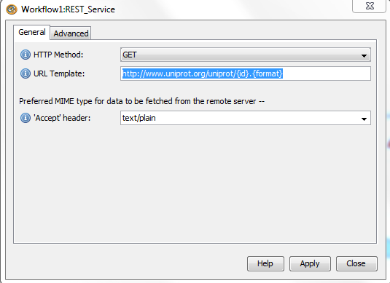
Configuring a REST service
Let’s add the format (xml, fasta and so on) as another parameter
Open the REST service configuration and add “.{format}” to the URL Template
Hint: In “Design” view, right click on the REST_Service and select Configure REST Service

Slide 9
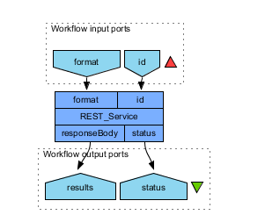
Configuring a REST service
Now we need to add an input port to the workflow

Slide 10
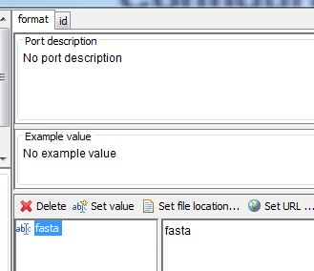
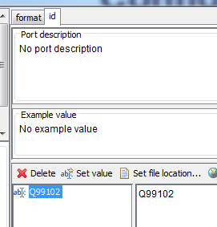
Configuring a REST service
Now when we run the workflow we need to specify the format as an input, the id must not include the format

Slide 11
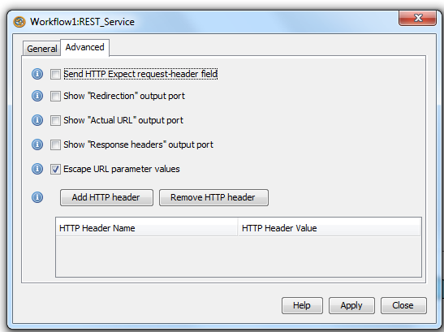
Advanced configuration of REST services

Slide 12
Advanced configuration of REST services
Send HTTP Expect request-header
This field option allows Taverna to set a special "Expect" header when sending a request to the REST service. Client requests using the POST method will expect to receive a 100-Continue or Redirect response from the service to indicate that the client should proceed to send the POST data.
This mechanism allows clients to avoid sending large amounts of data over the network twice when the service could reject or redirect the request. Selecting this option may significantly improve performance when large volumes of data are to be sent to the service and authentication or a redirect from the original URL to the one specified by the service is likely.

Slide 13
Advanced configuration of REST services
Redirection output port
The Show "Redirection" output port option makes the service's redirection output port visible as this output port is hidden by default. The port will contain the URL of the final redirect that has yielded the output data on the responseBody port.
Show "Actual URL" output port
If this box is selected, then the REST service will have a port called "actualURL". When the service is invoked, the URL that is used as a result of replacing all the parameter values is output on the port.

Slide 14
Advanced configuration of REST services
Show "Response headers" output port
If this box is selected, then the REST service will have a port called "responseHeaders". When the service is invoked, the list of HTTP headers from the REST service call will be output on the port. Note that if the calling of the service includes redirection, then it is the final set of HTTP headers that is output.
Escape URL parameter values
If this box is selected (the default) then when values are passed to the REST input and those values are included in the URL, they are escaped so that they can form part of a valid URL. It is not a good idea to uncheck this box.

Slide 15
Further exercises
There are many more REST services available in bioinformatics
Try to find these using BioCatalogue and test them using Taverna

