Slide 1


Taverna Xpath service Getting Data out of XML
Stian Soiland-Reyes and Christian Brenninkmeijer
University of Manchester
material by Mr Alan Williams
http://orcid.org/0000-0001-9842-9718
http://orcid.org/0000-0002-2937-7819 http://orcid.org/0000-0003-3156-2105
Bonn University, 2014-09-01 / 2014-09-03
http://www.taverna.org.uk/
This work is licensed under a
Creative Commons Attribution 3.0 Unported License

Slide 2
The Basics of XML
XML – eXtensible Markup Language
Designed for the storage and transport of data
This includes passing data between services or retrieving data from a Web page
Provides a machine readable dataset
Many service providers export data in XML
Notes:
2

Slide 3
Example
<?xml version="1.0"?>
<note>
<to>Katy</to>
<from>Helen</from>
<heading>Reminder</heading>
<body>Don't forget about Bonn Trip!</body>
</note>
The following website has lost of information about XML and tutorials: http://www.w3schools.com/xml

Slide 4
Extracting XML Elements
Often, we need to extract particular elements of the XML to feed into the next services in the workflow
Taverna has a dedicated service to help you do this
Go to the service panel and find “Xpath Service” in the Service Templates section.
We will use this service to explore the contents of an SBML file from the BioModels database, but first we need to find the BioModels services

Slide 5
Extracting XML Elements from SBML
SBML is the Systems Biology Mark-up Language. It is the community standard for describing systems biology models
SBML models contain information about the reactions between enzymes, genes, and metabolites, and their interactions in living systems
Well-annotated SBML models will contain descriptions of model entities and official IDs to link those entities back to their sources (e.g. Uniprot IDs for proteins/enzymes, KEGGIDs or ReactomeIDs for reactions etc)

Slide 6
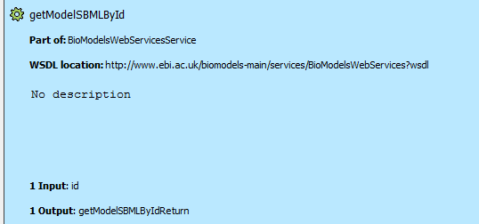
Extracting XML Elements from SBML
We will find all the BioModels constructed in yeast (Saccharomyces cerevisiae), and find the publications about them
In Biocatalogue, search for the ‘BioModels’:
getModelsIDByTaxonomy
getModelSBMLByID
And add these services to the Service Panel and your workflow.
Hint: As you did in the
REST exercise

Slide 7
Extracting XML Elements from SBML
Add a input port (rename the service to TaxonomySearch) and connect it with getModelsIdByTaxonomy
Then connect the output (Return) from getModelsIdByTaxonomy with the input for getModelSBMLById
Create an output port

Slide 8
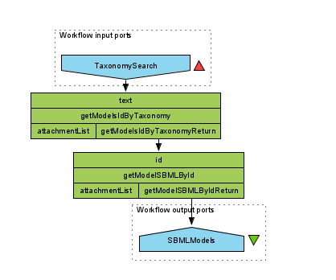
Extracting XML Elements from SBML
The workflow should look like this

Slide 9
Extracting XML Elements from SBML
Run the workflow using the value Saccharomyces cerevisiae
Hint: As you only need 1 Value you can “Cancel” the workflow as soon as a few Values appear
Save one of the SBML models as an XML file
Hint: In the results view select on of the Values from the List for example “Value 1”
Click on “Save Value”
Using a .xml file extension will make it easier to find

Slide 10
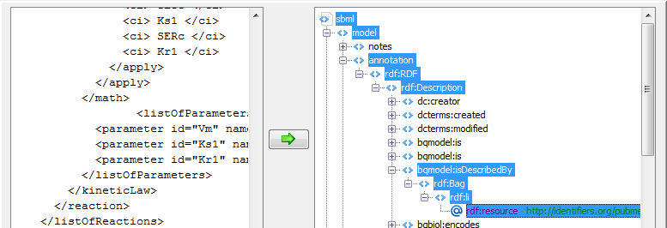
Extracting XML Elements from SBML
Now import the Xpath Service from Taverna
In the pop-up window, enter the path to the saved SBML file and click the green arrow to load it into the service
By expanding the + icons, you can explore the file
Expand the XML under ‘annotation’, until you reach RDF:resource

Slide 11
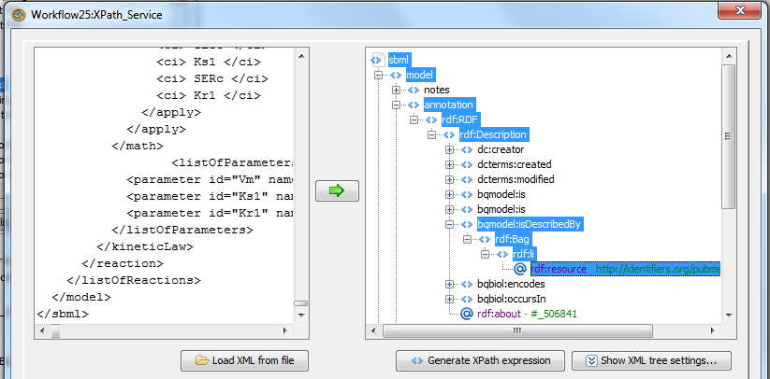
Extracting XML Elements from SBML
Click on ‘Generate Xpath From Expression’
Then Click on ‘Run Xpath’ and click ‘Apply’
This service will now pull out all the reactions from each model

Slide 12
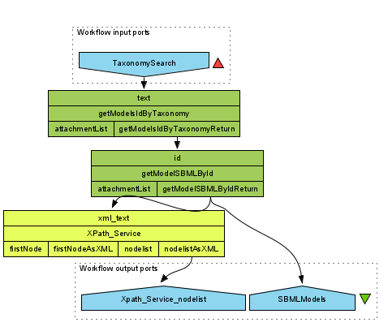
Extracting XML Elements from SBML
Connect it to the output of ‘getModelSBMLByID’
Add an output port to the Xpath service “nodeListAsXML”
Save and run the workflow again

Slide 13
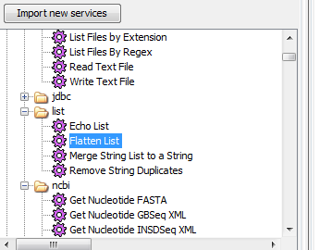
Extracting XML Elements from SBML
We can change the output of the Xpath service into a flattened list
(In Design View) Go to the Services Panel and add a Flatten List (from “Available Services”/Local Services”/“list”)

Slide 14
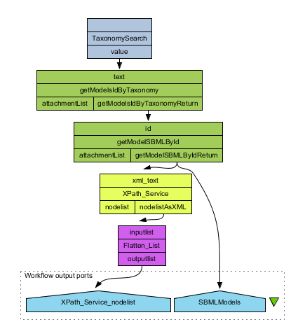
Extracting XML Elements from SBML
Connect the output of the Xpath service to the “Flatten List”
Connect the output of the “Flatten List” with the output port

Slide 15
Extracting XML Elements from SBML
Run the workflow again
Note: Flatten_List will not show any values until the workflow is finished as its output is a single list
Optional: Try the service with a different Xpath Query
In Design View right click the Xpath Service
Select Configure Xpath Service
This brings back up the configuration Screen you saw earlier.

