Slide 1


Asynchronous services in Taverna
Stian Soiland-Reyes and Christian Brenninkmeijer
University of Manchester
http://orcid.org/0000-0001-9842-9718
http://orcid.org/0000-0002-2937-7819
Bonn University, 2014-09-01 / 2014-09-03
http://www.taverna.org.uk/
This work is licensed under a
Creative Commons Attribution 3.0 Unported License

Slide 2
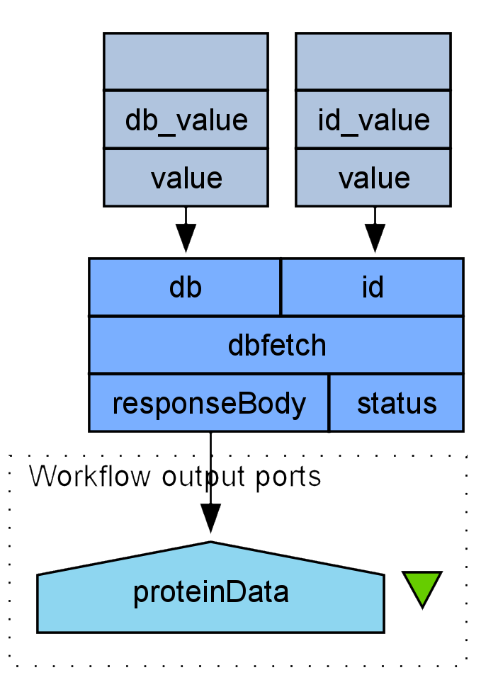
Synchronous web services
Most web services (REST and SOAP) are synchronous
No response until the processing/results are ready
Problem:
Long-running calculations (e.g. sequence alignment) can time out on the network
Can’t tell if the service is taking a long time to process, or is simply failing to respond

Slide 3
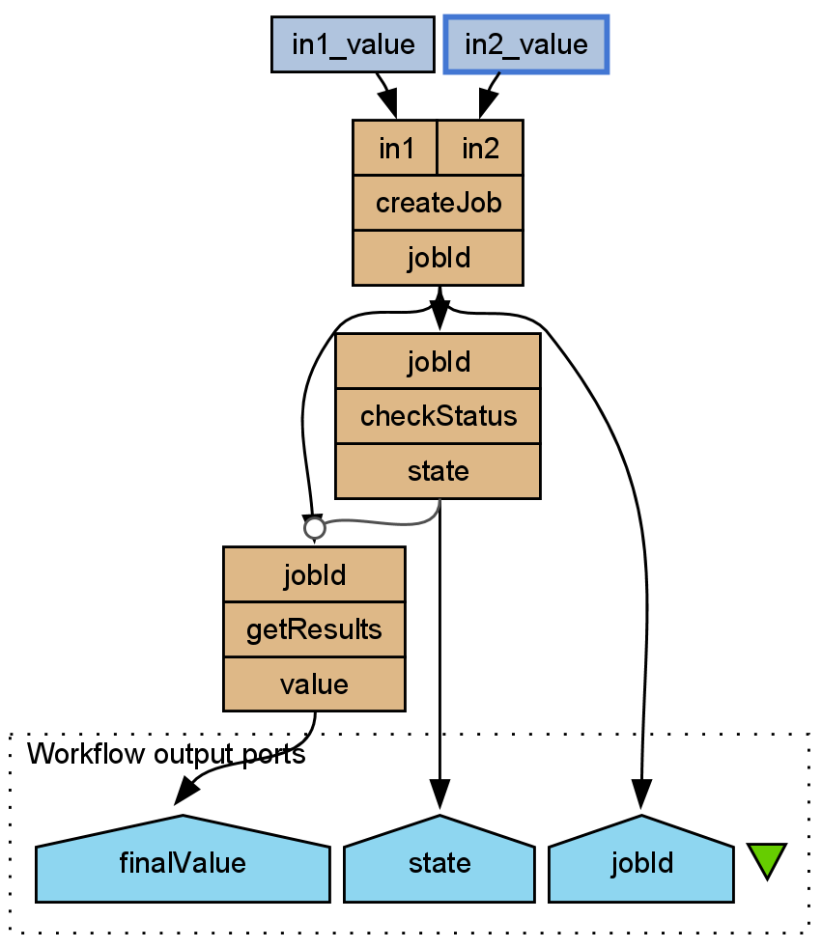
Asynchronous services
Asynchronous services on the other hand works by multiple calls in a fixed pattern.
Typical pattern:
createJob takes any inputs, and returns some kind of jobId – e.g. 001572
checkStatus return the current state of the job – e.g. RUNNING
getResults retrieve the outputs for the job

Slide 4
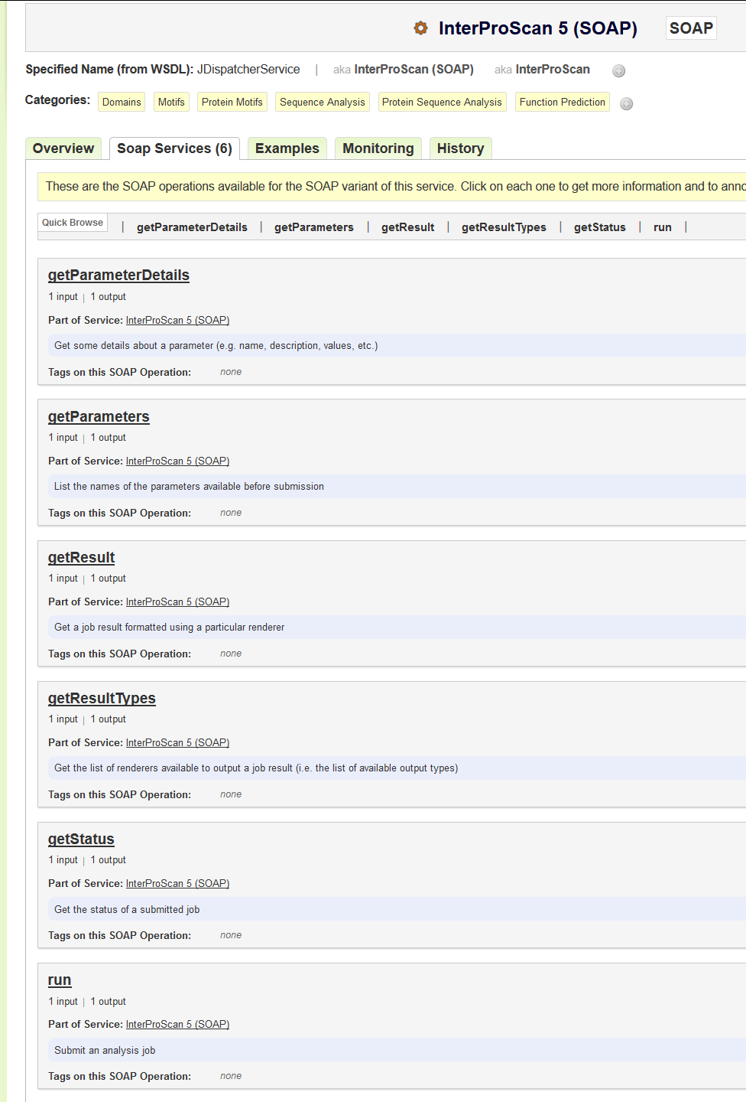
How to recognize an asynchronous service?
Although this is a common pattern, services vary in what they call each step and state. Typical names:
createJob, submit, run, runAsync, launch, sequenceAlignment
Returning jobId, job, id, run
checkStatus, job_state, check_job, isFinished
Might return more than just the status
getResults, retrieveOutput, jobOut
Sometimes merged with checkStatus
RUNNING, active, QUEUED, Finished, complete, ready
https://www.biocatalogue.org/services/3679/service_endpoint

Slide 5
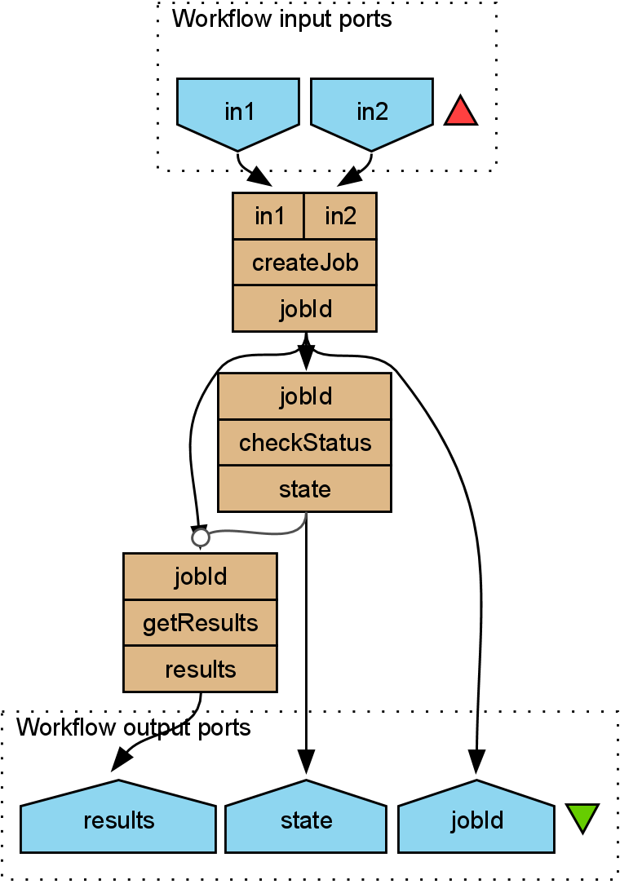
Asynchronous service pattern in Taverna
A control link ensures getResults does not run until checkStatus is finished
Looping on checkStatus to repeat until status is no longer RUNNING
Covering both FINISHED and FAILED
Might be a nested workflow
Wrapped as a nested workflow or component to appear as a single service within mother workflow

Slide 6
Exercises
“Looping” Exercise (in Advanced Taverna) details how to configure looping in a workflow using the EBI InterproScan protein signature recognition service.
“Control Links” Exercise details how to add control links to ensure results are not fetched before the job is complete.

