Slide 1


Nested workflows
http://dev.mygrid.org.uk/wiki/display/tav250/Nested+workflows
Stian Soiland-Reyes and Christian Brenninkmeijer
University of Manchester
http://orcid.org/0000-0001-9842-9718
http://orcid.org/0000-0002-2937-7819
Bonn University, 2014-09-01 / 2014-09-03
http://www.taverna.org.uk/
This work is licensed under a
Creative Commons Attribution 3.0 Unported License

Slide 2
A combination of services in a workflow can often be seen as playing a single functional role. For example:
A web service with shims that massage inputs and outputs
A series of services that perform a particular scientific function – e.g. filtering or merging
Nested workflows is a way to group such workflows – represented as a delimited box
Nested workflows can be collapsed to reduce clutter in the mother workflow
Nested workflows can either be made from scratch, or by importing an existing workflow.
A nested workflow can be reused in several mother workflows and are easier to replace/update.

Slide 3
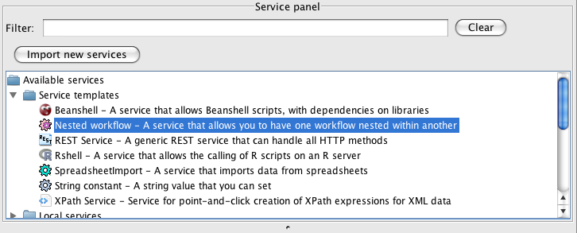
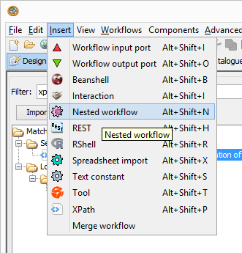
Adding a nested workflow
Start with File -> New workflow
Under Available services, expand Service templates
Select Nested Workflow.
Drag and drop the Nested Workflow to the Workflow Diagram.
In a dialog that pops up, you will have several options on how to import a nested workflow.
Alternatively, in the menu, click Insert -> Nested workflow

Slide 4
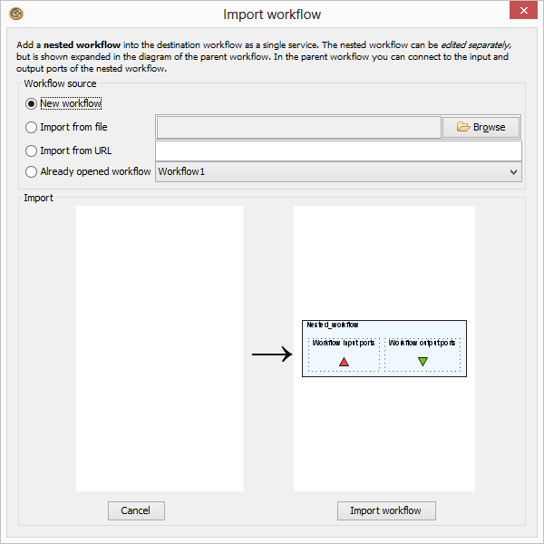
New nested workflow
Select New workflow and click Import workflow

Slide 5
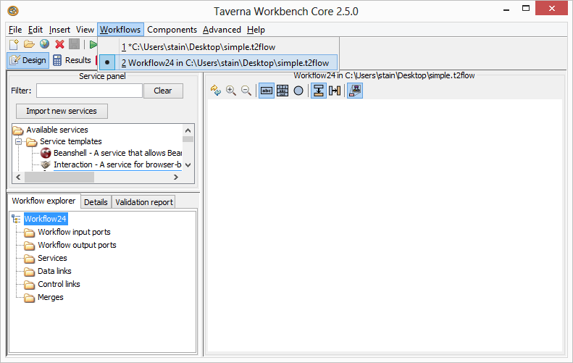
Workflows menu
What happened? Why is the Design perspective empty?
Look in the Workflows menu
Are you able to switch back and forth between the nested and mother workflow?

Slide 6
Building dbfetch workflow
Editing the nested workflow, and add:
REST service dbfetch
As of tutorial 2, from Service Catalogue / Available Services
Or using the URL template http://www.ebi.ac.uk/Tools/dbfetch/dbfetch/{db}/{id}
Workflow Input Port id
Workflow Output Port fetched (nicer name than responseBody)
Text Constant db – value uniprotkb
Connect dbfetch to workflow ports and text constant
To test, run the nested workflow separately, using the input P15409

Slide 7
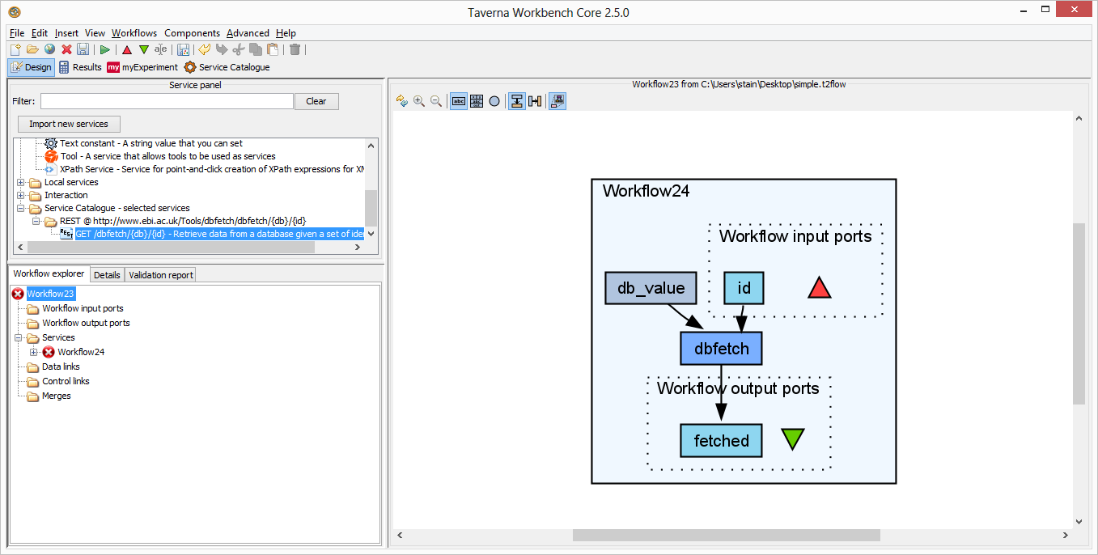
Saving nested workflow
Go back to the Design perspective.
To “save” the nested workflow into its parent, do File -> Save
Go to the parent using the Windows menu

Slide 8
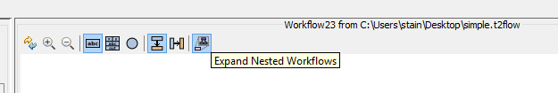
Collapse the nested workflow
Nested workflows can be collapsed to hide the implementation details
In the diagram toolbar, click to disable Expand Nested Workflows
Also click to Display all service ports

Slide 9
Nested workflow as a service
The nested workflow now appears as a regular service in the master workflow
Rename from Workflow4 to dbfetch
Right-click on id to set the Constant Value P15409
Connect fetched to a new Workflow Output port.
File -> Save the master workflow
Run the master workflow

Slide 10
Further exercises
Right-click on Workflow24 and Edit Nested Workflow
Replace db_value with another workflow input port
Use File -> Save as… to a file, then File -> Close
In the master workflow, Expand nested workflow. What happened?
Right click and use Replace nested workflow
Create a new nested workflow
Use “Import from file” or “Already opened workflow” to import the InterproScan workflow from the Asynchronous Service tutorial
Check how your master workflow now contains a nested, nested workflow.
(Advanced): Do you see any advantage of this approach with regards to the Control Link?
(Advanced): Try Insert -> Merge workflow
What do you see as advantages and problems with this approach?

