Slide 1


An Introduction to Running, Reusing and Sharing Workflows with Taverna
Stian Soiland-Reyes and Christian Brenninkmeijer
University of Manchester
materials by Katy Wolstencroft, Aleksandra Pawlik, Alan Williams
http://orcid.org/0000-0001-9842-9718
http://orcid.org/0000-0002-2937-7819 http://orcid.org/0000-0002-1279-5133
http://orcid.org/0000-0001-8418-6735
http://orcid.org/0000-0003-3156-2105
Bonn University, 2014-09-01 / 2014-09-03
http://www.taverna.org.uk/
This work is licensed under a
Creative Commons Attribution 3.0 Unported License

Slide 2
This tutorial will give you a basic introduction to reusing workflows in Taverna and my Experiment.
Other tutorials will explore nested workflows, the workflow engine (iteration, looping, parallel invocation)
Like in the previous tutorial workflows in this practical use small data-sets and are designed to run in a few minutes. In the real world, you would be using larger data sets and workflows would typically run for longer

Slide 3
Bigger Workflows: Enrichment Analysis
The previous examples were trivial, small tasks. Taverna’s real power is in iterating over large data sets
Many experiments result in a list of genes (e.g. microarray analysis, Chip-Seq, SNP identification etc).
In this exercise, we will use Taverna to analyse a gene set from a Chip-Seq experiment by finding and reusing existing workflows
We will enrich our dataset by discovering:
Which pathways our genes are involved in
The functions of the genes
Literature evidence for the phenotype/trait of interest
Notes:
###

Slide 4
Re-using workflows from myExperiment
Go to http://www.myexperiment.org and click on ‘find workflows’
You will see a list of the most viewed and downloaded workflow – see what the most popular workflow does by reading the description
Change the rank to ‘Latest’ and see what has been uploaded in the last few weeks
We will now find and download a workflow to identify the pathways each gene in our gene set is involved in

Slide 5
Re-using workflows from myExperiment
Find the workflow called “UnigeneID to KEGG Pathways” and look at the workflow entry page (uploaded by “Aleksandra Pawlik”)
Download the workflow by clicking on the link: “Download Workflow” and find out what it does by reading the descriptions in myExperiment
Open the workflow in Taverna by going to ‘File ->Open Workflow’
Run the workflow using the example values supplied (Hint: when you run the workflow you can add the example values by clicking on “Use examples”)
Look at the workflow output – now you will see pathway information and pathway diagrams

Slide 6
Combining workflows from myExperiment
To analyse all the genes from our ChipSeq study, we need to extract the gene list from our results file
To make it easier to work through the example, we have provided a Chip-Seq gene list on myExperiment, you can find it under “GalaxyGeneList - short : datafile for training”
Save this file to your local machine
Open the file in Excel
Save the file with a .csv extension
As you can see, the list of genes is in column D
Taverna can process and extract this column automatically

Slide 7
Combining workflows from myExperiment
In myExperiment, find and download the workflow called “Import and convert gene list”
This workflow will extract the list of genes in column D using Taverna’s built-in spreadsheet import tool (which can be found in the services panel, for future reference)
The next step in the workflow converts RefSeq IDs into unigene IDs (required for the pathways workflow – converting between different types of identifiers is a common problem in bioinformatics!)
Run the workflow. This time, in the input window, select “set file location” and set the location to the saved .csv gene list.
Look at the workflow results

Slide 8
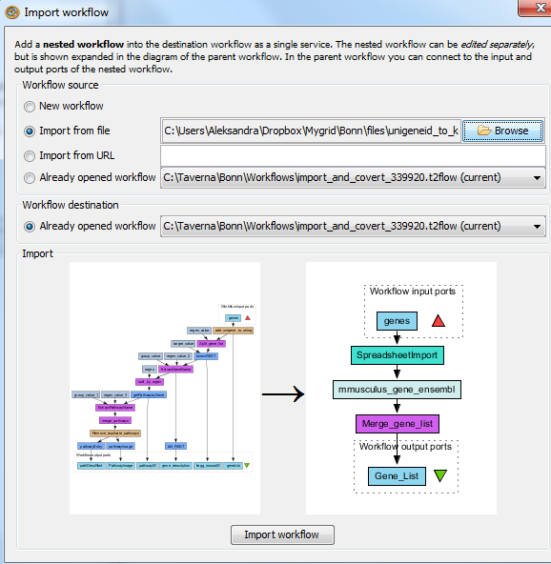
Combining workflows from myExperiment
We will now combine the two workflows
While you are still in the “import and convert” workflow, go to the top of the workbench and select “insert -> Nested workflow”
In the pop-up window, select “import from file” and find the pathways workflow you downloaded earlier.
Click on “import workflow” and the pathways workflow will appear in the main workflow diagram.

Slide 9
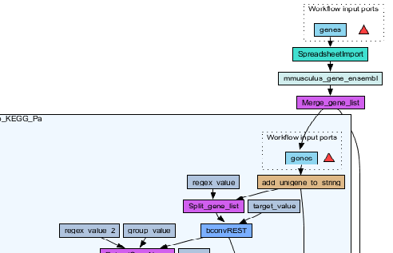
Combining workflows from myExperiment
Connect the workflows up by linking the output of the ‘Merge_Gene_List’ with the nested workflow input

Slide 10
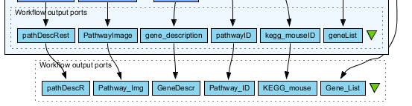
Combining workflows from myExperiment
Create new output ports for the Nested workflow and connect the Nested workflow outputs to the new outputs
NOTE: you don’t need to connect them all, just pathway descriptions, pathway images and gene descriptions
Save the workflow
Run the workflow (it may take a few minutes)

Slide 11
GO Associations
There are many different tools we could use to find Gene Ontology associations for your gene list
For example, we could simply modify the BioMart/Ensembl service in the ‘Import and convert gene list’ workflow we have already used
Reload the ‘Import and Convert gene list’ workflow
Right-click on the ‘mmusculus_gene_ensembl’ service and select ‘Copy’
Paste an extra copy of this service into the same workflow diagram
Notes:
11

Slide 12
GO Associations
This is a BioMart service. It allows you to retrieve omics data from ENSEMBL and other genomics resources. If you are familiar with BioMart, you will see the interface in Taverna is very similar to the web interface
We will modify the BioMart query to find all GO associations for each gene associated with a Chip-Seq peak
Right-click on the new copy of the service and select ‘Configure BioMart Query’
Notes:
12

Slide 13
GO Associations
The inputs (or filters) already accept RefSeq Ids from our input file, but we need to modify the outputs (or attributes)
Select ‘Attributes’ and expand the …‘External’… section.
Select ‘Go Term Accession’, ‘GO Term Definition’ and ‘Go Domain’
Unselect ‘UniGeneID’ and select ‘RefSeq mRNA’…
(See screenshot on the next slide for an example)
Notes:
13

Slide 14
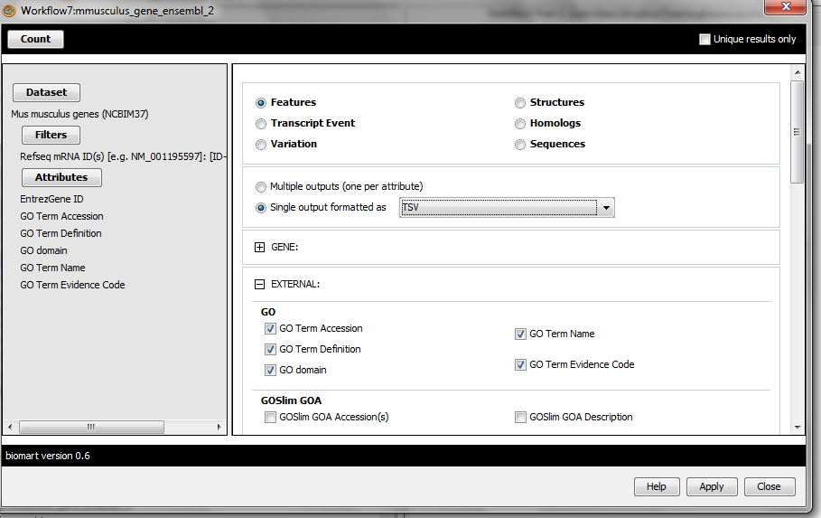
GO Associations
Notes:
14

Slide 15

GO Associations
Click ‘apply’ to save your changes, and ‘close’, to go back to Taverna
At the top of the workflow diagram, change the workflow view to show all ports by clicking on the table icon
Notes:
15

Slide 16
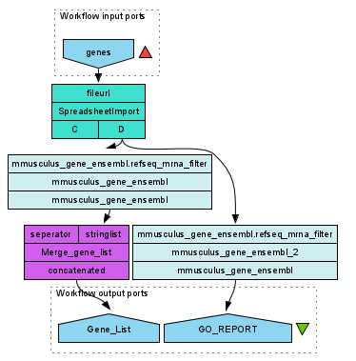
GO Associations
Connect your new service to the workflow by linking the ‘D’ output port of the spreadsheet service to the input of your new service
Make the new output ports and connect them as shown to your new service
Notes:
16

Slide 17
GO Associations
Save the workflow by going to ‘File -> Save Workflow’
Run the workflow
Set file location to the GalaxyGeneList file saved earlier
(Download and) view the GO report
In “GO_REPORT” tab select “Value 1” and press “Save Value”
Save as a .txt or as a .tsf (tab separated) file
Notes:
17

Slide 18
Simple Text Mining
So far we have looked at enriching the genomic information, but we could also use workflows for running data analyses (e.g. aligning mouse genes with human homologues) or performing literature searches
Think about the ways you could extend this analysis with literature searches (e.g. Correlations between pathways, genes, GO terms, phenotypes etc)
Search myExperiment for workflows involving text mining, using the search terms “text mining” and “Pubmed”
Notes:
18

Slide 19
Text Mining
Find and open the workflow “Phenotype to pubmed”
One of the services is no longer available in the nested workflow (the faded-out service). Taverna checks the availability of each service when you load the workflow and when you run it
In this case, the workflow will still run without the final nested workflow (clean text)
Delete the ‘clean text’ nested workflow (by selecting it and right-clicking), and reconnect the workflow output
Run the workflow with the search term ‘erythropoiesis’ (or a phenotype term to describe the disease you are studying)
Notes:
19

