Slide 1


An Introduction to Taverna Components
Stian Soiland-Reyes and Christian Brenninkmeijer
University of Manchester
materials by Aleksandra Pawlik
http://orcid.org/0000-0001-9842-9718
http://orcid.org/0000-0002-2937-7819 http://orcid.org/0000-0002-1279-5133
http://orcid.org/0000-0001-8418-6735
Bonn University, 2014-09-01
http://www.taverna.org.uk/
This work is licensed under a
Creative Commons Attribution 3.0 Unported License

Slide 2
What is a component?
Something that can be put into a workflow
Well described - what the component does
Behaves “well” - conforms to agreed good practice
Curated - someone looks after it
Produces and consumes data in agreed formats
Fails in described ways - meaningful error messages
Produces agreed type of provenance
Documentation
Example usage

Slide 3
Usefulness of components
Hide complexity
Predictable good behaviour
Guaranteed to work together
Can (in theory) check that data in a run conforms to the component specification

Slide 4
What is the agreement?
The agreement is a condition of being in a “component family”
Different domains, or even different uses within a domain, have different agreements
Astronomical data is not in the same formats as biodiversity data
Digital library components do not do the same tasks as biodiversity components
Agreement is formalized as a “component profile”

Slide 5
Implementation
A component family is
a pack on myExperiment, or
a directory on your local machine
A component is defined by a workflow (in a pack) in a component family pack
Components are versioned by the myExperiment’s versioning
Semantic annotations are stored in RDF as part of the workflow definition
Collated semantics, including workflow structure, are combined on myExperiment.

Slide 6
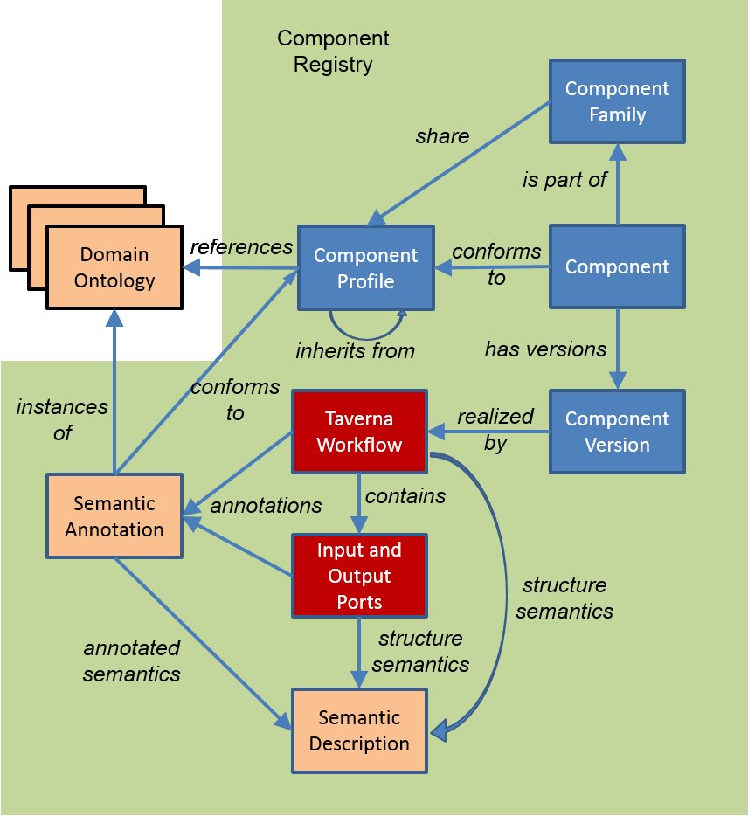
Implementation

Slide 7
Component pack
Contains:
Workflow ‘realizing’ the component
Example data
Documentation
Dependency specification

Slide 8
Component use
A component family is shown in the service panel of Taverna workbench
Components can be included within a Taverna workflow
Components are not simply the same as nested workflows
You could think of them as nested workflows that obey a set of rules and where you cannot see what is nested (and should not care)

Slide 9
Component creation
Components are created by annotating a workflow
Choice of a component family and so profile
Semantic annotation from the specified ontologies
Validation against the profile
Component saved into the component family
Can annotate:
Workflow
Input/Output ports
Services inside workflow
Extensions to myExperiment for
Pack snapshots
Semantic collation
Semantic searching

Slide 10
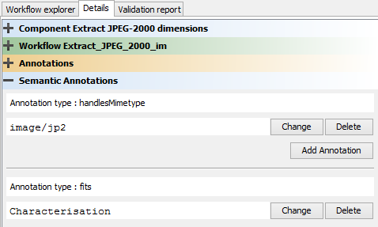
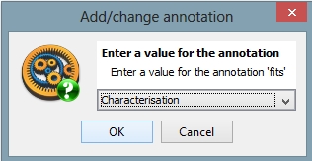
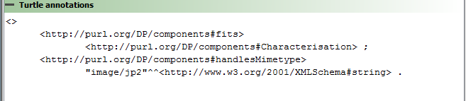
Semantic annotation

Slide 11
Effect on workflows
Use of components will allow
Component developers to work on the component
Component users to upgrade (or revert) the component versions
A workflow to remain ‘unchanged’ (if the component interfaces remain the same)
Powerful and dangerous
Proxies for components (re-run and re-play)
Components are “black boxes” in the workflow and workflow runs

Slide 12
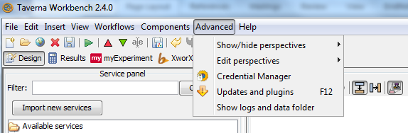
Taverna Components in practice
In this exercise we will create a component which removes duplicate words from a string
First, we need to install the components plugin
Select “Updates and plugins” from the “Advanced” menu

Slide 13
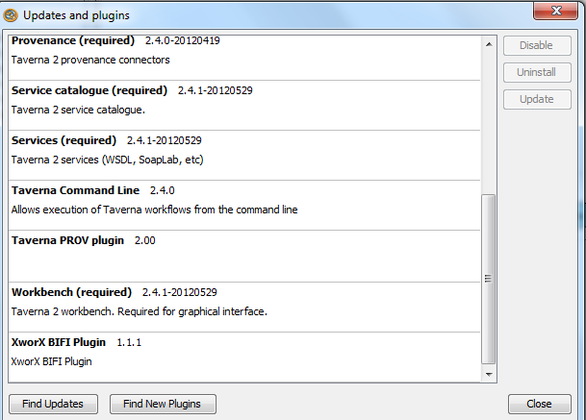
Taverna Components in practice
Search for the plugins – you should be able to find “Component Taverna plugin” and install it
Restart Taverna

Slide 14
EBI InterproScan
The workflow to call EBI InterproScan was quite complex.
It would be nice to be able to package that workflow up and be able to use it as a single service in other workflows
That is exactly what components allow

Slide 15
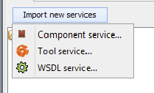
Importing a component family
Components are grouped into component families
Component families are held in a component registry
myExperiment is a component registry
You can import a component family into the Service Panel
Click Import new services and then
Component service…

Slide 16
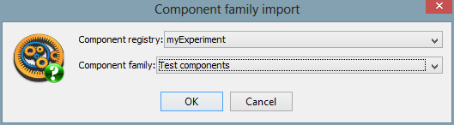
Selecting a component family
In the dialog
Select myExperiment component registry, and
Test components family
Click OK

Slide 17
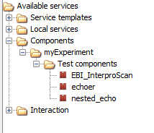
Added component family
In the Service panel you can now expand and see the Test components family

Slide 18
Adding a component to a workflow
Create a new workflow
Add the EBI_InterproScan component into the workflow
Create input and output workflow ports and connect them to the ports of the component

Slide 19
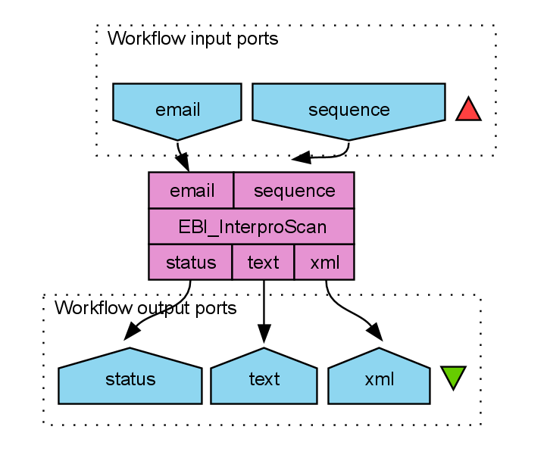
EBI InterproScan component

Slide 20
Running the workflow
You can now run the workflow
The value for the sequence should be something like:
>sp|Q9BTV4|TMM43_HUMAN Transmembrane protein 43 OS=Homo sapiens GN=TMEM43 PE=1 SV=1
MAANYSSTSTRREHVKVKTSSQPGFLERLSETSGGMFVGLMAFLLSFYLIFTNEGRALKT
ATSLAEGLSLVVSPDSIHSVAPENEGRLVHIIGALRTSKLLSDPNYGVHLPAVKLRRHVE
MYQWVETEESREYTEDGQVKKETRYSYNTEWRSEIINSKNFDREIGHKNPSAMAVESFMA
TAPFVQIGRFFLSSGLIDKVDNFKSLSLSKLEDPHVDIIRRGDFFYHSENPKYPEVGDLR
VSFSYAGLSGDDPDLGPAHVVTVIARQRGDQLVPFSTKSGDTLLLLHHGDFSAEEVFHRE
LRSNSMKTWGLRAAGWMAMFMGLNLMTRILYTLVDWFPVFRDLVNIGLKAFAFCVATSLT
LLTVAAGWLFYRPLWALLIAGLALVPILVARTRVPAKKLE

Slide 21
Connecting components
The workflow just contains the single service, we need to connect the component with other services
In the Design view, delete the sequence workflow input port
Right click and select Delete workflow input port
Add Local Services -> ncbi -> Get Protein FASTA to the workflow
Connect the outputText of Get Protein FASTA to the sequence port of the EBI_InterproScan
Connect the id port of Get Protein FASTA to a workflow input port

Slide 22
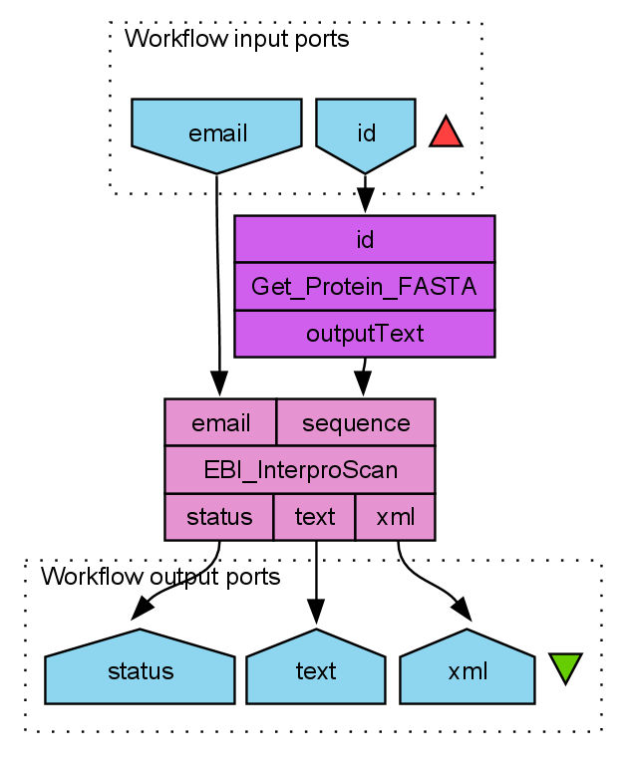
Connected component
Your workflow should now look like:

Slide 23
Running the workflow - 2
Run the workflow again
You can use Q9BTV4 as the value for id

Slide 24
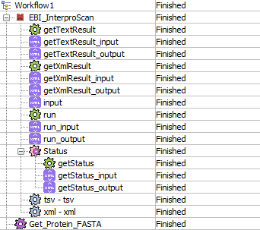
Is it really the complex workflow?
In the Results view you can click on Progress report
Expand EBI_InterproScan
You can see all the services “hidden” inside the component

Slide 25
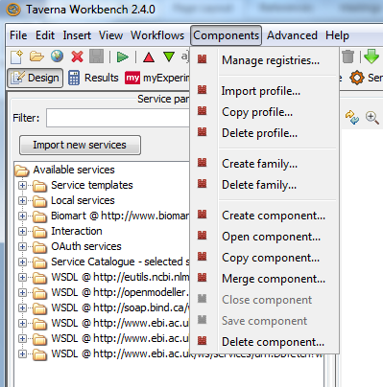
Taverna Components in practice
The menu has a “Components” option
Select “Create family”

Slide 26
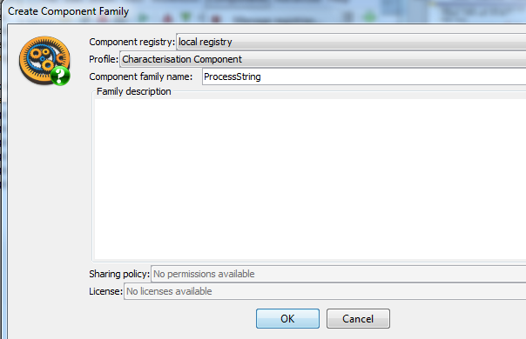
Taverna Components in practice
In the pop-up window set the registry to local
Select a Profile (or see next slide if no profile available)
Enter the family name (“ProcessString”)

Slide 27
Adding a Profile (if required)
Find your local registry directory
Hint: Components/ Manage Registries
Registry Location
In MyExperiment find the Empty profile
Hint: http://www.myexperiment.org/files/1027.html
Down File into the local registry directory

Slide 28
Taverna Components in practice
Add a local service “Split string into string list by regular expression” (from ‘text’)
Add the input port and set the regular expression to space
Add a local service “Remove string duplicates” (from ‘list’)
Connect the output from “Split string into string list by regular expression” with the input of “Remove string duplicates”
Add a local service “Merge String List to a String” and connect its input with the “Remove string duplicates” output and set the separator to be a space

Slide 29
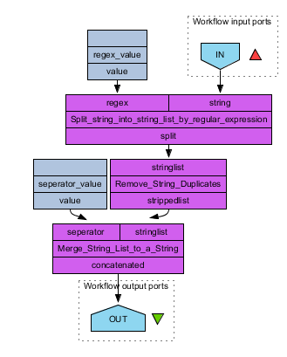
Taverna Components in practice

Slide 30
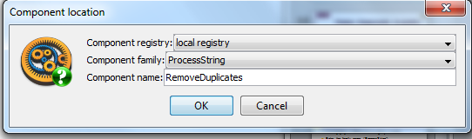

Taverna Components in practice
Select “Create component” from the “Components” menu
Provide a name for the component (Remove duplicates)
You should see a pink ribbon at the top
Save the component. You will see a warning message – it pops up because the component is not annotated. We can annotate it in the component details.

Slide 31
Using your Component
Close any open workflows
Add the component(s) to the service panel
Hint: Import Service/ Component Family
Component registry: Local registry
Component family: ProcessString
Add the component to the workflow
Hint: Available services/ Components …
Add input and output ports
Run

