Slide 1


Introduction to the Taverna Tool service
Stian Soiland-Reyes and Christian Brenninkmeijer
University of Manchester
material by Mr Alan Williams
http://orcid.org/0000-0001-9842-9718
http://orcid.org/0000-0002-2937-7819 http://orcid.org/0000-0003-3156-2105
Bonn University, 2014-09-01 / 2014-09-03
http://www.taverna.org.uk/
This work is licensed under a
Creative Commons Attribution 3.0 Unported License

Slide 2
What is a tool service?
Allows you to call a command line script as part of a workflow
Simplest case is calling a single tool
Can be run on your local machine or a machine that you can ssh to
Data is passed by reference
No big transfers to/from Taverna
Data kept where the script is run until/unless needed

Slide 3
Using a simple tool service
Choose “Tool” from the “Insert” menu
In the tool service popup type
java -version
Close the configuration
Connect the STDERR and STDOUT ports of the tool service to workflow output ports

Slide 4
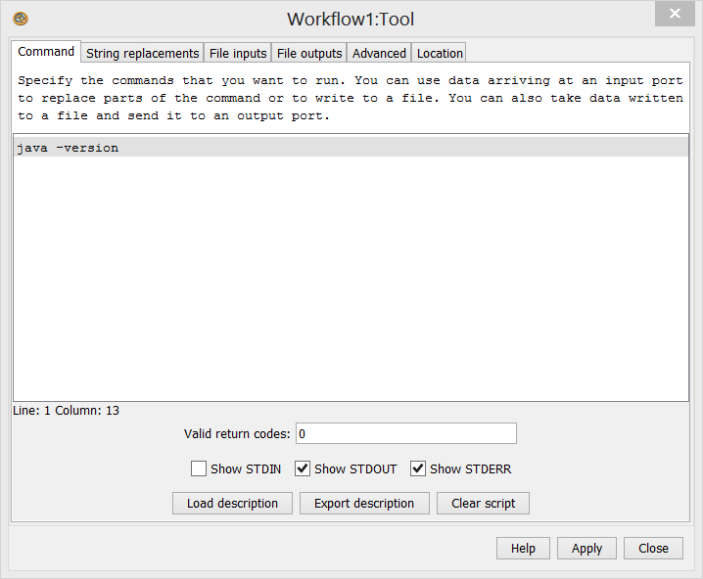
Simple tool service configuration

Slide 5
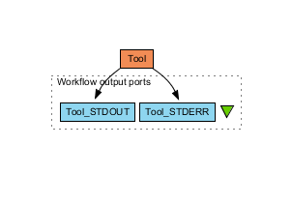
Simple tool workflow
Run the workflow
STDERR should look similar to:
java version "1.8.0"
Java(TM) SE Runtime Environment (build 1.8.0-b132)
Java HotSpot(TM) 64-Bit Server VM (build 25.0-b70, mixed mode)

Slide 6
Downloading an example tool
We are going to use the forester utilities by Christian Zmasek
Download
forester_1028.jar by following the links on https://sites.google.com/site/cmzmasek/home/software/forester/phyloxml-converter
..or download it from the myExperiment group
Remember which folder you downloaded it to

Slide 7
Calling the example tool - 1
Create a new workflow with a tool service that calls the jar (modify the path)
java -cp C:\Users\stain\Downloads\forester_1035.jar
Connect STDERR and STDOUT
Run the workflow
It fails. We cannot just call the jar

Slide 8
Calling the converter - 1
We cannot just call the jar
Look for the parameters of this tool at https://sites.google.com/site/cmzmasek/home/software/forester/phyloxml-converter
Change the tool service so the script says on one line:
java -cp C:\Users\stain\Downloads\forester_1035.jar org.forester.application.phyloxml_converter -f=nn infile outfile
This converts the infile to PhyloXML and writes it to outfile
Run the workflow

Slide 9
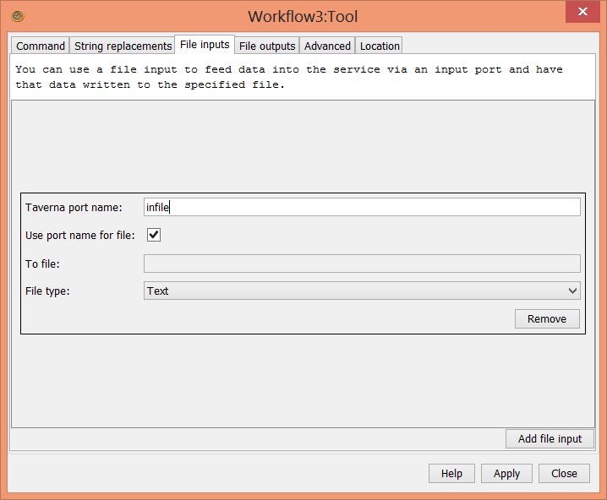
Calling the converter - 2
We need to pass an input file
Configure the tool service and add a file input called infile

Slide 10
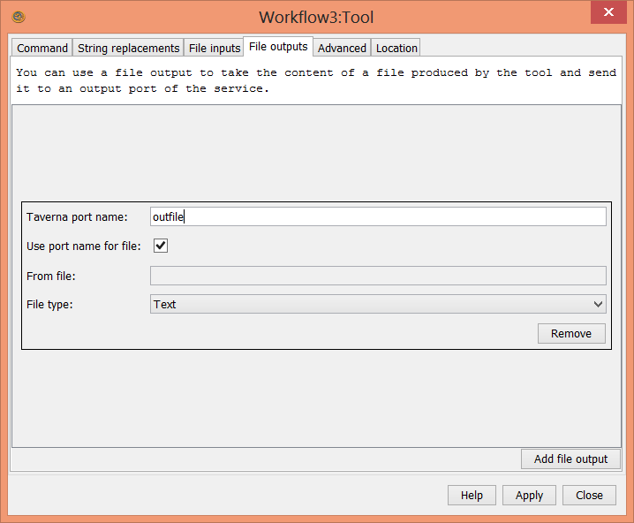
Calling the converter - 3
Add a file output called outfile

Slide 11
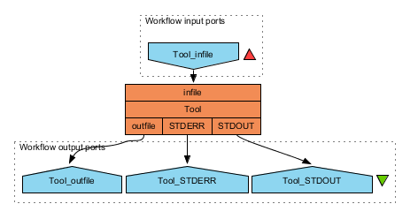
Calling the converter - 4
The tool service now has two extra ports
Connect infile to a workflow input port and outfile to a workflow output port

Slide 12
Calling the converter - 6
Run the workflow
As input, you can use the contents of http://www.myexperiment.org/files/1055/versions/1/download/example.nh.txt
(or use Set URL)
The outfile is in PhyloXML format
Click Value type: XML tree

Slide 13
Showing the PhyloXML - 1
Rename the first tool to converter
Add a new tool service that calls
java -cp C:\Users\stain\Downloads\forester_1035.jar org.forester.archaeopteryx.Archaeopteryx infile
Add a file input called infile
Rename the tool service to display
Connect the outfile of converter to the infile of display
Run the workflow

Slide 14
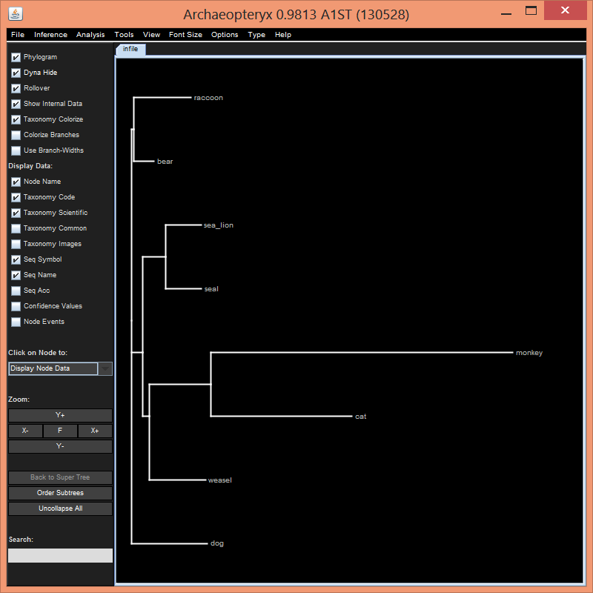
Showing the PhyloXML - 2
The archaeopteryx display tool will show – exit it to finish the run

Slide 15
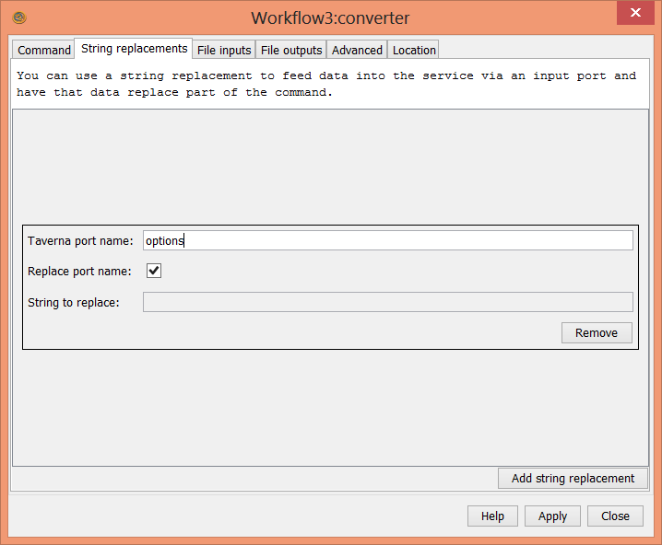
Using string replacement - 1
PhyloXML converter can take options
Add a new String replacement port to the converter service called options

Slide 16
Using string replacement - 2
Change the converter script to include the options
java -cp C:\Users\stain\Downloads\forester_1035.jar org.forester.application.phyloxml_converter -f=nn %%options%% infile outfile
%%options%% will be replaced by the string passed to the service
Connect the options port to a workflow input port
Run the workflow with options as the empty string
Run the workflow with options as –o
Compare the outfile with that from the previous run

Slide 17
Further exercises
Add the Xpath service to pick up the species name of the second-level clade branch (bear, raccoon)
Create a component family in your local registry called forester
Create a components in the forester family for the converter and display services
Build a workflow using the two components from Available Services
What possible problems can you imagine if you want to share a workflow using the External Tool service?
Expert: Are you able to modify your workflow to be sharable? Hint: Look at Advanced tab of Tool service.

