Slide 1


Performing Simple Interactions
Stian Soiland-Reyes and Christian Brenninkmeijer
University of Manchester
http://orcid.org/0000-0001-9842-9718
http://orcid.org/0000-0002-2937-7819
Bonn University, 2014-09-01
http://www.taverna.org.uk/
This work is licensed under a
Creative Commons Attribution 3.0 Unported License

Slide 2
Introduction
Taverna has the ability to take data from the workflow and pop up webpages asking the user for additional input while the workflow is running.
This simple Tutorial will show a few of the possible Interactions.
The interaction services can be found under available services/ Interactions

Slide 3
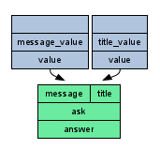
ASK
The “ask” service will pop up window displaying a message and a Textbox the user can fill in to return his answer.
Add an “ask” service to a new workflow
Add a constant value to the “message port” with the value “What is you name?”
Add a constant value to the “title port” with the vale “Name asking window”

Slide 4
CHOOSE
The “choose” service will pop up window displaying a message and a list of options the user can choose from.
Add an “choose” service to the workflow
Add a constant value to the “message port” with the value “Which Title shall I use?”
Add a constant value to the “title port” with the vale “Title asking window”

Slide 5
CHOOSE
Add a constant value to the “selectionValues” port with the value “Mr”
Now create another constant value service with the value “Mrs”
Connect the “Mrs” constant to the same “selectionValues” port
Notice how Taverna adds a merge between the two constants and the “selectionValues” port
You can click on this merge(circle) to see or change the order of the constants.
Add more title if you like.

Slide 6
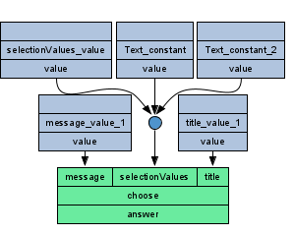
CHOOSE

Slide 7
Tell
The “tell” service will pop up window displays a message
Add an “tell” service to a new workflow
Add a constant value to the “title port” with the vale “Result window”
Add a “Concatenate_two_strings” service
Hint: Local Services / Text
Connect the choose to String1
Connect the ask to String2
Add an output to the tell service.

Slide 8
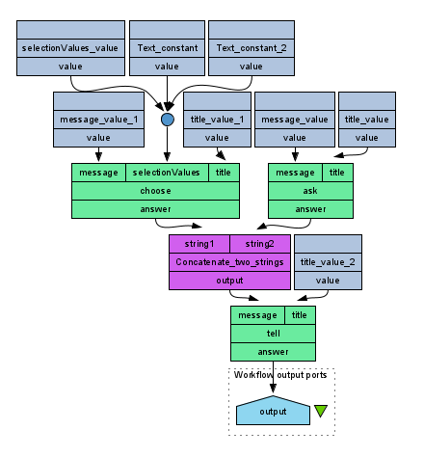
Full workflow

Slide 9
Running the workflow
Run the workflow
Find in the Title and Name windows
They may open at the same time in different tabs.
Answer the questions
A Result window will appear with your title and name
Before selecting OK or Cancel go back to Taverna and look at the results view
Notice the workflow has NOT finished.
There is still a Running displayed and Tell is still a light colour
This shows that interactions will block workflows so be carefull especially in very long running workflows

Slide 10
Finish the workflow
If you select “Cancel” in any of the Interactions including the Results/Tell an Error will be passed to the next service.
Try this by pressing Cancel in the page showing your name and title.
Notice how the workflow finished but the output is an exception.

Slide 11
Conclusion
This was a very basic overview of the Interaction Services.
Where the value are known before the workflow starts to run Text constants or input ports will always be better.
But if the values comes from a previous service, then interactions are very useful.
For example to pick from a list of results from another service.

