Slide 1


Performing statistical analyses using the Rshell processor
Stian Soiland-Reyes and Christian Brenninkmeijer
University of Manchester
Original material by Peter Li, University of Birmingham, UK Adapted by Norman Morrison
Bonn University, 2014-09-01
http://www.taverna.org.uk/
This work is licensed under a
Creative Commons Attribution 3.0 Unported License

Slide 2
Introduction
R is a popular scripting language oriented towards statistical computing
There are a large number of modules that add functionality to R such as BioConductor and rCDK
The Rshell service in Taverna allows workflows to include services that run R scripts on an installation of R
R can be located on the same machine as you use to run the workflow, or on a different machine
To allow Taverna to talk to the R installation, Rserve must also be running on the same machine as R

Slide 3
R Pages on the Taverna Wiki
Installation of a local R Server may be too much for today’s tutorial
In which case just read through the slides to see if Installing R is something you need/want
More information on Taverna and R can be found at:
http://dev.mygrid.org.uk/wiki/display/tav250/Rshell

Slide 4
Installation of R
Documentation available from:
http://cran.r-project.org/doc/manuals/R-admin.html
Windows
Download executable file
http://cran.r-project.org/bin/windows/base/
Linux
Depends on the version of linux
http://cran.r-project.org/
Mac
Download pkg file
http://cran.r-project.org/bin/macosx/

Slide 5
Installation of Rserve
After installing R, the easiest way to install Rserve is to install it from CRAN. Simply use in R:
install.packages("Rserve”);
Since Rserve comes as an R package, you can start Rserve within R by typing:
library(Rserve);
Rserve();
Please note that if you get an error (Fatal error: you must specify '--save', '--no-save' or '--vanilla'), then start Rserve with the following command
Rserve(args="--no-save")

Slide 6
Configuration of Rserve
Rserve is configured by the configuration file located at /etc/Rserv.conf
Configuration of Rserve on your R installation has already done using a Rserv.conf file
Documentation on configuring Rserve
http://www.rforge.net/Rserve/doc.html#conf

Slide 7
An example statistical analysis
To illustrate how to use the Rshell service, we will carry out a simple statistical analysis on a small hypothetical set of species incidence data from 4 species measured from 6 sites:
Site
Species | N1 | N2 | A1 | A2 | B1 | B2
Species_A | 90 | 110 | 190 | 210 | 290 | 310
Species_B | 190 | 210 | 390 | 410 | 590 | 610
Species_C | 90 | 110 | 110 | 90 | 120 | 80
Species_D | 200 | 100 | 400 | 90 | 600 | 200

Slide 8
An example statistical analysis
This data set can be found in a comma-separated file named biodiv_R_testdata.csv in the myExperiment group under “Biodiversity Test Data for Rservice Tutorial”. Download the file.
To analyse this data set using Rshell, the data has to be loaded into memory as part of the workflow
This can achieved by using the Read_Text_File service available in the Local services/io folder of the service palette (as shown on the next slide)

Slide 9
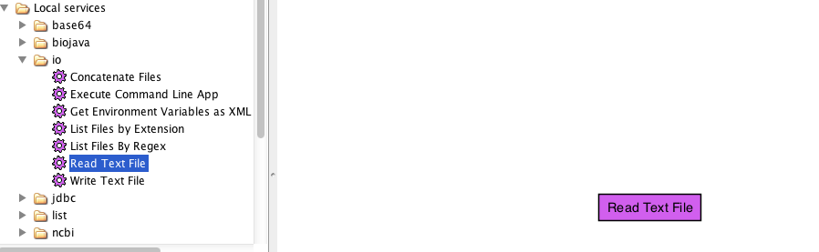
An example statistical analysis
Drag this service onto the workflow diagram and link it to a String constant containing the path to the testdata.csv file (as shown on the next slide)

Slide 10
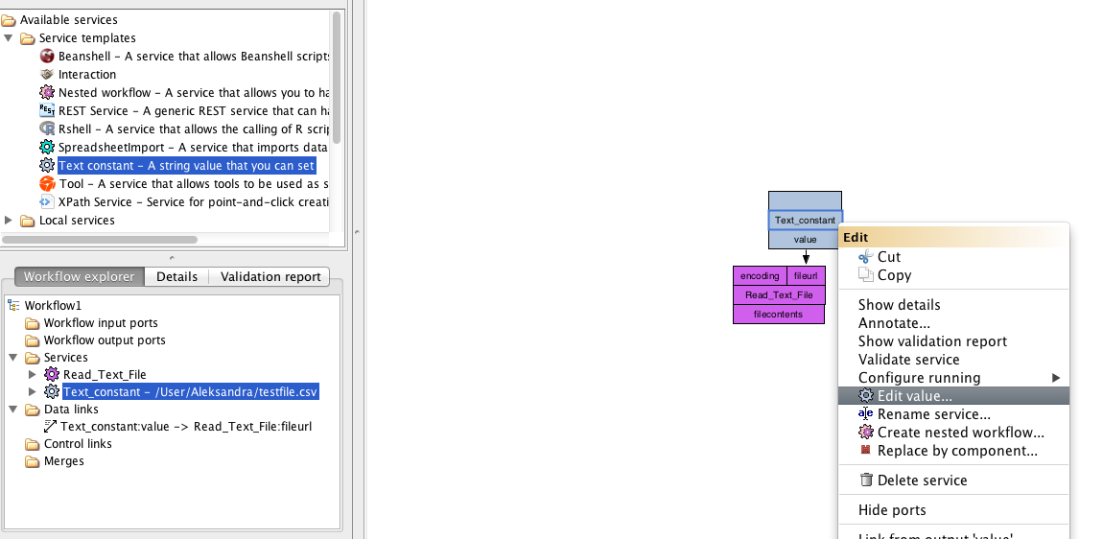
An example statistical analysis

Slide 11
Adding an Rshell service
Test this service works by attaching its output port to a workflow output and running the workflow
Now add an Rshell service to a workflow by locating it under Service templates in the Service panel and dragging it onto the workflow diagram

Slide 12
Configuring a Rshell service
A window will appear to configure the use of the Rshell service
The configuration of the Rshell service is split into several tabs
Each tab has Apply and Close buttons at the bottom. Apply saves the configuration as shown in the tabs, and Close closes the configuration dialog

Slide 13
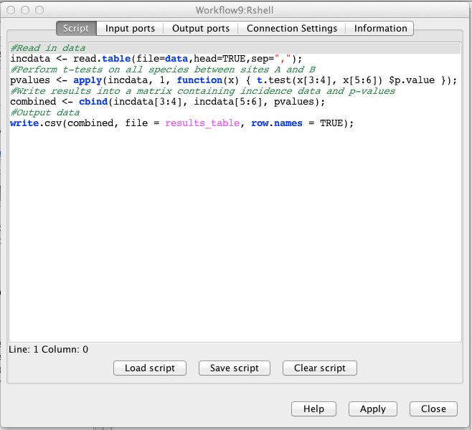
Configuring a Rshell service

Slide 14
Configuring a Rshell service
The first tab of the Rshell configuration is used to enter the R script that will be executed
We will use an R script that will perform a series of t-tests to see if species incidence differs significantly between site A and site B.
You should be careful about performing a t-test on as little as 2 replicates - this example is just for illustrative purposes

Slide 15
R script
#Read in data
incdata <- read.table(file=data,head=TRUE,sep=",");
#Perform t-tests on all species between sites A and B
pvalues <- apply(incdata, 1, function(x) { t.test(x[3:4], x[5:6]) $p.value });
#Write results into a matrix containing incidence data and p-values
combined <- cbind(incdata[3:4], incdata[5:6], pvalues);
#Output data
write.csv(combined, file = results_table, row.names = TRUE);
Copy and paste the above script into the Script tab of the Rshell configuration box

Slide 16
Rshell input and output ports
Input and output ports are the connection points between the rest of the workflow and the Rshell service
Rshell makes input ports available as variables in the script named after the port.
Output ports read their named variable after executing the script. The last assigned value to the variable will be the one returned from the service via the output port.

Slide 17
Rshell input and output ports
To add an input port:
Select the Input ports tab from the Rshell configuration dialog
Click Add port button
Enter the name of the input port, for this example use ‘data’
Specify the input port type, for this example use ‘Text-file’

Slide 18
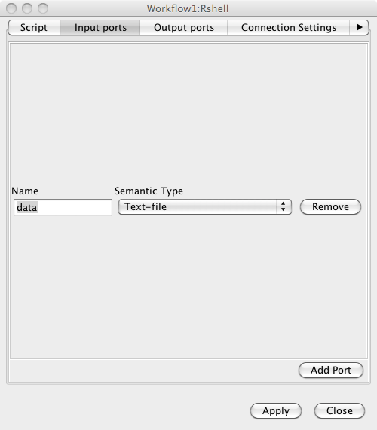
Rshell input and output ports

Slide 19
Rshell input and output ports
The input port type indicates the data type this variable will have within the R-script. The possible types for R input ports are:
Logical
Numeric
Integer
String
Logical vector
Numeric vector
Integer vector
String vector
Text-file

Slide 20
Rshell input and output ports
An output port can be added in a similar way:
Select the Output ports tab from the Rshell configuration dialog
Click Add port button
Enter the name of the output port, for this example use ‘results_table’
Specify the output port type, for this example use ‘Text-file’

Slide 21
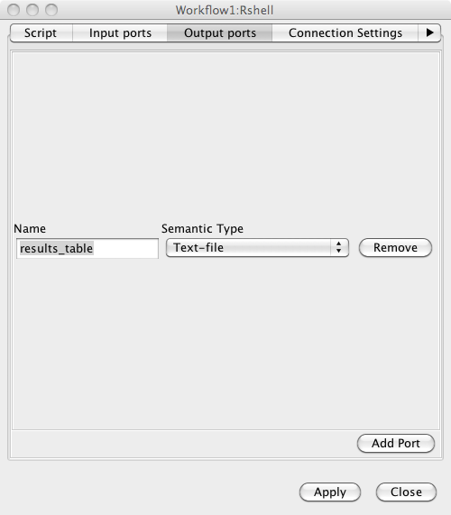
Rshell input and output ports

Slide 22
Rshell input and output ports
The output port type indicates the type this variable has within the R-script. The possible types for R output ports are:
Numeric
Integer
String
Logical vector
Numeric vector
Integer vector
String vector
Text-file

Slide 23
Rshell connection settings
Configuration of the connection parameters for Rserve is done using the Connection settings tab. This tab can be used to:
Configure the Rshell to use an Rserve installation on a different machine to where you run the Taverna workbench
Configure the access of Rserve on a different port
Provide authentication details for accessing Rserve in the form of a username and password
If you are using Rserve on the same machine that you are running Taverna on then you probably do not need to change the connection settings

Slide 24
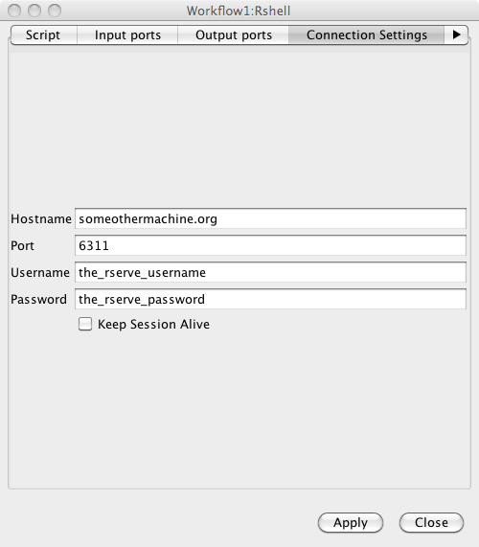
Rshell connection settings

Slide 25
Completing the workflow
To complete the workflow:
Attach the output port of the Read_text_file to the “data” input port of the Rshell service
Create a workflow output from the results_table output port of the Rshell service
Your workflow should now look as follows:

Slide 26
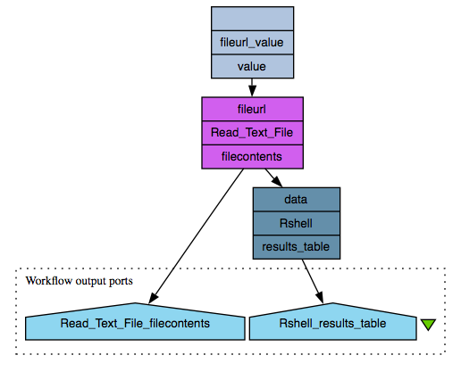
Completing the workflow

Slide 27
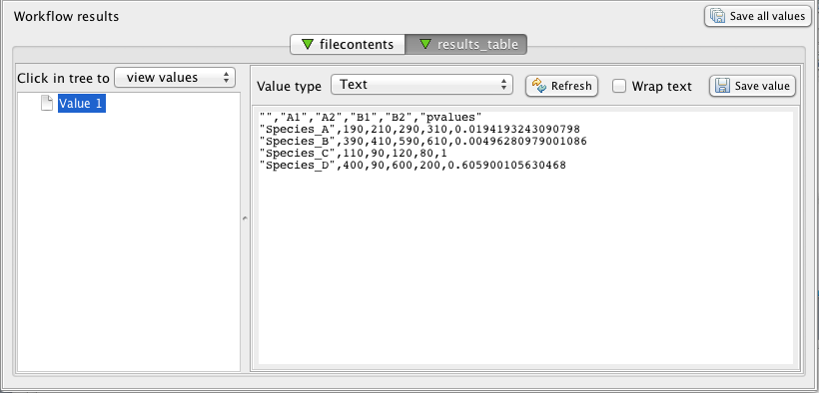
Results
When you run the workflow, you should get the following results:

Slide 28
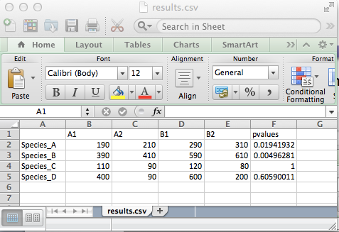
Results
Try saving the results as a csv file and opening the file in Excel. You see something as follows:

Slide 29
Results
The results show that:
The incidence of species b is significantly different at 0.01 level
The incidence of species a is not significant at 0.01 level
The incidence of Species c and d have no significant difference. For species d that is because even though an increasing trend is observed, the variation within each category is too high to allow any conclusions.

Slide 30
Output of images from Rshell
The results from R scripts may be in the form of images such as a plot or a graph
These images can be output from an Rshell service

Slide 31
Output of images from Rshell
Add another Rshell processor onto the current workflow from the service template folder
Provide the processor with the R script below:

Slide 32
Output of images from Rshell
#Read in data
incdata <- read.table(file="data",head=TRUE,sep=",");
#Transpose
t <- t(incdata);
#Calculate means
mean_a <- mean(t[,"Species_A"]);
mean_b <- mean(t[,"Species_B"]);
mean_c <- mean(t[,"Species_C"]);
mean_d <- mean(t[,"Species_D"]);
#Combine data
means <- c(mean_a, mean_b, mean_c, mean_d);
#Transform to data frame
means <- data.frame(means, row.names = c("Species_A", "Species_B", "Species_C", "Species_D"));
png(filename=figure, height=400, width=400, bg="white");
#Plot
barplot(t(means[1]), main = "mean species incidence levels", xlab = "Species");
dev.off();

Slide 33
Output of images from Rshell
Complete the configuration for this Rshell processor by:
Creating an input port called data and associating it with a Text-file data type
Creating an output port called figure and associating it with a png-file data type
Also, finish building the workflow by connecting a workflow output to the figure output port of the Rshell processor
Your workflow will now look as follows:

Slide 34
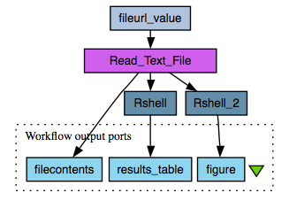
Output of images from Rshell

Slide 35
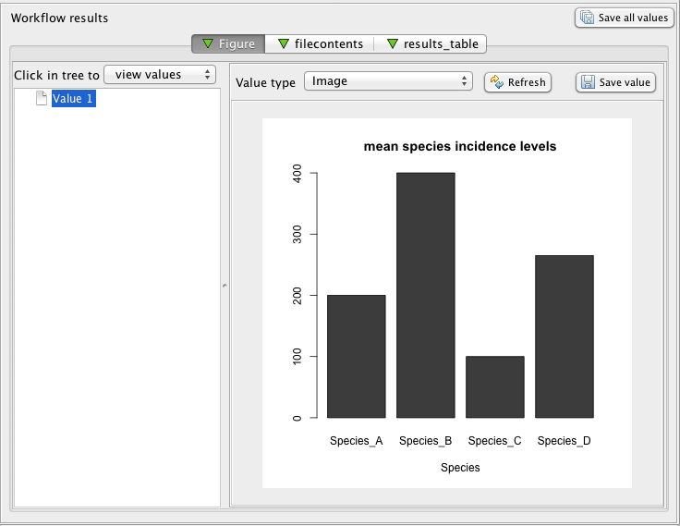
Output of images from Rshell
Now run the workflow. You should get the following results:
The result is an image showing a bar plot of the mean incidence levels of the four species

