Slide 1


Taverna Workflows a bio diversity example
Stian Soiland-Reyes and Christian Brenninkmeijer
University of Manchester
materials by Katy Wolstencroft and Aleksandra Pawlik
http://orcid.org/0000-0001-9842-9718
http://orcid.org/0000-0002-2937-7819
http://orcid.org/0000-0002-1279-5133 http://orcid.org/0000-0001-8418-6735
Bonn University, 2014-09-01
http://www.taverna.org.uk/
This work is licensed under a
Creative Commons Attribution 3.0 Unported License

Slide 2
The Overall Workflow
Scientific question
Selection of species
Discussion of results
1. Convert species name into an identifier
?
8. Visualization of current vs. predicted distribution
2. Get species occurrence data from identifiers
Loop 1
7. Get climate scenario layers from WORLDCLIM-IPCC
3. Check geographic completeness and taxonomic accuracy
4.1. Select algorithm
4.2. Select environmental layers
5. Select parameters that are likely to be important for the species
6. Validate/optimize
the variables/model to match model with distribution
Loop 2

Slide 3
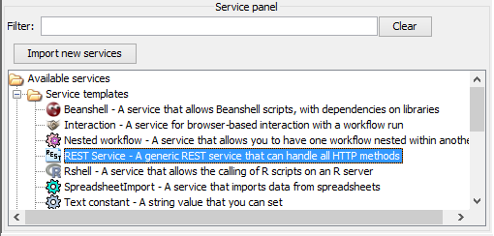
Select Species of Interest
The first step in our workflow demonstrates how to find and use REST services. We will use REST to find a species of interest and return occurrence data
Drag and drop the REST service onto the workflow diagram
Now we need to find an appropriate REST endpoint (i.e. The address of a service that will perform the species search)

Slide 4
Bio-diversity research example
In this example we are going to use Taverna to help find the occurrences of Marmota marmot
Optionally we will then show the locations using google earth.
Alternatively a xpath service could be added to extract interesting data.

Slide 5
Find the service in Biocatalogue
Go to http://biocatalogue.org
Search for occurrence
Find the GBIF occurrence service and copy the address where the web page shows the ‘base URL’
GBIF have several different REST services (or REST endpoints)
(It should look like this:
http://data.gbif.org/ws/rest/occurrence )
Hint: Sometime opening the base URL in a web browser will open a useful help page
We used this information to get the parameters used on the next slides

Slide 6
Configure the Service
In Taverna, paste the GBIF base URL into the REST pop-up window (this should already be open – if not, right-click on the REST service in the workflow diagram and select ‘Configure REST Service’ in the drop-down menu).
To the end of the address, add /list?scientificname={species_name}
Make sure the HTTP Method is set to ‘GET’, click ‘apply’ and close the pop up window.

Slide 7
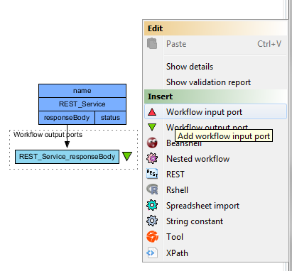
Input & Output Ports
In a blank area of the workflow diagram, right-click and select ‘add workflow input port’ and name it ‘species’
Link the new input to the REST service by clicking and dragging the arrow across
Repeat the process to add an output port to the responseBody

Slide 8
Test Run the Workflow
Save the workflow by going to ‘file -> save’
Run the workflow by going to ‘file -> run’
In the pop-up ‘run workflow’ window, click-on ‘set value’ and type ‘Marmota marmota’ where it says ‘some data goes here’
As the workflow runs, you can see the progress in the Results window, which you are automatically switched to
View the results by clicking ‘value’ in the bottom left panel

Slide 9
Add More Parameters
These results show all the occurrence data. To restrict it to a particular geographical area, substitute the simple GBIF endpoint for one that will allow you to add latitude and longitude values.
We do this by adding more parameters to the REST service address.
You could find this by going to the BioCatalogue web page, or by going to the BioCatalogue plugin in Taverna.
Go to the top of the workbench and click on ‘Service Catalogue’ and search for “occurrence” again.

Slide 10
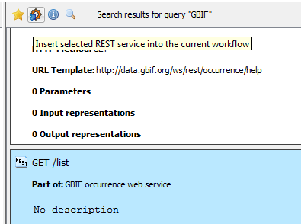
Add More Parameters
2. ...and add it to the workflow here
1. Select this service.......

Slide 11

Explore the Ports
This is an easier way of adding new REST services, but it only works if they are registered in the BioCatalogue.
Go back to the workflow window by clicking on the ‘Design’ tab and expand the workflow view to show all input and output ports
Now you will see the new REST service.
Show all ports

Slide 12
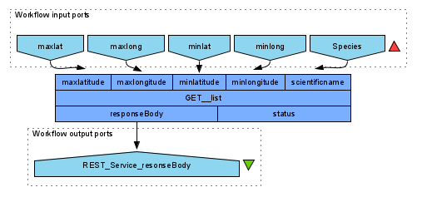
Redesign the Workflow
Delete the original REST service by right-clicking and selecting ‘delete service’
Connect the new service to the original input and output by dragging arrows between the boxes
Make new input ports for the co-ordinates by right-clicking on the workflow diagram and selecting ‘add new workflow inputs’
Connect the new
inputs to the REST
service

Slide 13
Provide co-ordinates
Run the workflow, entering Marmota marmota and the following co-ordinates:
-89 (for minlat)
89 (for maxlat)
-179.9 (for minlong)
179.9 (for maxlong

Slide 14
Handle XML
The service returns XML data. This is good for computers, but not easy to read.
You can plot the data on Google earth to make it easier to interpret. We have already written a workflow that does this.
See the next 2 slides
Alternatively try adding an Xpath service to extract some interesting data from the XML

Slide 15
Google Earth Plot
In Taverna, go to file -> ‘Open workflow location’ and copy the following link into the pop-up box:
http://www.myexperiment.org/workflows/2592/download?version=1
It is possible to load workflows from a file, or from a web link
This workflow opens a local copy of Google Earth. If you don’t, have it, please go to Google Earth and install it: http://www.google.com/earth
For windows See also http://www.myexperiment.org/workflows/2592.html

Slide 16
Google Earth Plot
Run this workflow with the same parameters as you used in your own workflow (e.g. Marmota marmota and lat, long). NOTE: there are some example values in the workflow, but you may need to select or change them.
You need to specify an additional parameter for the location of your local Google Earth program.
This time, the results are plotted on Google Earth.
Additionally, an interactive step allows you to modify lat/long values while the workflow is running.

Slide 17
Test the Workflow with other Species
The workflow you ran only has information from one species, but selecting species can be complex
Re-run the workflow twice, once with the species Abraxas sylvatus, and once with Abraxas sylvata. Do you get different results?
They both represent the same species, but one is simply a different spelling. You may need to discover all species names and synonyms and combine data before continuing with your modelling.

Slide 18
Test the Workflow with other Species
The workflow you ran only has information from one species, but selecting species can be complex
Re-run the workflow twice, once with the species Abraxas sylvatus, and once with Abraxas sylvata. Do you get different results?
They both represent the same species, but one is simply a different spelling. You may need to discover all species names and synonyms and combine data before continuing with your modelling.
You may also want to add your own data from a database or spreadsheet (we will come back to this in a later exercise).

Slide 19
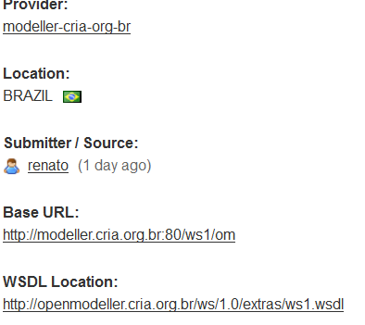
Select algorithms
The next step in the workflow selects which algorithm(s) you wish to use from Open Modeller and determines their parameter values. This requires the use of a WSDL web service
In BioCatalogue, search for OpenModeller
Find the WSDL address and copy it

Slide 20
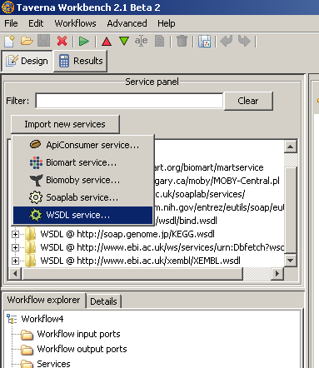
Add New WSDL Services
Go to the services panel in Taverna and click “import new services”. For each type of service, you are given the option to add a new service
Select ‘WSDL service…’ A window will pop-up asking for a web address

Slide 21
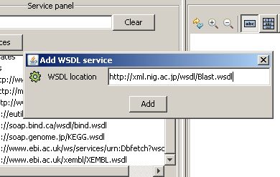
Configure New WSDL Services
Enter the service address you just copied
Scroll down the Services list, you will see your new service there
Open Modeller contains a collection of services
Notes:
21

Slide 22
Adding New Services via BioCatalogue Plugin
We discovered and added the OpenModeller service from the Biocatalogue web page, but you can also add services through the BioCatalogue plugin in Taverna
Click on the ‘Service Catalogue’ tab at the top of the workbench
Type ‘OpenModeller’ in the search box
In the returned results, click on the ‘getAlgorithm’ service
From here, you can add services into the service panel or directly into the workflow by clicking on the icons at the top of the panel.

Slide 23
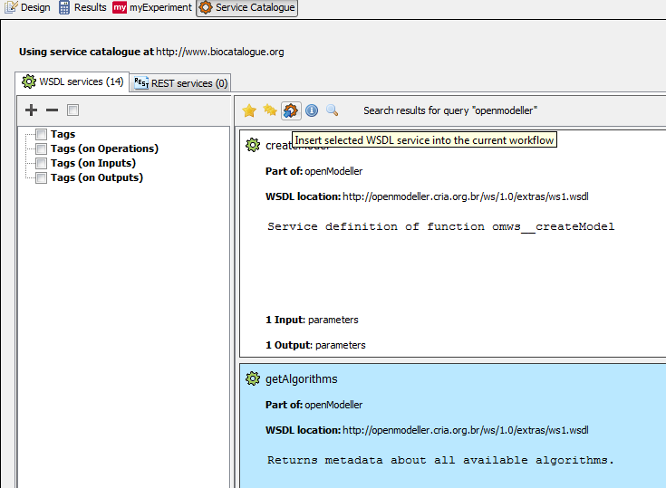
Biocatalogue Plugin
Import Options
Service Types
Selected Service

Slide 24
Select algorithms
Go back to the Taverna Design window by clicking on the Design tab
From the file menu, select ‘New Workflow’. In the services panel, add the ‘getAlgorithms’ service from OpenModeller by dragging and dropping it on the blank workflow diagram
At the top of the diagram, change the view to show the input and output ports of the service
Show all ports

Slide 25
Handle XML with the XPath query
This workflow doesn’t have any input ports, but we need to add an output port in the same way we did for the REST service.
Right-click in the workflow diagram and select ‘Add new workflow output’ and call it ‘algorithm’.
Connect the output port to the “parameters” output of the “getAlgorithms” service.
Run the workflow and you will see you get an XML document back with all the algorithm details
Save the results in XML format
XML is not easy to read, but we can extract the elements we are interested in with an XPath query

Slide 26
Configure XPath Query
In the control panel, search for ‘xpath’ and drag and drop the ‘Xpath Servic’e into the workflow diagram
In the pop-up window, load the XML you saved from the workflow run and click the green arrow to display it on the right of the screen (see screenshot on next page).
Navigate the XML on the right until you find the ‘Name’ element

Slide 27
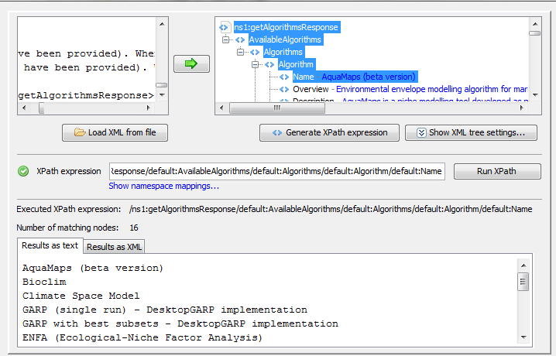
Configure XPath Query
1. Click here to generate your xpath expression......
2.....and here to run your xpath.......
3. Result = list of available algorithms

Slide 28
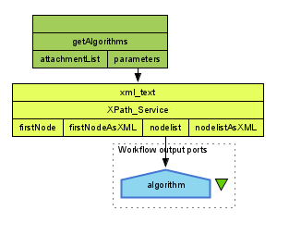
Connect XPath in the Workflow
When you have configured your XPath query, click ‘Apply’ and close the pop-up.
In the workflow, connect the new xpath service to the getAlgorithm output and add a workflow output to the xPath service
Run the workflow. This time you will get a list of algorithms

Slide 29
XPaths and Shims
The XPath query does not obtain or analyse data, it simply re-formats it.
In Taverna, any ‘helper service’ that is only involved in reformatting is called a shim.
We will use shims throughout the workflow where service formats are incompatible, or where we want to convert and view something in a different format.
Many shims are local scripts that Taverna provides by default.

Slide 30
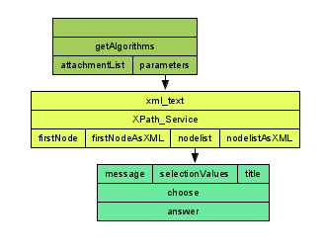
Interactive Choice of Shims
Now we need an interactive step in the workflow to allow users to choose which algorithm to run (another shim)
(In design view) Search for ‘choose’ in the services panel and drag in the ‘choose’ service.
Change the workflow view to see
all ports
Connect the Xpath service output
to the selectValues input of choose

Slide 31
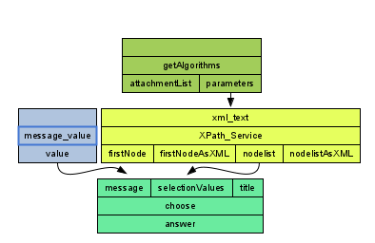
Interactive Algorithm Selection
The other two inputs will be added as constant values (this saves you having to add input values that don’t change for each workflow run)
Right-click on the ‘message’ input and select ‘Constant value’. Set the value to ‘please select algorithm’
Right-click on the title input and add a constant value of ‘Algorithm selection’

Slide 32
Interactive Algorithm Selection
Add an output for the new ‘choose’ service and save and run the workflow again
When the workflow gets to the ‘choose’ service, it pop up a web page asking you to select an algorithm. Select ‘Maximum Entropy’
Your selection is passed to the output port.

Slide 33
Getting Algorithm Parameters
Each algorithm has different sets of parameters. In order to run them, we need to extract the right parameters based on the users choice. This involves adding more XPath services after the ‘choose’ service.
Instead, we will use one that has already been built and is available on myExperiment

Slide 34
Exploring myExperiment
There are already several workflows available for BioVel on myExperiment. Go to myExperiment
Find the workflow called ‘Create Algorithm’ and see what it does by reading its description.

Slide 35
Using Workflows from myExperiment
Go back to Taverna and click on the myExperiment icon at the top of the workbench
Go to ‘my stuff’ and log in (using the same credentials as the web page)
Hint: Select the “My Stuff” tab after selecting “myExperiment”
Find the “Bonn Workshop Sep 2014” BioVel Workshop group by using the ‘search’ option.
Look at the shared items and find the workflow called ‘Create Algorithm’
Click on ‘open’ and this workflow will be automatically imported into your Taverna design window
Run the workflow and select ‘Maximum Entropy’ again

Slide 36
Selecting Layers
In order to run the algorithm you selected, you have to decide which layers you need. We can do this by calling a different web service from Open Modeller
Create a new workflow by going to ‘file’ -> ‘new workflow’ and drag and drop the Open Modeller ‘getLayers’ service. Again, this service does not need inputs, but again the output is XML and difficult to view.
Go to the myExperiment plugin in Taverna and find the workflow called ‘selectLayers’ in the BioVel workshop group
Select ‘Import’. You can import the workflow as a nested workflow, or you can merge it with the existing workflow

Slide 37
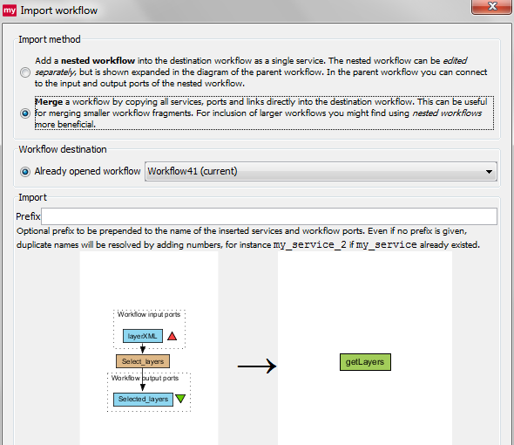
Selecting Layers
In many cases, it is beneficial to add workflows as nested workflows so that they stay as separate modules, but in this case, we can select ‘Merge’ because this extra service is a shim for viewing the results.

Slide 38
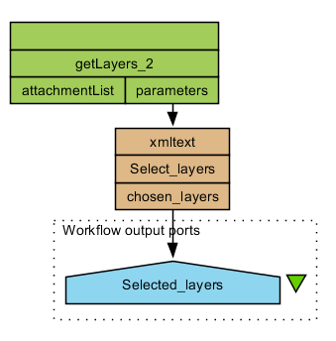
Selecting and Configuring Layers
In the workflow diagram, expand the view to show all ports.
Delete the input port from
the imported workflow
Connect the output of ‘getLayers’ to the input of the new ‘Select_Layers’ service
Save and run the workflow

Slide 39
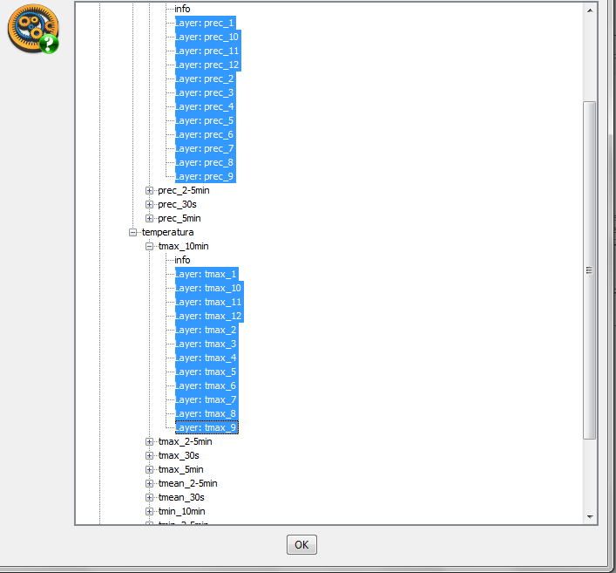
Selecting and Configuring Layers
You will see a tree view of all layers available
For this exercise, select some worldClim layers for precipitation & temperature

Slide 40
Create Model
We now have all of the inputs required for our model.
To create the model, we need to use some other services from Open Modeller
These services are more complicated to execute and require the use of more advanced workflow execution techniques.
The next few exercises will show you how to invoke asynchronous services, how to use looping in your workflows, how to use control links and how to set retries.

Slide 41
Create Model
Find and open the ‘Create Model’ workflow from BioVel workshop group in myExperiment
The workflow will not work until we configure it
This workflow is asynchronous. This means that when you submit data to the ‘create model’ service, it will return a jobID and place your job in a queue (this is very useful if your job will take a long time!)
The ‘loop_until_progress_complete’ nested workflow will query your job ID to find out if it is complete
When it is complete, the ‘getModel’ service will retrieve the results.

Slide 42
Create Model - Looping
The default behaviour in a workflow is to call each service only once for each item of data – so what if your job has not finished when ‘loop_until_progress_complete’ workflow asks?
Run the workflow using the example input value provided in the workflow
Almost every time, the workflow will fail because the results have not been returned before the workflow reaches the ‘getModel’ service

Slide 43
Create Model - Looping
This is where looping is useful. Taverna can keep running the ‘getProgress’ service until it reports that the job is done.
Select the ‘loop_until_progress_complete’ nested workflow and click on the ‘details’ tab in the workflow explorer
Select ‘advanced’ and click on ‘add looping’
Use the drop-down boxes in the looping window to set ‘output_progress’ ‘is_equal_to’ 100 (100 is the status returned by the service when the model is created and the job is done).

Slide 44
Create Model – Control Links
Save the workflow and run it again
This time, the workflow will run until the ‘loop_until_progress_complete’ nested workflow reports that it is done, but you still may not see any results
We need to add a Control Link to ensure that the ‘getModel’ service is not executed until the nested workflow is finished
Right-click on getModel_input and select ‘run after -> loop_until_progress_complete nested workflow’
Save and run the workflow again, this time it is likely you will see the model created, but you may still see a failure

Slide 45
Create Model – Retries
If there is a delay in making the model available, ‘getModel’ could still fail
We can make this step more robust by using Taverna’s retry function. This feature is also very useful to guard against network problems in long-running workflows.
In the workflow, click on the ‘getModel_Input’ service and go to the ‘Details’ tab
In the ‘Advanced’ section, select ‘Configure’ and change the number of retries to 3 in the pop-up window
Run the workflow again. This time is should complete successfully

Slide 46
Testing and Projecting the Model
Now that the model has been created, we can test it and project it using other services from OpenModeller. These services are also asynchronous and follow the same pattern of execution as the Create Model workflow.
Download the ‘Create and Project’ workflow and run it with the example data

Slide 47
Putting the Workflow Together
We now have all the major building blocks required to construct the complete workflow:
Get species, Select algorithm, Select layers, Create model, Test model and Project model
Building workflows as modules is typically how you should work. These modules are then easy to connect together.
To save time today, we have pulled all these sections together into the whole workflow and provided a few other shims needed.

Slide 48
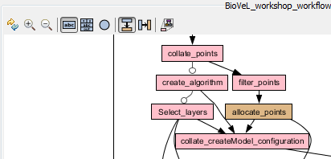
Putting the Workflow Together
Find the “BioVeL workshop reduced full workflow” in the BioVel workshop group on myExperiment and open it
As you can see, when the workflows get bigger, they get harder to view.
At the top of the workflow diagram, click on the icon to hide the nested workflows

Slide 49
Putting the Workflow Together
There are more nested workflows than we have built today because we required a few more shims to put the whole workflow together
Explore the whole workflow by right-clicking and expanding individual nested workflows to understand what each part does

Slide 50
Putting the Workflow Together
Before we run the workflow, we will change some settings in Taverna to ensure this larger workflow doesn’t use up all your Java virtual memory
Go to File -> Preferences
In the pop-up menu un-tick the ‘in-memory storage’ option. We will now run the workflow using a database to capture intermediate results. In-memory usage is fine for testing, but not recommended when the workflows get bigger

Slide 51
Running the Whole Workflow
Run the complete workflow with species Marmota marmota and with the suggested lat, long co-ordinates
Us the Maximum Entropy algorithm with the default parameters, and select a couple of layers from worldclim
For each workflow section, think about other functionality and extensions you would like to see
In the next section, we will examine some of these and discuss other possibilities

Slide 52
Exploring the Workflow in Depth

Slide 53
Adding your Own Data
Earlier, we assumed we were looking for only one species (which had one name) and we assumed that we were only interested in data held in GBIF. However, you may also want to analyse your own data, or you may want to add your data to data available in GBIF.
The spreadsheet import tool in Taverna can make it easy to add your own data
From the BioVel workshop group, download the excel file called ‘limulus_locations.xls’
Look at the data. This is occurrence data for the horseshoe crab

Slide 54
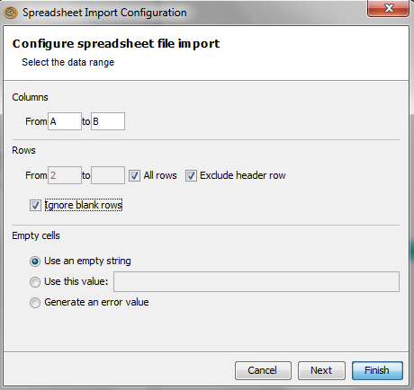
Adding your Own Data
In a new workflow, find and import the spreadsheet import service from the services panel
We can configure which columns should be read into the workflow from the spreadsheet
Enter columns A to D
Tick the option to exclude
the header row
Tick the option to
ignore blank rows
Click ‘finish’

Slide 55
Adding your Own Data
In the workflow diagram, change the view to show all ports
Create an input port and an output port for each of the new outputs
Run the workflow
In the input window, enter the path to the excel file on your filesystem (e.g. C:\Users\katy\Downloads\Limulus locations_Manchester.xls)
Each column is imported separately. This means you can feed the data easily into other services
We can add this capability to our completed workflow

Slide 56
Adding your Own Data
Load the ‘BioVel workshop workflow’ from the BioVel workshop group
Drag and drop a new spreadsheet import tool
We only need the latitude and longitude figures to incorporate the data
Locate this column in the horseshoe crab spreadsheet (it should have both values separated by a comma) and configure the import tool accordingly (again, make sure you ignore the header and blank lines).

Slide 57
Adding your Own Data
Locate this column in the horseshoe crab spreadsheet (it should have both values separated by a comma) and configure the import tool accordingly (again, make sure you ignore the header and blank lines).
This time, instead of clicking ‘Finish’ in the spreadsheet configuration window, click ‘next’
In the second window, select ‘A single CSV formatted output’
Change the value delimiter character to ‘:’ and click ‘Finish’
Create an input port for the spreadsheet import
Substitute the new spreadsheet input tool for the ‘extra points’ input, by deleting the ‘extra points’ input and attaching the spreadsheet import

Slide 58
Adding your Own Data
Run the workflow. Select ‘Limulus polyphemus’ as the species name.
When prompted, select the SVM algorithm with the default parameters
When prompted, select the following marine layers:
'ice concentration', 'salinity-bottom', 'temperature-bottom’
This time, you will see GBIF data combined with the data you just added

Slide 59
Iterating over model choices
In the original workflow, we assumed that you were happy with your first choice of algorithm, parameters and layers. In reality, this is an iterative process.
Future versions of the workflow will allow you to automatically loop around and change model properties, but for now, this is a manual process.
In this exercise, we will explore the effects of changing the algorithms, parameters and layers in the model

Slide 60
Using Different Algorithms
First, we will explore the effects of changing the algorithm.
Like the previous exercise, we will use the following layers
'ice concentration', 'salinity-bottom', 'temperature-bottom’
Run the workflow using the SVM algorithm again, but this time, select different parameters. You may want to get a better spread of parameter choices by working with other groups, each choosing different values
Repeat the exercise with the aquamaps algorithm
How different are your results? How would you test which is better?

Slide 61
Using Different Layers
Repeat the previous exercise, only this time, use the Abraxis data available on myExperiment. Fix the algorithm to BioClim with its default parameters.
Run the workflow twice – once with all BioClim layers and then again with a smaller subset
How does the layer choice influence the results?

