Slide 1
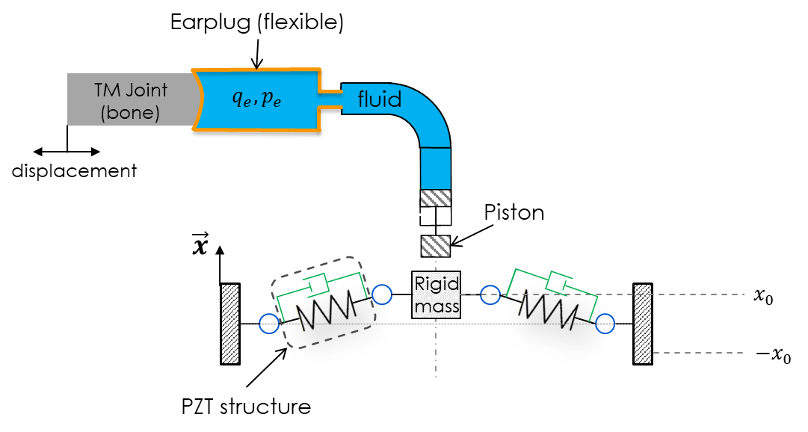
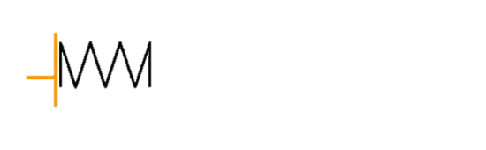



Earplug (flexible)
Hydraulic circuit
TM Joint
(bone)
$$q_{e},p_{e}$$
fluid
Displacement
Piston
$$\vec{x}$$
Rigid
mass
$$x_{0}$$
$${−x}_{0}$$
PZT structure

Slide 2
Jaw-closing phase
Dwelling time
Jaw-opening phase

Slide 3
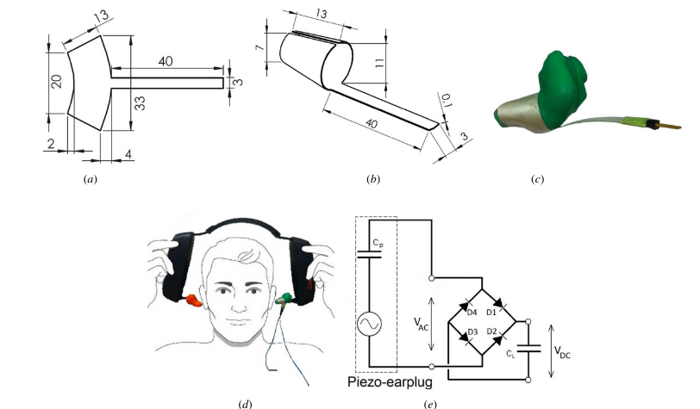





$$(a)$$
$$(b)$$
$$(c)$$
$$(d)$$
$$(e)$$

Slide 4
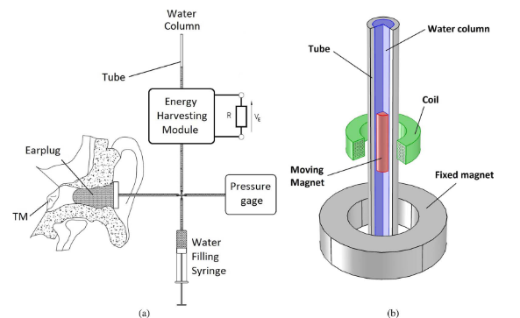


$$(a)$$
$$(b)$$

Slide 5
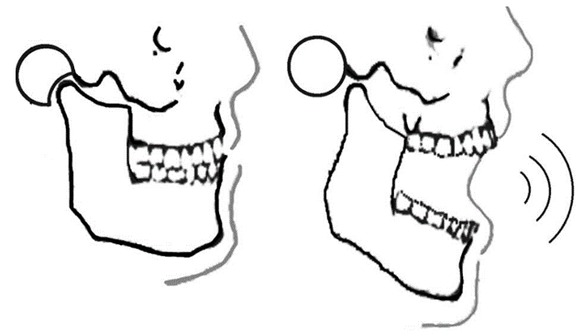
Closed jaw
Opened jaw
Ear canal
Jaw
Temporomandibular joint

Slide 6
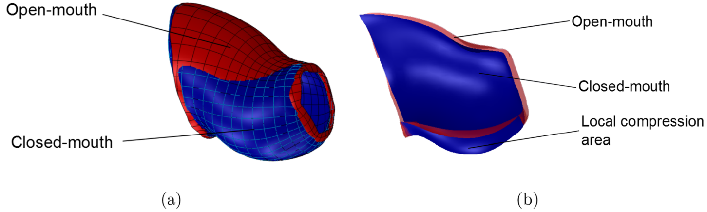

Slide 7
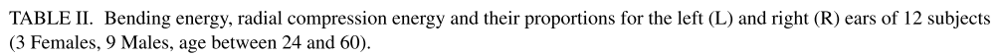
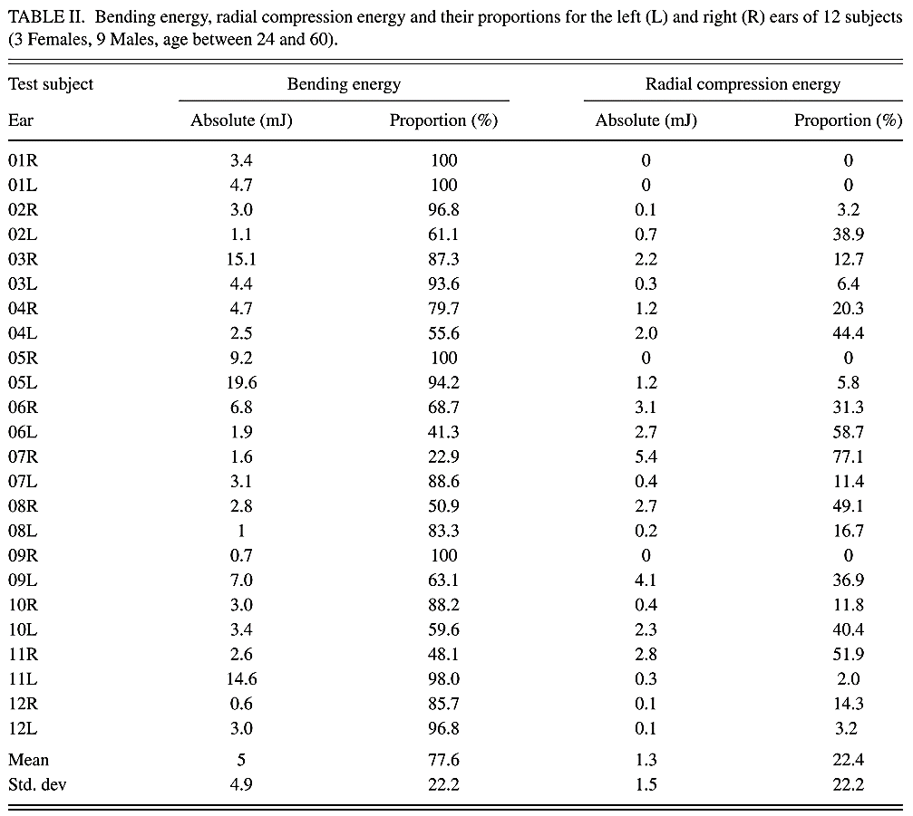
Test subject
Ear
Global flexion energy
Radial compression energy
Absolute (mJ)
Proportion (%)
Absolute (mJ)
Proportion (%)
01D
01G
02D
02G
03D
03G
04D
04G
05D
05G
06D
06G
07D
07G
08D
08G
09D
09G
10D
10G
11D
11G
12D
12G
Mean
Std. deviation

Slide 8
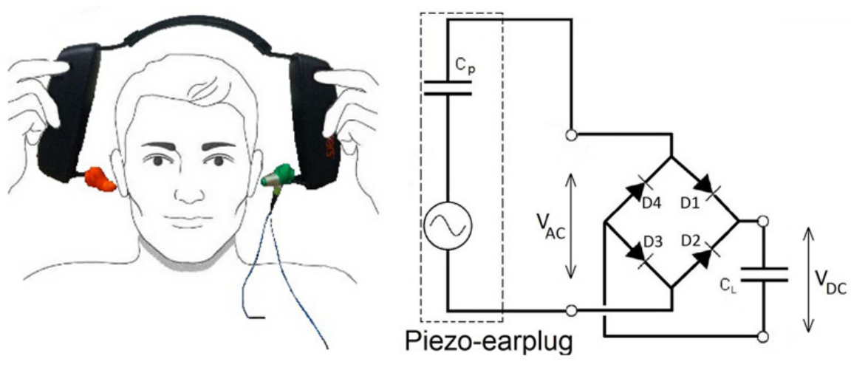
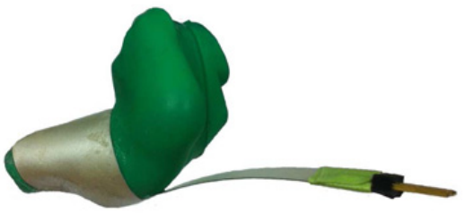

Slide 9
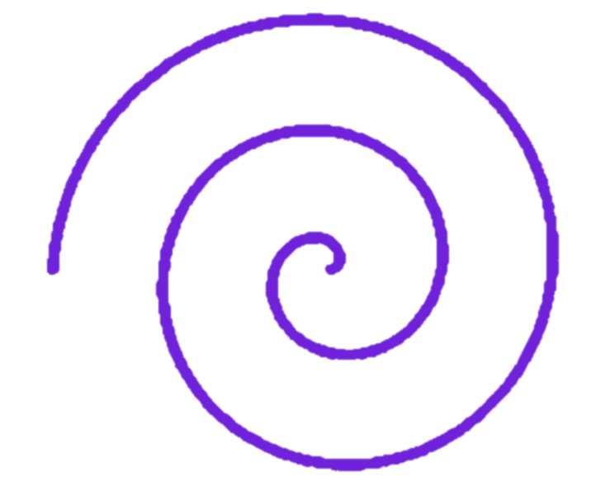
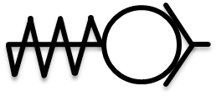


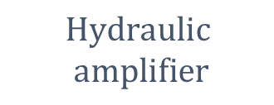
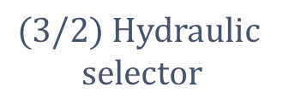

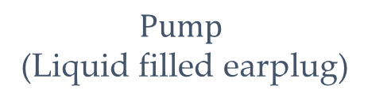
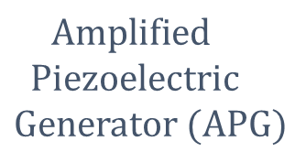
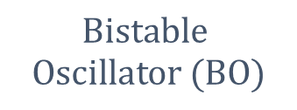

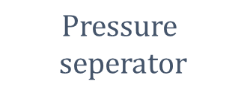



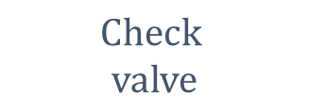
$$Pressure$$
$$seperator$$
$$(3/2\text{)} Hydraulic$$
$$selector$$
$$Bistable$$
$$Oscillator (BO)$$
« Upside » cylinder
$$Check$$
$$valve$$
$$M$$
$$K_{φ}$$
$$\vec{x}$$
$$α$$
$$\vec{z}$$
$$K$$
$$Hydraulic$$
$$amplifier$$
$$Amplified$$
$$Piezoelectric$$
$$Generator (APG)$$
$$Pump$$
(Liquid filled earplug)
« Downside » $cylinder$

Slide 10
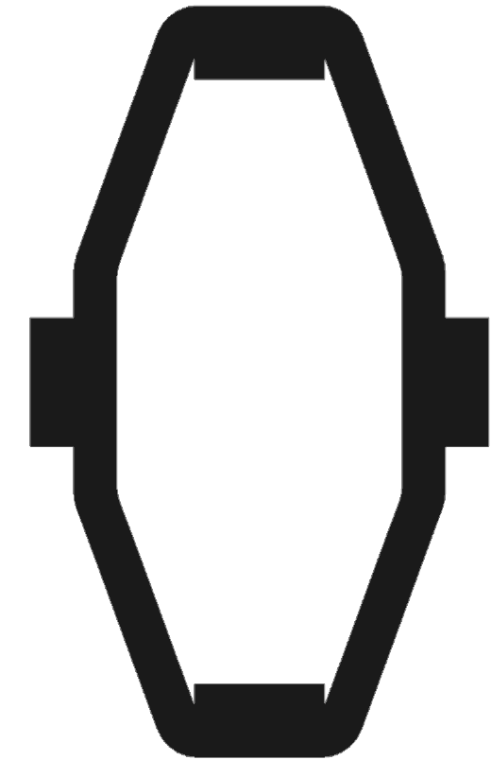




Prestressing wedge
PZT stack
$$\vec{z}$$
$$12.8mm$$
$$\vec{x}$$
Flextension structure
$$4.7mm$$

Slide 11
