Slide 1
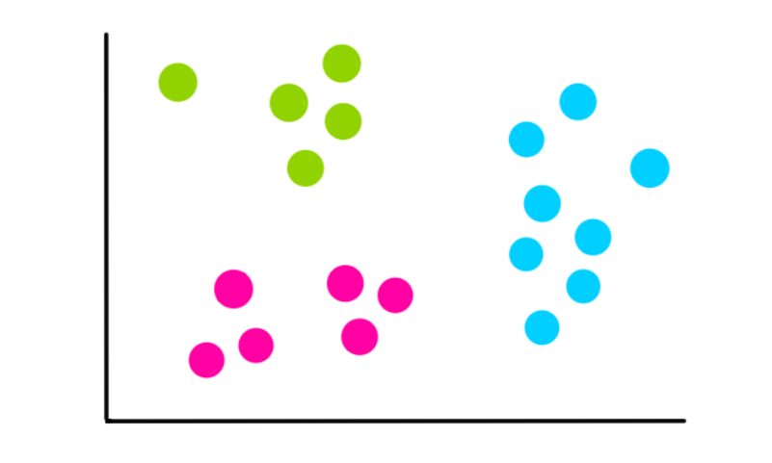
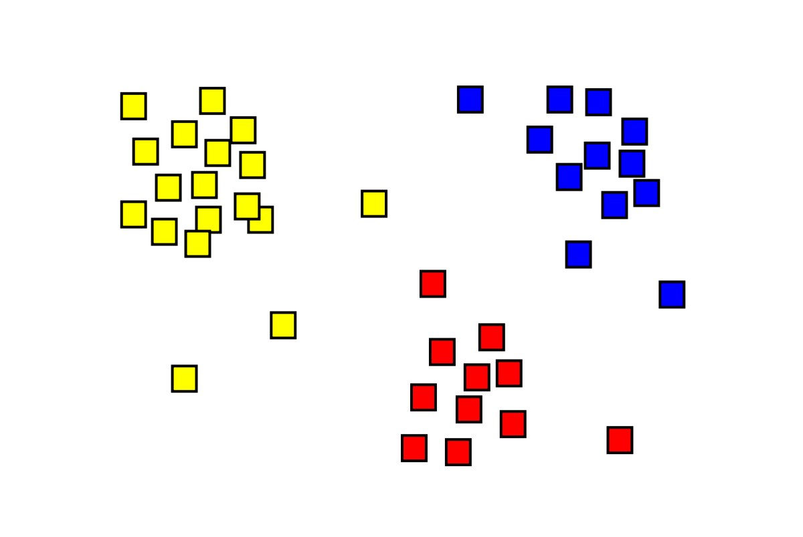
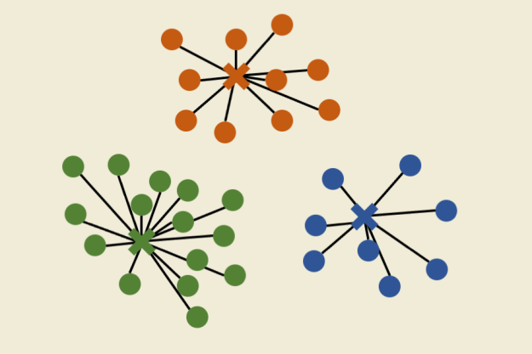
Clustering: CLARA
Mitrica Octavian

Slide 2
Key points
1. Introduction
2. What is CLARA?
3. Algorithm presentation
4. Performance and issues
5. References

Slide 3
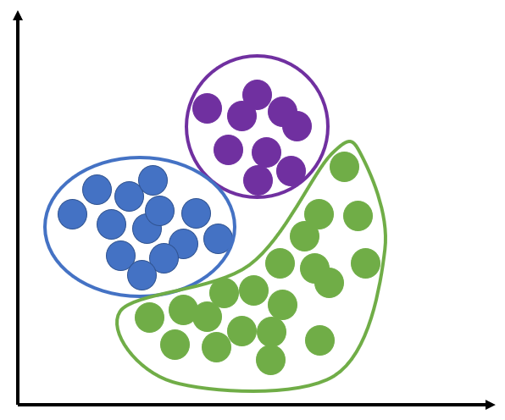
Introduction
Clustering is a process of unsupervised learning which denotes the task of grouping data based on how similar the new item is compared with existing ones.

Slide 4
Introduction
There are more types of clustering algorithms, including:
Centroid-based clustering
Hierarchical clustering
Distribution-based clustering
Density-based clustering
Grid-based clustering

Slide 5
What is CLARA?
CLARA (Clustering Large Applications) is a centroid-based clustering algorithm used for handling large sets of data.
It shares some similarities with K-means, but instead of using means as the center points, we switch to medoids. We will also use Manhattan distance instead of Euclidian as in means [1].
This method is called K-medoids and the best known algorithm for it is Partitioning Around Medoids (PAM).

Slide 6
What is CLARA?
CLARA is an extension of K-medoids, that uses the sampling approach in order to process large datasets with a lower computational cost.
Instead of applying the calculating the medoids for the entire data set, CLARA considers a sample with fixed size and applies the PAM algorithm to generate an optimal set of medoids for the sample[3].

Slide 7
Algorithm presentation
In order to better understand how CLARA works, we are going to do a comparison between CLARA, K-means and PAM.
These are the simplified steps for each algorithm [5]:
K-means
Choose number of clusters K
Initialize K centroids randomly
Assign each point to the closest centroid
Recalculate centroids
Iteratively minimize total within sum of square
PAM
Choose number of clusters K
Calculate distance matrix
Assign each point to its closest medoid
Select new medoid
If at least one medoid has changed go to (3), else end

Slide 8
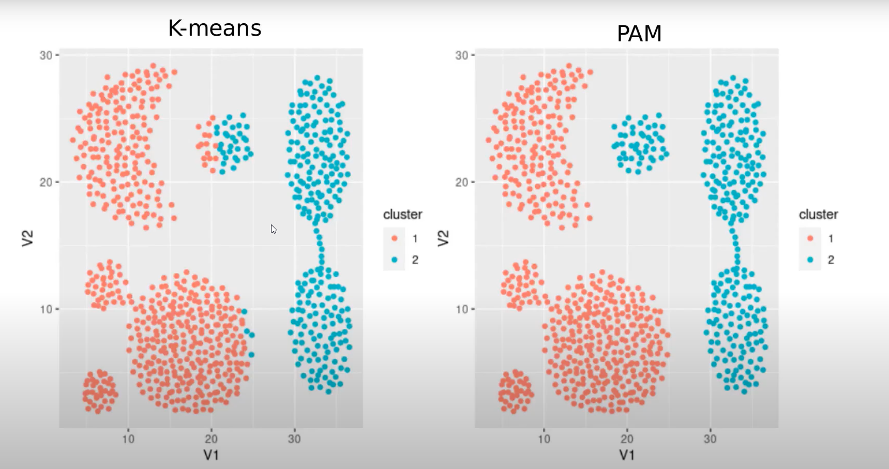
Algorithm presentation
As we can see from this cluster representation, PAM is better at classifying outliers than K-means[5].
Fig1. K-means VS PAM (K-medoids)[5]

Slide 9
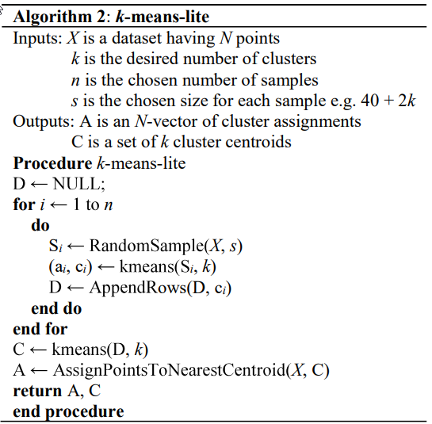
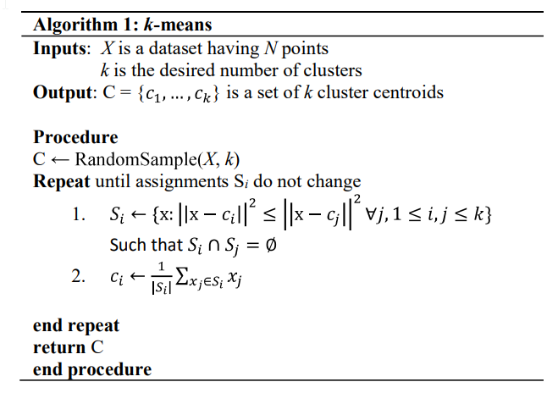
Algorithm presentation
Fig2. K-means algorithm [4]
Fig3. K-means-lite algorithm [4]

Slide 10
Algorithm presentation
CLARA
1. Create random multiple subsets with fixed size (sampsize) from the original data set.
2. Compute PAM algorithm on each subset and choose the corresponding k representative objects (medoids). Assign each observation of the entire data set to the closest medoid.
3. Calculate the mean (or the sum) of the dissimilarities of the observations to their closest medoid.
4. Retain the sub-dataset for which the mean (or sum) is minimal. A further analysis is carried out on the final partition.

Slide 11
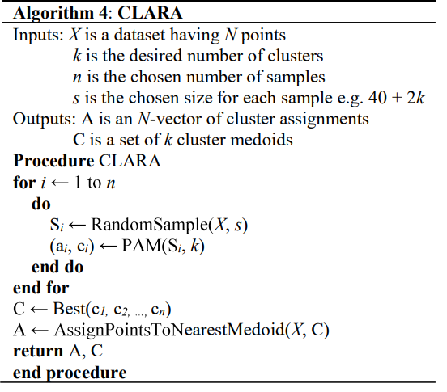
Algorithm presentation
Fig4. K-means-lite algorithm [4]
Fig5. CLARA algorithm [4]

Slide 12
Performance and issues
K-means and PAM are good classifying algorithms but the problem with them is that they consume a lot of memory and resources.
This is where the need for CLARA comes in, using subsampling to reduce that computation time.

Slide 13
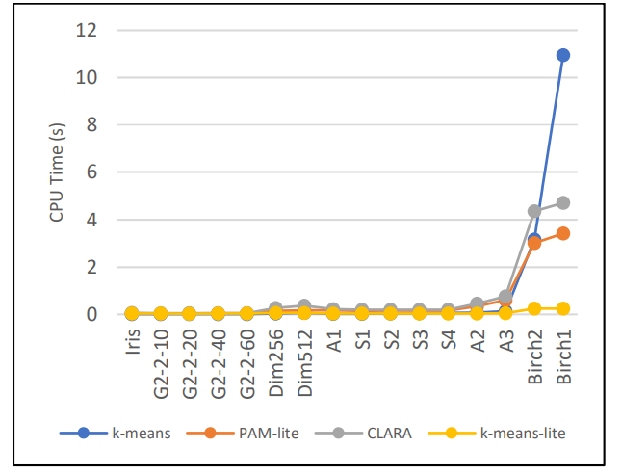
Performance and issues
Fig6. CPU times comparation [4]

Slide 14
Performance and issues
Although better than K-means and PAM, CLARA leaves room for improvement as it is not the fastest. As seen in the last graph, K-means-lite and PAM-lite are faster once the data size increases.
However, the algorithm may give wrong clustering results if one or more sampled medoids are away from the actual best medoids[6].
Furthermore, CLARANS takes care of the cons of CLARA, using random search.

Slide 15
References
[1] Gupta, T., & P. Panda, S. (2019). A Comparison of K-Means Clustering Algorithm and CLARA Clustering Algorithm on Iris Dataset. International Journal of Engineering & Technology, 7(4), 4766–4768. https://doi.org/10.14419/ijet.v7i4.21472
[2] Schubert, E., Rousseeuw, P.J. (2019). Faster k-Medoids Clustering: Improving the PAM, CLARA, and CLARANS Algorithms. In: Amato, G., Gennaro, C., Oria, V., Radovanović , M. (eds) Similarity Search and Applications. SISAP 2019. Lecture Notes in Computer Science(), vol 11807. Springer, Cham. https://doi.org/10.1007/978-3-030-32047-8_16
[3] CLARA in R : Clustering Large Applications (https://datanovia.com/en/lessons/clara-in-r-clustering-large-applications/) - Accessed on 20.11.2023
[4] P. O. Olukanmi, F. Nelwamondo and T. Marwala, "Performance evaluation of sampling-based large-scale clustering algorithms," 2019 Southern African Universities Power Engineering Conference/Robotics and Mechatronics/Pattern Recognition Association of South Africa (SAUPEC/RobMech/PRASA), Bloemfontein, South Africa, 2019, pp. 194-199, doi: 10.1109/RoboMech.2019.8704854
[5] M. Castro - Advanced Partitional clustering: medoids, PAM and CLARA and lite versions - https://github.com/mariocastro73/ML2020-2021 - Accessed on 20.11.2023
[6] Comprehensive Guide To CLARANS Clustering Algorithm (https://analyticsindiamag.com/comprehensive-guide-to-clarans-clustering-algorithm/) – Accessed on 20.11.2023

