Slide 1
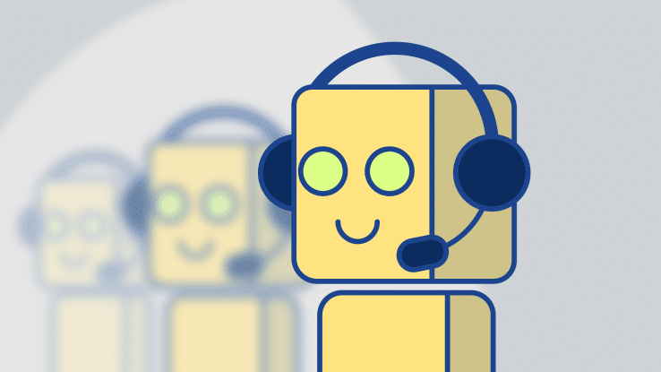
Group Project: Dialog System
COMP5412 Fundamentals of Chinese Computing
Members:
CHEUNG KIN YI (17006441G)
FUNG KIN KOK (17008299G)
LI HIU WA (18070633G)
ZHAO HAIQI (18087348G)

Slide 2

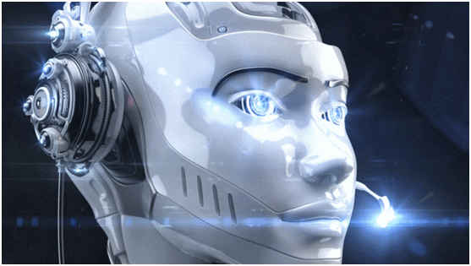
What is Chatbot?
Artificial intelligence (AI) software that can simulate a conversation (or a chat) with a user in natural language
Channels - messaging applications, websites, mobile apps, or telephone

Slide 3


Commonly Used Approaches
Task-specific
Frame based approaches
Dialogue management
Non-task-specific
Rule-based approaches
Retrieval-based approaches
Generation-based approaches
Hybrid approaches

Slide 4
Our System Approach
Hybrid approach
Generation based (Sequence to Sequence)
Rule based – Chatterbot
Task-specific approach
Additional functions

Slide 5
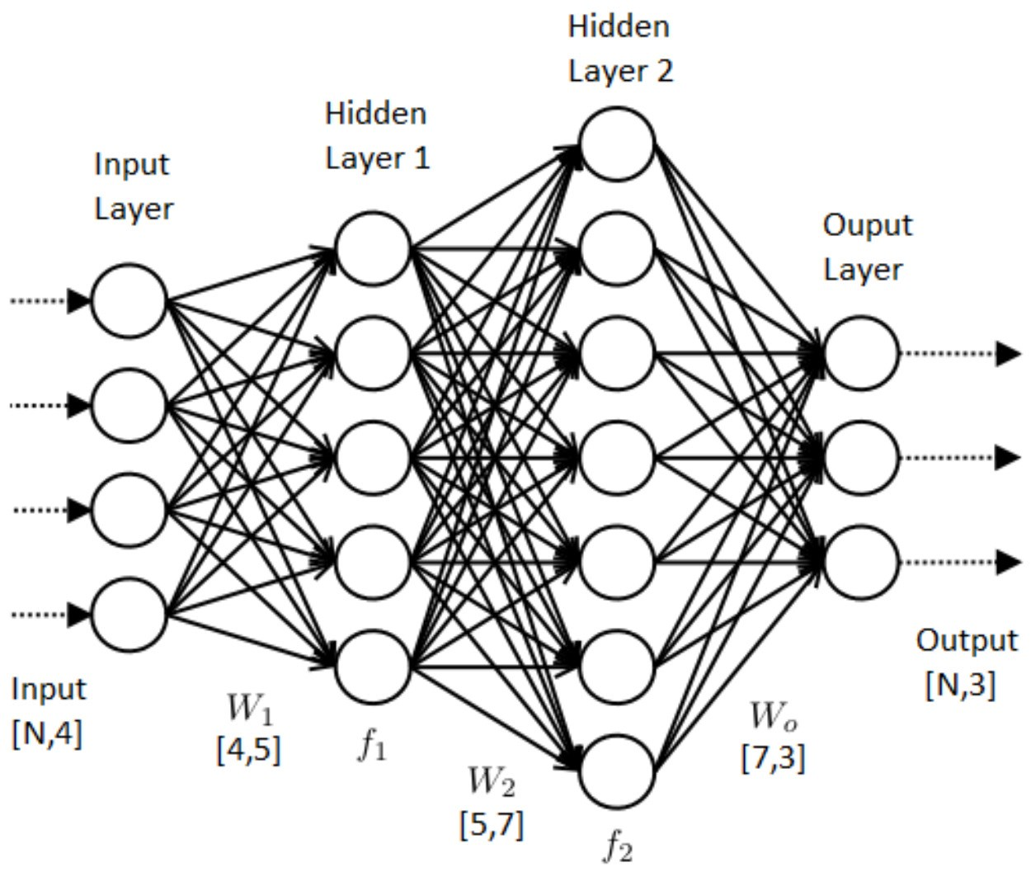
Our Function
Generation based (Sequence to Sequence)
Chinese chit-chat
English chit-chat
Rule based – Chatterbot
Chinese chit-chat
English chit-chat
Confidence evaluation

Slide 6
Our Function
Task-specific approach (Frame based)
Booking services for movie tickets
Additional functions (Chinese and English)
Emoji response
Telling Joke
Simple calculation
Provide date and time
Prevent repetitive response
Traditional Chinese compatible

Slide 7
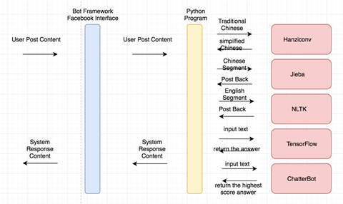
System flowchart

Slide 8
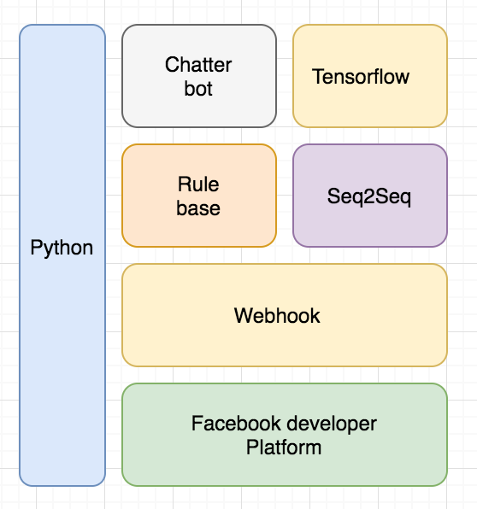
System flowchart

Slide 9
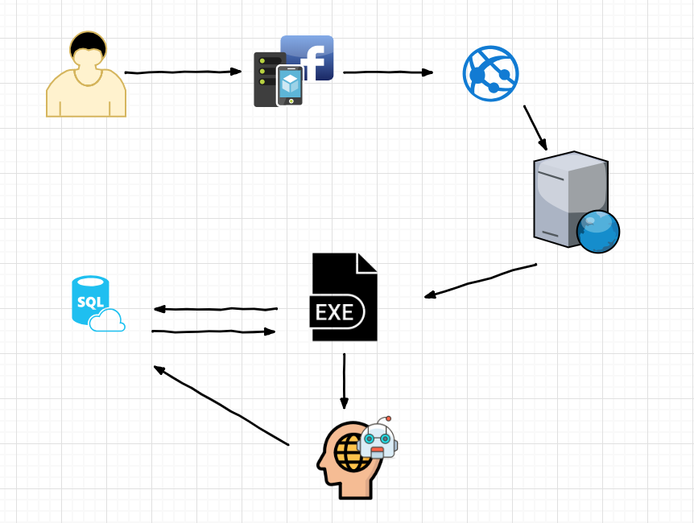
System flowchart

Slide 10
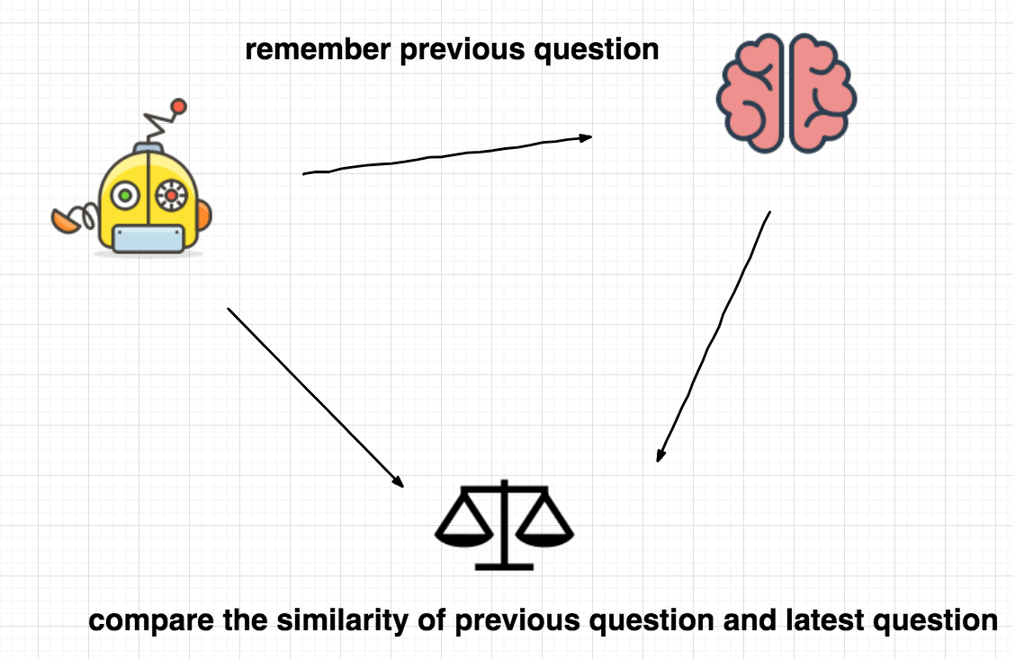
System flowchart

Slide 11
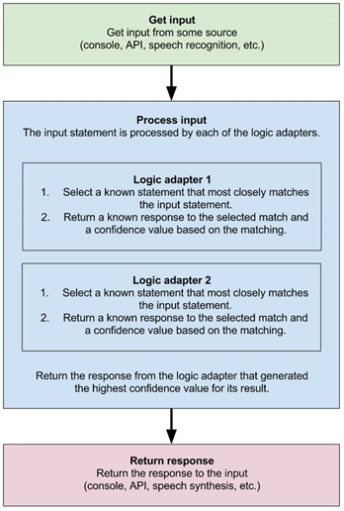
ChatterBot Mechanism

Slide 12
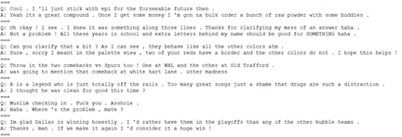
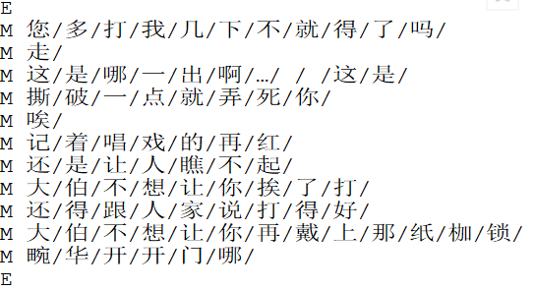
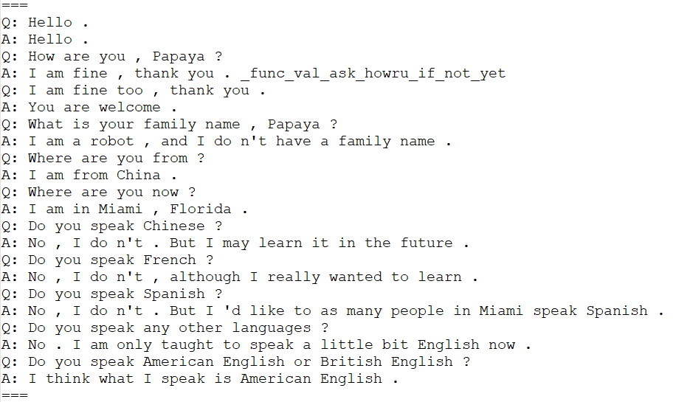
Dataset –Seq2Seq
Chinese conversation corpus
Cleaned reddit comment
Papaya dataset

Slide 13
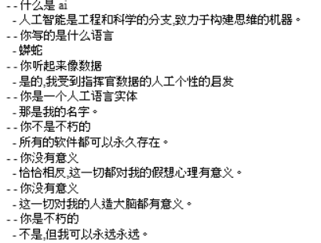
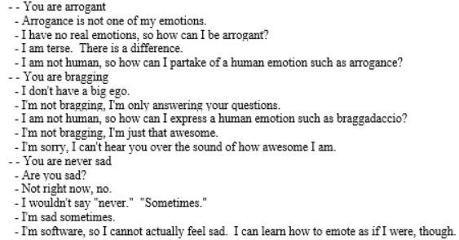
Dataset –Chatterbot
Simplified Chinese
English

Slide 14
Implementation
Data preprocessing:
Tokenization of English Corpus using NLTK
Chinese Segmentation using Jieba
Build the model:
Using two Sequence-to-sequence models to build LSTM neural network
Implement Attention mechanism
Reverse encoder inputs
Anti-language model

Slide 15
Difficulties & Solution
Difficulties in System Integration:
Chinese and English sequence to sequence model
Chatterbot and Facebook Messenger Web server
Chitchat and task-specified mode inside Chatterbot
Chatterbot and Sequence-to-sequence model
Solutions
Good design on the system mechanism
Integration step-by-step

Slide 16
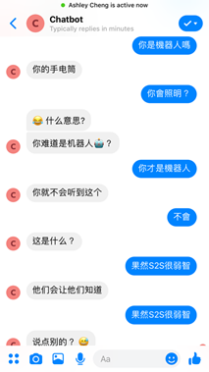
Demonstration

Slide 17
END OF PRESENTATION THANK YOU! More Detail: https://github.com/tavik000/python-key-chatbot

Slide 18
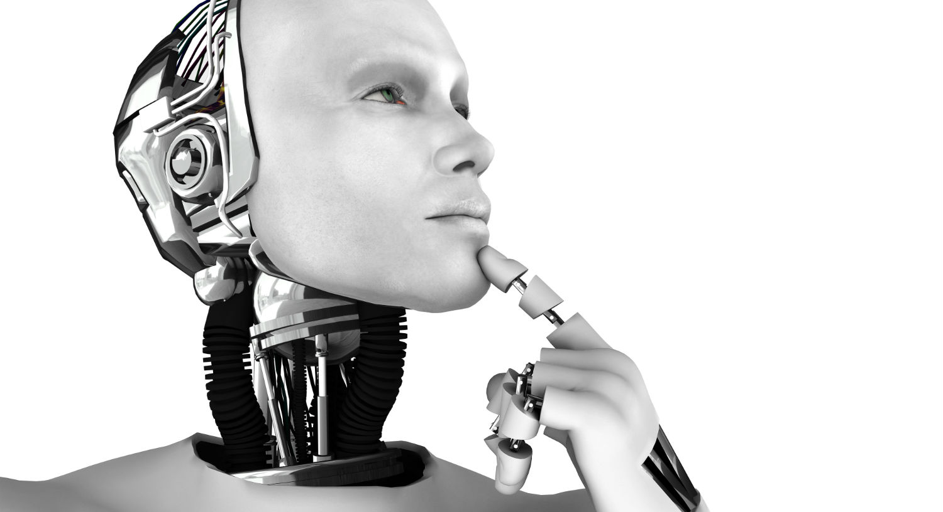
QUESTIONS & ANSWER

