Slide 1
NBA Zip Code
By: Tavion Sims & Quinton Lopez

Slide 2
Abstract
In the pursuit of expanding its fan base and revenue domestically, the National Basketball Association (NBA) seeks to identify optimal zip codes for targeted marketing campaigns. Leveraging publicly available demographic and economic data, this study aims to pinpoint zip codes with the highest potential for attracting new fans and increasing revenue streams for the NBA. By analyzing key factors such as population demographics, household income, and other relevant metrics, this research endeavors to provide actionable insights into which zip codes hold the most promising opportunities for the NBA's growth initiatives. Through strategic identification and targeting of these high-potential zip codes, the NBA can enhance its presence and engagement within specific geographical areas, ultimately driving greater fan participation and financial success.

Slide 3
Table Contents
Introduction
Analytics
Exploratory Data Analysis
Preprocessing
Model
Model Performance Evaluation
Results
Summary
Reflection
References

Slide 4
Introduction
Identify growth areas near NBA zip codes by:
Conduct exploratory data analysis (EDA)
Categorization into low, medium, and high opportunity classes
Validate findings with secondary research

Slide 5

Analytics - Exploratory Data Analysis
During the exploratory data analysis phase we went through several steps to look at the data and identify trends, errors, anomalies and relationships. We first:
Did some feature engineering to identify zip codes by high, medium and low opportunities.
For example: for a high opportunity zipcode we Identified the zip codes by proximity to NBA arenas based off zip code, State, and a NBA concentration above 0.50
We also addressed any missing values by employing robust techniques to columns by replacing nulls with the mean, median, or researched values.
Data visualization: In the visualization phase we leveraged different techniques to gain insights into the distribution of economic demographic and economic factors.
We added a histogram visual which represents our numerical columns and the distributions. Which offer insights into variability.
We used word clouds to see view the frequency each state and city were mentioned in the dataset
Then we constructed a correlation heatmap to uncover relationships between variables.

Slide 6
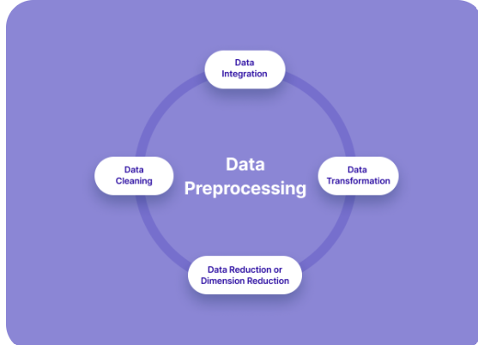
Prepossessing
Since we are using a classification model:
Re-checked the data to look at data types and to make sure there were no null values before moving forward
Categorical Encoding: to facilitate model training, we used OneHotEncoder and Labelencoder to ensure compatibility with the model.
Data Splitting: Where we partitioned the data into training and testing sets to enable model evaluation and validation

Slide 7
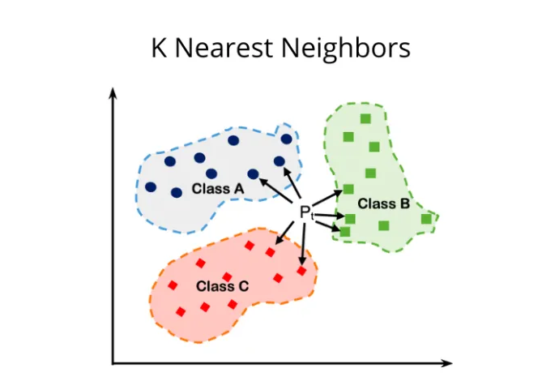
Model
Champion Model: K Nearest Neighbor(KNN)
Trained the model: To predict fan and revenue opportunities based on demographic and economic variables
Performance Evaluation: where we used evaluation metrics such as confusion matrix, classification report, and accuracy score, to assess the model's effectiveness.
Parameter Tuning: Where we used cross-validation techniques and fine tune parameters to optimize performances

Slide 8
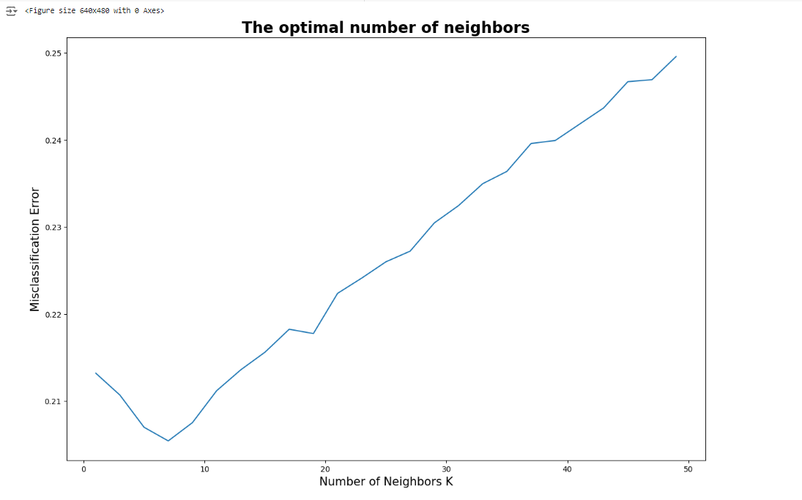
Model Performance Evaluation
Performance Metrics:
The confusion matrix provided insights into true positives, true negatives, false positives and false negatives
Classification Report: Offers metrics such as precision, recall, F1-score, and support for each class (High, Medium, and Low opportunity).
Accuracy Score: Achieved an accuracy score of 79%, indicating the model's overall correctness in predicting fan opportunities.
We also used the optimal neighbors that was specified in the misclassification error chart which was 7

Slide 9
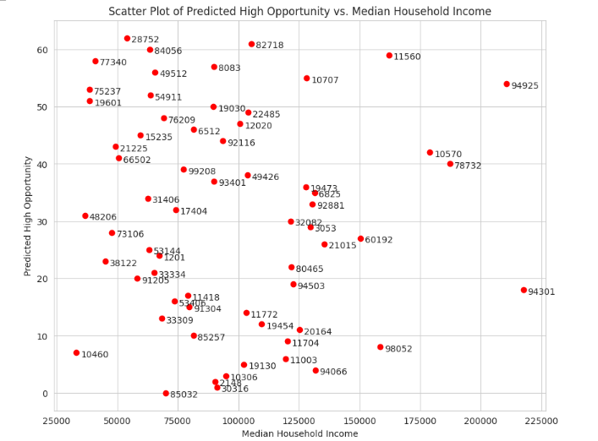
Post Processing Analysis
After model prediction, the post-processing analysis involved visualizing the predicted opportunity levels across different demographic and economic factors. This step aimed to provide deeper insights into regions with high and medium potential for NBA fan engagement and revenue generation.
We used scatter plots to illustrate the distributions
Mean Household Income vs. Predicted Opportunity (High & Medium)
Mean Household Income vs. Predicted High Opportunity
Mean Household Income vs. Predicted Medium Opportunity (Income > $300,000)
Median Household Income vs. Predicted High Opportunity
Fan Concentration vs. Predicted High Opportunity

Slide 10
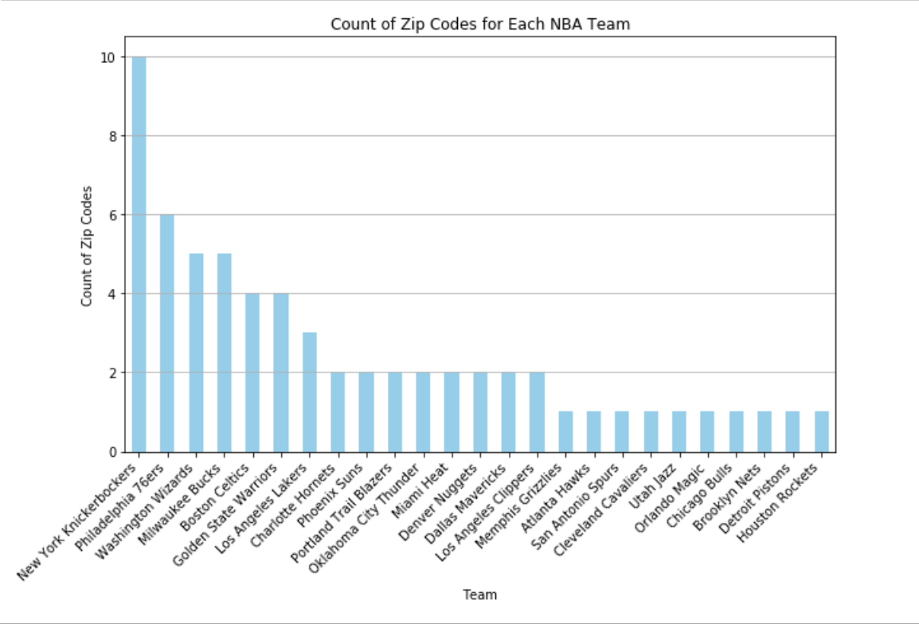
Results
Zip Code Team
85032 Phoenix Suns
30316 Atlanta Hawks
02148 Boston Celtics
10306 Brooklyn Nets
94066 Golden State Warriors
19130 Philadelphia 76ers
11003 New York Knickerbockers
10460 New York Knickerbockers
98052 Portland Trail Blazers
11704 New York Knickerbockers
85257 Phoenix Suns
20164 Washington Wizards
19454 Philadelphia 76ers
33309 Miami Heat
11772 New York Knickerbockers
91304 Los Angeles Clippers
53406 Milwaukee Bucks
11418 New York Knickerbockers
94301 Golden State Warriors
94503 Golden State Warriors
91205 Los Angeles Lakers
33334 Miami Heat
80465 Denver Nuggets
38122 Memphis Grizzlies
01201 Boston Celtics
53144 Milwaukee Bucks
21015 Washington Wizards
60192 Chicago Bulls
73106 Oklahoma City Thunder
11560 New York Knickerbockers
84056 Utah Jazz
82718 Denver Nuggets
28752 Charlotte Hornets
08083 Philadelphia 76ers
Zip Code Team
03053 Boston Celtics
32082 Orlando Magic
48206 Detroit Pistons
17404 Washington Wizards
92881 Los Angeles Lakers
31406 Charlotte Hornets
06825 New York Knickerbockers
19473 Philadelphia 76ers
93401 Los Angeles Clippers
49426 Milwaukee Bucks
99208 Portland Trail Blazers
78732 San Antonio Spurs
66502 Oklahoma City Thunder
10570 New York Knickerbockers
21225 Washington Wizards
92116 Los Angeles Lakers
15235 Cleveland Cavaliers
06512 New York Knickerbockers
12020 Boston Celtics
76209 Dallas Mavericks
22485 Washington Wizards
19030 Philadelphia 76ers
19601 Philadelphia 76ers
54911 Milwaukee Bucks
75237 Dallas Mavericks
94925 Golden State Warriors
10707 New York Knickerbockers
49512 Milwaukee Bucks

Slide 11
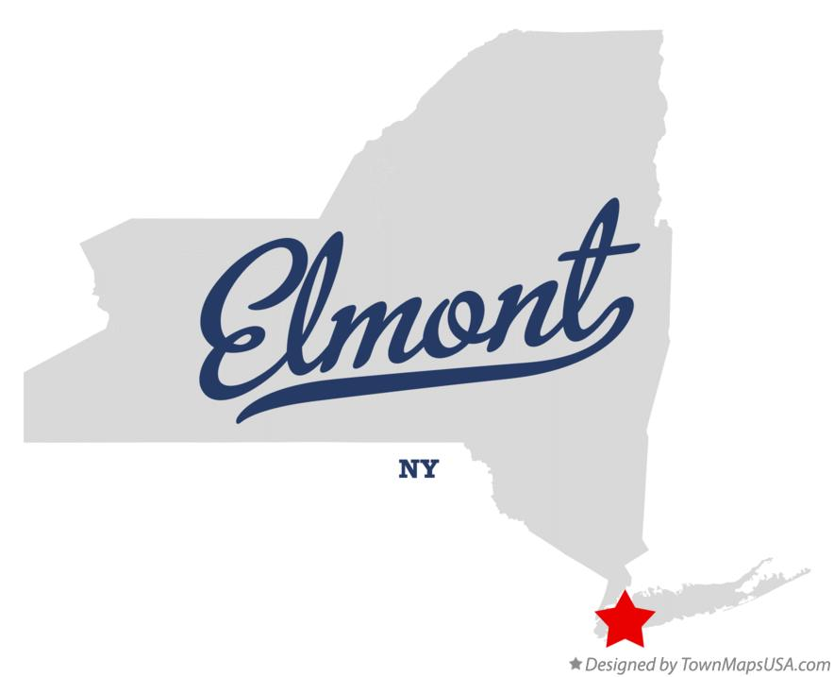
New York Knicks - High Opportunity
New York Knicks
Have ten(10) zip codes with high growth opportunity
Current playoff success further increases advertising success
Zip Code - 11003
Large population of people aged 20 - 40, representing NBA target audience
Higher median income compared to country
Slightly higher compared to nearby zip codes
Close proximity to arena
Cheap housing area with high median income suggest excess capital to spend on entertainment

Slide 12
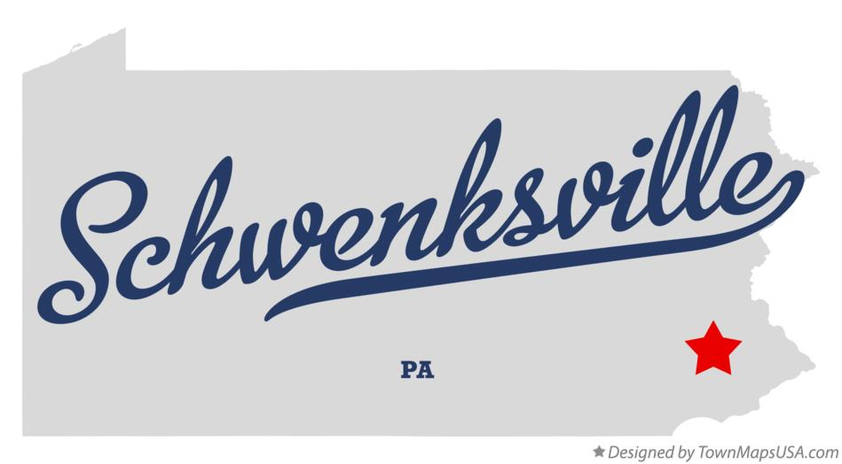
Philadelphia 76ers - High Opportunity
Philadelphia 76ers
2nd largest NBA arena
Underrepresented in home arena in Game 4 of recent playoff series with New York Knicks
https://www.nba.com/news/sixers-owners-buy-tickets-game-6-knicks-philadelphia
Zip Code - 19473
Above average total population
Large population of people aged 20 - 40, representing NBA target audience
Significant population of children under 18 for continued marketing success
Strong median household income, $89k, compared to rest of country
https://www.unitedstateszipcodes.org/19473/

Slide 13
Summary
Identifying optimal zip codes for targeted marketing can attract new fans and increase revenue streams for the NBA
High opportunity area consist of an area with NBA target median age, above average median/mean income and geographic location to arena
There are a multiple zip codes the NBA can target for NBA teams
An F1-score of 0.79 indicates the harmonic mean of precision and recall for the model

Slide 14
Reflection
Key Learning
The success and reliability of outcomes heavily hinge on a robust, clean dataset
Combining datasets add value but must be done correctly
Correctly identifying and implementing a machine learning model tailored to the business use case
Understanding continuous improvement within a project and data model like parameter tuning
Applying strategic analysis and decision support for users or stakeholders
Improvements
With a continuation and improvement of the dataset and modeling, the following variables would potentially be valuable
Rank - Better performing teams will have increased fan participation
Schedule Strength - Having a moderate schedule can contribute to better winning percentage
Draft Score - A promising draft prospect can revitalize a fan base and substantially improve a team
Playoff Appearances - It may provide insight to future performance based on recent appearances

Slide 15
References
https://www.unitedstateszipcodes.org/11003/
https://www.nba.com/news/sixers-owners-buy-tickets-game-6-knicks-philadelphia
https://www.unitedstateszipcodes.org/19473/
https://www.livesportsontv.com/news/the-nba-stadiums-with-largest-seating-capacity

