Slide 1

Predicting NBA Player’s True Shooting%
Data 495 Data Science Capstone
Final Project Presentation
Tavion Sims
Professor: Steve Chesney

Slide 2
Data Analysis Project Description
The data analytics problem that I am analyzing is focused on leveraging historical NBA player statistics and advanced metrics to predict True Shooting Percentage for the upcoming season.
You can think of True Shooting Percentage as assessing how well a player performs any time one of his possessions ends in a shot attempt. TS% considers not just field goals, but also free throws and three-pointers, providing a comprehensive measure of a player's offensive contribution.
Accurate TS% predictions empower teams to optimize offensive strategies, enhance their competitive edge, and increase their chances of success in the highly competitive NBA environment.
TS% serves as a key indicative of a player and team’s success. It directly impacts a team's ability to outscore opponents and secure victories on the court, making it a crucial metric for evaluating player performance and potential roster rotations.

Slide 3
Data Set Description
The dataset utilized for this project encompasses NBA player statistics from the 2022-2023 season, providing a comprehensive overview of player performance.
Structured in a tabular format, the dataset comprises 29 columns and 610 rows, with each row representing an individual player and columns including player name, team affiliation, and position.
Basic performance metrics such as Points per game, Rebounds per game, Assists per game, Steals per game, and Blocks per game are included, offering fundamental insights into player contributions on the court.
Advanced statistics such as True Shooting Percentage, Efficiency Field Goal Percentage, Usage Percentage, and Offensive Rating are also incorporated, providing a deeper understanding of player efficiency and impact on team success.

Slide 4
Describe the Data
The dataset consists of 29 columns and 610 rows, capturing NBA player statistics for the 2022-2023 season.
Key variables include Player Name, Team, Minutes Per Game (MPG), Points Per Game (PPG), Usage Percentage (USG%), Efficiency Field Goal (eFG%), Games Played, and true shooting percentage (TS%).Describe relationship of the variables
Relationships between variables reveal a positive correlation between PPG, eFG%,MPG, and USG% against TS%. This influences our features for our Predictive model
I found that these relationships provides valuable insights into player performance and informs strategic decisions for NBA teams.

Slide 5
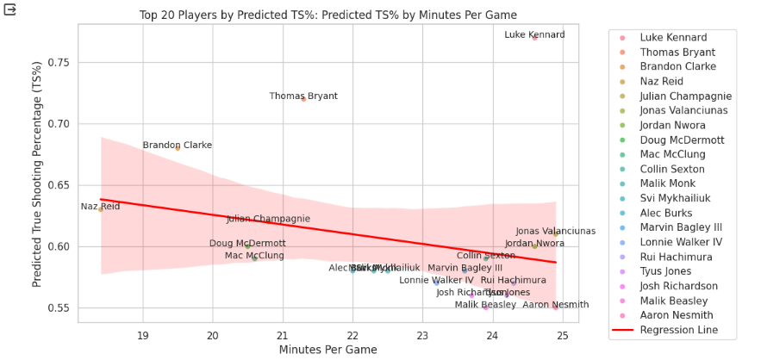
Visualizations
Relationship between TS% and USG% Visual:
- After the correlation I wanted to explore the relationship between True Shooting Percentage (TS%) and Usage Percentage (USG%)
- Line graph illustrates trend in the data
- Provides insights into the trade-off between usage and efficiency & Facilitates strategic decision-making for coaches and analysts
Top 20 Players by Predicted TS% and Minutes Per Game:
- Linear regression model scatter plot with Best fit line
- Visualization depicts relationship between mpg and predicted TS%
- Each data point represents a player
- Helps identify players with high efficiency despite limited playing time

Slide 6
Models
Linear Regression Model:
- Method: Utilized linear regression to predict True Shooting Percentage (TS%) based on various player attributes.
- Features: Offensive Rating (ORtg), Usage Percentage (USG%), Minutes Per Game (MPG), Efficiency Field Goal Percentage (eFG%).
- Visualization: Scatter plot comparing predicted TS% with actual TS%, accompanied by a best-fit line.
- Performance: Model demonstrated high accuracy with low errors (RMSE: 0.0319, R-squared: 0.923).
Decision Tree Regressor Model:
- Method: Employed decision tree regression to predict TS% by partitioning data into subsets based on features.
- Features: ORtg, USG%, MPG, eFG%, PPG.
- Process: Generated a tree-like structure where nodes represent decisions based on features and leaves represent predicted TS%.
-Performance: Achieved respectable results with mean squared error of 0.00299 and R-squared of 0.7781.

Slide 7
Findings
Champion model selection:
- The linear regression model emerged as the champion model due to its superior predictive accuracy, evidenced by a high R-squared value (0.923) and low root mean squared error (RMSE) of 0.0319. This model effectively captured the relationships between player attributes (ORtg, USG%, MPG, eFG%) and True Shooting Percentage (TS%), providing valuable insights for player evaluation and strategy development.
Visualization Impact:
- The scatter plot comparing predicted TS% with actual TS% revealed a strong alignment between the predicted and observed values
- the scatter plot showcasing the relationship between TS% and Usage Percentage (USG%) highlighted a negative correlation, suggesting that higher usage rates may lead to lower shooting efficiency.
Undervalued player Evaluation:
- The linear regression model led us to identify top performing players who exhibited high TS% and scoring ability while playing under 25 minutes per game. Notable players such as Luke Kennard, Thomas Bryant, and Brandon Clarke were identified as impactful contributors, offering valuable insights for Free Agency, Roster rotations, and Trades.

Slide 8
Recommendations
Utilize Champion Model Insights:
- I would use the linear regression model to inform player evaluation, strategy development, and decision-making processes. The model's accurate predictions of True Shooting Percentage (TS%) based on player attributes provide actionable insights for optimizing team performance and maximizing offensive efficiency.
Use of Power BI:
- I would use Power Bi to create better visualizations By doing this, I could make the report more interactive and even give users the ability to view different players by there TS% along with other metrics.
Additional Data sources:
-Lastly, I would use additional data sources. More historical data would better predict a player’s TS% and we could also predict other metrics as well.

Slide 9
Lessons Learned
I have learned the end-to-end process of a full data project. This was very extensive and insightful; I have learned so much through this process.
Data Selection: it is important to select your data carefully and look for credible sources and that data is aligned with the 5 C’s
Hypothesis: Make sure you question your project, and you list out the questions and predictions that you think are going to happen so you can research it more in your EDA or Post Processing Analysis
Model Selection: Look into the Consideration of model interpretability, performance metrics, and domain relevance in selecting appropriate predictive models.
Iterate through different models: It is very important to iterate through different models and evaluate their predictions to ultimately choose a champion model.

Slide 10
References
1. Bal, B. (2012, April). Hawk-Eye: A Logical Innovative Technology Use in Sports for Effective Decision Making. Sport Science Review, XXI(1-2). https://doi.org/10.2478/v10237-012-0006-6
2. Breiman, L., Friedman, J. H., Olshen, R. A., & Stone, C. J. (1984). Classification and regression trees. CRC press. https://doi.org/10.1201/9781315139470
3. James, G., Witten, D., Hastie, T., & Tibshirani, R. (2013). An introduction to statistical learning (Vol. 112). Springer. https://scholar.google.com/scholar?q=DOI+10.1007/978-1-4614-7138-7&hl=en&as_sdt=0&as_vis=1&oi=scholart
4. Ioannidis, Y. (2003). The History of Histograms (abridged). Retrieved from https://www.vldb.org/conf/2003/papers/S02P01.pdf
5. Kalmukov, Y. (2021). Using word clouds for fast identification of papers' subject domain and reviewers' competences. Retrieved from https://arxiv.org/ftp/arxiv/papers/2112/2112.14861.pdf#:~:text=Word%20clouds%20represent%20a%20powerful,without%20reading%20them%20at%20all.
6. Kubatko, J. (2007, February). A Starting Point for Analyzing Basketball Statistics. Journal of Quantitative Analysis in Sports, 3(3), 1-1. https://doi.org/10.2202/1559-0410.1070
7. NBA Stuffer. (n.d.). Analytics 101. Retrieved from https://www.nbastuffer.com/analytics-101/
8. Peebles, D., & Ali, N. (2015). Expert interpretation of bar and line graphs: the role of graphicacy in reducing the effect of graph format. Frontiers in Psychology, 6, 1673. https://doi.org/10.3389/fpsyg.2015.01673
9. Sampaio, J., McGarry, T., Calleja-González, J., Jiménez Sáiz, S., Schelling i del Alcázar, X., & Balciunas, M. (2015). Exploring Game Performance in the National Basketball Association Using Player Tracking Data. PLoS One, 10(7), e0132894. https://doi.org/10.1371/journal.pone.0132894
10. Souders, M. (1986). Baseball’s First Publicist: Henry Chadwick. Baseball Research Journal, 15, 2-6. Retrieved from https://sabr.org/journal/article/baseballs-first-publicist-henry-chadwick/
11. Zając, T., Mikołajec, K., Chmura, P., Konefał, M., Krzysztofik, M., & Makar, P. (2023). Long-Term Trends in Shooting Performance in the NBA: An Analysis of Two- and Three-Point Shooting across 40 Consecutive Seasons. International Journal of Environmental Research and Public Health, 20(3), 1924. https://doi.org/10.3390/ijerph20031924

