Slide 1
HTTPS

Slide 2
HTTPS
HTTPS – A secure form of HTTP.
HTTPS = HTTP + SSL ( Secure Socket Layer)
More security, More Trust.
Uses port – 443 which in case of HTTP was port-80

Slide 3
Why?
Security still remains a top priority in IT world.
HTTP was not up to the mark in terms of security.
Data Stream in HTTPS is secured using special encryption protocols promoting a much confidential environment.

Slide 4
How?
Encryption using SSL or nowadays TLS(Transport Layer Security).
Conversion to code word using cryptography.

Slide 5
SSL
SSL provide data encryption and authentication between application and server.
A layer of SSL is used with HTTP to provide secure transmission of data.
A public key is sent to client using SSL certificate.

Slide 6
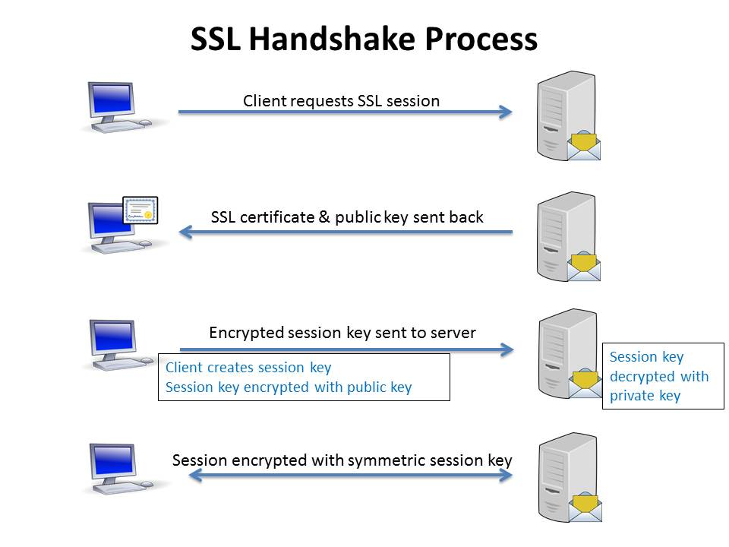
SSL WORKING

Slide 7
TLS
Successor to SSL v. 3.0
SSL failed in case of POODLE attack
TLS provides a mechanism to elevate security which was a flaw in SSL.

Slide 8
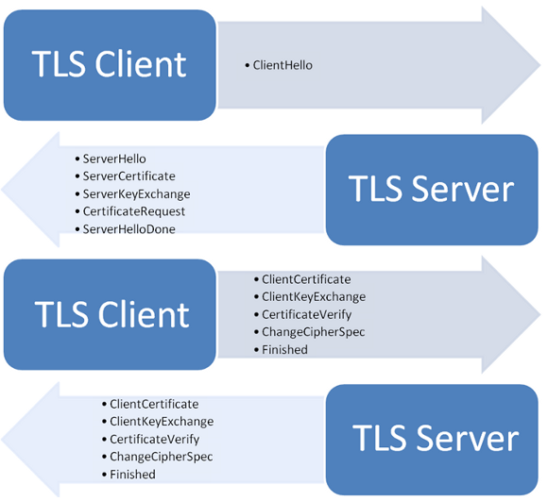
TLS Working…

Slide 9
Thank You

