Slide 1
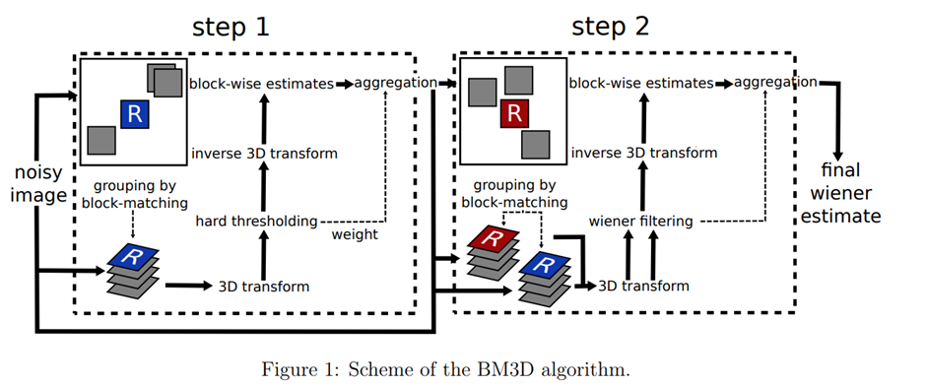
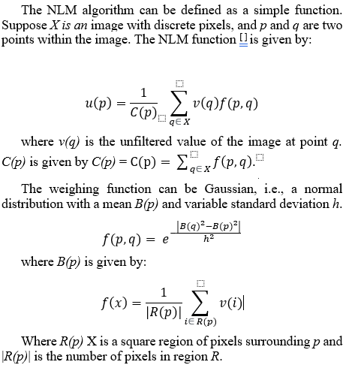
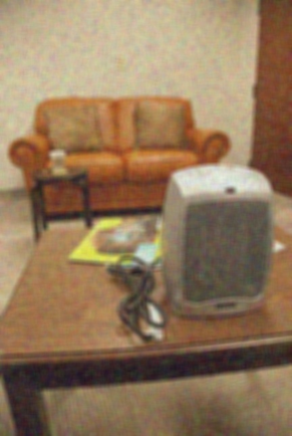

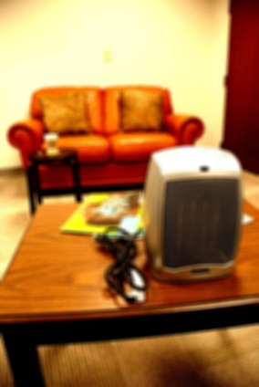

Image Denoising using Non-Local Means and Block Matching and 3D Filtering
Tavish Vats, Sivakumar, Nikhil V
BM3D and NLM
Results for SIDD and UPoly Datasets
Object Recognition – CURE-OR
BM3D is a 3-D block-matching algorithm used primarily for noise reduction in images. It's an expansions of the non-local means (NLM) methodology.
NLM: this method computes each pixel's value as a weighted average of similar regions, providing robustness against noise.
Accuracy scores of ResNet50 model
BM3D | UNI QUE | MS-UN IQUE | CSV | SUMMER
mean | 0.17 | 0.1 | 0 | 0.03
min | -0.15 | -0.08 | 0 | -1.25
max | 0.39 | 0.44 | 0.01 | 0.21
NLM | UNI QUE | MS-UN IQUE | CSV | SUMMER
mean | 0.18 | 0.11 | 0 | 0.05
min | -0.12 | -0.06 | 0 | -0.3
max | 0.48 | 0.51 | 0.01 | 0.18
BM3D | UNI QUE | MS-UN IQUE | CSV | SUM MER
mean | 0.16 | 0.07 | 0 | 0.08
min | -0.06 | -0.04 | 0 | -0.09
max | 0.4 | 0.14 | 0.01 | 0.24
NLM | UNI QUE | MS-UN IQUE | CSV | SUM MER
mean | 0.16 | 0.08 | 0 | 0.06
min | -0.06 | -0.04 | 0 | -0.11
max | 0.45 | 0.15 | 0.01 | 0.18
Denoise type | Under exposure | Over exposure | Contrast | S&P Noise
Distorted | 94% | 30% | 20% | 81%
Non-Local Means | 30% | 18% | NIL | 76%
BM3D | 77% | 66% | 76% | 94%
BM3D Block Diagram:
Conclusions
NLM Equations:
Both SIDD and UPoly dataset show improved IQA performance for BM3D and NLM.
BM3D doesn't improve CURE-TSR's complex challenges
Object Recognition for CURE-OR shows BM3D is better than NLM for RGB Images.
CURE-OR – BM3D denoises better
PSNR (dB) | SSIM | CW-SSIM
10.12 | 0.20 | 0.43
10.01 | 0.21 | 0.44
9.74 | 0.19 | 0.46
PSNR (dB) | SSIM | CW-SSIM
15.74 | 0.36 | 0.53
15.68 | 0.37 | 0.53
15.75 | 0.37 | 0.54
NLM BM3D
NLM
BM3D
NLM
BM3D
Pre-trained models obtained from:
Keras Applications

