Slide 1
Ansible - Notes
Authors: eb001, eb004

Slide 2


Slide 3
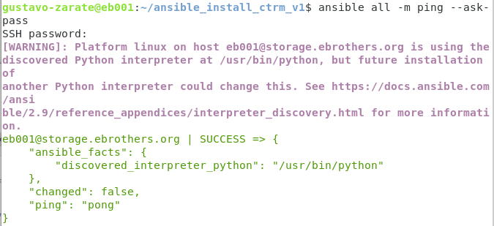
ansible_install_ctrm_v1

Slide 4

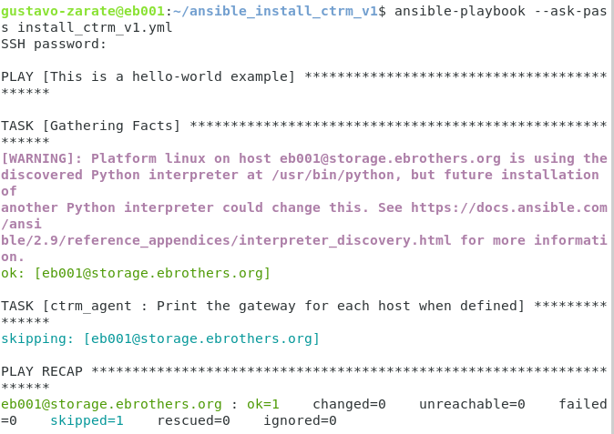

Slide 5


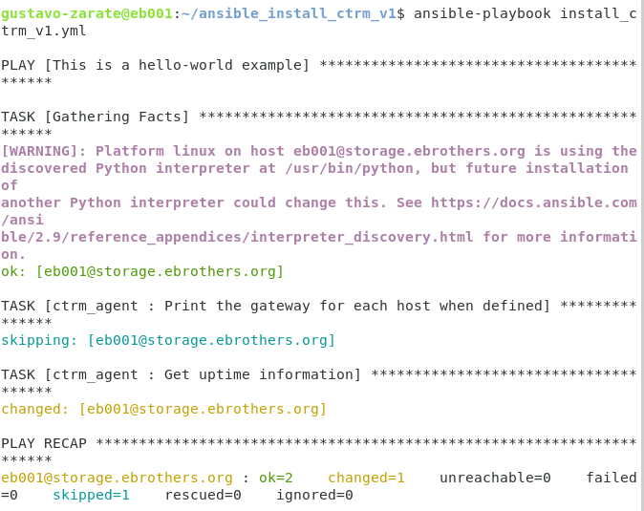

Slide 6
