Slide 1
Install ansible
Authors: eb001, eb004

Slide 2

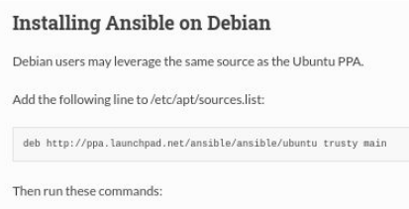
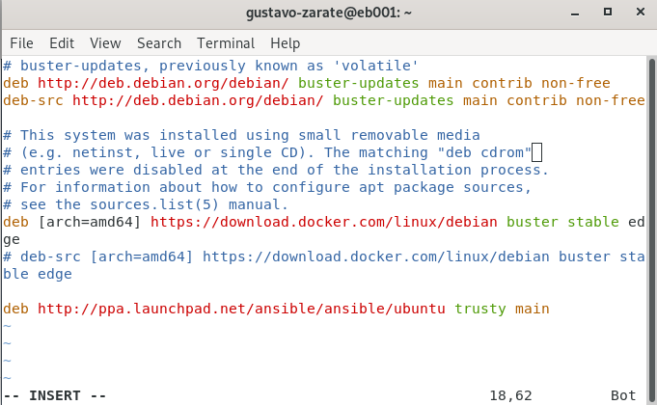
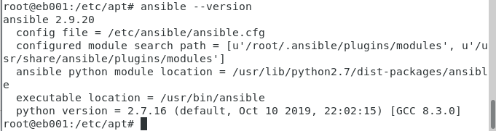
sudo apt-key adv --keyserver keyserver.ubuntu.com --recv-keys 93C4A3FD7BB9C367
sudo apt update
sudo apt install ansible
https://docs.ansible.com/ansible/latest/installation_guide/intro_installation.html#installing-ansible-on-debian

Slide 3


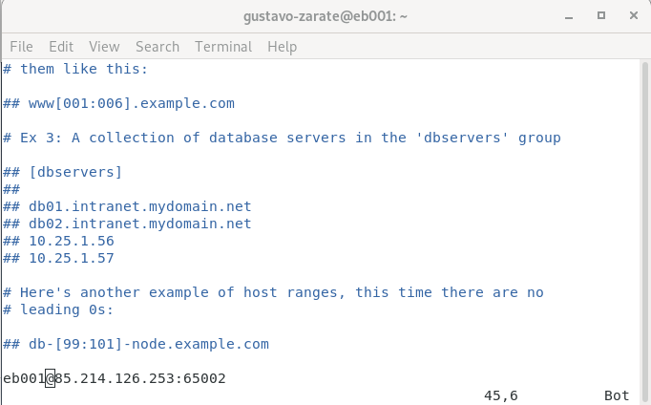
Inventory
To add a host you must add the ip or the domain of the computer in the /etc/ansible/hosts file.

Slide 4
In order to establish a group of hosts, you proceed as follows:
host[1:20].domain.com
In this way, it will take all the hosts replacing from 1 to twenty

Slide 5
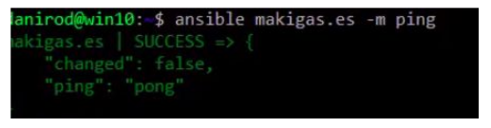
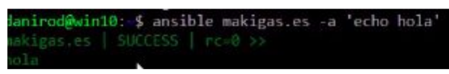
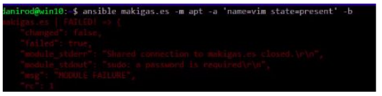
Verify that a host is ready
run a command on all hosts
Before executing a command temporarily, please change the user you have used to access.

Slide 6
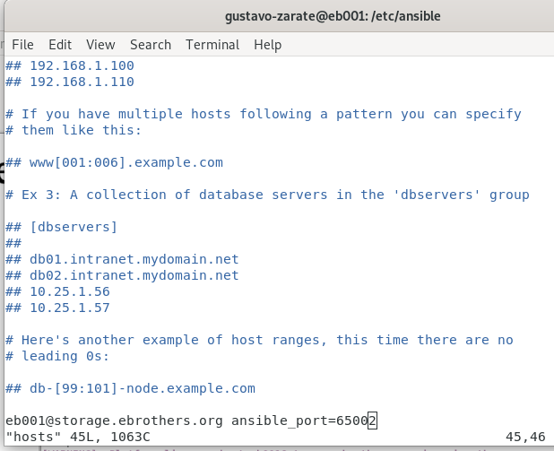
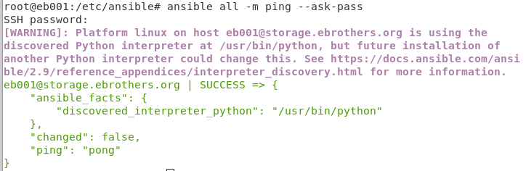

Slide 7
You also can create an inventory file.

