Slide 1
Ansible - Inventory
Authors: eb001, eb004

Slide 2
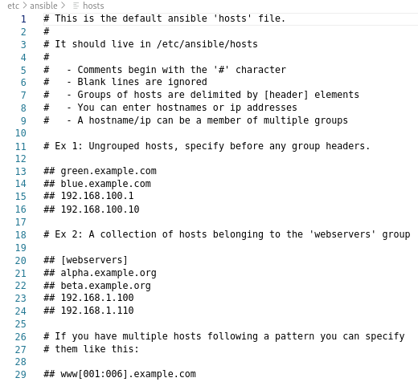
This is the file to overwrite when creating the inventory file

Slide 3
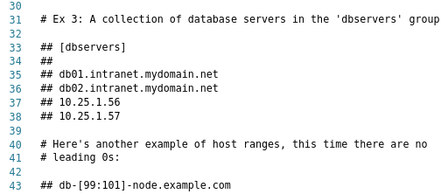

Slide 4



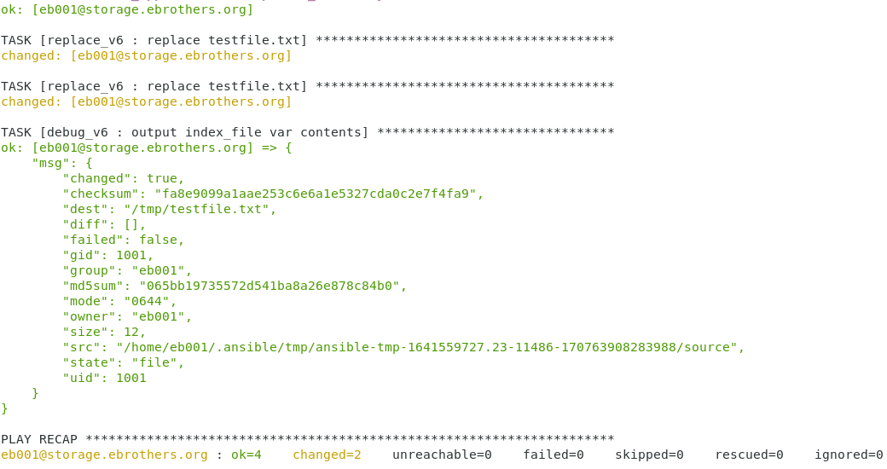


Slide 5

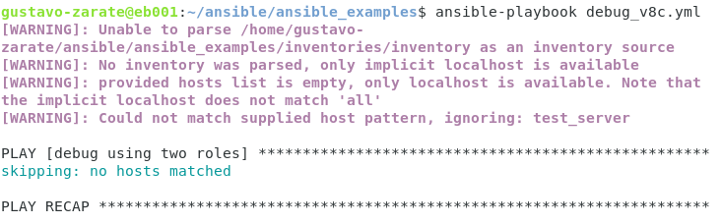
Let’s rename the inventory file to inventory2
Ansible does not find the group test_server, because ansible only searched in inventores/inventory

Slide 6

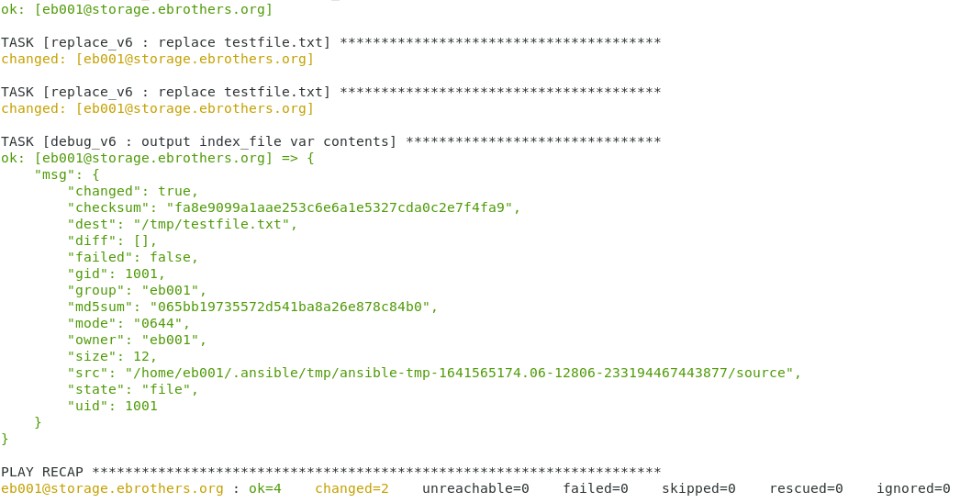
Let’s create a folder called inventory and store the inventory2 file inside
Ansible recognized inventory as a folder, and it searched in all subfolders and files inside inventory… Let’s see other example

Slide 7
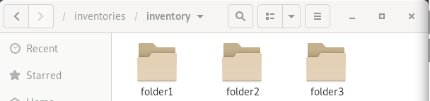
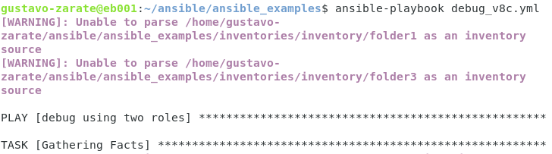
We have created 3 different folders and we have stored the file inventory2 inside folder 2.
read!
It was just saying, that ansible did not find files in folder1 and folder3

Slide 8
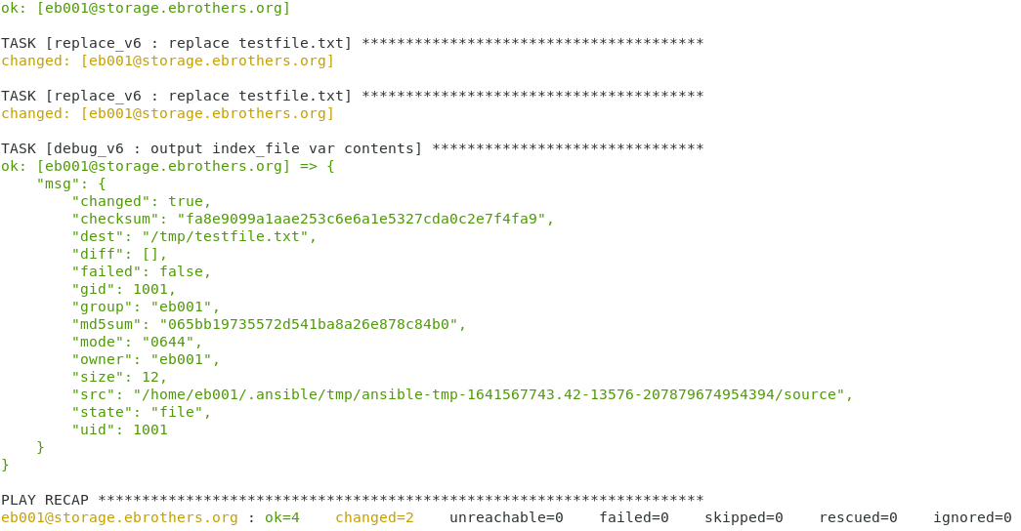

Slide 9
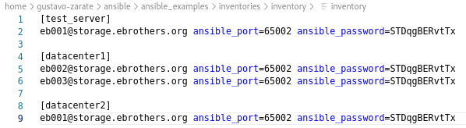
Here we have changed the inventory file. Let’s run a playbook only for datacenter2
And that’s how it is done!

Slide 10



