Slide 1
Ansible - Notes
Authors: eb001, eb004

Slide 2
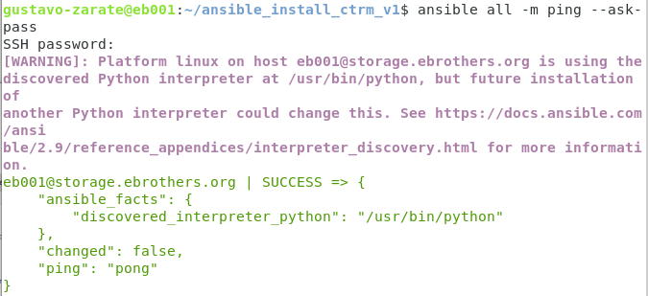
ansible_install_ctrm_v1

Slide 3

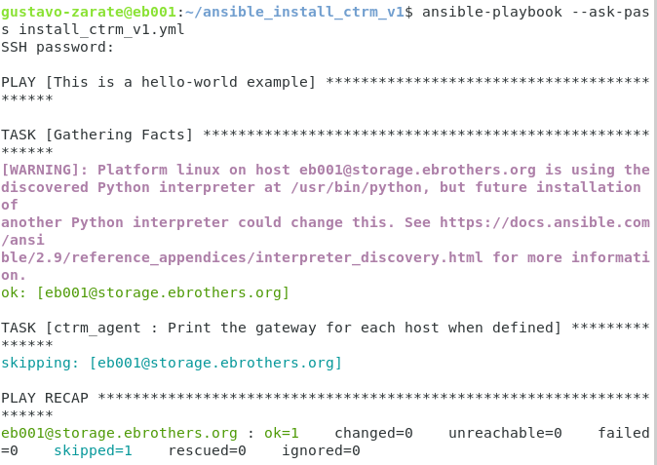

Slide 4


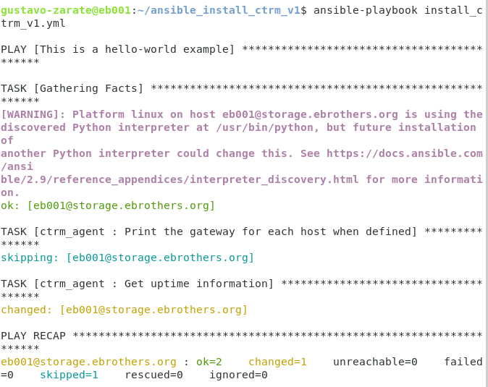

Slide 5
