Slide 1
Ansible_examples
Authors: eb00X

Slide 2
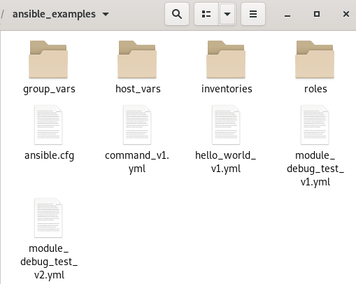


Setup hosts file

Slide 3
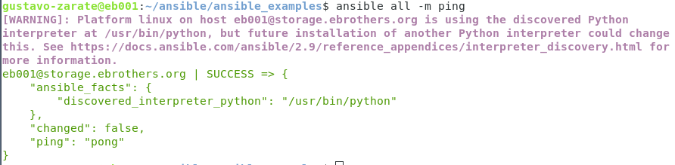
Run ad hoc commands

Slide 4
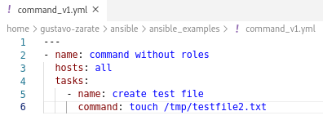
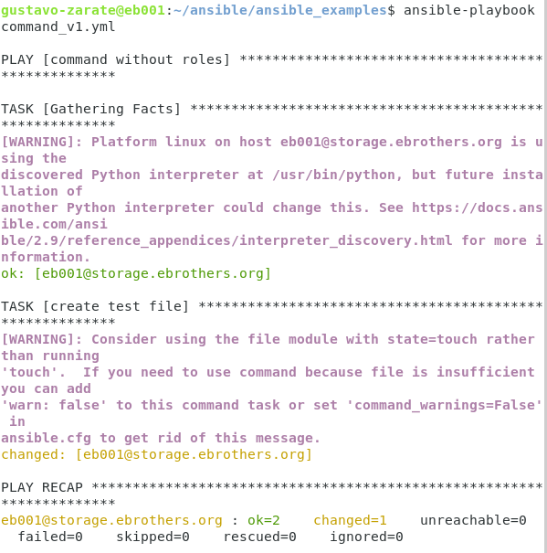
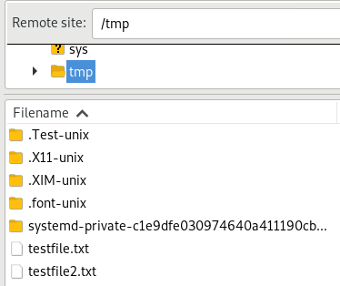
ansible-playbook command_v1.yml

Slide 5
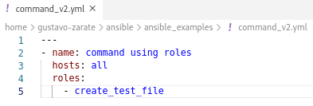

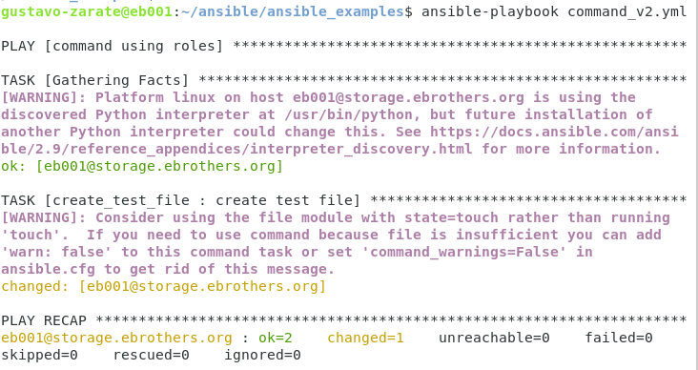
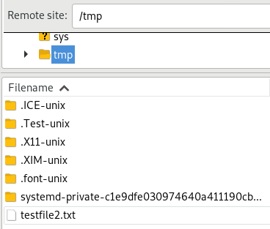
ansible-playbook command_v2.yml

Slide 6
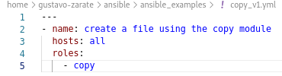
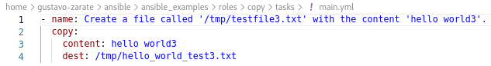
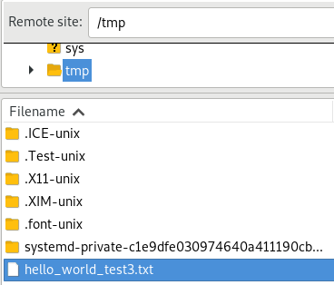

ansible-playbook copy_v1.yml

Slide 7
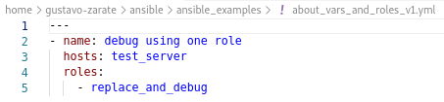
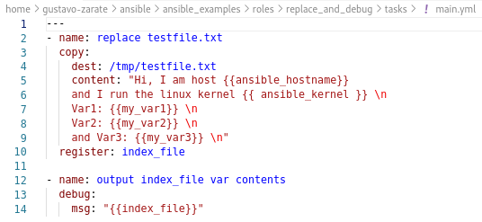



ansible-playbook about_vars_and_roles_v1.yml

Slide 8
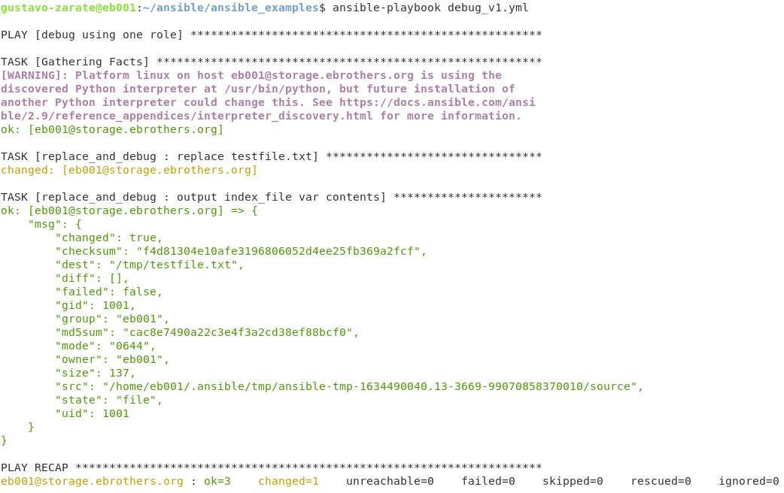
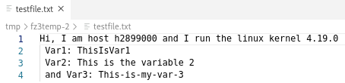
ansible-playbook about_vars_and_roles_v1.yml

Slide 9
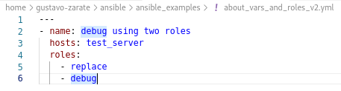
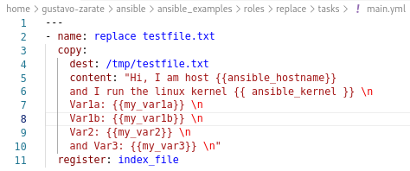


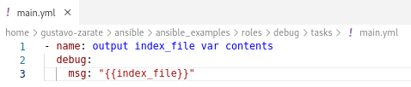
ansible-playbook about_vars_and_roles_v2.yml

Slide 10
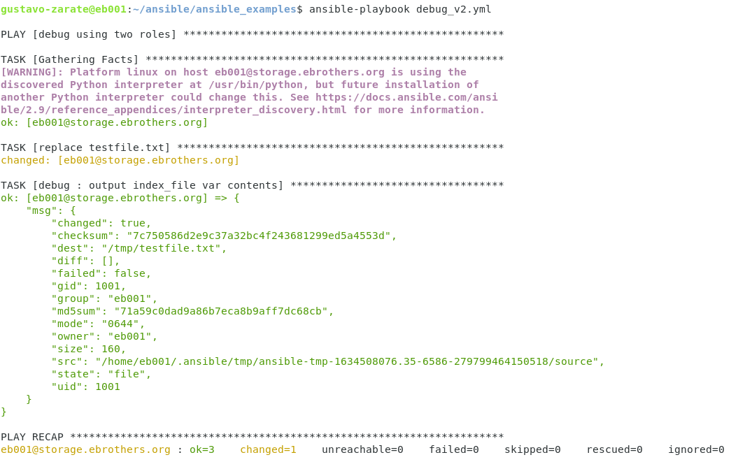
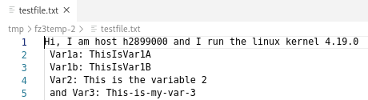
ansible-playbook about_vars_and_roles_v2.yml

Slide 11

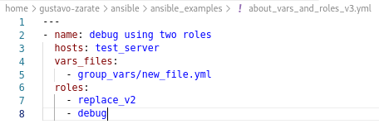
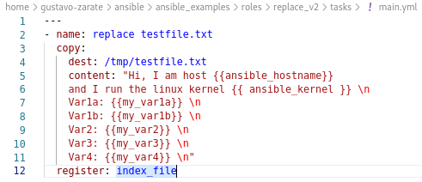


ansible-playbook about_vars_and_roles_v3.yml
We have to say ansible where is my_var4

Slide 12

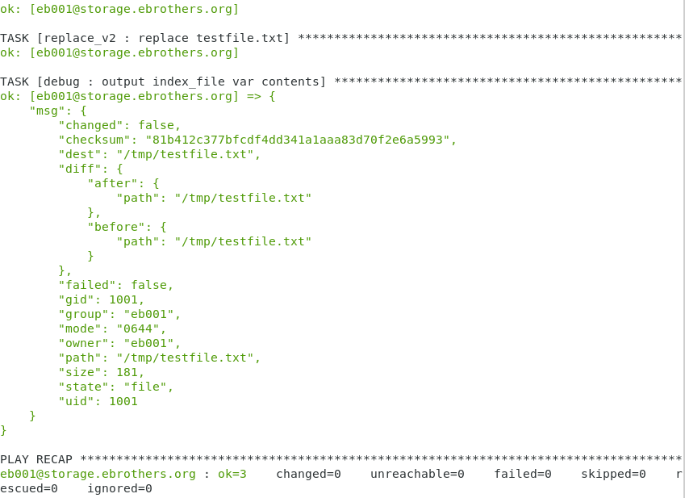
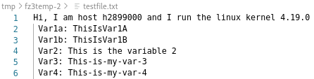

Slide 13
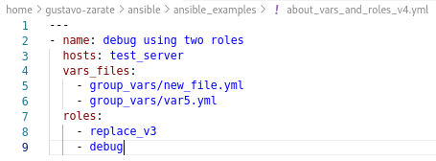
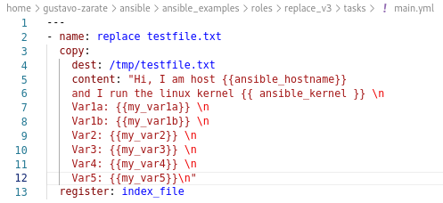

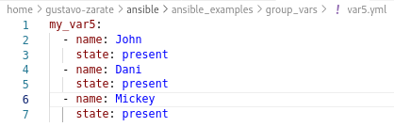
ansible-playbook about_vars_and_roles_v4.yml

Slide 14

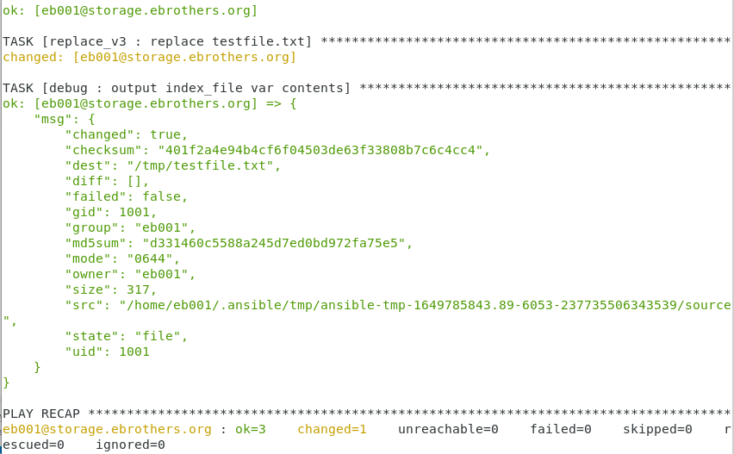
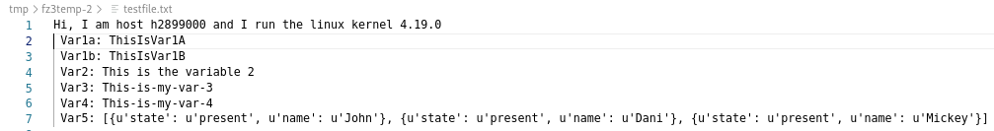

Slide 15
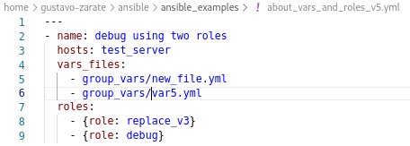
ansible-playbook about_vars_and_roles_v5.yml

Slide 16

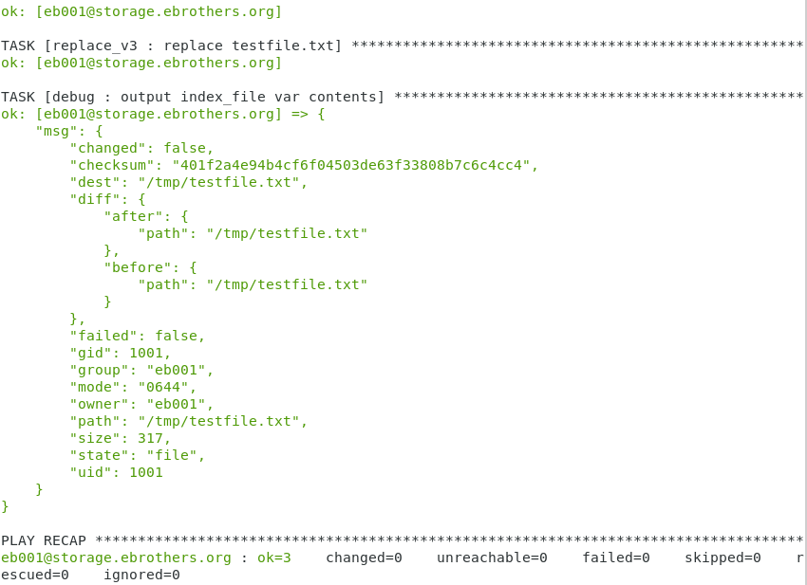
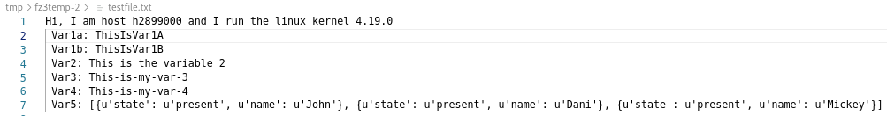

Slide 17
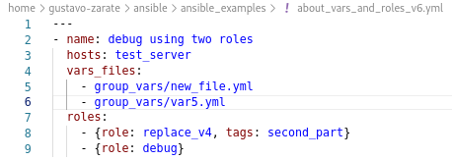
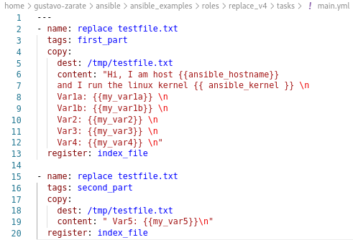

ansible-playbook about_vars_and_roles_v6.yml

Slide 18

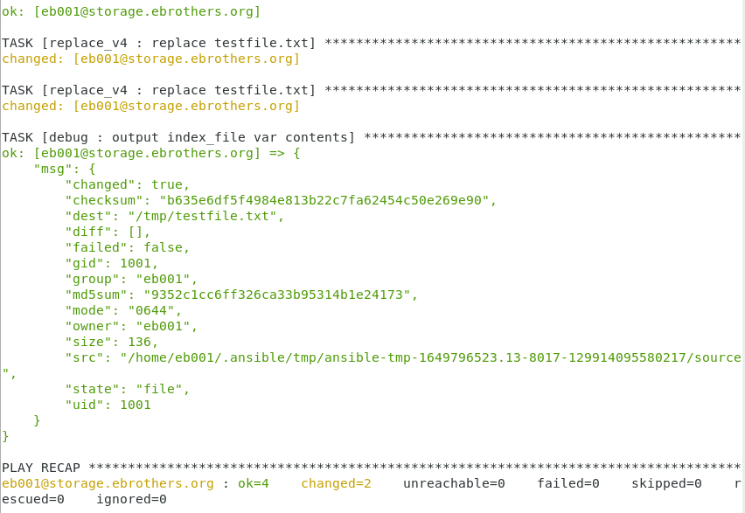

Slide 19
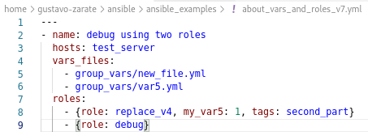
ansible-playbook debug_v7.yml

Slide 20

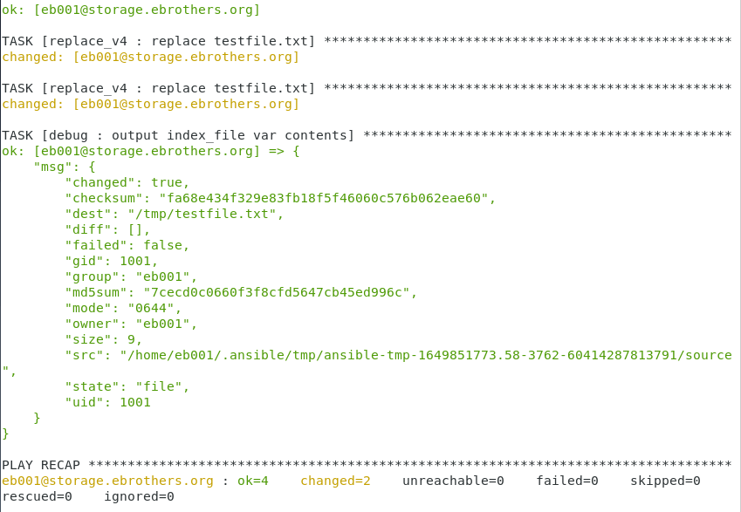


Slide 21
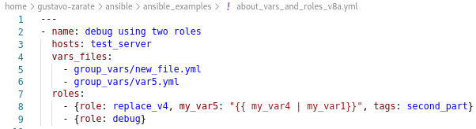
ansible-playbook about_vars_and_roles_v8a.yml

Slide 22

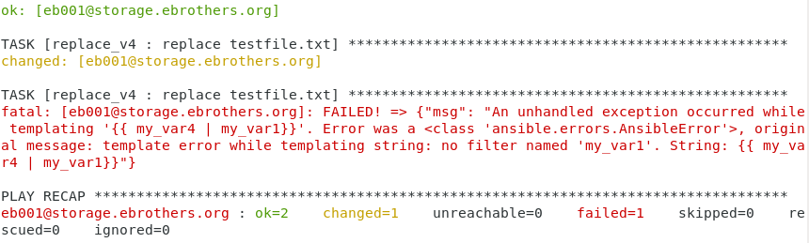
The pipe does not work completely as an or. It usually comes with a default
so
variable OR default value

Slide 23
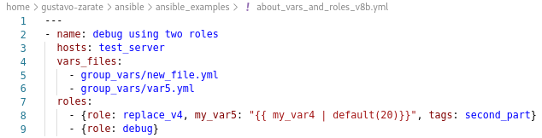
ansible-playbook about_vars_and_roles_v8b.yml
As a result, we will have the content of my_var4

Slide 24

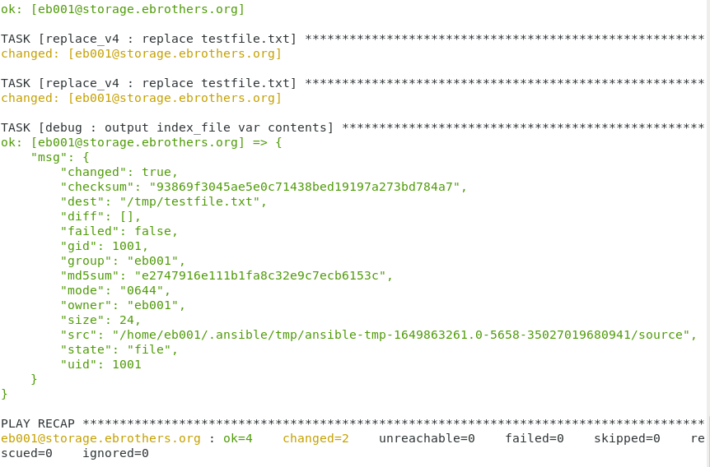


Slide 25
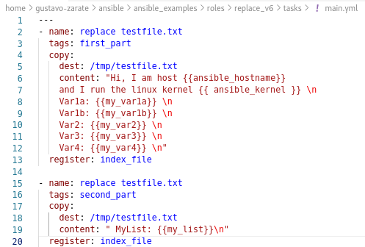
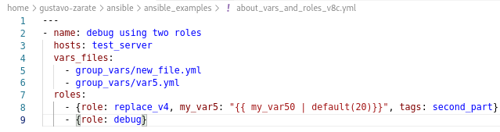


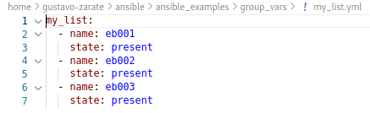
ansible-playbook about_vars_and_roles_v8c.yml
Here we have a variable, which does not exist

Slide 26

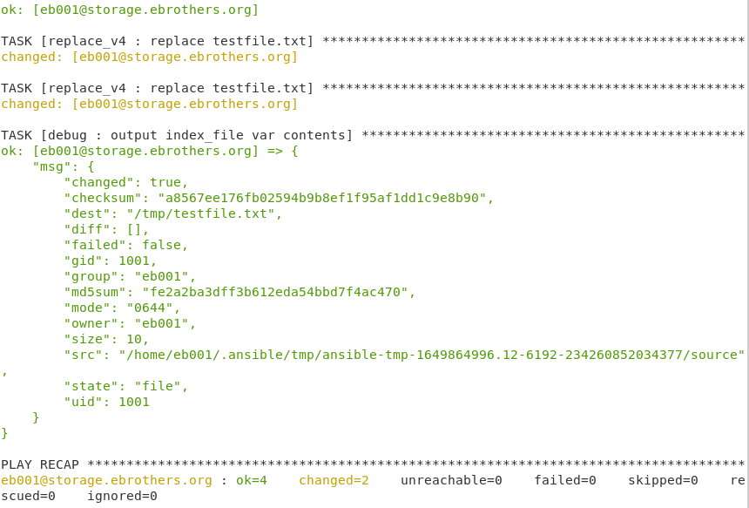


Slide 27
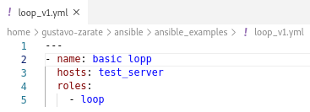
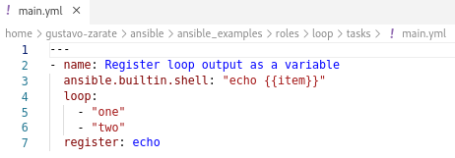
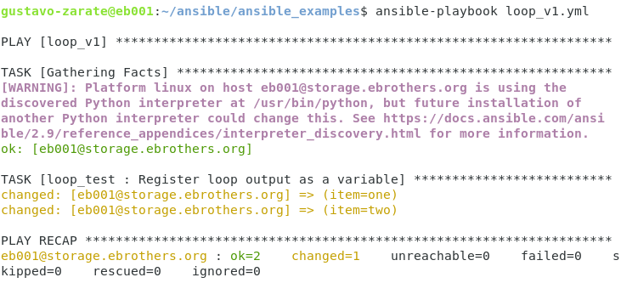
ansible-playbook loop_v1.yml

Slide 28
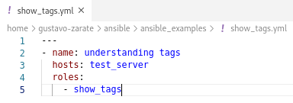
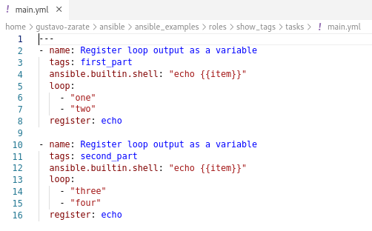
ansible-playbook show_tags.yml

Slide 29



Slide 30


Slide 31


ansible-playbook command_vs_shell.yml

Slide 32


Slide 33

Here only shell_output has been created.

Slide 34


ansible-playbook command_vs_shell_v2.yml

Slide 35

We have no standard error

Slide 36

The standard output appears because “Hello, command > /tmp/command_output”, has been treated as a string

Slide 37


ansible-playbook line_in_file.yml

Slide 38



Slide 39



ansible-playbook list_in_list_iteration.yml

Slide 40
ansible-playbook list_in_list_iteration.yml

