Slide 1
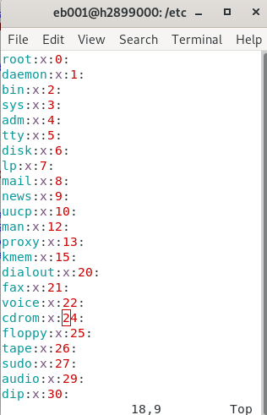

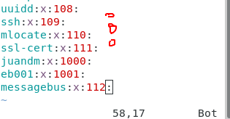

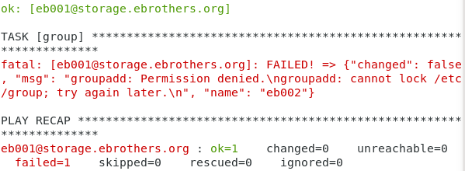
Note: The group module is suitable to edit the /etc/group file
This is just saying that eb002 does not exist in the /etc/group file

Slide 2


Note: The group module is suitable to edit the /etc/group file
This is just saying that eb002 exists in the /etc/group file

Slide 3

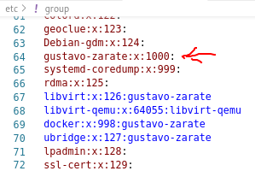
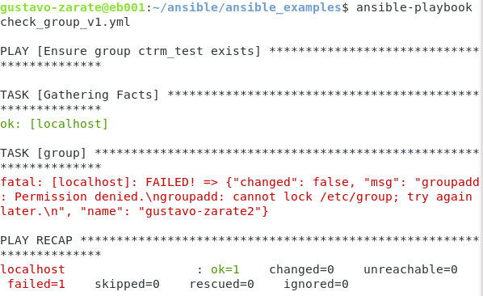
This is just saying that eb002 does not exist in the /etc/group file

