Slide 1
Ansible_test1
Authors: eb00X

Slide 2
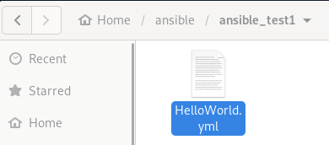
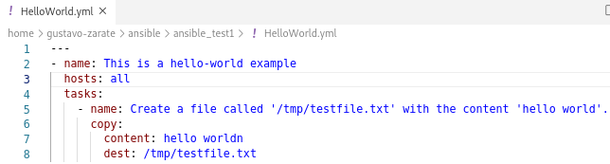

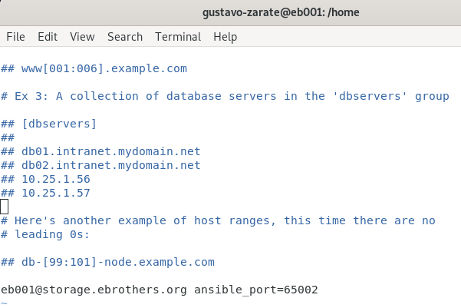
Setup hosts file
In this test, the host has been stored in /etc/ansible/hosts
It is not recommended to store the hosts here, because different programmers would need to write in this file.

Slide 3

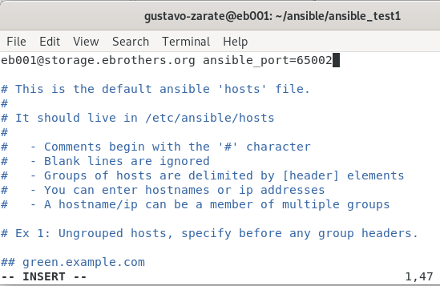
How to setup the hosts file
To edit the hosts file, you must have root permission. Use vim or nano to edit the hosts file.

Slide 4
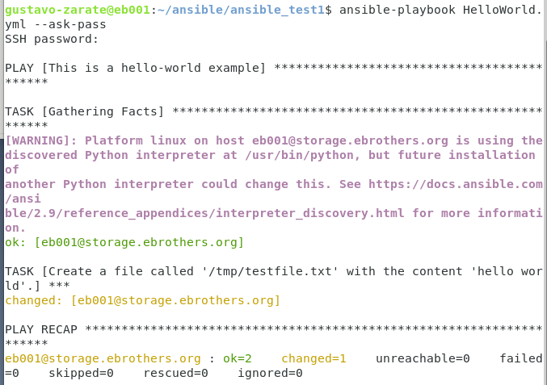
Testing Playbook

