Slide 1
Ansible_test2
Authors: eb00X

Slide 2
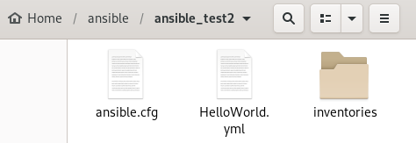

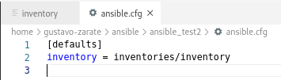
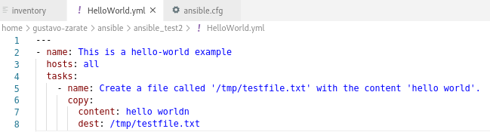
Setup hosts file
Here we are using the inventories folder, which is better to store hosts than /etc/ansible/hosts

Slide 3
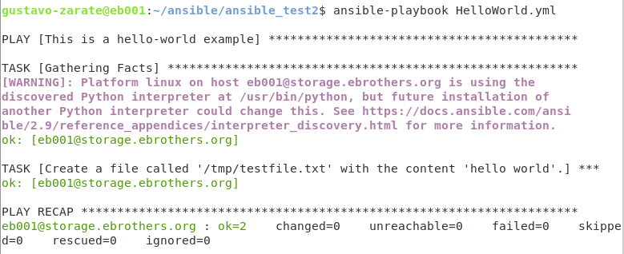
Testing Playbook

